Slide 1
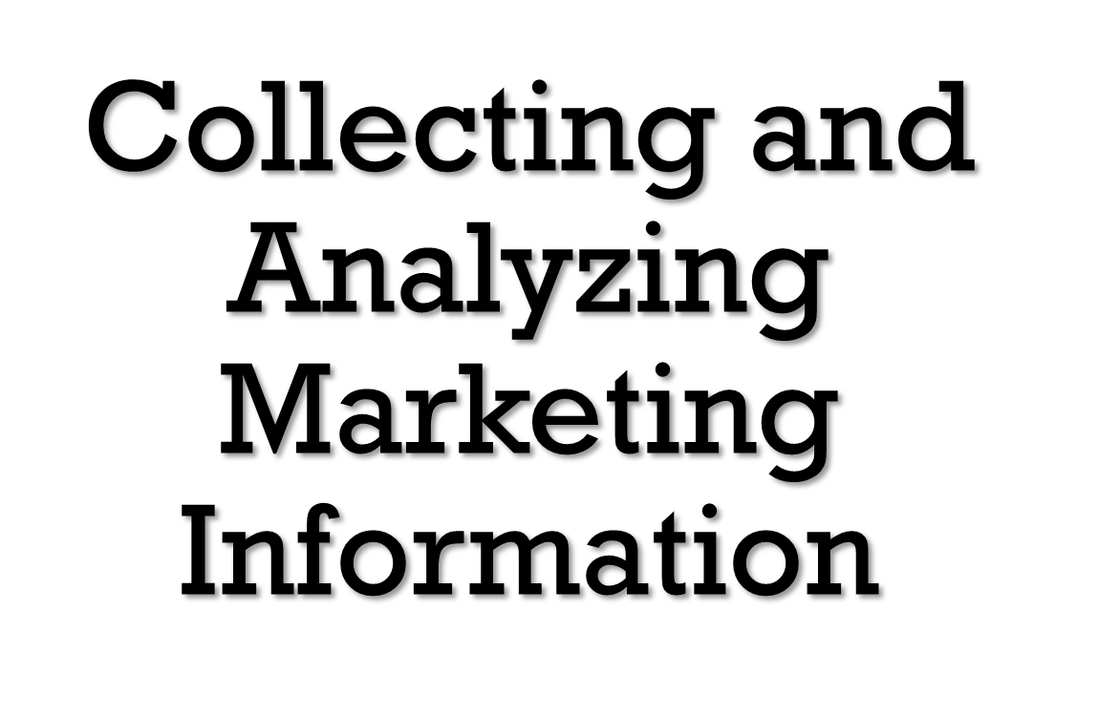
Chapter 3
Add By;DR.Heyam Al Mousa

Slide 2
Introduction
The purpose of the situation analysis is to describe current and future issues and key trends as they affect three key environments: the internal environment, the customer environment, and the external environment.
Although staying abreast of trends in the marketing environment is one of several tasks performed by marketing managers, it is perhaps the most important, as practically all planning and decision making depends on how well this analysis is conducted. [Exhibit 3.1]

Slide 3
Issues to Be Considered in a Situation Analysis (Exhibit 3.1)

Slide 4
Conducting a Situation Analysis
Analysis Alone is Not the Solution
Data and Information are Not the Same
The Benefits of Analysis Must Outweigh the Costs
Conducting a Situation Analysis is a Challenging

Slide 5
1- Analysis Alone Is Not a Solution
While a comprehensive situation analysis can lead to better planning and decision making, analysis itself is not enough.
Situation analysis is a necessary, but insufficient, prerequisite for effective strategic planning.
A thorough situation analysis empowers the marketing manager because it encourages both analysis and synthesis of information.

Slide 6
2- Data Is Not the Same as Information
Good, useful information is not the same as data. Data are easy to collect and store, but good information is not.
Data do not become informative until a person or process transforms or combines them with other data in a manner that makes them useful.

Slide 7
3- The Benefits of Analysis Must Outweigh the Costs
Situation analysis is valuable only to the extent that it improves the quality of the resulting marketing plan.
Although the costs of acquiring data are easy to determine, the benefits of improved decisions are difficult to estimate.
Perpetually analyzing data without making any decisions is usually not worth the additional costs in terms of time or financial resources.

Slide 8
4- Conducting a Situation Analysis Is a Challenging Exercise
Situation analysis is one of the most difficult tasks in developing a marketing plan.
The most important aspect of any situation analysis is that it must be an ongoing effort.
Tracking all three environments (internal, customer, and external) at the same time is challenging due to their interconnectedness. [Exhibit 3.2]

Slide 9
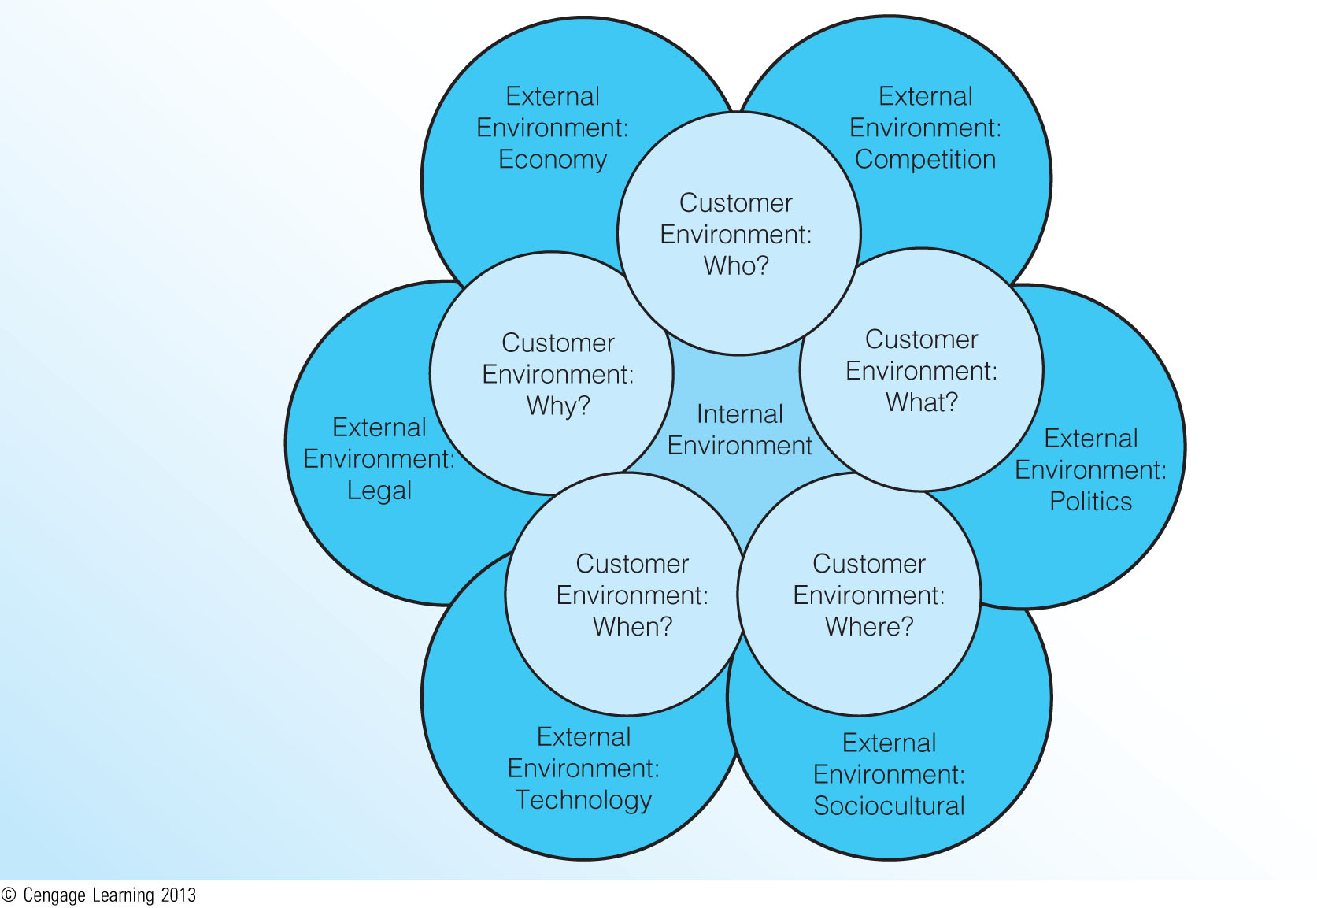
Internal, Customer, and External Environments (Exhibit 3.2)

Slide 10
The Internal Environment(Exhibit 3.3)
EXHIBI T 4.3 A FRAMEWORK FOR ANALYZING THE INTERNAL ENVIRONMENT
Review of Current Marketing Objectives, Strategy, and Performance
1. What are the current marketing goals and objectives?
2. Are the marketing goals and objectives consistent with the corporate or business-unit mission, goals,
and objectives? Are they consistent with recent changes in the customer or external environments? Why
or why not?
3. How are current marketing strategies performing with respect to anticipated outcomes (for example,
sales volume, market share, profitability, communication, brand awareness, customer preference, customer
satisfaction)?
4. How does current performance compare to other organizations in the industry? Is the performance of
the industry as a whole improving or declining? Why?
5. If performance is declining, what are the most likely causes? Are marketing objectives inconsistent? Is
the strategy flawed? Was the strategy poorly implemented?
6. If performance is improving, what actions can be taken to ensure that performance continues to improve?
Is the improvement in performance due to a better than anticipated environment or superior
planning and implementation?
Review of Current and Anticipated Organizational Resources
1. What is the state of current organizational resources (for example, financial, human, experience, relationships
with key suppliers or customers)?
2. Are these resources likely to change for the better or worse in the near future? How?
3. If the changes are for the better, how can these added resources be used to better meet customers’ needs?
4. If the changes are for the worse, what can be done to compensate for these new resource constraints?
Review of Current and Anticipated Cultural and Structural Issues
1. What are the positive and negative aspects of the current and anticipated organizational culture?
2. What issues related to internal politics or management struggles might affect the organization’s marketing
activities?
3. What is the overall position and importance of the marketing function as seen by other functional
areas? Are key executive positions expected to change in the future?
4. How will the overall market- or customer-orientation of the organization (or lack thereof) affect marketing
activities?
5. Does the organization emphasize a long- or short-term planning horizon? How will this emphasis affect
marketing activities?
6. Currently, are there positive or negative issues with respect to motivating employees, especially those in
frontline positions (for example, sales and customer service)?

Slide 11
Review of Current Objectives, Strategy, and Performance
A periodic assessment of marketing objectives is necessary to ensure that they remain consistent with the firm's mission and the changing customer and external environments.
The marketing manager should also evaluate the performance of the current marketing strategy with respect to sales volume, market share, profitability, and other relevant measures.
Poor or declining performance may be the result of:
a)holding on to marketing goals or objectives that are inconsistent with the current realities of the customer or external environments.
b)a flawed marketing strategy.
c)poor implementation.
d)changes in the customer or external environments beyond the control of the firm.

Slide 12
Availability of Resources
This review includes an analysis of financial, human, and experience resources, as well as any resources the firm might hold in key relationships with supply chain partners, strategic alliance partners, or customer groups.
It is also important to gauge whether the availability or level of these resources is likely to change in the near future.

Slide 13
Organizational Culture and Structure
One of the most important issues in this review involves the internal culture of the firm.
In some organizations, marketing does not hold a prominent position in the political hierarchy.
The internal culture also includes any anticipated changes in key executive positions within the firm.
Other structural issues to be considered include the overall customer orientation of the firm (or lack thereof), issues related to employee motivation and commitment to the organization (particularly among unionized employees), and the relative emphasis on long- versus short-term planning.
For most firms, culture and structure are relatively stable issues that do not change dramatically from one year to the next.

Slide 14
The Customer Environment (Exhibit 3.4)
Who are our Current and Potential Customers?
What do Customers do with our Products?
When do Customers Purchase our Products?
Why (and How) do Customers Select our Products?
Why do Potential Customers not Purchase our Products?

Slide 15
EXHI B I T 4.4 THE EXPANDED 5W MODEL FOR CUSTOMER ANALYSIS
a)Who Are Our Current and Potential Customers?
1. What are the demographic, geographic, and psychographic characteristics of our customers?
2. Who actually purchases our products?
3. How do these purchasers differ from the users of our products?
4. Who are the major influencers of the purchase decision?
5. Who is financially responsible for making the purchase?
b)What Do Customers Do with Our Products?
1. In what quantities and in what combinations are our products purchased?
2. How do heavy users of our products differ from light users?
3. Do purchasers use complementary products during the consumption of our products? If so, what is the
nature of the demand for these products, and how does it affect the demand for our products?
4. What do our customers do with our products after consumption?
5. Are our customers recycling our products or packaging?
c)Where Do Customers Purchase Our Products?
1. From what types of vendors are our products purchased?
2. Does e-commerce have an effect on the purchase of our products?
3. Are our customers increasing their purchasing from nonstore outlets?
d)When Do Customers Purchase Our Products?
1. Are the purchase and consumption of our products seasonal?
2. To what extent do promotional events affect the purchase and consumption of our products?
3. Do the purchase and consumption of our products vary based on changes in physical/social surroundings,
time perceptions, or the purchase task?
e)Why (and How) Do Customers Select Our Products?
1. What are the basic features provided by our products and our competitors’ products? How do our
products compare to those of competitors?
2. What are the customer needs fulfilled by our products and our competitors’ products? How well do our
products meet these needs? How well do our competitors’ products meet these needs?
3. Are the needs of our customers expected to change in the future? If so, how?
4. What methods of payment do our customers use when making a purchase? Is the availability of credit or
financing an issue with our customers?
5. Are our customers prone to developing close long-term relationships with us and our competitors, or do
they buy in a transactional fashion (primarily based on price)?
6. How can we develop, maintain, or enhance the relationships we have with our customers?
f)Why Do Potential Customers Not Purchase Our Products?
1. What are the basic needs of noncustomers that our products do not meet?
2. What are the features, benefits, or advantages of competing products that cause noncustomers to
choose them over our products?
3. Are there issues related to distribution, promotion, or pricing that prevent noncustomers from purchasing
our products?
4. What is the potential for converting noncustomers into customers of our products?

Slide 16
a) Who Are Our Current and Potential Customers?
Answering the "who" question requires an examination of the relevant characteristics that define target markets, such as demographic geographic, and psychographic characteristics.
The analysis must also assess the viability of potential customers or markets that may be acquired in the future.

Slide 17
b) What Do Customers Do with Our Products?
The "what" question entails an assessment of how customers consume and dispose of the firm's products.
In the case of derived demand—where the demand for one product depends on (is derived from) the demand of another product—the marketer must also examine the consumption and usage of the complementary product.
Marketers have become increasingly interested in how customers dispose of products, such as whether customers recycle the product or its packaging.
Another post-consumption issue deals with the need for reverse channels of distribution to handle product repairs.

Slide 18
c) Where Do Customers Purchase Our Products?
The "where" question is mainly one of distribution and customer convenience.
The fastest growing form of distribution today is nonstore retailing—which includes vending machines; direct marketing through catalogs, home sales, or infomercials; and electronic merchandising through the Internet, interactive television, and video kiosks.

Slide 19
d) When Do Customers Purchase Our Products?
The "when" question refers to any situational influences that may cause customer purchasing activity to vary over time.
The "when" question also includes subtler influences that can affect purchasing behavior, such as physical and social surroundings, time perceptions, and the purchase task.

Slide 20
e) Why (and How) Do Customers Select Our Products?
The "why" question involves identifying the basic need-satisfying benefits provided by the firm's products.
The "how" part of this question refers to the means of payment that customers use when making a purchase. The availability of credit makes it possible for customers to take possession of high-priced products.
Barter—an exchange of goods and services for other goods and services—has reemerged in business markets.

Slide 21
f) Why Do Potential Customers Not Purchase Our Products?
There are many potential reasons why customers might not purchase a firm's products:
a)Noncustomers have a basic need that the firm’s product does not fulfill.
b)Noncustomers perceive that they have better or lower-priced alternatives, such as competing substitute products.
c)Competing products actually have better features or benefits than the firm’s product.
d)The firm’s product does not match noncustomers’ budgets or lifestyles.
e)Noncustomers have high switching costs.

Slide 22
f)Noncustomers do not know that the firm’s product exists.
g)Noncustomers have misconceptions about the firm’s product (weak or poor image).
h)Poor distribution makes the firm’s product difficult to find.
The potential for converting noncustomers into customers must also be assessed.

Slide 23
The External Environment (Exhibit 3.5)
Competition
Economic Growth and Stability
Political Trends
Legal and Regulatory Issues
Technological Advancements
Sociocultural Trends

Slide 24
EXHI B I T 4.5 A FRAMEWORK FOR ANALYZING THE EXTERNAL ENVIRONMENT
a)Competition
1. Who are our major brand, product, generic, and total budget competitors? What are their characteristics
in terms of size, growth, profitability, strategies, and target markets?
2. What are our competitors’ key strengths and weaknesses?
3. What are our competitors’ key capabilities and vulnerabilities with respect to their marketing program
(for example, products, distribution, promotion, and pricing)?
4. What response can we expect from our competitors if environmental conditions change or if we change
our marketing strategy?
5. How is our set of competitors likely to change in the future? Who are our new competitors likely to be?
b)Economic Growth and Stability
1. What are the general economic conditions of the country, region, state, and local area in which our firm
operates?
2. What are the economic conditions of our industry? Is our industry growing? Why or why not?
3. Overall, are customers optimistic or pessimistic about the economy? Why?
4. What are the buying power and spending patterns of customers in our industry? Are our industry’s
customers buying less or more of our products? Why?
c)Political Trends
1. Have recent elections changed the political landscape within our domestic or international markets? If
so, how?
2. What type of industry regulations do elected officials favor?
3. What are we doing currently to maintain good relations with elected officials? Have these activities
been effective? Why or why not?
d)Legal and Regulatory Issues
1. What proposed changes in international, federal, state, or local laws and regulations have the potential
to affect our marketing activities?
2. Do recent court decisions suggest that we should modify our marketing activities?
3. Do the recent rulings of federal, state, local and self-regulatory agencies suggest that we should modify
our marketing activities?
4. What effect will changes in global trade agreements or laws have on our international marketing
opportunities?
e)Technological Advancements
1. What impact has changing technology had on our customers?
2. What technological changes will affect the way that we operate or manufacture our products?
3. What technological changes will affect the way that we conduct marketing activities such as distribution
or promotion?
4. Are there any current technologies that we do not use to their fullest potential in making our marketing
activities more effective and efficient?
5. Do any technological advances threaten to make our products obsolete? Does new technology have the
potential to satisfy previously unmet or unknown customer needs?
f)Sociocultural Trends
1. How are society’s demographics and values changing? What effect will these changes have on our
customers, products, pricing, distribution, promotion, and our employees?
2. What challenges or opportunities have changes in the diversity of our customers and employees created?
3. What is the general attitude of society about our industry, company, and products? Could we take
actions to improve these attitudes?
4. What social or ethical issues should we be addressing?

Slide 25
a) Competition
When a firm defines the target markets it will serve, it simultaneously selects a set of competing firms.
Most firms face four basic types of competition: [Exhibit 3.6]
a)Brand competitors, which market products with similar features and benefits to the same customers at similar prices.
b)Product competitors, which compete in the same product class, but with products that are different in features, benefits, and price.
c)Generic competitors, which market very different products that solve the same problem or satisfy the same basic customer need.
d)Total budget competitors, which compete for the limited financial resources of the same customers.

Slide 26
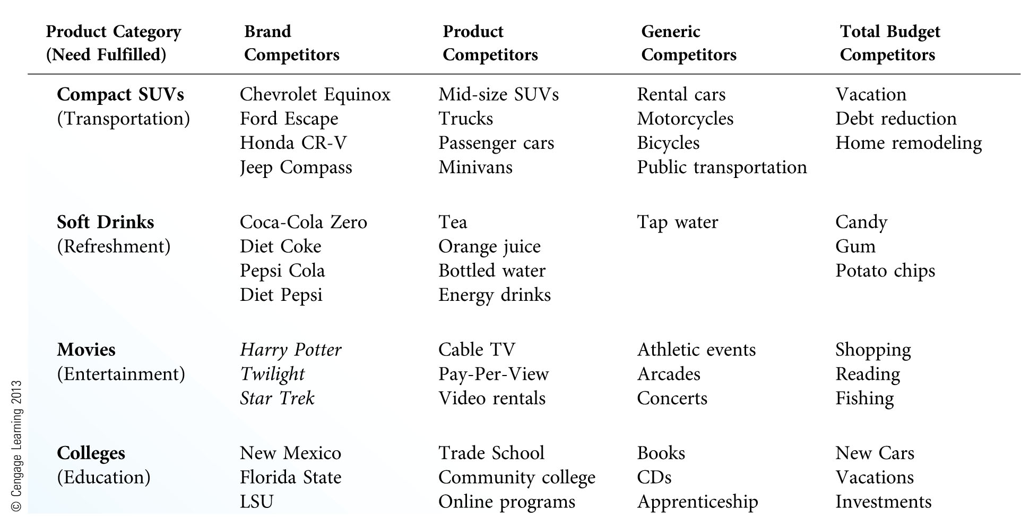
Major Types of Competition (Exhibit 3.6)

Slide 27
Brand competitors rightfully receive the greatest attention because customers see different brands as direct substitutes for each other. For this reason, strategies aimed at getting customers to switch brands are a major focus in any effort to beat brand competitors.
Competitive analysis has received greater attention recently for several reasons:
a)more intense competition from sophisticated competitors
b)increased competition from foreign firms
c)shorter product life cycles
d)dynamic environments, particularly in the area of technological innovation

Slide 28
Competitive intelligence involves the legal and ethical observation, tracking, and analysis of the total range of competitive activity; including competitors' capabilities and vulnerabilities with respect to sources of supply, technology, marketing, financial strength, manufacturing capacities and qualities, and target markets.

Slide 29
Competitive analysis should progress through the following stages:
1. Identification .Identify all current and potential brand, product, generic, and totalbudget competitors.
2. Characteristics .Focus on key competitors by assessing the size, growth, profitability,objectives, strategies, and target markets of each one.
3. Assessment. Assess each key competitor’s strengths and weaknesses, including the major capabilities and vulner abilities that each possesses within its functional areas (marketing, research and development, production, human resources, etc.).
4. Capabilities. Focus the analysis on each key competitor’s marketing capabilities in terms of its products, distribution, promotion, and pricing.
5. Response .Estimate each key competitor’s most likely strategies and responses under different environmental situations, as well as its reactions to the firm’s own marketing efforts.

Slide 30
b) Economic Growth and Stability
A thorough examination of economic factors requires marketing managers to gauge and anticipate the general economic conditions of the nation, region, state, and local area in which they operate.
General economic conditions include inflation, employment and income levels, interest rates, taxes, trade restrictions, tariffs, and the current and future stages of the business cycle (prosperity, stagnation, recession, depression, and recovery).
Consumers’ confidence, their overall impressions of the economy, and their ability and willingness to spend are also important.

Slide 31
c) Political Trends
Most organizations should track political trends and attempt to maintain good relations with elected officials.
Elected officials who have negative attitudes toward a firm or its industry are more likely to create or enforce regulations unfavorable for the firm.

Slide 32
d) Legal and Regulatory Issues
The simple existence of laws and regulations causes many firms to accept their influence as a predetermined aspect of market planning.
In reality, most laws and regulations are fairly vague, which often forces firms to test the limits of certain laws by operating in a legally questionable manner.
Managers should also examine recent court rulings, as well as the decisions of federal, state, local and self-regulatory trade agencies to determine their effects on marketing activities.

Slide 33
e) Technological Advancements
Technology refers to the way we accomplish specific tasks or the processes we use to create the "things" we consider as new.
Some technologies assume a frontstage presence (advances that are most noticeable to customers) in creating new marketing opportunities.
Other technological changes can also assume a backstage presence when their advantages are not necessarily apparent to customers.

Slide 34
f) Sociocultural Trends [Exhibit 3.7]
Sociocultural factors are those social and cultural influences that cause changes in attitudes, beliefs, norms, customs, and lifestyles.
One of the most important sociocultural changes taking place today is the shifting demographic makeup of the U.S. population. [Exhibit 3.8]
Changes in cultural values—the guiding principles of everyday life—can also create opportunities and challenges for marketers.

Slide 35
EXHIBI T 4.7 TRENDS IN THE SOCIOCULTURAL ENVIRONMENT
Demographic Trends
Aging of the American population
Decline in the teen population (as a percentage of the total population)
Population growth in Sun Belt states
Increasing number of single-member/individual households
Increasing participation of women in the workforce
Increasing number of single-parent families
Increasing population diversity, especially in the number of Hispanic Americans
Increasing immigration (legal and illegal)
Increasing number of wealthy Americans
Lifestyle Trends
Clothing becoming more casual, especially at work
Clothing becoming more revealing, especially for women
Growing participation in body modification (e.g., tattoos, piercings)
Americans having less time for leisure activities
Vacationing at home becoming more common
Less shopping in malls, more shopping from home
Continuing focus on health, nutrition, and exercise
Increasing importance of leisure time versus work time
Declining time spent watching television and reading newspapers
Increasing time spent using computers and talking/texting on wireless phones
Growing popularity of fuel-efficient hybrid vehicles
Growing ubiquity of digital entertainment
Value Trends
Shorter attention spans and less tolerance for waiting
Less focus on ‘‘me-oriented’’ values
More value-oriented consumption (good quality, good price)
Importance of maintaining close, personal relationships with others
Increasing importance of family and children
Increasing concerns about the natural environment
Greater focus on ethics and social responsibility
Increased interest in giving back to the community
Less tolerance of smoking in public places
More tolerance of individual lifestyle choices
Growing disconnect with government
Growing skepticism about business

Slide 36
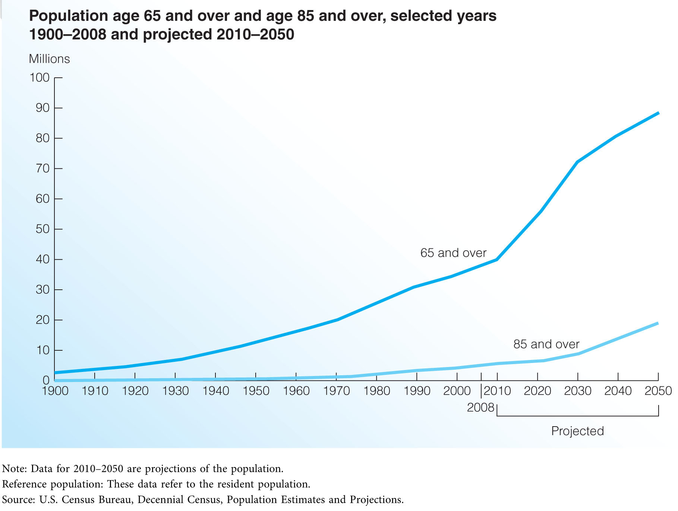
Growth in the Number of Older Americans (Exhibit 3.8)

Slide 37
Collecting Marketing Data and Information
Secondary Information Sources
Internal data sources
Government sources
Book and periodical sources
Commercial sources
Primary Data Collection
Direct observation
Focus groups
Surveys
Experiments

Slide 38
1-Secondary Information Sources
Internal Data Sources—The firm's own records are the best source of data on current objectives, strategy, performance, and available resources
Government Sources—The sheer volume of available information on the economy, population, and business activities is the major strength of most government data sources. Government sources are also easily accessible and low in cost(Federal Trade-FedWorld-Edgar Database-Small Business Administration).
Book and Periodical Sources—The articles and research reports available in books and periodicals provide a gamut of information about many organizations, industries, and nations(Subscription services-Major trade associations-Academic journals-General business publications)
Commercial Sources—These sources are almost always relevant to a specific issue because they deal with the actual behaviors of customers in the marketplace(The Nielsen Company-Mediamark Research and Intelligence-The Audit Bureau of Circulations-Surveys.com)

Slide 39
2-Primary Data Collection
The situation analysis should always begin with an examination of secondary data sources due to their availability and low cost.
Since each secondary data source has its advantages and disadvantages, the best approach is one that blends data and information from a variety of sources.
Primary marketing research has the major advantages of being relevant to the specific problem, as well as trustworthy due to the control the manager has over data collection.

Slide 40
There are four major types of primary data collection:
a)Direct observation, where the researcher records the overt behaviors of customers, competitors, or suppliers in natural settings.
b)Focus groups, where the researcher moderates a panel discussion among a gathering of 6-10 people who openly discuss a specific subject.
c)Surveys, where the researcher asks respondents to answer a series of questions on a particular topic.
d)Experiments, where the researcher selects matched subjects and exposes them to different treatments while controlling for extraneous variables.

Slide 41
As with secondary data, often the best approach to primary data collection is to use a combination of data sources.
Focus groups and direct observation can be used to gain a more complete understanding of a particular issue or marketing phenomenon.
Surveys can then be used to further test for certain tendencies or effects before launching into a full-scale test-marketing program.

Slide 42
Overcoming Problems in Data Collection
One of the most common problems in data collection is an incomplete or inaccurate assessment of the situation that the gathering of data should address.
Another common difficulty is the expense of collecting environmental data. Although there are always costs associated with data collection (even if the data are free), the process need not be prohibitively expensive.
A third issue is the time it takes to collect data and information.
It can also be challenging to find a way to organize the vast amount of data and information collected during the situation analysis.

