Slide 1
Chapter 3
The Marketing Research Process and
Defining the Problem and Research Objectives

Slide 2
Learning Objectives
To gain insights into marketing research by learning the steps in the marketing research process
To understand when marketing research is not needed
- To understand the difference between the problem and the research objective

Slide 3
- To know the importance of properly defining the problem
- To appreciate a process for defining the problem as decision alternatives
- To know the criteria all research objectives should have and to know the sources of problems, the role of symptoms, and the role of the researcher

Slide 4
- To understand that marketing research is needed when managers are uncertain of their assumptions needed to specify consequences of decision alternatives
- To know what an action standard is and why it is needed
- To learn the components of the marketing research proposal and ethical issues related to the research proposal

Slide 5
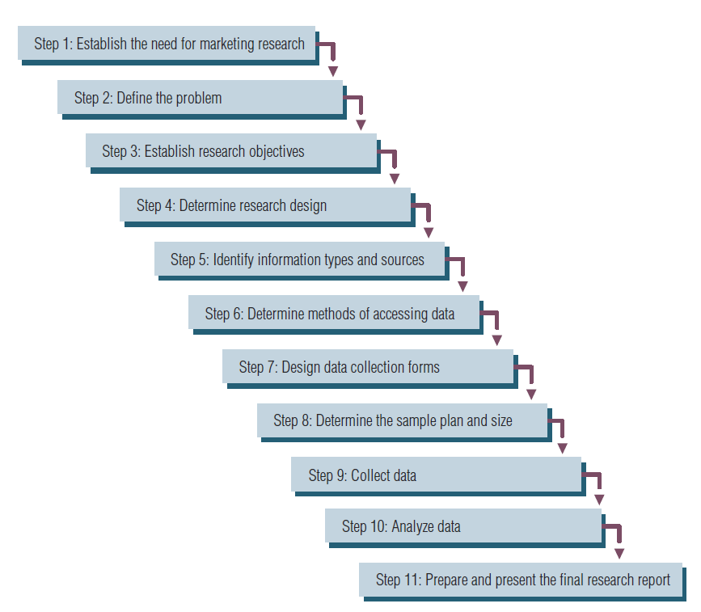
The Marketing Research Process

Slide 6
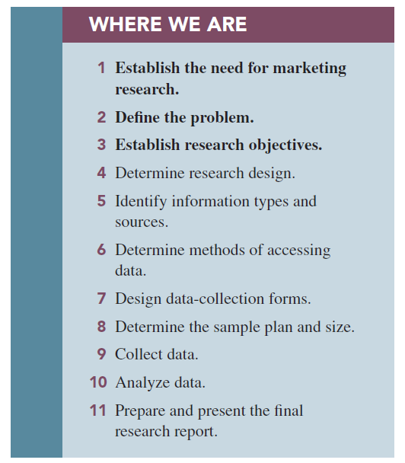

Slide 7
Caveats to a Step-by-Step Process
Not always presented as an 11-step process.
Not all studies use all 11 steps.
You may be able to solve the problem with secondary data
Few studies follow the steps in order.
Notes:
Change title

Slide 8
Step 1: Establish the Need for Marketing Research
Is there a real need for marketing research?
Research takes time and costs money.
- Managers must weigh the value that my possibly be derived from conducting marketing research and the cost of obtaning that information.
Is there a real need for marketing research?
- Marketing research is not always needed.

Slide 9
-The need for marketing research arises when mangers must make decisions, and they have inadequate information.
Company Policy Regarding he Use of marketing research : several choices must be made 1- some companies conduct different types of studies at specified intervals.
2- management may adopt a policy to use certain types of studies whenever a particular situation occurs.

Slide 10
3- Firms may elect to conduct marketing research on an as-needed basis.
4- Company policy regarding marketing research may also show a preference for the type of research management prefers.

Slide 11
When is marketing research not needed?
1-The information is already available.
2-The timing is wrong to conduct marketing research.
3-Funds are not available for marketing research.
4-Costs outweigh the value of marketing research: if costs outweigh the value of research , it shold not be undertaken.

Slide 12
Step 2: Define the Problem –Stating the Decision Alternatives
This is the most important of the 11 steps (assuming we’ve decided to do marketing research!).
If the problem is incorrectly defined, all else is wasted effort.
The need to make a decision requires decision alternatives. If there are no alternatives, no decision is necessary.

Slide 13
Step 3: Establish Objectives
Research objectives, when achieved, provide the information necessary to solve the problem identified in step 2.
Research objectives state what the researchers must do.

Slide 14
Step 4: Determine Research Design
A decision that is made in determining the research objective is whether the research will be.
Descriptive research: a set of methods and procedures describing marketing variables , such as a study conducted to measure customer satisfaction on 10-point scale.
Diagnostic research: designed to determine sources of satisfaction and dissatisfaction,such
Notes:
Check type vs. design

Slide 15
as retailer finding out that customer perceive that it carries too little inventory.
Prescriptive research: provides information that allows the manager to best remedy the dissatisfaction , for example : prescriptive research would allows the retailer to choose which variety of merchandise to add to gain the greatest increases in customer satifaction.
By research design we are referring to the research approach undertaken to meet the research objectives.

Slide 16
We have 3 type of research:
1-Exploratory research: collecting information in an unstructured and informal manner
2-Descriptive research: research that describes the phenomena of interest
3-Causal studies: attempt to uncover what factor or factors cause some event

Slide 17
Step 5: Identify Information Types and Sources
There are 2 types of information:
1- Primary information: information collected specifically for the problem at hand
2-Secondary information: information already collected
- Secondary information should always be sought first , since it is much cheaper and faster to collect than primary information.

Slide 18
Step 6: Determine Methods of Accessing Data
Secondary data is relatively easy to access; primary data is more complex.
The most popular form of accessing data is online surveys. Traditional modes of data collection, such as telephone, mail, and face-to-face intercepts, still have a place in marketing research.

Slide 19
Four main choices for primary data:
1-Have a person ask questions
2-Use computer-assisted or direct questioning
3-Allow respondents to answer questions themselves without computer assistance
4-Use some combination of two or more of the previous methods
Notes:
CHANGED, added fourth option

Slide 20
Step 7: Design Data Collection Forms
If we communicate with respondents , the form is called questionnaire.
The questionnaire must be worded objectively, clearly, and without bias in order to communicate with respondents.
If we observe respondents, the form is called an observation form.
Software programs are available to assist marketing researchers in preparing forms.

Slide 21
Step 8: Determine Sample Plan and Size
In many cases, marketing research studies are undertaken to learn about population by taking a sample of that population.
A Population consists of entire group about which the researcher wishes to make inferences based on information provided by the sample data.
The sample plan describes how each sample element, or unit, is to be drawn from the total population. Gives you representativeness!

Slide 22
Sample size refers to determining how many elements of the population should be included in the sample. Gives you accuracy!
In the end of chapter 9 you will learn more about both sample plan and sample size.

Slide 23
Step 9: Collect Data
Errors in collecting data may be attributed to fieldworkers or to respondents, and they may be intentional or nintentional.
Researchers must know the sources of these errors and implement controls to minimize them.
Researchers aim to minimize this possibility by undertaking a control referred to as validation.
Companies that specialize in data collection are referred to as field service firms.

Slide 24
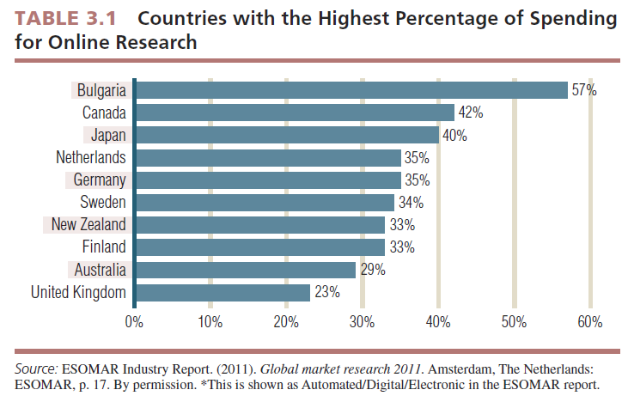

Slide 25
Step 10: Analyze Data
Data analysis involves entering data into computer files, inspecting data for errors, and running tabulations and various statistical tests.
The objective of data analysis is to use statistical tools to present data in a form that satifies the research objective.
You will learn more IBM SPSS and different types of data analysis in chapter 12-15
Notes:
Check for new spss image

Slide 26
Step 11: Prepare and Present the Final Research Report
Reporting, the last step, is one of the most important phases of marketing research.
Its importance cannot be overstated because it is the report, or its presentation, that properly communicates the results to the client.

Slide 27
Defining the Problem
What is the problem and the “Research objective”?
Problems are situations calling for managers to make choices among decision alternatives.
In defining the problem , mangers must first determine what decision they must make, and they should define those decisions in the form of decision alternatives.
Next they must ask if they have adequate information already available to make the decision.

Slide 28
Research objectives are specific and tell the researcher exactly what information must be collected to solve the problem by facilitating selection of an alternative.
-The Research Objective should be:
1-Specify from whom information is to be gathered
2-Specify what information is needed
3-Specify the unit of measurement used to gather information
4-Word questions used to gather information using the respondents’ frame of reference

Slide 29
The Importance of Properly Defining the Problem
When you define a problem incorrectly, there is nothing you can do in the research process to overcome this error. This makes defining the problem and research objectives the most important step in the marketing research process.

Slide 30
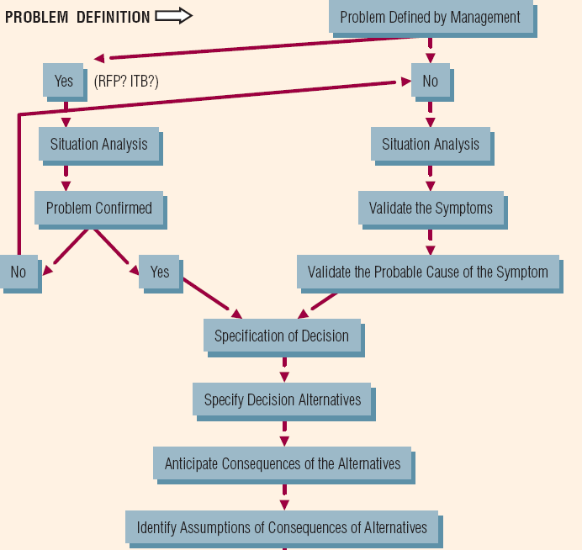
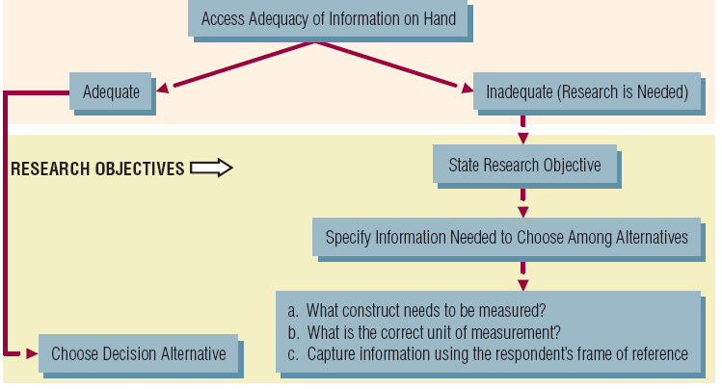
A Process for defining the problem and research objectives

Slide 31
First: Sources of problems
Two sources of problem:
1-Failure to meet an objective
2-Opportunity: represents what might happen, the problem arises when an opportunity is lost , when there is a gab between what did happened and what could have happened.
This situation represents a failure to realize a “favorable circumstance ” or chance for progress or advancement.
Marketing opportunity has been defined as an area of buyer need or potential interest in which a company can perform profitably.

Slide 32
Second: Recognizing the Problem
Here we consider two systems help managers identify the problems:
1- A Control system: to help mangers to recognize opportunities, managers must have a system for identification of opportunities.
Managers must be aware of opportunities. Unless they have a system for monitoring opportunities, sometimes referred to as opportunity identification, they will not likely identify these problems.

Slide 33
2- opportunity identification system:
-Kotler refers to this process as Market opportunity analysis (MOS) this help company when it wishes to take advantage of opportunities , it must have a system in place to help identify opportunities when they emerge.

Slide 34
Role of Symptoms in Problem Recognition
Symptoms are not the problem but are the “signals” that alert us to the problem.
Symptoms are changes in the level of some key monitor that measures the achievement of an objective.
A Symptom may also be a perceived change in the behavior of some market factor that implies an emerging opportunity.

Slide 35
Thirdly: Problem Definition- Defining Decision Alternatives
Whether managers define the problem themselves or call in marketing research to help define the problem, the marketing researcher plays an important role.
The Role of the Researcher in Problem Definition:
-When managers have already defined the problem prior to bringing research in, researchers must resist the temptation to “go along” with the first definition suggested.

Slide 36
A situation analysis is a form of exploratory research undertaken to gather background information and gather data pertinent to the problem area that might be helpful in defining the problem decision.
Invitations to bid (ITBs) or requests for proposals (RFPs) are often used in the marketing research process, these are routinely used in all business sectors when a firm desires supplier firms to present proposals or bids.

Slide 37
According to the researcher , the “problem is confirmed” the decision t be made is stated and we are now ready to move to the “specification of decision” which includes stating the decision alternative.
When Management has not already defined the problem in terms of a decision to be made , sometimes managers call researcher when they sense something is wrong and they need help, they may be aware of symptoms but are not sure what the problem is, they are not sure what decision they should make, here the researcher should also undertake a situation analysis.

Slide 38
Conduct a situation analysis
This analysis is essential when management has not determined the problem.
This step begin with the researcher learning about the industry, the competitors, key products , markets, market segments.
The researcher should than move to the company itself: its history, performance, products, unique competencies, marketing plans, customers, and major competitors.

Slide 39
Validate the symptoms of the problem
First: the researcher should clarify or validate the symptoms early in the research process.
- Are we certain the symptoms are true indicators of what they supposedly represent.
-Company vary greatly in terms of defining their objectives, monitoring their result and taking corrective action.
Next: Researcher need to assess the symptoms true or not.
-once the researcher has validated the symptoms, he or she is now ready to examine their couses.

Slide 40
Determine the Probable Cause(s) of the Symptom
It is crucial to determine all possible causes. If only a partial list of causes is made, it is possible that the real cause will be overlooked.
When a probable cause of the symptom is identified, this triggers a decision to be made by management.

Slide 41
After discussion with researcher all possible causes my be grouped in the following categories:
1- competitors action.
2- changes in the consumers.
3- something about the apartment complex itself.
4- general environmental.
Specification of the decision: management must decide what to do to win back market share, and as decisions consist of decision alternatives, mangers must specify the decision alternatives.

Slide 42
Specify Decision Alternatives That May Alleviate the Symptom
Decision alternatives include any marketing action that the manager thinks may resolve the problems such as price change, product modification or improvement, promotion of any kind, or even adjustments in channels of distribution.
Once the decision alternatives are determined, a manager must try to determine the consequences of choosing each alternative.

Slide 43
Consequences of the Alternatives
Consequences are the results of marketing action.
- Decision makers make assumptions when they assign consequences to decision alternatives.
Assumptions are assertions that certain conditions exist or that certain reactions will take place if the considered alternatives are implemented.
- If we do not feel that information is adequate to make assumptions about decision alternatives, we will likely need new information .This new information will be gathered by conducting marketing research .

Slide 44
Information state is the quantity and quality of evidence a manager possesses for each of his or her assumptions.
Information gaps are discrepancies between the current information level and the desired level of information at which the manager fells comfortable resolving the problem at hand.
-

Slide 45
Finally: Defining Research Objectives
Research objectives state specifically what information the researcher must produce so that the manager can choose the correct decision alternative to solve his or her problem.
Hypotheses are statements that are taken as true for the purposes of argument or investigation.

Slide 46
*From whom will we gather information:
-Research objectives should address who has the information we need.
-Not all respondents are willing to provide the information we seek.

Slide 47
What Construct Do We Wish to Measure?
A construct is an abstract idea inferred from specific instances that are thought to be related.
What is the unit of measure?
- As an operational definition defines a construct, such as intention to buy or satisfaction, which describes the operations to be carried out for the construct to be measured empirically.

Slide 48
What ever the unit of measurement, the researcher and manger must agree on it before defining the research objectives to ensure that the choice among alternatives can be made after the research project.

Slide 49
Completing the Process
The research objective specifies exactly what information the researcher must collect to fill the information gaps.
Once this information is provided, the manager should be able to choose among the decision alternatives.
But exactly how will that decision be made? What must the information look like for a certain alternative to be selected over others?

Slide 50
Action Standards
An action standard is a predesignation of some quantity of a measured attribute or characteristic that must be achieved for a research objective for a predetermined action to take place.
The manager and researcher should try to determine, prior to collecting the data, at which point they would still make this decision.

Slide 51
The action standard is an important component of the problem definition and research objectives determination process because it requires the client to focus on predetermining what information he or she will need in order to take action.

Slide 52
Elements of the Marketing Research Proposal
Elements include the following:
1-Statement of the problem
2-The research objectives
3-The research method
4-Statement of deliverables
5-Costs
6-Timetable

