Slide 1
Chapter 3
The Marketing Research Process and
Defining the Problem and Research Objectives

Slide 2
Learning Objectives
To gain insights into marketing research by learning the steps in the marketing research process
To understand when marketing research is not needed
To understand the difference between the problem and the research objective

Slide 3
Learning Objectives
To know the importance of properly defining the problem
To appreciate a process for defining the problem as decision alternatives
To know the criteria all research objectives should have and to know the sources of problems, the role of symptoms, and the role of the researcher

Slide 4
Learning Objectives
To understand that marketing research is needed when managers are uncertain of their assumptions needed to specify consequences of decision alternatives
To know what an action standard is and why it is needed
To learn the components of the marketing research proposal and ethical issues related to the research proposal

Slide 5
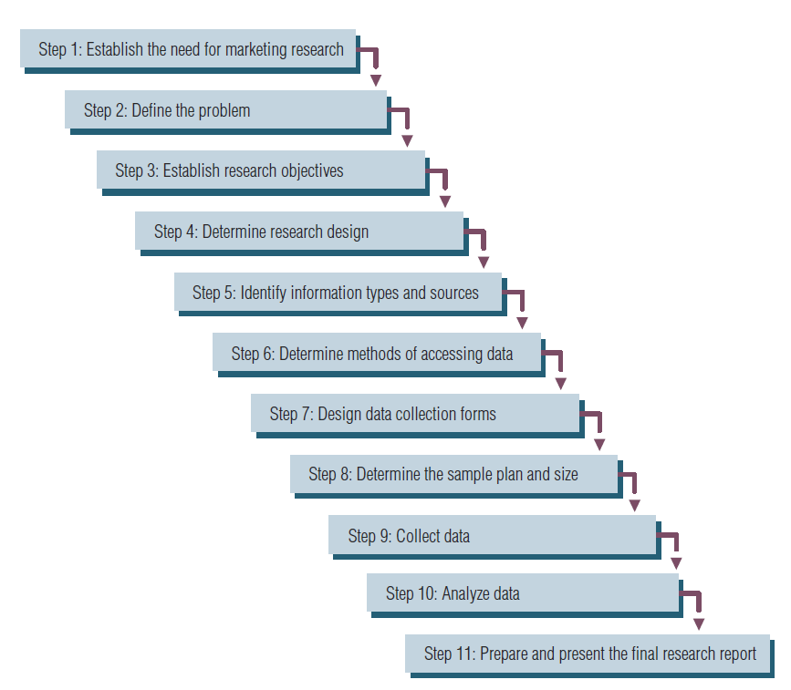
The Marketing Research Process

Slide 6
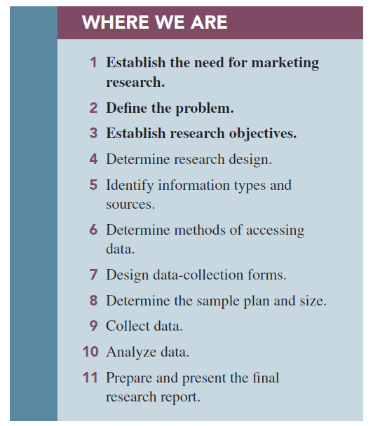

Slide 7
Caveats to a Step-by-Step Process
Not always presented as an 11-step process.
Not all studies use all 11 steps.
You may be able to solve the problem with secondary data (a visit to the library or Google™).
Few studies follow the steps in order.
Notes:
Change title

Slide 8
Step 1: Establish the Need for Marketing Research
Is there a real need for marketing research?
Research takes time and costs money.
Value of information versus cost of information?

Slide 9
Step 1: Establish the Need for Marketing Research
Is there a real need for marketing research?
Marketing research is not always needed.
We often have the information.

Slide 10
Step 1: Establish the Need for Marketing Research
When is marketing research not needed?
The information is already available.
The timing is wrong to conduct marketing research.
Funds are not available for marketing research.
Costs outweigh the value of marketing research.

Slide 11
Step 2: Define the Problem –Stating the Decision Alternatives
This is the most important of the 11 steps (assuming we’ve decided to do marketing research!).
If the problem is incorrectly defined, all else is wasted effort.

Slide 12
Step 2: Define the Problem
The need to make a decision requires decision alternatives. If there are no alternatives, no decision is necessary.

Slide 13
Step 3: Establish Objectives
Research objectives, when achieved, provide the information necessary to solve the problem identified in step 2.
Research objectives state what the researchers must do.

Slide 14
Step 4: Determine Research Design
Descriptive research: a set of methods and procedures describing marketing variables
Diagnostic research: designed to determine sources of satisfaction and dissatisfaction
Prescriptive research: provides information that allows the manager to best remedy the dissatisfaction
Notes:
Check type vs. design

Slide 15
Step 4: Determine Research Design
Exploratory research: collecting information in an unstructured and informal manner
Descriptive research: research that describes the phenomena of interest
Causal studies: attempt to uncover what factor or factors cause some event

Slide 16
Step 5: Identify Information Types and Sources
Primary information: information collected specifically for the problem at hand
Secondary information: information already collected

Slide 17
Step 6: Determine Methods of Accessing Data
Secondary data is relatively easy to access; primary data is more complex.
The most popular form of accessing data is online surveys. Traditional modes of data collection, such as telephone, mail, and face-to-face intercepts, still have a place in marketing research.

Slide 18
Step 6: Determine Methods of Accessing Data
Four main choices for primary data:
Have a person ask questions
Use computer-assisted or direct questioning
Allow respondents to answer questions themselves without computer assistance
Use some combination of two or more of the previous methods
Notes:
CHANGED, added fourth option

Slide 19
Step 7: Design Data Collection Forms
The questionnaire must be worded objectively, clearly, and without bias in order to communicate with respondents.
If we observe respondents, the form is called an observation form.

Slide 20
Step 7: Design Data Collection Forms
Software programs are available to assist marketing researchers in preparing forms.

Slide 21
Step 8: Determine Sample Plan and Size
The sample plan describes how each sample element, or unit, is to be drawn from the total population. Gives you representativeness!
Sample size refers to determining how many elements of the population should be included in the sample. Gives you accuracy!

Slide 22
Step 9: Collect Data
Nonsampling errors in data collection will occur, so researchers must know the sources of these errors and implement controls to minimize them.
Researchers aim to minimize this possibility by undertaking a control referred to as validation.
Companies that specialize in data collection are referred to as field service firms.

Slide 23
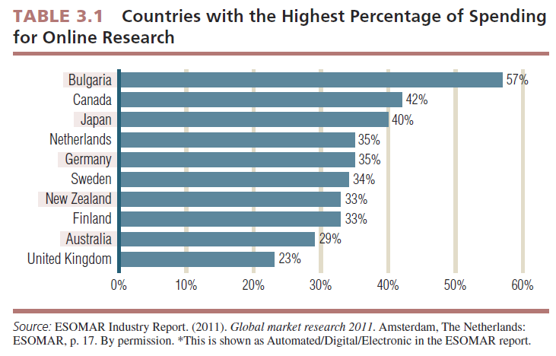

Slide 24
Step 10: Analyze Data
Data analysis involves entering data into computer files, inspecting data for errors, and running tabulations and various statistical tests.
SPSS®
Notes:
Check for new spss image

Slide 25
Step 11: Prepare and Present the Final Research Report
Reporting, the last step, is one of the most important phases of marketing research.
Its importance cannot be overstated because it is the report, or its presentation, that properly communicates the results to the client.

Slide 26
Defining the Problem
Problems are situations calling for managers to make choices among decision alternatives.

Slide 27
The Research Objective
Research objectives are specific and tell the researcher exactly what information must be collected to solve the problem by facilitating selection of an alternative.

Slide 28
The Research Objective
Specify from whom information is to be gathered
Specify what information is needed
Specify the unit of measurement used to gather information
Word questions used to gather information using the respondents’ frame of reference

Slide 29
The Importance of Properly Defining the Problem
When you define a problem incorrectly, there is nothing you can do in the research process to overcome this error. This makes defining the problem and research objectives the most important step in the marketing research process.

Slide 30
Sources of Problems
Failure to meet an objective
Opportunity
Marketing opportunity has been defined as an area of buyer need or potential interest in which a company can perform profitably.

Slide 31
Recognizing the Problem
Managers must be aware of opportunities. Unless they have a system for monitoring opportunities, sometimes referred to as opportunity identification, they will not likely identify these problems.

Slide 32
Role of Symptoms in Problem Recognition
Symptoms are not the problem but are the “signals” that alert us to the problem.
Symptoms are changes in the level of some key monitor that measures the achievement of an objective.

Slide 33
The Role of the Researcher in Problem Definition
Invitations to bid (ITBs) or requests for proposals (RFPs) are often used in the marketing research process.

Slide 34
The Role of the Researcher in Problem Definition
A situation analysis is a form of exploratory research undertaken to gather background information and gather data pertinent to the problem area that might be helpful in defining the problem decision.

Slide 35
Determine the Probable Cause(s) of the Symptom
It is crucial to determine all possible causes. If only a partial list of causes is made, it is possible that the real cause will be overlooked.
When a probable cause of the symptom is identified, this triggers a decision to be made by management.

Slide 36
Specify Decision Alternatives That May Alleviate the Symptom
Once the decision alternatives are determined, a manager must try to determine the consequences of choosing each alternative.

Slide 37
Consequences of the Alternatives
Consequences are the results of marketing decisions.
Assumptions are assertions that certain conditions exist or that certain reactions will take place if the considered alternatives are implemented.
Information state is the quantity and quality of evidence a manager possesses for each of his or her assumptions.
Information gaps are discrepancies between the current information level and the desired level of information.

Slide 38
Defining Research Objectives
Research objectives state specifically what information the researcher must produce so that the manager can choose the correct decision alternative to solve his or her problem.
Hypotheses are statements that are taken as true for the purposes of argument or investigation.

Slide 39
Defining Research Objectives
Criteria for writing research objectives:
Specify from whom information is to be gathered
Specify what information (construct) is needed
Specify the unit of measurement used to gather the information
Word questions used to gather information using the respondents’ frame of reference

Slide 40
What Construct Do We Wish to Measure?
A construct is an abstract idea inferred from specific instances that are thought to be related.
An operational definition defines a construct, such as intention to buy or satisfaction, which describes the operations to be carried out for the construct to be measured empirically.

Slide 41
Completing the Process
The research objective specifies exactly what information the researcher must collect to fill the information gaps.
Once this information is provided, the manager should be able to choose among the decision alternatives.
But exactly how will that decision be made? What must the information look like for a certain alternative to be selected over others?

Slide 42
Action Standards
An action standard is a predesignation of some quantity of a measured attribute or characteristic that must be achieved for a research objective for a predetermined action to take place.

Slide 43
Elements of the Market Research Proposal
The marketing research proposal serves as the basis of a contract as it documents what the marketing researcher proposes to deliver to the client for some consideration, typically a fee.

Slide 44
Elements of the Market Research Proposal
Elements include the following:
Statement of the problem
The research objectives
The research method
Statement of deliverables
Costs
Timetable

Slide 45
All rights reserved. No part of this publication may be reproduced, stored in a retrieval system, or transmitted, in any form or by any means, electronic, mechanical, photocopying, recording, or otherwise, without the prior written permission of the publisher. Printed in the United States of America.

