Slide 1
Coulomb’s law
Eng. Abdulsalam

Slide 2
Properties of Electrical force :
Properties of the electric force between two stationary charged particles :
1) is inversely proportional to the square of the separation r between the particles and directed along the line joining them .

Slide 3
Properties of Electrical force :
2) Is direct proportional to the product of the charges q₁ and q₂ on the two particles .
3) is attractive if the charges are of opposite sign and repulsive if the charges have the same sign .
4) is a conservative force .

Slide 4
Coulomb’s law :

Slide 5
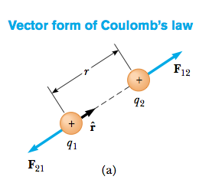
Vector form of Coulomb’s law :
F₂₁

Slide 6
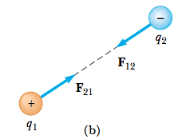
Vector form of Coulomb’s law :

Slide 7
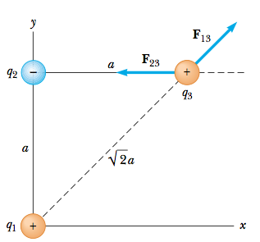
Example :
Consider three point charges located at the corners of a right triangle as shown in Figure, where q₁ = q₃ = 5.0 μC , q₂ = 2.0 μC, and exerted on q₃and , a = 0.10 m. Find the resultant force.

Slide 8
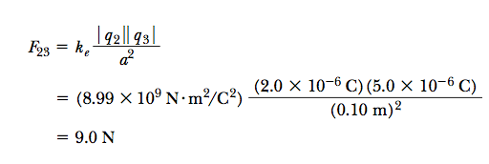
Answer :

Slide 9
Answer :

Slide 10
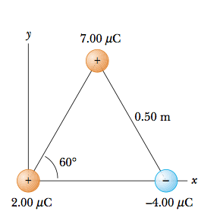
Problem :

Slide 11
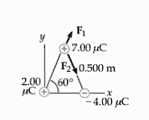
Answer :

Slide 12
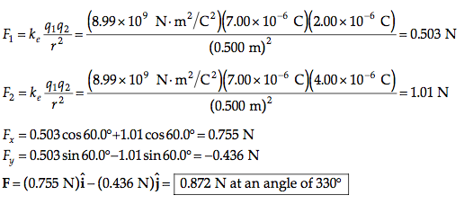
Answer :

Slide 13
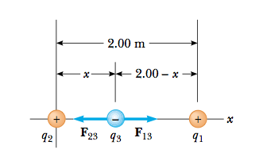
Example :
Three point charges lie along the x axis as shown in Figure. The positive charge q₁ = 15.0 μC is at x = 2.00 m, the positive charge q₂ = 6.00 μC is at the origin, and the resultant force acting on q₃ is zero. What is the x coordinate of q₃?

Slide 14
Thank you

