Slide 1
Strategic Marketing Planning

Slide 2
Introduction
Although the process of strategic marketing planning can be complex (a large multinational corporation) or relatively straight forward (a small single proprietor business), the planning process is the same in many ways.
Large or small, all marketers strive to meet the needs of their customers while meeting their own business and marketing objectives.

Slide 3
The Strategic Planning Process
Whether at the corporate, business unit, or functional level, the planning process begins with an in-depth analysis of the organization's internal and external environments—sometimes referred to as a situation analysis.
Planning efforts within each functional area will result in the creation of a strategic plan for that area. [Exhibit 2.1]

Slide 4
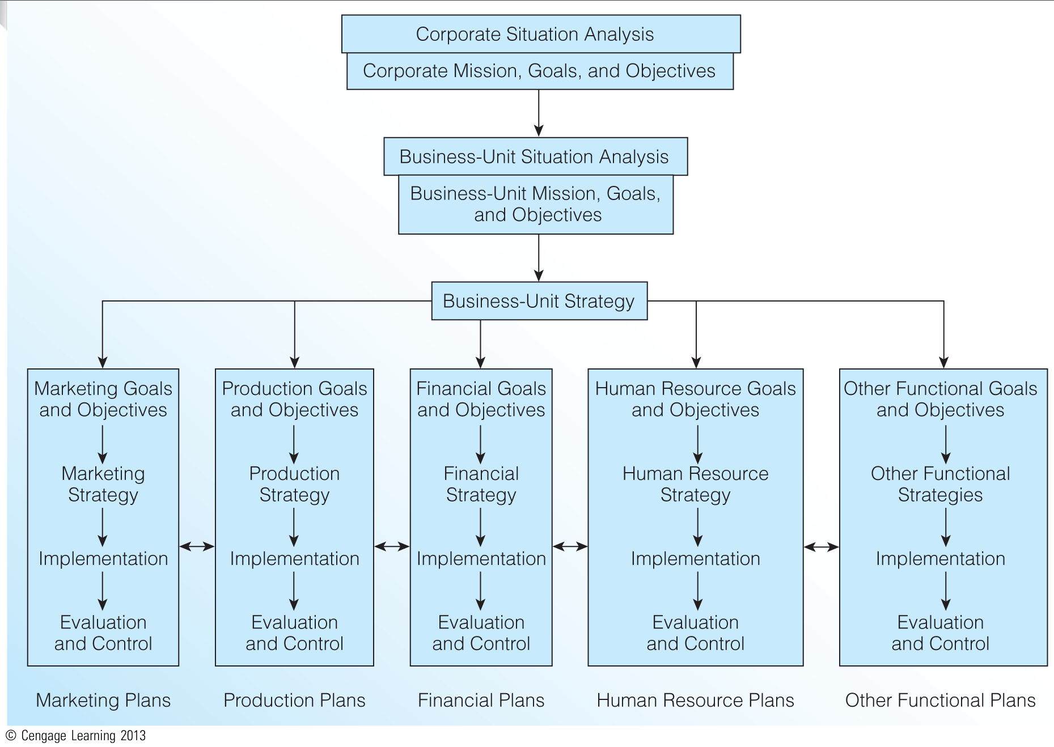
The Strategic Planning Process (Exhibit 2.1)

Slide 5
A marketing plan is a written document that provides the blueprint or outline of the organization's marketing activities, including the implementation, evaluation, and control of those activities.
The marketing plan serves a number of purposes:
1.It clearly explains how the organization will achieve its goals and objectives.
2.It serves as the "road map" for implementing the marketing strategy.
3.It instructs employees as to their roles and functions in fulfilling the plan.
4.It provides specifics regarding the allocation of resources and includes the specific marketing tasks, responsibilities of individuals, and the timing of all marketing activities.

Slide 6
Marketing decisions must be made within the boundaries of the organization's overall mission, goals, and objectives.

Slide 7
Organizational Mission versus Organizational Vision
A mission, or mission statement, seeks to answer the question "What business are we in?" It is a clear and concise statement (a paragraph or two at most) that explains the organization's reason for existence.
A vision, or vision statement, seeks to answer the question "What do we want to become?" An organization's vision tends to be future oriented, in that it represents where the organization is headed and where it wants to go.

Slide 8
Mission Statement | Vision Statement
Answers… “What business are we in?” | Answers… “What do we want to become?”
Clear and concise | Tends to be future oriented
Explains the organization’s reason for exis | Represents where the organization is headed

Slide 9
Elements of the Mission Statement
A well-devised mission statement for any organization, unit within an organization, or single-owner business should answer the same five basic questions to be answered:
Who are we?
Who are our customers?
What is our operating philosophy?
What are our core competencies or competitive advantages?
What are our responsibilities with respect to being a good steward of our human, financial, and environmental resources?
A mission statement that delivers a clear answer to each of these questions installs the cornerstone for the development of the marketing plan. [Exhibit 2.2]
The mission statement should be included in annual reports and major press releases, framed on the wall in every office, and personally owned by every employee of the organization.

Slide 10
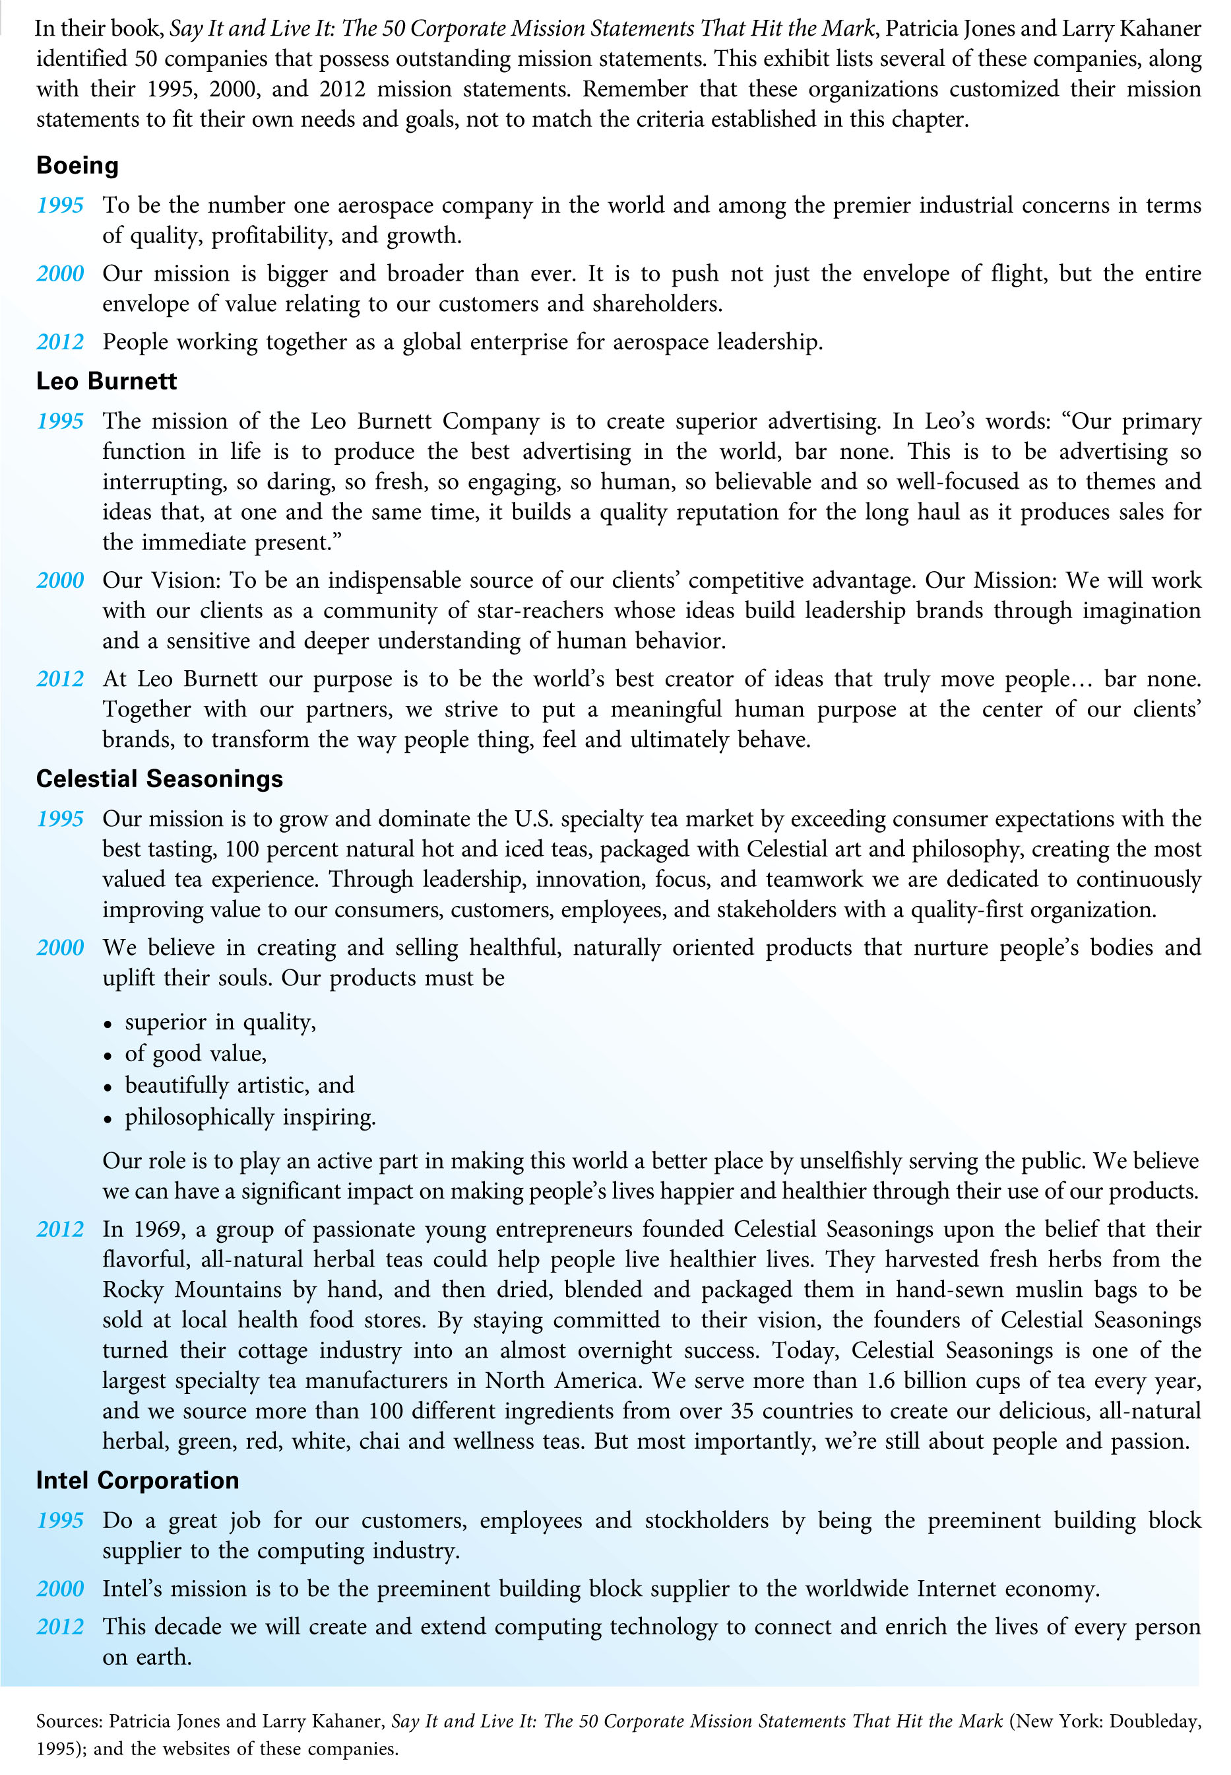
The Best Mission Statements(Exhibit 2.2)

Slide 11
Mission Width and Stability
In crafting a mission statement, management should be concerned about the statement's width.
Overly broad missions can lead companies to establish plans and strategies in areas where their strengths are limited.
Overly narrow mission statements that constrain the vision of the organization can prove just as costly.
Mission stability refers to the frequency of modifications in an organization's mission statement. Of all the components of the strategic plan, the mission should change the least frequently.

Slide 12
Customer-Focused Mission Statements
In recent years, mission statements have become much more customer oriented. People's lives and businesses should be enriched because they have dealt with the organization.
A focus on profit in the mission statement means that something positive happens for the owners and managers of the organization, not necessarily for the customers or other stakeholders.

Slide 13
For example,a focus on customers is one of the leading reasons for the long running success of Southwest Airline mission has not changed since 1988:
The mission of Southwest Airline is dedication to the highest quality of customer service delivered with a sense of warmth,friendliness,individual pride,and company spirit.

Slide 14
Ben & Jerry’s 3 Part Mission

Slide 15
(for example)The mission statement of culture icon Ben&Jerry’s Ice Cream consists of three interrelated parts,and good example of how an organization can work to have a positive impact on customers and society:
*Social Mission: To operate the company in a way that actively recognizes the central role that business plays in society by initiating innovative ways to improve the quality of life locally,nationally and internationally.
*Product Mission: To make,distribute and sell the finest quality all natural ice cream and euphoric concotions with a continued commitment to incorporating wholesome,natural ingredients and promoting business practices that respect the Earth and the Environment.
*Economic Mission: To operate the company on a sustainable financial basis of profitable growth,increasing value for our stakeholders and expanding opportunities for development and career growth for our employee.

Slide 16
Corporate or Business-Unit Strategy
All organizations need a corporate strategy, the central scheme or means for utilizing and integrating resources in the areas of production, finance, research and development, human resources, and marketing, to carry out the organization's mission and achieve the desired goals and objectives.
Larger firms often find it beneficial to devise separate strategies for each strategic business unit (SBU), subsidiary, division, product line, or other profit center within the parent firm.
Business-unit strategy determines the nature and future direction of each business unit, including its competitive advantages, the allocation of its resources, and the coordination of the functional business areas.

Slide 17
In small businesses, corporate strategy and business-unit strategy are essentially the same.
When a firm possesses capabilities that allow it to serve customers' needs better than the competition, it is said to have a competitive, or differential, advantage.
Competitive advantages cannot be fully realized unless customers see them as valuable. The key issue is the organization's ability to convince customers that its advantages are superior to those of the competition.

Slide 18
Functional Goals and Objectives
Marketing and all other business functions must support the organization's mission and goals, translating these into objectives with specific quantitative measurements.
All functional objectives should be expressed in clear, simple terms so that all personnel understand what type and level of performance the organization desires. In other words, objectives should be written so that their accomplishment can be measured accurately.
It is also important for all functional objectives to be reconsidered for each planning period.

Slide 19
Functional Strategy
Organizations design functional strategies to provide a total integration of efforts that focus on achieving the area's stated objectives.
In marketing strategy, the process focuses on selecting one or more target markets and developing a marketing program that satisfies the needs and wants of members of that target market.
Functional strategy decisions must:
a)fit the needs and purposes of the functional area with respect to meeting its goals and objectives.
b)be realistic given the organization's available resources and environment.
c)be consistent with the organization's mission, goals, and objectives.

Slide 20
Implementation
Implementation involves activities that actually execute the functional area strategy.
All functional plans have at least two target markets: an external market (customers, suppliers, investors, potential employees, the society at large) and an internal market (employees, managers, executives).
Even seemingly disconnected events in finance or human resources can have an effect on the firm's ultimate customers—the individuals and businesses that buy the firm's products.
In order for a functional strategy to be implemented successfully, the organization must rely on the commitment and knowledge of its employees—its internal target market.

Slide 21
Evaluation and Control
Organizations design the evaluation and control phase of strategic planning to keep planned activities on target with goals and objectives. The critical issue in this phase is coordination among functional areas.
The key to coordination is to ensure that functional areas maintain open lines of communication at all times.
In some ways, the evaluation and control phase of the planning process is an ending and a beginning. On one hand, evaluation and control occur after a strategy has been implemented. On the other hand, evaluation and control serves as the beginning point for the planning process in the next planning cycle.

Slide 22
The Marketing Plan
The marketing plan provides a detailed formulation of the actions necessary to carry out the marketing program. Think of the marketing plan as the handbook for marketing implementation, evaluation, and control.
A marketing plan is not the same as a business plan.
A good marketing plan requires a great deal of information from many different sources. This requires looking at the marketing plan holistically rather than as a collection of related elements.

Slide 23
Marketing Plan Structure(Exhibit 2.3)
There are many ways to structure a marketing plan. [Exhibit 2.3]
A good marketing plan outline is:
a)comprehensive: to ensure that there are no omissions of important information.
b)flexible: to ensure the plan will fit the unique needs of your situation.
c)consistent: to ensure that the marketing plan and the planning process will be understood by executives and employees outside of marketing.
d)logical: to ensure that the plan can be sold to top managers.

Slide 24
EXHI B I T 2.3 MARKETING PLAN STRUCTURE
I. Executive Summary
a. Synopsis
b. Major aspects of the marketing plan
II. Situation Analysis
a. Analysis of the internal environment
b. Analysis of the customer environment
c. Analysis of the external environment
III. SWOT Analysis (Strengths, Weaknesses, Opportunities, and Threats)
a. Strengths
b. Weaknesses
c. Opportunities
d. Threats
e. Analysis of the SWOT matrix
f. Developing competitive advantages
g. Developing a strategic focus
IV. Marketing Goals and Objectives
a. Marketing goals
b. Marketing objectives
V. Marketing Strategy
a. Primary (and secondary) target market
b. Product strategy
c. Pricing strategy
d. Distribution/supply chain strategy
e. Integrated marketing communication (promotion) strategy
VI. Marketing Implementation
a. Structural issues
b. Tactical marketing activities
VII. Evaluation and Control
a. Formal controls
b. Informal controls
c. Implementation schedule and timeline
d. Marketing audits

Slide 25
1-Executive Summary
The executive summary is a synopsis of the overall marketing plan, with an outline that conveys the main thrust of the marketing strategy and its execution.
Individuals both within and outside of the organization may read the executive summary for reasons other than marketing planning or implementation.
The executive summary should always be the last element to be written because it is easier (and more meaningful) to write after the entire marketing plan has been developed.

Slide 26
2-Situation Analysis
The situation analysis summarizes all pertinent information obtained about three key environments: the internal environment, the customer environment, and the firm’s external environment.
A clear and comprehensive situation analysis is one of the most difficult parts of developing a marketing plan.

Slide 27
3-SWOT (Strengths, Weaknesses, Opportunities, and Threats) Analysis
SWOT analysis focuses on the internal factors (strengths and weaknesses) and external factors (opportunities and threats)—derived from the situation analysis in the preceding section—that give the firm certain advantages and disadvantages in satisfying the needs of its target market(s).
Strengths and weaknesses are internal issues unique to the firm conducting the analysis.
Opportunities and threats are external issues that exist independently of the firm conducting the analysis. A common mistake is to list the firm's strategic alternatives as opportunities.

Slide 28
4-Marketing Goals and Objectives
Marketing goals and objectives are formal statements of the desired and expected outcomes resulting from the marketing plan.
This section of the marketing plan sets the performance targets that the firm seeks to achieve and it defines the parameters by which the firm will measure actual performance in the evaluation and control phase.

Slide 29
5-Marketing Strategy
The strategy section of the marketing plan outlines how the firm will achieve its marketing objectives.
In its broadest sense, marketing strategy refers to how the firm will manage its relationships with customers in a manner that gives it an advantage over the competition.

Slide 30
6-Marketing Implementation
The implementation section of the marketing plan describes how the marketing program will be executed. This section also answers several questions:
1)What specific marketing activities will be undertaken?
2)How will these activities be performed?
3)When will these activities be performed?
4)Who is responsible for the completion of these activities?
5)How will the completion of planned activities be monitored?
6)How much will these activities cost?

Slide 31
Without a good plan for implementation, the success of the marketing strategy is seriously jeopardized. For this reason, the implementation phase of the marketing plan is just as important as the marketing strategy phase.

Slide 32
7-Evaluation and Control
This section of the marketing plan details how the results of the marketing program will be evaluated and controlled.
Marketing control involves establishing performance standards, assessing actual performance by comparing it with these standards, and taking corrective action if necessary to reduce discrepancies between desired and actual performance.
The financial assessment of the marketing plan is also an important component of evaluation and control. Estimates of costs, sales, and revenues determine financial projections.
A marketing audit—a systematic examination of the firm's marketing objectives, strategy, and performance—can be used to pinpoint potential causes for discrepancies.

Slide 33
Using the Marketing Plan Structure
Tips for using the marketing plan framework to develop a marketing plan:
1-Plan ahead
2-Revise, revise, revise
3-Be creative
4-Use common senses and judgment
5-Think ahead to implementation
6-Update regularly
7-Communicate to others

Slide 34
1-Plan ahead: Writing a comprehensive marketing plan is very time consuming, especially if the plan is under development for the first time.
2-Revise, then revise again: After the situation analysis, you will spend most of your time revising the remaining elements of the marketing plan to ensure that they mesh with each other.
3-Be creative: A marketing plan is only as good as the information it contains and the effort and creativity that go into its creation.
4-Use common sense and judgment: Writing a marketing plan is an art. Common sense and judgment are necessary to sort through all of the information, weed out poor strategies, and develop a sound plan.

Slide 35
5-Think ahead to implementation: As you develop the plan, you should always be mindful of how the plan will be implemented.
6-Update regularly: Once the marketing plan has been developed and implemented, it should be updated regularly with the collection of new data and information.
7-Communicate to others: One critical aspect of the marketing plan is its ability to communicate to colleagues, particularly top managers who look to the marketing plan for an explanation of the marketing strategy, as well as for a justification of needed resources, like the marketing budget.

Slide 36
Purposes and Significance of the Marketing Plan
A good marketing plan will fulfill five purposes in detail:
a)It explains both the present and future situations of the organization. This includes the situation and SWOT analyses and the firm's past performance.
b)It specifies the expected outcomes (goals and objectives) so that the organization can anticipate its situation at the end of the planning period.
c) It describes the specific actions that are to take place so that the responsibility for each action can be assigned and implemented.
d)It identifies the resources that will be needed to carry out the planned actions.
e) It permits the monitoring of each action and its results so that controls may be implemented. Feedback from monitoring and control provides information to start the planning cycle again in the next time frame.

Slide 37
These five purposes are very important to various persons in the firm.

Slide 38
Organizational Aspects of the Marketing Plan
In many organizations, the marketing manager, brand manager, or product manager writes the marketing plan.
The authority to approve the marketing plan is typically vested in upper-level executives. These top managers ask:
a)Will the proposed marketing plan achieve the desired marketing, business unit, and corporate goals and objectives?
b)Are there alternative uses of resources that would better meet corporate or business unit objectives than the submitted marketing plan?
In most cases, final approval of the marketing plan lies with the president, chairman, or CEO of the organization.
Once a marketing plan has been approved, it still faces many obstacles before its marketing programs can come to fruition. [Exhibit 2.4]

Slide 39
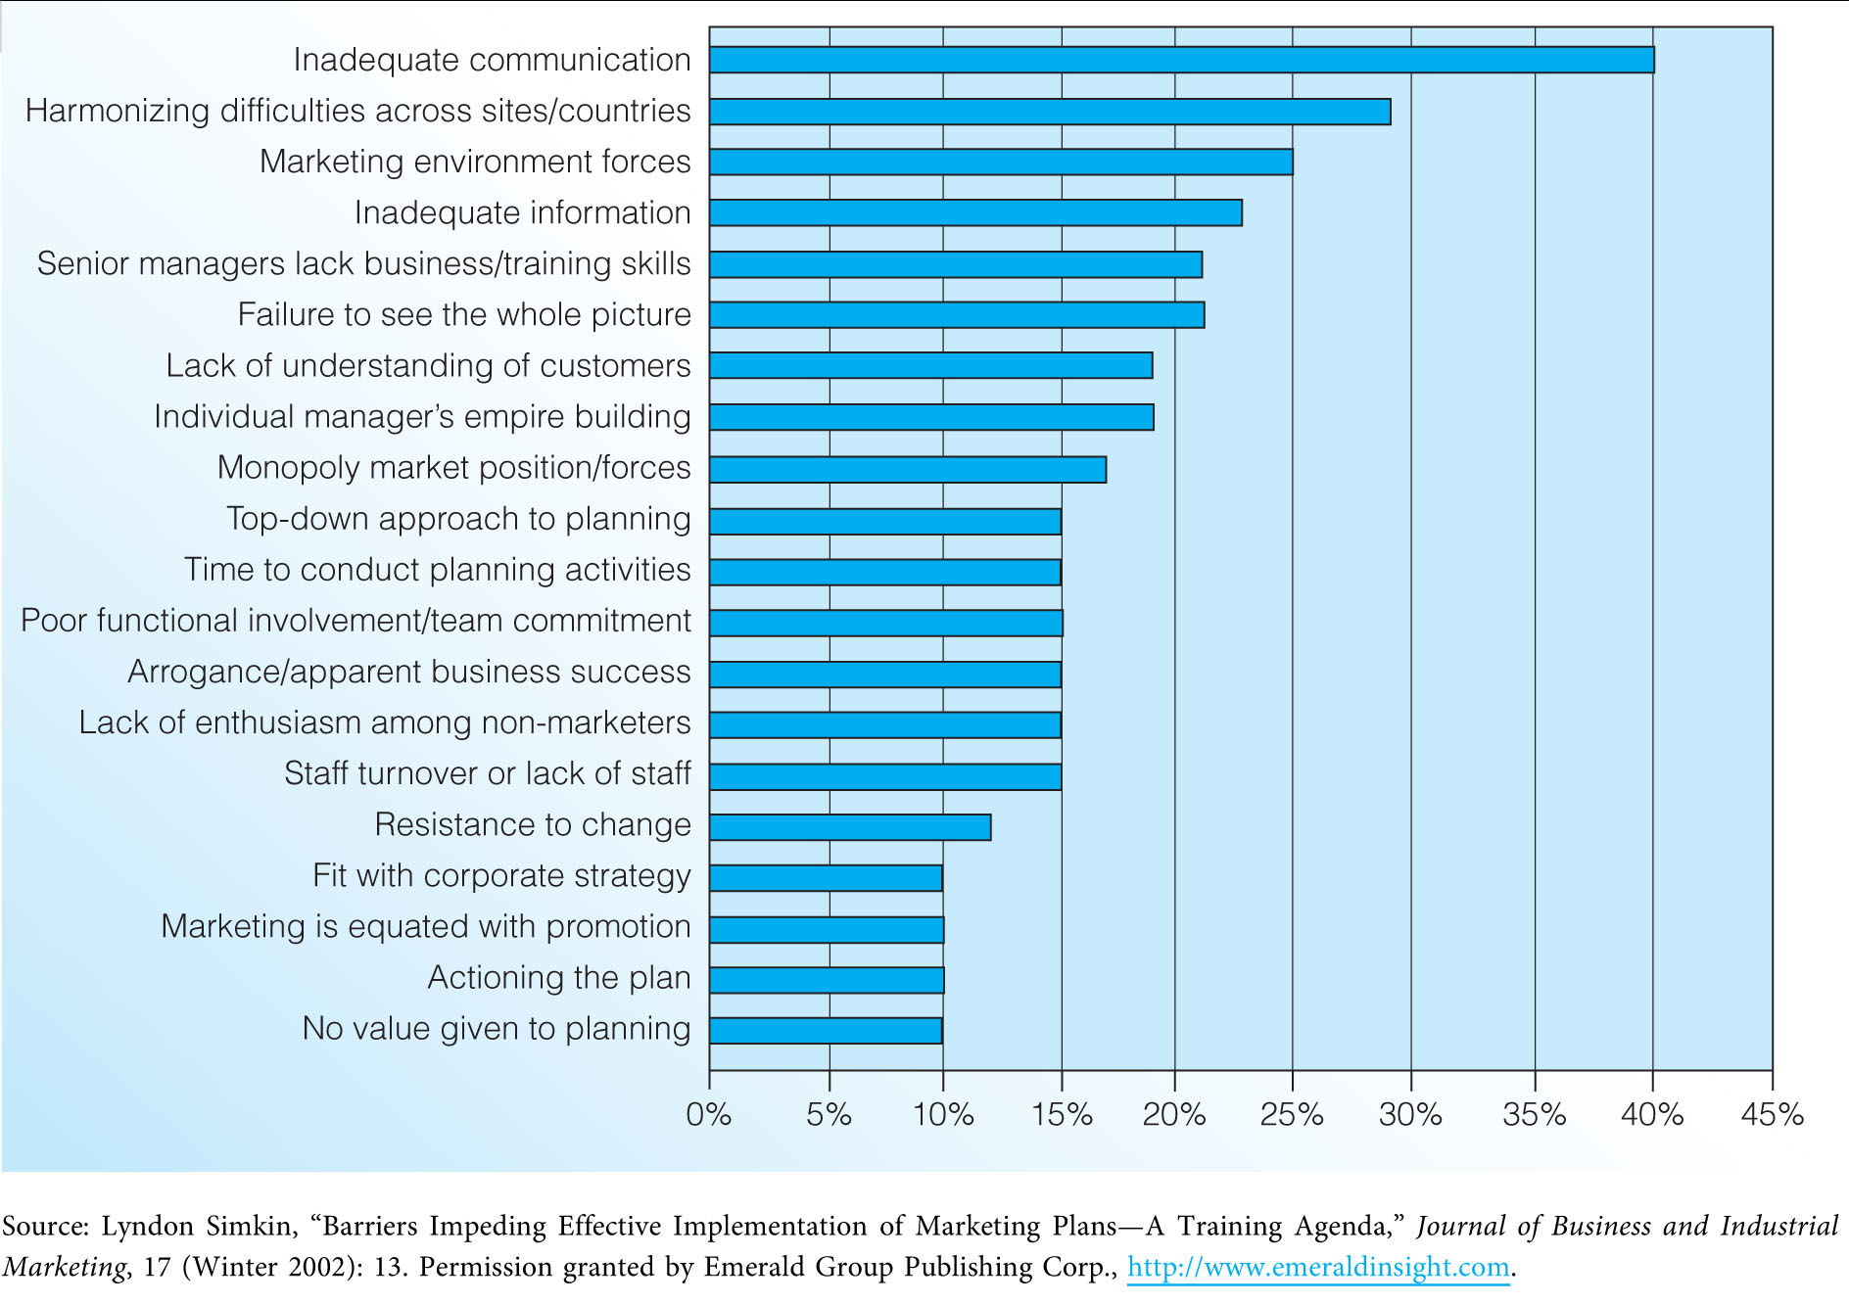
Obstacles to Developing Marketing Plans (Exhibit 2.4)

Slide 40
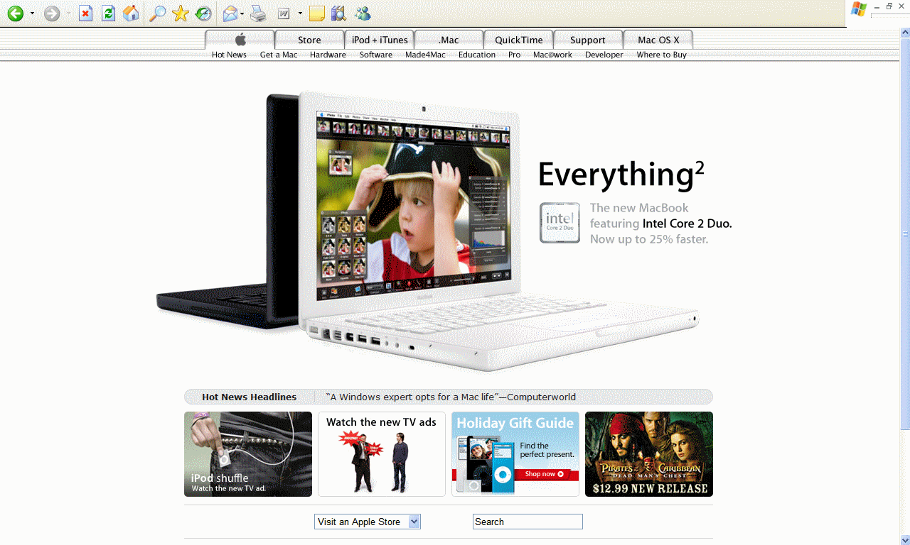
Apple’s Changing Strategic Focus

Slide 41
Maintaining Customer Focus and Balance in Strategic Planning
Many firms have changed the focus and content of their marketing plans. Of these changes, two stand out:
renewed emphasis on the customer.
the advent of balanced strategic planning.
These changes have required shifting focus from the company's products to the unique requirements of specific target market segments, as well as tighter integration with other functional areas.

Slide 42
1-Customer-Focused Strategic Planning
Focusing on the customer has not been the hallmark of strategic planning throughout history. The emphasis in marketing planning has shifted from production (efficiency and quality), to selling, to the marketing concept.
The marketers of today focus on long-term, value-added relationships with customers, employees, suppliers, and other partners. The focus has shifted from customer transactions to customer relationships, and from competition to collaboration.
Market-oriented firms successfully generate, disseminate, and respond to market information. These firms focus on customer analysis, competitor analysis, and integrating the firm's resources to provide customer value and satisfaction, as well as long-term profits.
For an organization to be truly market oriented, it must instill a corporate culture that puts customers first. [Exhibit 2.5]
In today's business environment, an orientation towards customers also requires that the organization's suppliers and even competitors be customer-oriented as well.

Slide 43
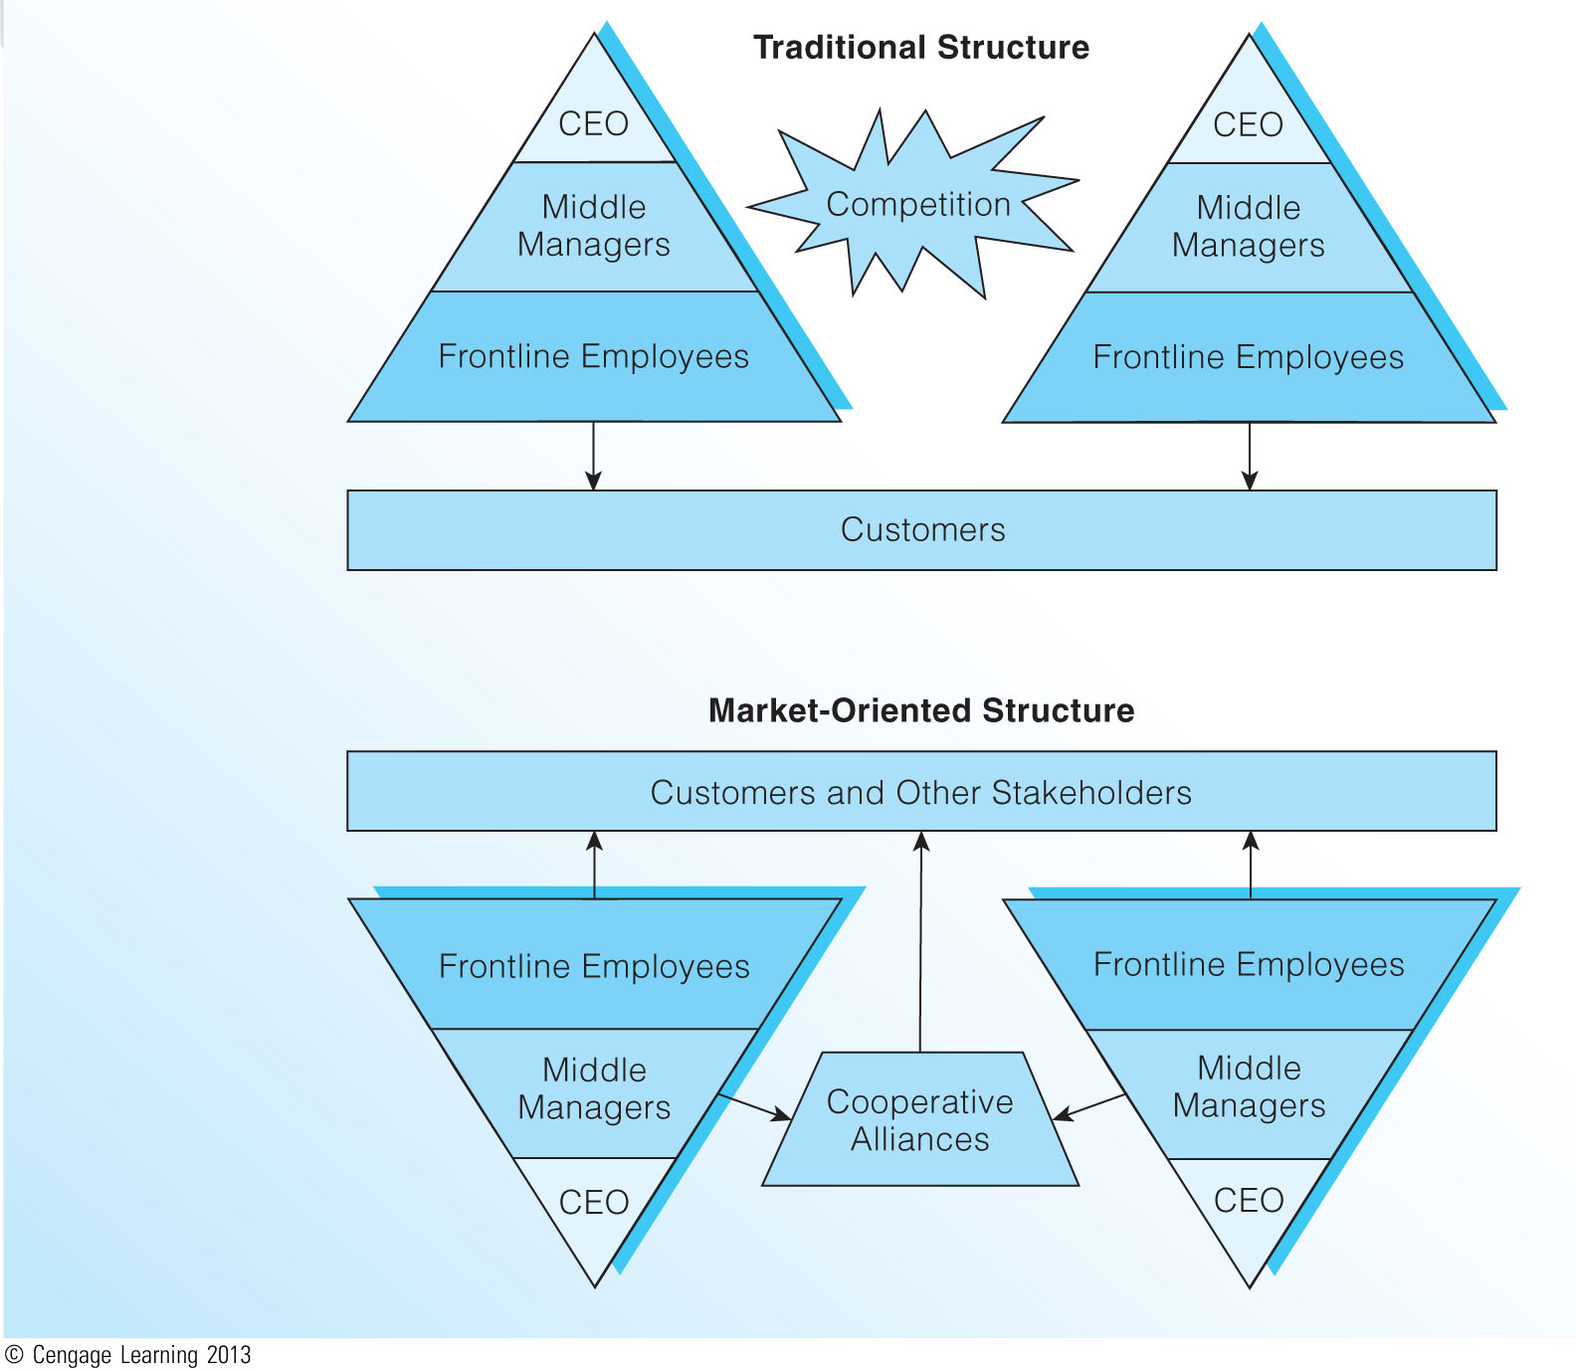
Traditional versus Market-Oriented Structures (Exhibit 2.5)

Slide 44
2-Balanced Strategic Planning
As firms approached the twenty-first century, they realized that traditional planning and measurement approaches could not capture value created by the organization’s intangible assets (customer relationships, processes, human resources, innovation, and information).
These assets are increasingly important to business success, but are not reported through traditional financial measures.
The balanced scorecard approach aligns strategic efforts by approaching strategy from four complementary perspectives: financial, customer, internal process, and learning and growth. [Exhibit 2.6]

Slide 45
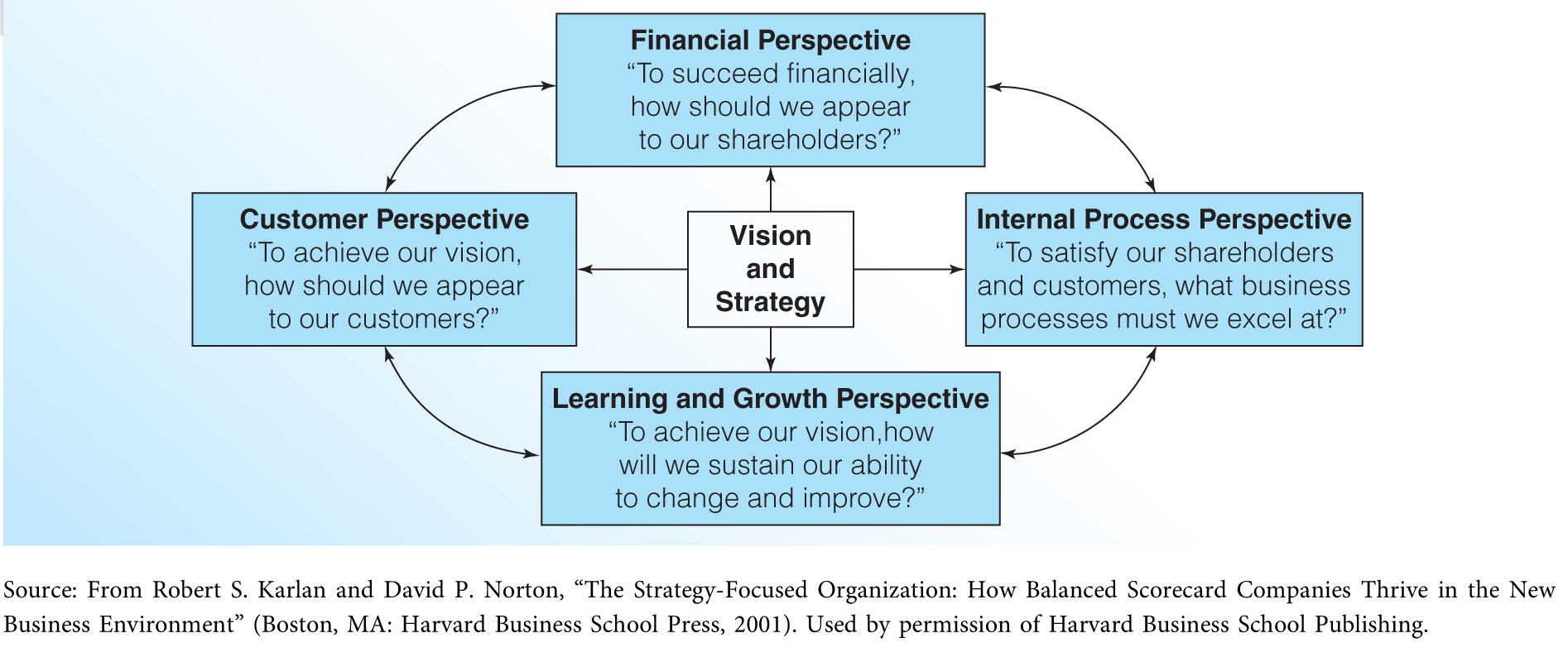
The Balanced Performance Scorecard (Exhibit 2.6)

Slide 46
The balanced scorecard has been used successfully by many organizations. These firms tend to adhere to five common principles (How Successful Firms Use the Balanced Scorecard):
a)Translate the strategy into operational terms
b)Align the organization to strategy
c)Make strategy everyone’s everyday job
d)Make strategy a continual process
e)Mobilize change through executive leadership

Slide 47
The balanced scorecard doesn’t refute the traditional approach to strategic planning. It does, however, caution business leaders to look at strategy and performance as a multidimensional issue. Financial measures, though important, simply cannot tell the whole story.
The balanced scorecard forces organizations to explicitly consider during strategy formulation those factors that are critical to strategy execution. Issues within the balanced scorecard such as employee training, corporate culture, organizational learning, and executive leadership are critical to the implementation of any strategy.

