Slide 1
Chapter 2
The Marketing Research Industry
Copyright © 2014 Pearson Education, Inc.

Slide 2
Learning Objectives
To learn a brief history of the marketing research industry
To learn the different types of marketing research firms and the industry structure
To be aware of criticisms of the industry and the industry’s focus on self-improvement

Slide 3
Learning Objectives
To appreciate the areas of ethical sensitivity in the marketing research process and to examine the ethical codes and standards developed by professional associations serving the marketing research industry
To learn about careers in the marketing research industry

Slide 4
Earliest Known Studies
Charles Coolidge Parlin is known as the “father of marketing research.”
Parlin conducted the first continuous marketing research in the early 1900s for the Curtis Publishing Company.
The purpose of Parlin’s research was to increase advertising for The Saturday Evening Post magazine.

Slide 5
20th Century Led to a “Mature Industry”
The Industrial Revolution led to manufacturers producing goods for distant markets.
Manufacturers needed to know about faraway consumers.
This led to the growing need for marketing research.

Slide 6
Who Conducts Marketing Research?
Internal suppliers: organizations that supply their own marketing research information
Client-side research: conducted by internal suppliers
DYI research: facilitated by Internet access to secondary data and better knowledge of data analysis software such as SPSS

Slide 7
Who Conducts Marketing Research?
External suppliers: outside firms hired to fulfill a company’s marketing research needs
Agency: firm specializing in marketing research and offer their services to buyers needing information to make more informed decisions

Slide 8
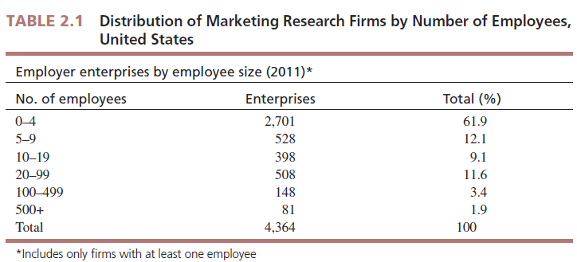
Industry Structure
Firm Size by Employees

Slide 9
Industry Structure
Firm size by revenue

Slide 10
Industry Structure
Types of firms and their specialties
Full-service supplier firms: have the capability to conduct the entire marketing research project for buyer firms
Limited-service supplier firms: specialize in one or, at most, a few marketing research activities

Slide 11
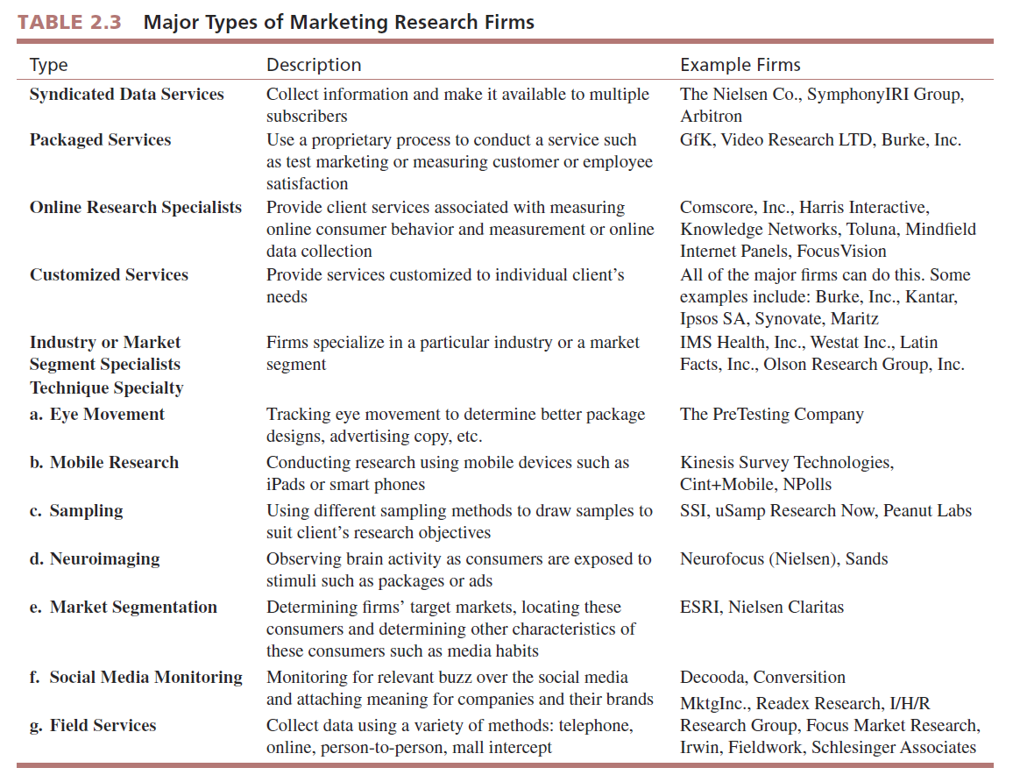

Slide 12
Industry Performance: Industry Revenues and Profits
ESOMAR estimates worldwide revenues for the marketing research industry at $31.2 billion.
Revenues vary around the world.

Slide 13
Industry Performance: Industry Revenues and Profits

Slide 14
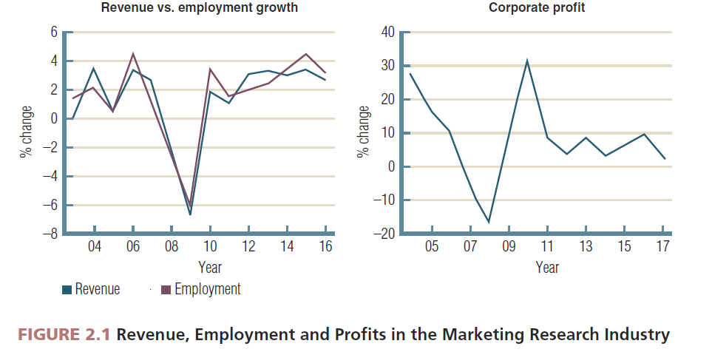

Slide 15
Industry Performance: Qualitative Evaluation
Questions about what constitutes marketing research
New methods to collect and analyze consumer information (primarily from social media) and challenges traditional marketing research information-gathering techniques

Slide 16
Industry Performance: Qualitative Evaluation
Mistreatment of respondents
Too many requests for research, overly long surveys, and breaches of promised anonymity have led to a decrease in the number of respondents willing to take part in research.

Slide 17
Industry Performance: Qualitative Evaluation
Marketing research is too focused on techniques
Clients may steer clear of companies that promote their standardized technique, preferring to work with firms over a longer time to develop an understanding of their business.

Slide 18
Industry Performance: Qualitative Evaluation
Marketing research viewed as a commodity
Too many executives view marketing research as providing a commodity to be outsourced to “research brokers,” who are hired to conduct a component of the research process when they should be involved in the entire process.

Slide 19
Industry Initiatives
Best practices
Maintaining public credibility of research
Monitoring industry trends
Improving ethical conduct
Certification of qualified research professionals
Continuing education

Slide 20
All rights reserved. No part of this publication may be reproduced, stored in a retrieval system, or transmitted, in any form or by any means, electronic, mechanical, photocopying, recording, or otherwise, without the prior written permission of the publisher. Printed in the United States of America.

