Slide 1
E-Marketing/7E Chapter 2
Strategic E-Marketing and
Performance Metrics

Slide 2
Chapter 2 Objectives
After reading Chapter 2, you will be able to:
Explain the importance of strategic planning, strategy, e-business strategy, and e-marketing strategy.
Identify the main e-business models at the activity, business process, and enterprise levels.
Discuss the use of performance metrics and the Balanced Scorecard to measure e-business and e-marketing performance.
Enumerate key performance metrics for social media communication.

Slide 3
The Amazon Story
Founded in 1995 as an online retailer.
Did not become profitable until Q4 2001.
In 2011, generated $48.1 billion in net sales, $631 million in net income.
Leveraged its competencies into different e-business models.
Core business is online retailing, “everything store.”
Established e-commerce partnerships.
Developer services provider.
Content provider.
Created the first affiliate program.

Slide 4
The Amazon Story, cont.
Founder and CEO Jeff Bezos is not interested in expanding to the physical world.
Amazon’s success is based on selection, lower prices, better availability, innovative technology, and better product information.
Which of Amazon’s core competencies do you think will drive its strategy in the future?

Slide 5
Strategic Planning
The process of developing and maintaining a strategic fit between the organization’s goals and capabilities and its changing market opportunities.
Process identifies firm’s goals for
Growth
Competitive position
Geographic scope
Other objectives, such as industry, products, channels, etc.

Slide 6
ESP: Environment, Strategy, and Performance
The ESP model illustrates the relationships among environment, strategy, and performance.
A SWOT analysis of the business environment (E) leads to the development of strategy (S) and the measurement of performance (P).
Performance metrics are designed to evaluate effectiveness and efficiency of e-business and e-marketing operations.

Slide 7
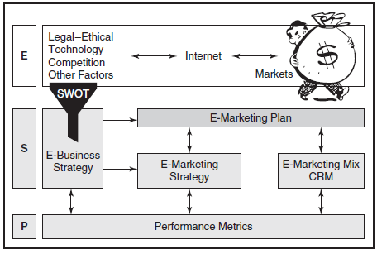
ESP model focuses on strategy and performance

Slide 8
Strategy
Strategy is the means to achieve a goal.
E-business strategy
Deploys enterprise resources to reach performance objectives and create competitive advantage.
E-marketing strategy
Capitalizes on information technology to reach specified objectives.

Slide 9
Business Models
A company will select one or more business models as strategies to accomplish enterprise goals.
An e-business model is a method by which the organization sustains itself in the long term using information technology, which includes its value proposition for partners and customers as well as its revenue streams.

Slide 10
SELECTING A BUSINESS MODEL
Components of business model selections:
Customer value | Scope
Price | Revenue sources
Connected activities | Implementation
Capabilities | Sustainability

Slide 11
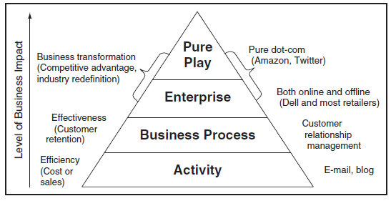
Level of Commitment to E-Business

Slide 12
Activity-Level E-Business Models
Online purchasing
Order processing
E-mail
Content publishing
Business intelligence (BI)
Online advertising and public relations (PR)
Online sales promotions
Pricing strategies
Social media communication
Search marketing

Slide 13
Business Process-Level E-Business Models
Customer relationship management (CRM)
Knowledge management
Supply chain management
Community building
Affiliate programs
Database marketing
Enterprise resource planning (ERP)
Mass customization
Crowdsourcing
Freemium
Location-based marketing

Slide 14
Enterprise-Level E-Business Models
E-commerce refers to online transactions: selling goods and services on the internet.
Social commerce uses social media to facilitate online sales.
Direct distribution is when manufacturers sell directly to consumers.
Content sponsorship is a form of e-commerce in which companies sell advertising on their Web pages, YouTube videos, or other online media.
A portal is a point of entry to the internet that combines diverse content from many sources.

Slide 15
Enterprise-Level E-Business Models, cont.
Social network sites are those that bring users together to share interests and personal or professional profiles.
Online brokers are intermediaries who assist in the purchase negotiations without actually representing either buyers or sellers.
Manufacturer’s agents represent more than one seller.
Purchasing agents represent buyers.

Slide 16
Pure Play
Pure plays are businesses that began on the internet.
They represent the final level of the pyramid.
Pure plays face significant challenges.
They must compete as new brands.
They may need to take customers away from established businesses.
Some pure plays have redefined industries: Yahoo!, Google, Twitter, Flickr, and eBay.

Slide 17
Performance Metrics Inform Strategy
Performance metrics are specific measures designed to evaluate the effectiveness and efficiency of operations, online and offline.
Performance metrics:
Provide measurable outcomes.
Must be easy to understand and use.
Must be actionable.
Can motivate employees to make decisions that lead to desired outcomes.

Slide 18
Web Analytics
Web analytics is the e-marketing term for the study of user behavior on Web pages.
Metrics measure activities such as:
Click throughs from advertising.
Page views.
Number of comments posted on a blog.
Number of fans on a company Facebook page.
Conversions to sales.

Slide 19
Data Collection
Data for Web analytics are collected in several ways:
Website server logs
Cookie files
Page tags
Geolocation

Slide 20
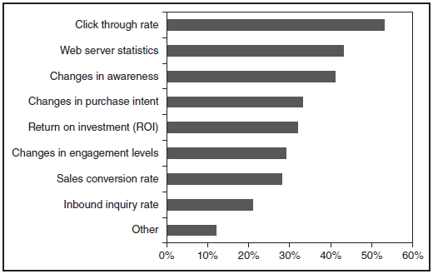
Metrics Used to Measure Internet Marketing Performance

Slide 21
The Balanced Scorecard
The Balanced Scorecard provides a framework for understanding e-marketing metrics.
The Balanced Scorecard provides 4 perspectives.
Customer perspective
Internal perspective
Learning and growth perspective
Financial perspective

Slide 22
The Balanced Scorecard: Customer Perspective
The customer perspective scorecard includes ways to measure goals such as customer satisfaction, engagement and retention.
Loyalty and satisfaction measures may include percentage of visitors who return to site, time between visits, and shopping cart abandonment.
Customer engagement could include the number of comments, photos or videos posted.
Exhibit 2.7 provides a list of customer goals and measures.

Slide 23
The Balanced Scorecard: Internal Perspectives
The Internal perspective includes ways to measure goals related to the quality of online services and measures for the entire supply chain.
Number of customers who use service
Number of complaints in social media
Amount of time to answer customer e-mail
Number of updates per day
Exhibit 2.8 provides a list of internal goals and measures.

Slide 24
The Balanced Scorecard: Learning and Growth Perspectives
The learning and growth perspective scorecard includes human resources, product innovation and continuous improvement of marketing processes.
Number of new service products to market
Number of customer complaints and fixes
Number of conversions from online leads
Exhibit 2.9 provides a list of learning and growth goals and measures.

Slide 25
The Balanced Scorecard: Financial Perspectives
The financial perspective scorecard includes ways to measure financial goals such as sales, profits and return on investment (ROI), including:
Sales growth and market share.
Average order value.
Individual customer profit.
Exhibit 2.10 provides a list of financial goals and measures.

Slide 26
Social Media Performance Metrics
Unique visitors
Page views
Impressions
Number of searches
Search engine ranking
Number of followers, registrations, or subscribers

Slide 27
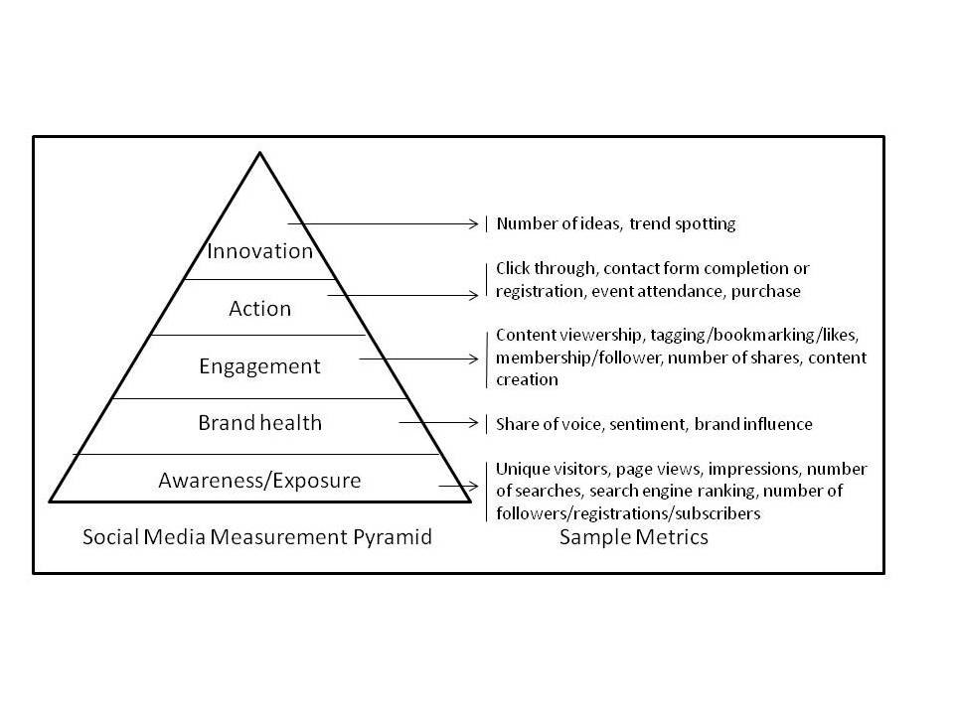

Slide 28
Brand Health Metrics
Share of Voice (SOV)
Sentiment
Brand influence

Slide 29
Engagement Metrics
Content viewership
Tagging, bookmarking or “likes”
Membership/Follower
Number of shares
Content creation

Slide 30
Action & Innovation Metrics
Action metrics
Click-through to an advertiser’s site.
Contact form completion or registration.
Event attendance.
Purchase.
Innovation metrics
Number of ideas shared.
Trend spotting.

Slide 31
31
All rights reserved. No part of this publication may be reproduced, stored in a retrieval system, or transmitted, in any form or by any means, electronic, mechanical, photocopying, recording, or otherwise, without the prior written permission of the publisher. Printed in the United States of America.
Copyright © 2014 Pearson Education, Inc.
Publishing as Prentice Hall

