Slide 1
Hello! CHAPTER#2 Life tables
Salma Alsuwailem

Slide 2
Life table notations!
Let lx be the expected number of survivors at age x, and ndx be the number of deaths between age x and x+n.
Observe:
This life table starts at age 0 with 100 survivors. $l_{0}$ is called the radix of the life table and is an arbitrary positive number.
At age 1, the expected number of survivors reduces to 50. This means the expected number of deaths between age 0 and age 1, $d_{1}$, is 100−50=50.
At age 2, the expected number of survivors is 0. This means all people are dead by age 2. The age by which all people are dead is called the limiting age.
x | lx
0 | 100
1 | 50
2 | 0
Salma Alsuwailem

Slide 3
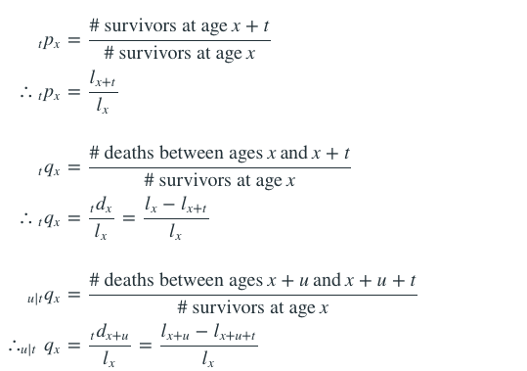
Life table
Salma Alsuwailem

Slide 4
Fractional ages!
1- Uniform Distribution of Deaths (UDD)
Key Idea
The key assumption is that the number of survivors decreases linearly between integer ages. Given lx and lx+1, we can calculate lx+t (where 0≤t<1) using linear interpolation:
Salma Alsuwailem

Slide 5
2- Constant Force of Mortality
Key Idea
The key assumption is that the force of mortality is constant between integer ages. Given lx and lx+1, we can calculate lx+t (where 0≤t<1) using exponential interpolation:
Salma Alsuwailem

Slide 6
examples
You are given l20=80,l21=76,l22=71,l.
Find 0.8q20.3.
assuming UDD for fractional ages.
assuming CFOM for fractional ages.
Salma Alsuwailem

Slide 7
For a certain mortality table, you are given:
μ80.5=0.0202
μ81.5=0.0408
μ82.5=0.0619
Deaths are uniformly distributed between integral ages.
Calculate the probability that a person aged 80.5 will die within two years.
Salma Alsuwailem

Slide 8
You are given:
lx = 10000$e^{−0.05x}$
Find 5|15q10.
Salma Alsuwailem

Slide 9
Select Mortality!
When mortality depends on the age when a person is selected, it is called select mortality. The age at which a person is selected is denoted as [x].
For example:
q[50] is the probability that a person currently aged 50, who was selected at age 50, dies within a year.
q[49]+1 is the probability that a person currently aged 50, who was selected a year ago at age 49, dies within a year.
q[41]+9 is the probability that a person currently aged 50, who was selected 9 years ago at age 41, dies within a year.
Notice all mortality rates in the example above are mortality rates for a person aged 50. The only difference is the age at which the person is selected.
Since the selection process wears off (i.e., we know less about a person if he/she was selected longer ago), we have: q[50]≤q[49]+1
Salma Alsuwailem

Slide 10
Select and Ultimate Mortality!
we assume after a certain number of years, selection has no effect on mortality. This period, after which the age at selection has no effect on mortality, is called the select period. The mortality after the select period is called the ultimate mortality. Thus, the complete model consists of a select period followed by the ultimate period.
For example, if the select period is 3 years, this means that selection has no effect after 3 years. As a result:
The probability that a person currently aged 50, who was selected 3 years ago at age 47, dies within a year is the same as the probability that a randomly selected person aged 50 dies within a year. q[47]+3=q50
The probability that a person currently aged 47, who was selected at age 47, survives 3 years and dies within the following year is: 3|q[47]= 3p[47]⋅q50 =p[47]⋅p[47]+1⋅p[47]+2⋅q50 since q[47]+3=q50.
Salma Alsuwailem

Slide 11
examples
You are given the following select–and–ultimate life table with a two year select period.
And q[x]+t=$\frac{t+1}{3}$ qx+t
Calculate l[90]+1
x | l[x] | l[x]+1 | lx+2
90
91 | 1250 |  | 920
92 | 1000 | 900
Salma Alsuwailem

Slide 12
You are given a select-and-ultimate mortality table with a 2-year select period.
x | q[x] | q[x]+1 | qx+2
50 | 0.012 | 0.024 | 0.036
51 | 0.022 | 0.034 | 0.046
52 | 0.033 | 0.045 | 0.057
Complete the following table:
x | l[x] | l[x]+1 | lx+2
50 | 100,000
51
52
Salma Alsuwailem

Slide 13
Select mortality rates for [45] are half of the Illustrative Life Table’s mortality rates for a selection period of 3 years.
Calculate 2|3q[45]
Salma Alsuwailem

Slide 14
THANKS!
Any questions?
Salma Alsuwailem

