Slide 1
Artificial Intelligence
Problem solving by searching
CSC 361
University of Berkeley, USA
http://www.aima.cs.berkeley.edu

Slide 2
Problem Solving by Searching
Search Methods :
Local Search for
Optimization Problems

Slide 3
Heuristic Functions
A heuristic function is a function f(n) that gives an estimation on the “cost” of getting from node n to the goal state – so that the node with the least cost among all possible choices can be selected for expansion first.
Three approaches to defining f:
  f measures the value of the current state (its “goodness”)
  f measures the estimated cost of getting to the goal from the current state:
    f(n) = h(n) where h(n) = an estimate of the cost to get from n to a goal
  f measures the estimated cost of getting to the goal state from the current state and the cost of the existing path to it. Often, in this case, we decompose f:
    f(n) = g(n) + h(n) where g(n) = the cost to get to n (from initial state)

Slide 4
Approach 1: f Measures the Value of the Current State
Usually the case when solving optimization problems
  Finding a state such that the value of the metric f is optimized
Often, in these cases, f could be a weighted sum of a set of component values:
  Chess
    Example: piece values, board orientations …
  Traveling Salesman Person
    Example: the length of a tour (sum of distances between visited cities)

Slide 5
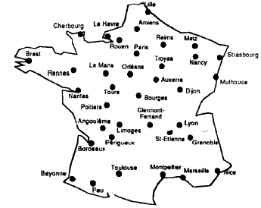
Traveling Salesman Person
Find the shortest Tour traversing all cities once.

Slide 6
Traveling Salesman Person
A Solution: Exhaustive Search
  (Generate and Test) !!
The number of all tours
is about (n-1)!/2
If n = 36 the number is about:
566573983193072464833325668761600000000
Not Viable Approach !!

Slide 7
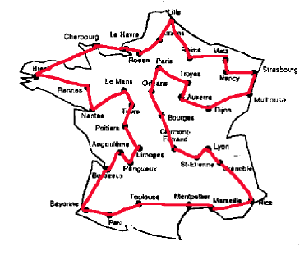
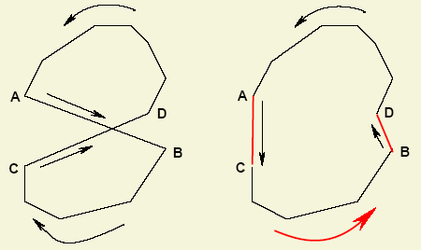

Traveling Salesman Person
A Solution: Start from an initial solution and improve using local transformations.

Slide 8
2-opt mutation for TSP
Choose two edges at random

Slide 9
2-opt mutation for TSP
Choose two edges at random

Slide 10
2-opt mutation for TSP
Remove them

Slide 11
2-opt mutation for TSP
Reconnect in a different way (there is only one valid new way)

Slide 12
Optimization Problems
Local Search Algorithms

Slide 13
Local Search Algorithms
The search algorithms we have seen so far keep track of the current state, the “fringe” of the search space, and the path to the final state.
In some problems, one doesn’t care about a solution path but only the orientation of the final goal state
  Example: 8-queen problem
Local search algorithms operate on a single state – current state – and move to one of its neighboring states
  Solution path needs not be maintained
  Hence, the search is “local”

Slide 14

Local Search Algorithms
Example:
Put N Queens on an n × n board with no two queens on the same row, column, or diagonal
Initial state … Improve it … using local transformations (perturbations)

Slide 15
Local Search Algorithms
Basic idea: Local search algorithms operate on a single state – current state – and move to one of its neighboring states.
The principle: keep a single "current" state, try to improve it
  Therefore: Solution path needs not be maintained.
  Hence, the search is “local”.
Two advantages
  Use little memory.
  More applicable in searching large/infinite search space. They find reasonable solutions in this case.

Slide 16
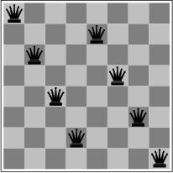
Local Search Algorithms for optimization Problems
Local search algorithms are very useful for optimization problems
systematic search doesn’t work
however, can start with a suboptimal solution and improve it
Goal: find a state such that the objective function is optimized
Minimize the number
of attacks

Slide 17
Local Search Algorithms
Hill Climbing,
Simulated Annealing,
Tabu Search

Slide 18
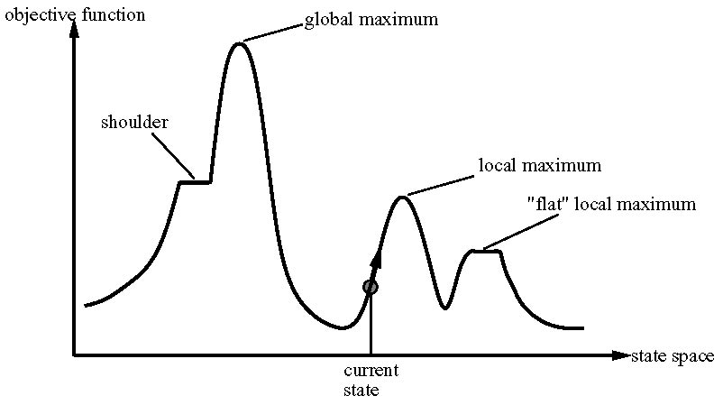
Local Search: State Space
A state space landscape is a graph of states associated with their costs

Slide 19

Hill Climbing
"Like climbing Everest in thick fog with amnesia"
Hill climbing search algorithm (also known as greedy local search) uses a loop that continually moves in the direction of increasing values (that is uphill).
It teminates when it reaches a peak where no neighbor has a higher value.

Slide 20
Steepest Ascent Version
Steepest ascent version
Function Hill climbing (problem) return state that is a local maximun
Inputs: problem, a problem
Local variables: current, a node
neighbor, a node
Current ← Make-Node (initial-state [problem])
Loop do
neighbor ← a highest-valued successor of current
If Value[neighbor] ≤ Value[current] then return state [current]
Current ← neighbor

Slide 21
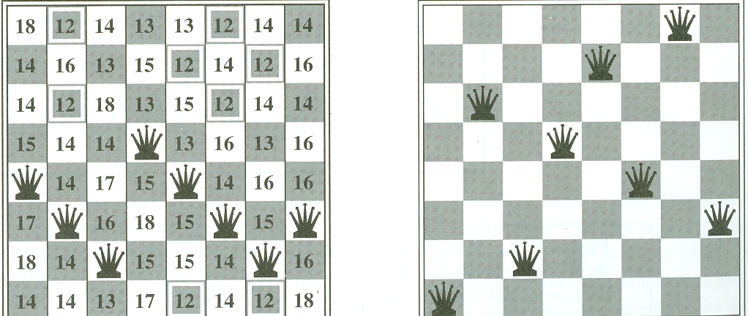
Hill Climbing: Neighborhood
Consider the 8-queen problem:
A State contains 8 queens on the board
The neighborhood of a state is all states generated by moving a single queen to another square in the same column (8*7 = 56 next states)
The objective function h(s) = number of queens that attack each other in state s.
h(s) = 17 best next is 12 h(s)=1 [local minima]

Slide 22
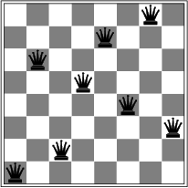
Hill Climbing Drawbacks
Local maxima/minima : local search can get stuck on a local maximum/minimum and not find the optimal solution
Local minimum
Cure
  + Random restart
  + Good for Only few local maxima

Slide 23
Hill Climbing
Cost
States

Slide 24
Hill Climbing
Current Solution

Slide 25
Hill Climbing
Current Solution

Slide 26
Hill Climbing
Current Solution

Slide 27
Hill Climbing
Current Solution

Slide 28
Hill Climbing
Best

Slide 29
Local Search Algorithms
Simulated Annealing
(Stochastic hill climbing …)

Slide 30
Simulated Annealing
Key Idea: escape local maxima by allowing some "bad" moves but gradually decrease their frequency
Take some uphill steps to escape the local minimum
Instead of picking the best move, it picks a random move
If the move improves the situation, it is executed. Otherwise, move with some probability less than 1.
Physical analogy with the annealing process:
  Allowing liquid to gradually cool until it freezes
The heuristic value is the energy, E
Temperature parameter, T, controls speed of convergence.

Slide 31
Simulated Annealing
Basic inspiration: What is annealing?
In mettallurgy, annealing is the physical process used to temper or harden metals or glass by heating them to a high temperature and then gradually cooling them, thus allowing the material to coalesce into a low energy cristalline state.
Heating then slowly cooling a substance to obtain a strong cristalline structure.
Key idea: Simulated Annealing combines Hill Climbing with a random walk in some way that yields both efficiency and completeness.
Used to solve VLSI layout problems in the early 1980

Slide 32
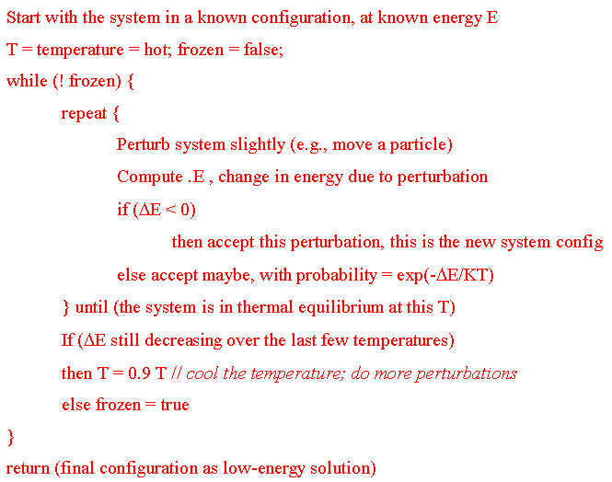
Simulated Annealing

Slide 33
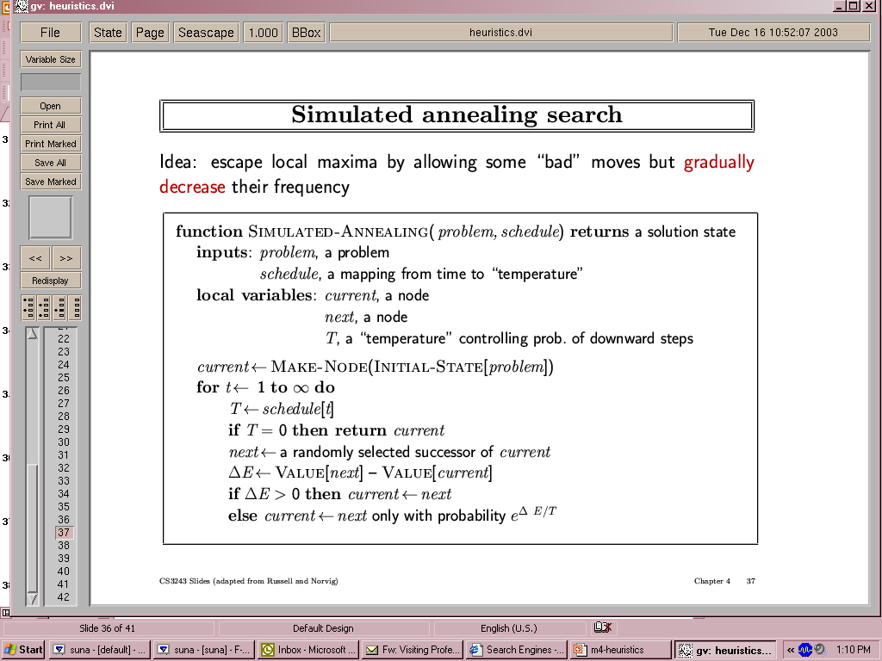
Simulated Annealing

Slide 34
Simulated Annealing
Temperature T
  Used to determine the probability
  High T : large changes
  Low T : small changes
Cooling Schedule
  Determines rate at which the temperature T is lowered
  Lowers T slowly enough, the algorithm will find a global optimum
In the beginning, aggressive for searching alternatives, become conservative when time goes by

Slide 35
Simulated Annealing
Cost
Best
States

Slide 36
Simulated Annealing
Cost
Best
States

Slide 37
Simulated Annealing
Cost
Best
States

Slide 38
Simulated Annealing
Cost
Best
States

Slide 39
Simulated Annealing
Cost
Best
States

Slide 40
Simulated Annealing
Cost
Best
States

Slide 41
Simulated Annealing
Cost
Best
States

Slide 42
Simulated Annealing
Cost
Best
States

Slide 43
Simulated Annealing
Cost
Best
States

Slide 44
Simulated Annealing
Cost
Best
States

Slide 45
Simulated Annealing
Cost
Best
States

Slide 46
Simulated Annealing
Cost
Best
States

Slide 47
Simulated Annealing
Cost
Best
States

Slide 48
Simulated Annealing
Cost
Best
States

Slide 49
Simulated Annealing
Cost
Best
States

Slide 50
Simulated Annealing
Cost
Best
States

Slide 51
Simulated Annealing
Cost
Best
States

Slide 52
Simulated Annealing
Cost
Best
States

Slide 53
Simulated Annealing
Cost
Best
States

Slide 54
Simulated Annealing
Cost
Best
States

Slide 55
Simulated Annealing
Cost
Best
States

Slide 56
Simulated Annealing
Cost
Best
States

Slide 57
Simulated Annealing
Cost
Best
States

Slide 58
Local Search Algorithms
Tabu Search
(hill climbing with small memory)

Slide 59
Tabu Search
The basic concept of Tabu Search as described by Glover (1986) is "a meta-heuristic superimposed on another heuristic.
The overall approach is to avoid entrainment in cycles by forbidding or penalizing moves which take the solution, in the next iteration, to points in the solution space previously visited ( hence "tabu").
The Tabu search is fairly new, Glover attributes it's origin to about 1977 (see Glover, 1977).

Slide 60
Tabu Search: TS
Cost
States

Slide 61
Tabu Search: TS
Best

Slide 62
Tabu Search: TS
Best

Slide 63
Tabu Search: TS
Best

Slide 64
Tabu Search: TS
Best

Slide 65
Tabu Search: TS
Best

Slide 66
Tabu Search: TS
Best

Slide 67
Tabu Search: TS
Best

Slide 68
Tabu Search: TS
Best

Slide 69
Tabu Search: TS
Best

Slide 70
Tabu Search: TS
Best

Slide 71
Tabu Search: TS
Best

Slide 72
Tabu Search: TS
Best

Slide 73
Tabu Search: TS
Best

Slide 74
Tabu Search: TS
Best

Slide 75
Tabu Search: TS
Best

Slide 76
Tabu Search: TS
Best

Slide 77
Tabu Search: TS
Best

Slide 78
Tabu Search: TS
Best

Slide 79
Tabu Search: TS
Best

Slide 80
Tabu Search: TS
Best

Slide 81
Tabu Search: TS
Best

Slide 82
Tabu Search: TS
Best

Slide 83
Optimization Problems
Population Based Algorithms
Beam Search, Genetic Algorithms & Genetic Programming

Slide 84
Population based Algorithms
Beam Search Algorithm

Slide 85
Local Beam Search
Unlike Hill Climbing, Local Beam Search keeps track of k states rather than just one.
It starts with k randomly generated states.
At each step, all the successors of all the states are generated.
If any one is a goal, the algorithm halts, otherwise it selects the k best successors from the complete list and repeats.
LBS≠ running k random restarts in parallel instead of sequence.
Drawback: less diversity. → Stochastic Beam Search

Slide 86
Local Beam Search
Idea: keep k states instead of just 1
  Begins with k randomly generated states
  At each step all the successors of all k states are generated.
  If one is a goal, we stop, otherwise select k best successors from complete list and repeat

Slide 87
Local Beam Search
Cost
States

Slide 88
Local Beam Search

Slide 89
Local Beam Search

Slide 90
Local Beam Search

Slide 91
Local Beam Search

Slide 92
Local Beam Search

Slide 93
Local Beam Search

Slide 94
Local Beam Search

Slide 95
Local Beam Search

Slide 96
Local Beam Search

Slide 97
Local Beam Search

Slide 98
Local Beam Search

Slide 99
Local Beam Search

Slide 100
Local Beam Search

Slide 101
Local Beam Search

Slide 102
Local Beam Search

Slide 103
Population based Algorithms
Genetic Algorithms
Genetic programming

Slide 104
Stochastic Search: Genetic Algorithms
Formally introduced in the US in the 70s by John Holland.
GAs emulate ideas from genetics and natural selection and can search potentially large spaces.
Before we can apply Genetic Algorithm to a problem, we need to answer:
    - How is an individual represented?
    - What is the fitness function?
    - How are individuals selected?
    - How do individuals reproduce?

Slide 105
Stochastic Search: Genetic Algorithms
Representation of states (solutions)
Each state or individual is represented as a string over a finite alphabet. It is also called chromosome which Contains genes.
genes
1001011111
Solution: 607
Encoding
Chromosome:
Binary String

Slide 106
Stochastic Search: Genetic Algorithms
Fitness Function
Each state is rated by the evaluation function called fitness function. Fitness function should return higher values for better states:
Fitness(X) should be greater than Fitness(Y) !!
[Fitness(x) = 1/Cost(x)]
Cost
States
X
Y

Slide 107
Stochastic Search: Genetic Algorithms
Selection
How are individuals selected ?
Roulette Wheel Selection
1
2
3
4
5
6
7
8
1
2
3
1
3
5
1
2
0
Rnd[0..18] = 7
Chromosome4
Rnd[0..18] = 12
Chromosome6
18

Slide 108
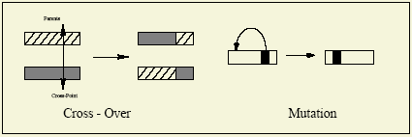
Stochastic Search: Genetic Algorithms
Cross-Over and Mutation
How do individuals reproduce ?

Slide 109
Stochastic Search: Genetic Algorithms
Crossover - Recombination
1010000000
Parent1
Offspring1
1011011111
1001011111
Parent2
Offspring2
1010000000
Crossover single point - random
With some high probability (crossover rate) apply crossover to the parents. (typical values are 0.8 to 0.95)

Slide 110
Stochastic Search: Genetic Algorithms
Mutation
mutate
Offspring1
1011011111
Offspring1
1011001111
Offspring2
1010000000
Offspring2
1000000000
Original offspring
Mutated offspring
With some small probability (the mutation rate) flip each bit in the offspring (typical values between 0.1 and 0.001)

Slide 111
Genetic Algorithms
GA is an iterative process and can be described as follows:
Iterative process
  Start with an initial population of “solutions” (think: chromosomes)
  Evaluate fitness of solutions
  Allow for evolution of new (and potentially better) solution populations
    E.g., via “crossover,” “mutation”
  Stop when “optimality” criteria are satisfied

Slide 112
Genetic Algorithms
Algorithm:
  1. Initialize population with p Individuals at random
  2. For each Individual h compute its fitness
  3. While max fitness < threshold do
    Create a new generation Ps
  4. Return the Individual with highest fitness

Slide 113
Genetic Algorithms
Create a new generation Ps:
Select (1-r)p members of P and add them to Ps. The probability of selecting a member is as follows:
P(hi) = Fitness (hi) / Σj Fitness (hj)
Crossover: select rp/2 pairs of hypotheses from P according to P(hi).
For each pair (h1,h2) produce two offspring by applying the Crossover operator. Add all offspring to Ps.
Mutate: Choose mp members of Ps with uniform probability. Invert one bit in the representation randomly.
Update P with Ps
Evaluate: for each h compute its fitness.

Slide 114
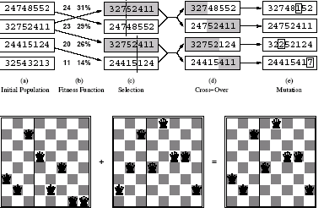
Stochastic Search: Genetic Algorithms

Slide 115
Genetic Algorithms
Cost
States

Slide 116
Genetic Algorithms
Mutation
Cross-Over

Slide 117
Genetic Algorithms

Slide 118
Genetic Algorithms

Slide 119
Genetic Algorithms

Slide 120
Genetic Algorithms

Slide 121
Genetic Algorithms

Slide 122
Genetic Algorithms

Slide 123
Genetic Algorithms

Slide 124
Genetic Algorithms

Slide 125
Genetic Algorithms

Slide 126
Genetic Algorithms

Slide 127
Genetic Algorithms

Slide 128
Genetic Algorithms

Slide 129
Genetic Algorithms

Slide 130
Genetic Algorithms

Slide 131
Genetic Algorithms

Slide 132
Genetic Algorithms

Slide 133
Genetic Algorithms

Slide 134
Optimization Problems
Genetic programming: GP

Slide 135
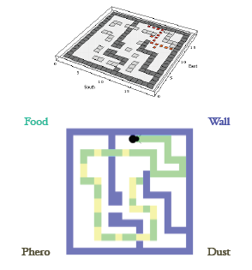
Genetic Programming
Genetic programming (GP)
Programming of Computers
by Means of Simulated Evolution
How to Program a Computer
Without Explicitly Telling It What to Do?
Genetic Programming is Genetic Algorithms where solutions are programs …

Slide 136
Genetic programming
When the chromosome encodes an entire program or function itself this is called genetic programming (GP)
In order to make this work,encoding is often done in the form of a tree representation
Crossover entials swaping subtrees between parents

Slide 137
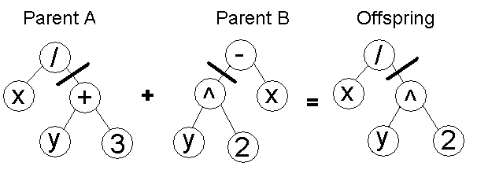
Genetic programming
It is possible to evolve whole programs like this but only small ones. Large programs with complex functions present big problems

Slide 138
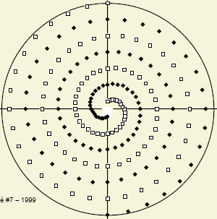
Genetic programming
Inter-twined Spirals: Classification Problem
Red Spiral
Blue Spiral

Slide 139
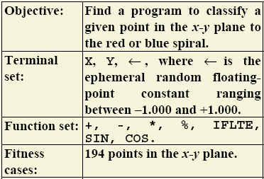
Genetic programming
Inter-twined Spirals: Classification Problem

Slide 140
Optimization Problems
New Algorithms
ACO, PSO, QGA …

Slide 141

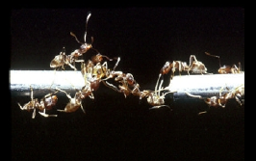
Anything to be Learnt from Ant Colonies?
Fairly simple units generate complicated global behaviour.
An ant colony expresses a complex collective behavior providing intelligent solutions to problems such as:
  carrying large items
  forming bridges
  finding the shortest routes from the nest to a food source, prioritizing food sources based on their distance and ease of access.
“If we knew how an ant colony works, we might understand more about how all such systems work, from brains to ecosystems.”
(Gordon, 1999)

Slide 142
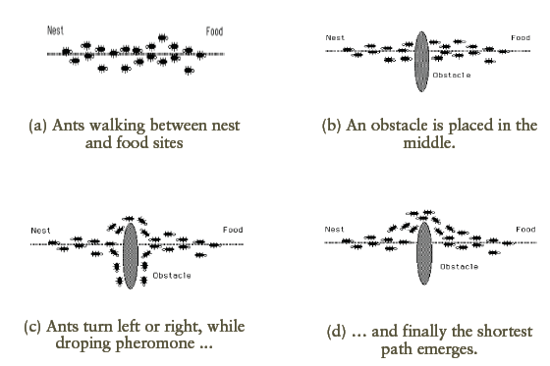
Shortest path discovery

Slide 143
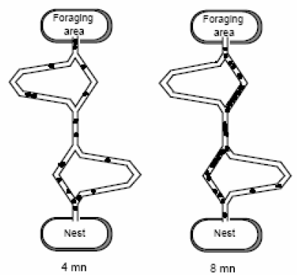
Shortest path discovery
Ants get to find the shortest path after few minutes …

Slide 144
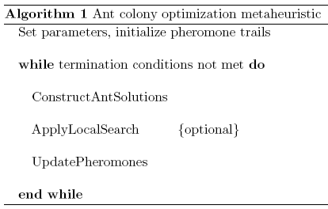
Ant Colony Optimization
  Each artificial ant is a probabilistic mechanism that constructs a solution to the problem, using:
        Artificial pheromone deposition
        Heuristic information: pheromone trails, already visited cities memory …

Slide 145
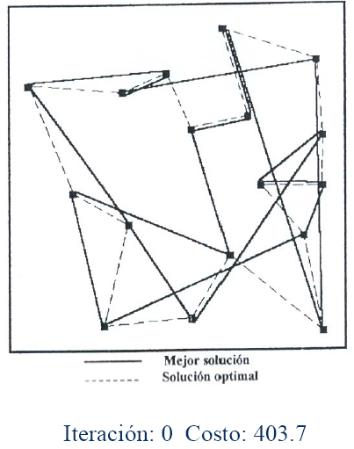
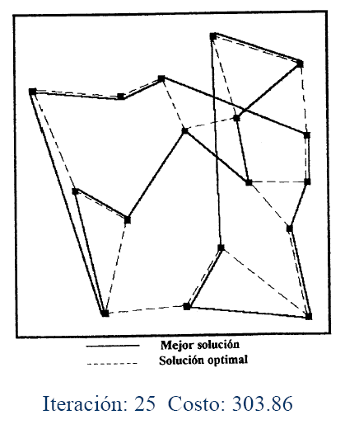
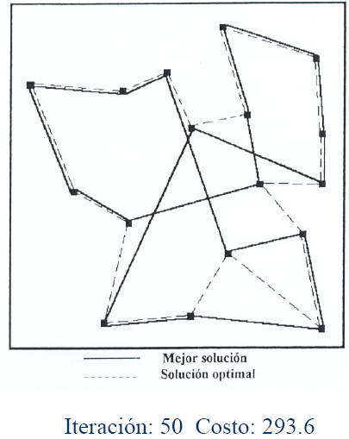
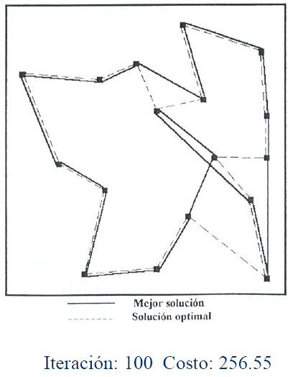
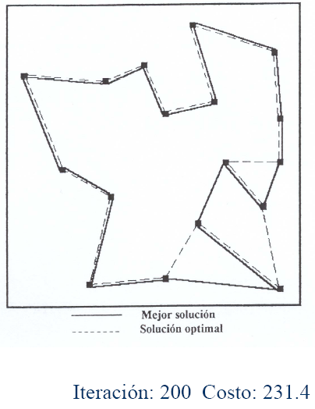
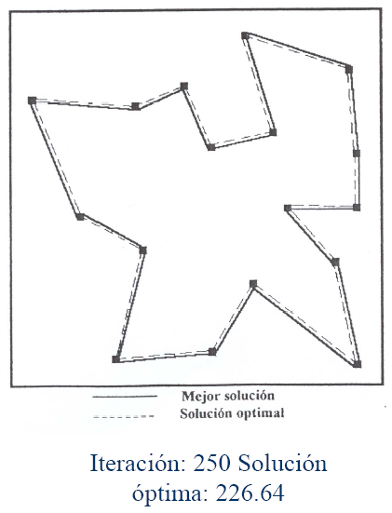
TSP Solved using ACO

Slide 146
Summary
* Local search methods keep small number of nodes in memory.
They are suitable for problems where the solution is the goal state
itself and not the path.
* Hill climbing, simulated annealing and local beam search are
examples of local search algorithms.
* Stochastic algorithms represent another class of methods for
informed search. Genetic algorithms are a kind of stochastic hill-
climbing search in which a large population of states is
maintained. New states are generated by mutation and by
crossover which combines pairs of states from the population.

