Slide 1
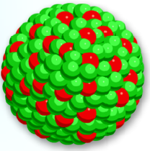
Atoms, Molecules and Ions
2
Copyright © The McGraw-Hill Companies, Inc. Permission required for reproduction or display.

Slide 2
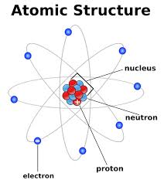
Atomic structure

Slide 3
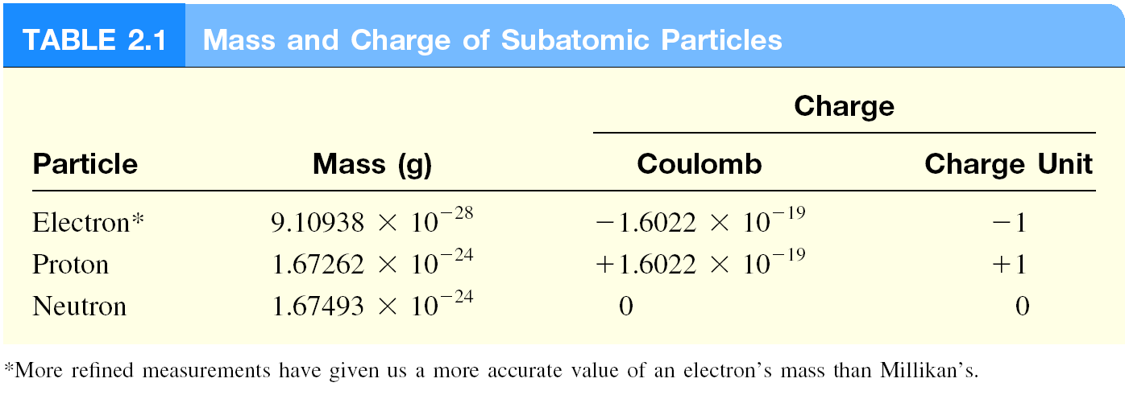
mass p ≈ mass n ≈ 1840 x mass e⁻

Slide 4
Atomic number, Mass number and Isotopes
Atomic number (Z) = number of protons in nucleus
Mass number (A) = number of protons + number of neutrons
= atomic number (Z) + number of neutrons
Isotopes are atoms of the same element (X) with different numbers of neutrons in their nuclei
Mass Number
A
X
Element Symbol
Atomic Number
Z
1
2
3
H
H (D)
H (T)
1
1
1
235
U
238
U
92
92

Slide 5
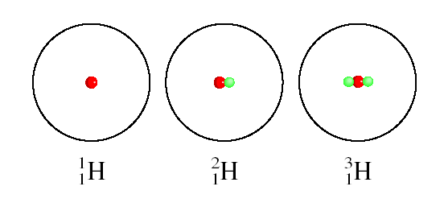
The Isotopes of Hydrogen

Slide 6
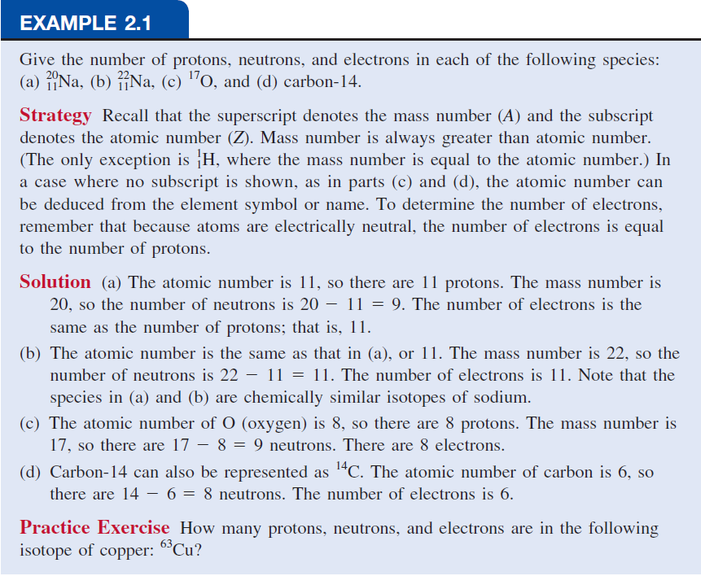

Slide 7
14
How many protons, neutrons, and electrons are in
C
?
6
6 protons, 8 (14 - 6) neutrons, 6 electrons
11
How many protons, neutrons, and electrons are in
C
?
6
6 protons, 5 (11 - 6) neutrons, 6 electrons

Slide 8
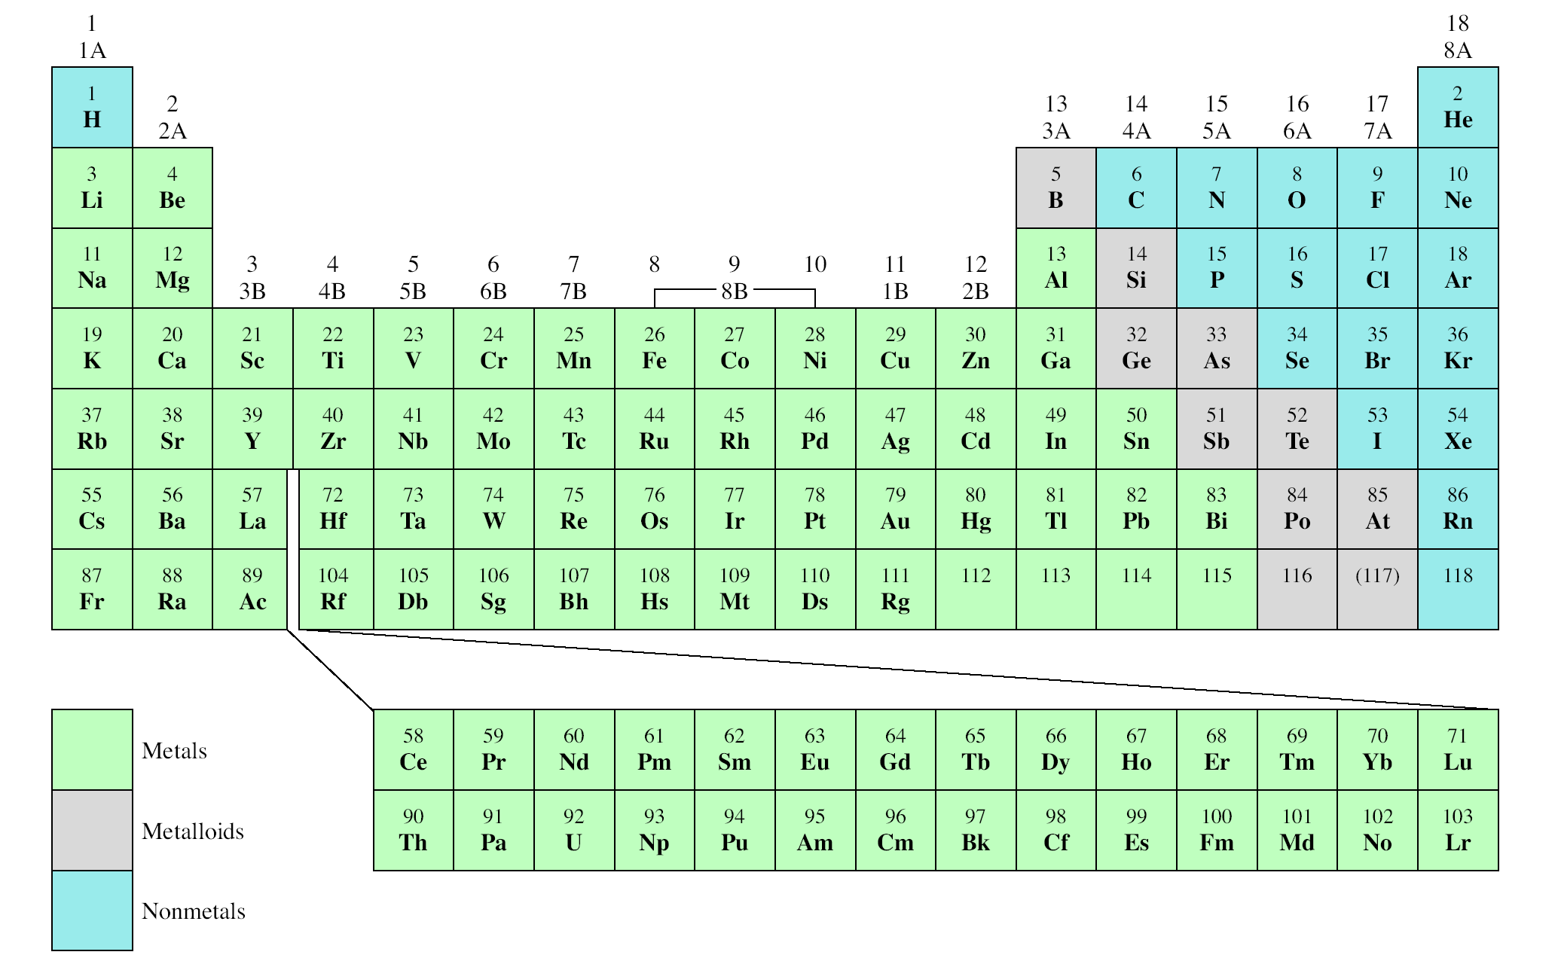
The Modern Periodic Table
Alkali Earth Metal
Alkali Metal
Noble Gas
Period
Group
Halogen

Slide 9
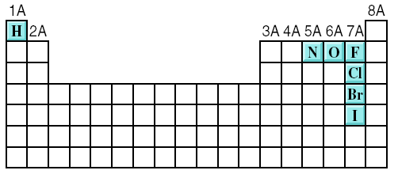
A molecule is an aggregate of two or more atoms in a definite arrangement held together by chemical forces
H₂
H₂O
NH₃
CH₄
A diatomic molecule contains only two atoms
H₂, N₂, O₂, Br₂, HCl, CO
diatomic elements
A polyatomic molecule contains more than two atoms
O₃, H₂O, NH₃, CH₄

Slide 10
An ion is an atom, or group of atoms, that has a net positive or negative charge.
cation – ion with a positive charge
If a neutral atom loses one or more electrons
it becomes a cation.
Na
11 protons
11 electrons
11 protons
10 electrons
Na⁺
anion – ion with a negative charge
If a neutral atom gains one or more electrons
it becomes an anion.
Cl
17 protons
17 electrons
17 protons
18 electrons
Cl⁻

Slide 11
A monatomic ion contains only one atom
Na⁺, Cl⁻, Ca²⁺, O²⁻, Al³⁺, N³⁻
A polyatomic ion contains more than one atom
OH⁻, CN⁻, NH₄⁺, NO₃⁻

Slide 12
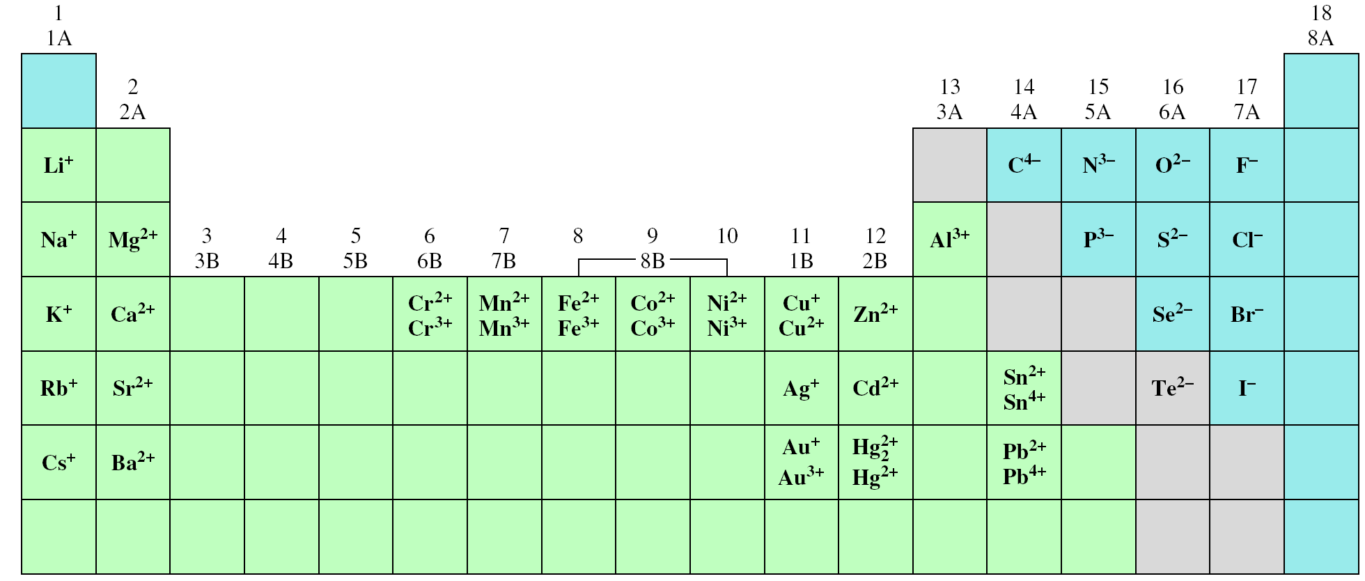
Common Ions Shown on the Periodic Table

Slide 13
27
3+
How many protons and electrons are in ?
Al
13
13 protons, 10 (13 – 3) electrons
78
2-
How many protons and electrons are in ?
Se
34
34 protons, 36 (34 + 2) electrons

Slide 14
A molecular formula shows the exact number of atoms of each element in the smallest unit of a substance
An empirical formula shows the simplest
whole-number ratio of the atoms in a substance
molecular
empirical
H₂O
H₂O
C₆H₁₂O₆
CH₂O
O₃
O
N₂H₄
NH₂

Slide 15
ionic compounds consist of a combination of cations and an anions
The formula is usually the same as the empirical formula
The sum of the charges on the cation(s) and anion(s) in each formula unit must equal zero
The ionic compound NaCl

Slide 16
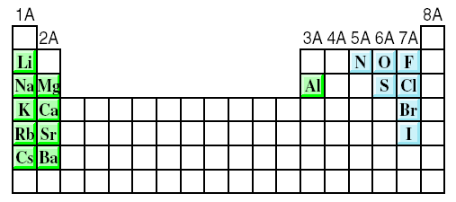
The most reactive metals (green) and the most reactive nonmetals (blue) combine to form ionic compounds.

Slide 17
Chemical Nomenclature
Ionic Compounds
Often a metal + nonmetal
Anion (nonmetal), add “ide” to element name
BaCl₂
barium chloride
K₂O
potassium oxide
Mg(OH)₂
magnesium hydroxide
KNO₃
potassium nitrate

Slide 18
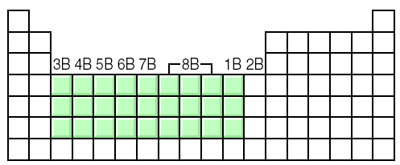
Transition metal ionic compounds
indicate charge on metal with Roman numerals
FeCl₂
2 Cl⁻ -2 so Fe is +2
iron(II) chloride
FeCl₃
3 Cl⁻ -3 so Fe is +3
iron(III) chloride
Cr₂S₃
3 S⁻² -6 so Cr is +3 (6/2)
chromium(III) sulfide

Slide 19
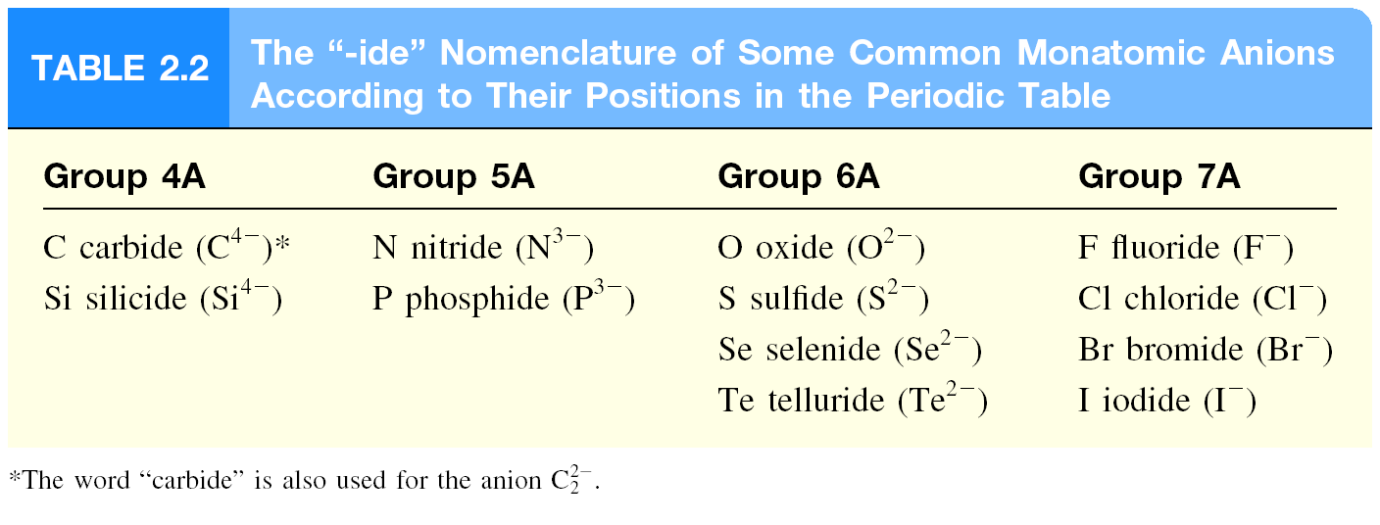

Slide 20
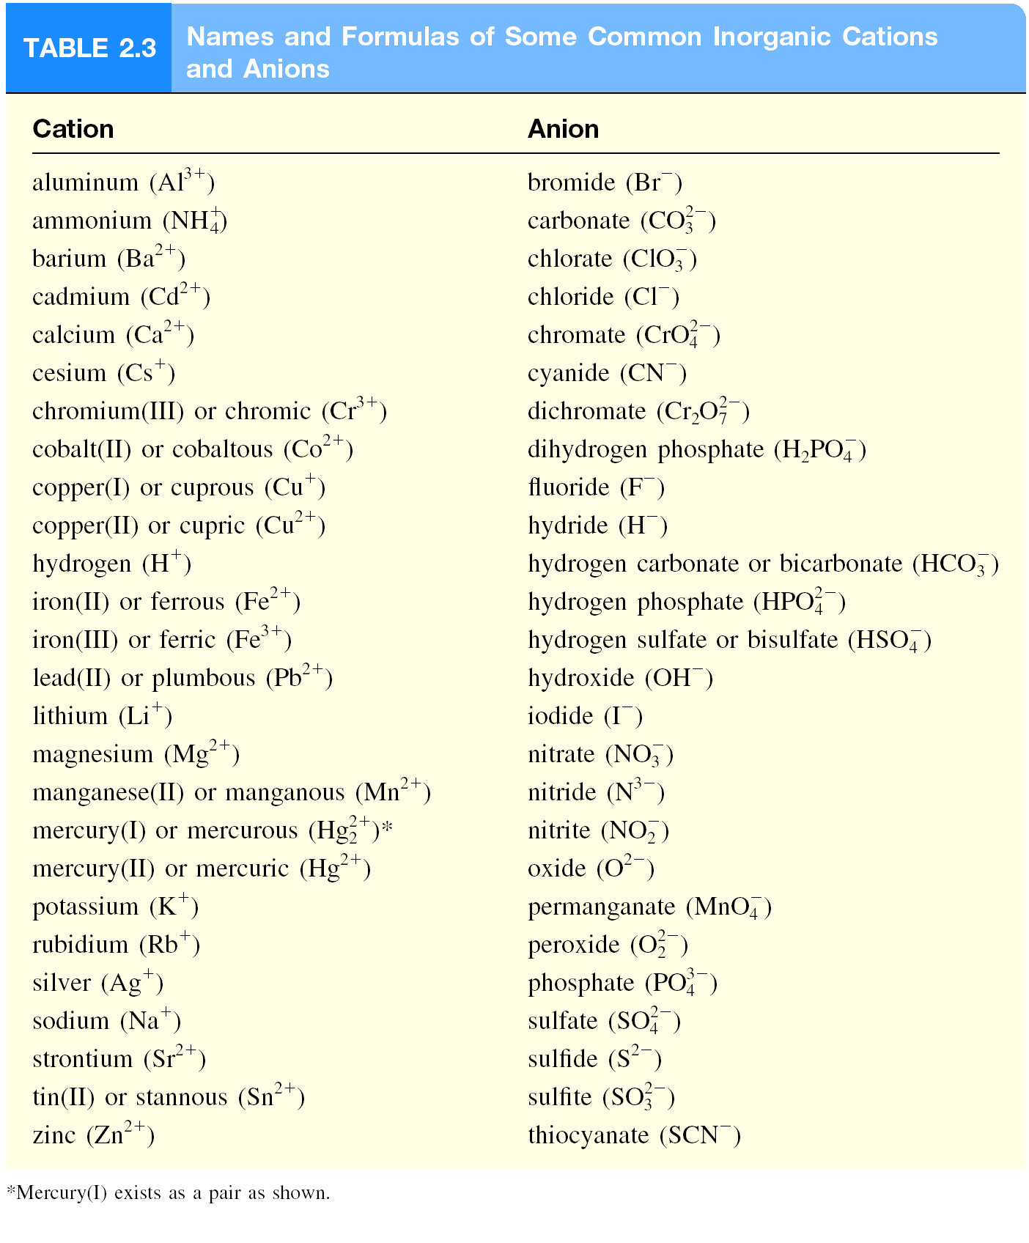

Slide 21
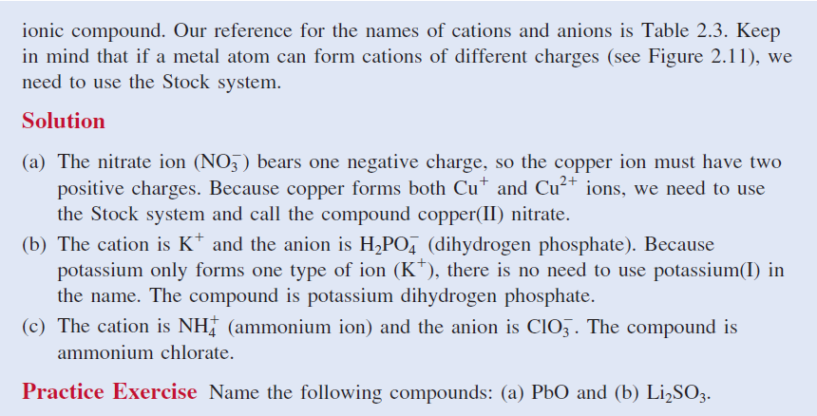

Slide 23
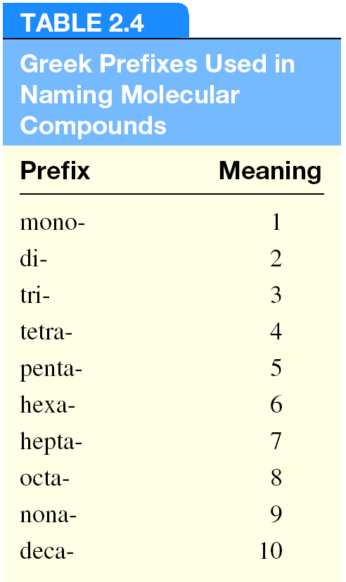
Molecular compounds
Nonmetals or nonmetals + metalloids
Common names
H₂O, NH₃, CH₄,
Element furthest to the left in a period and closest to the bottom of a group on periodic table is placed first in formula
If more than one compound can be formed from the same elements, use prefixes to indicate number of each kind of atom
Last element name ends in ide

Slide 24
Molecular Compounds
HI
hydrogen iodide
NF₃
nitrogen trifluoride
SO₂
sulfur dioxide
N₂Cl₄
dinitrogen tetrachloride
NO₂
nitrogen dioxide
N₂O
dinitrogen monoxide

Slide 25
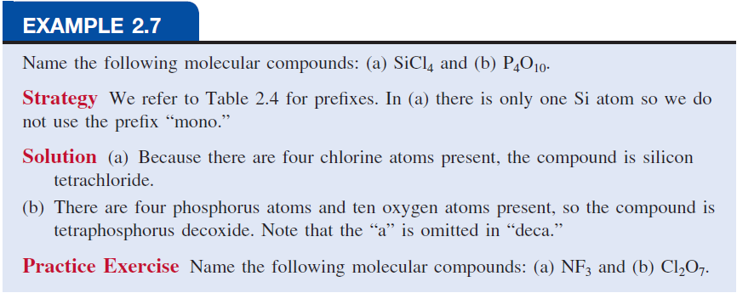

Slide 26
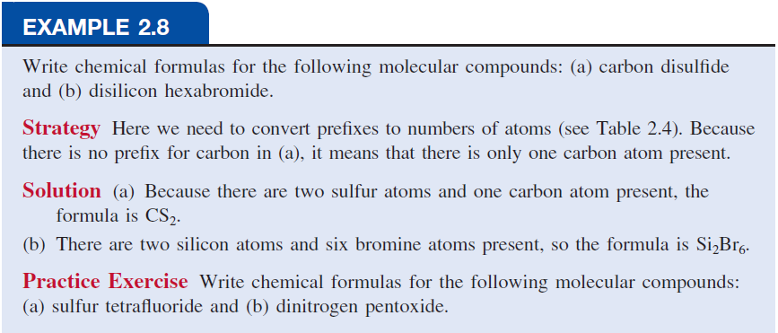

Slide 27
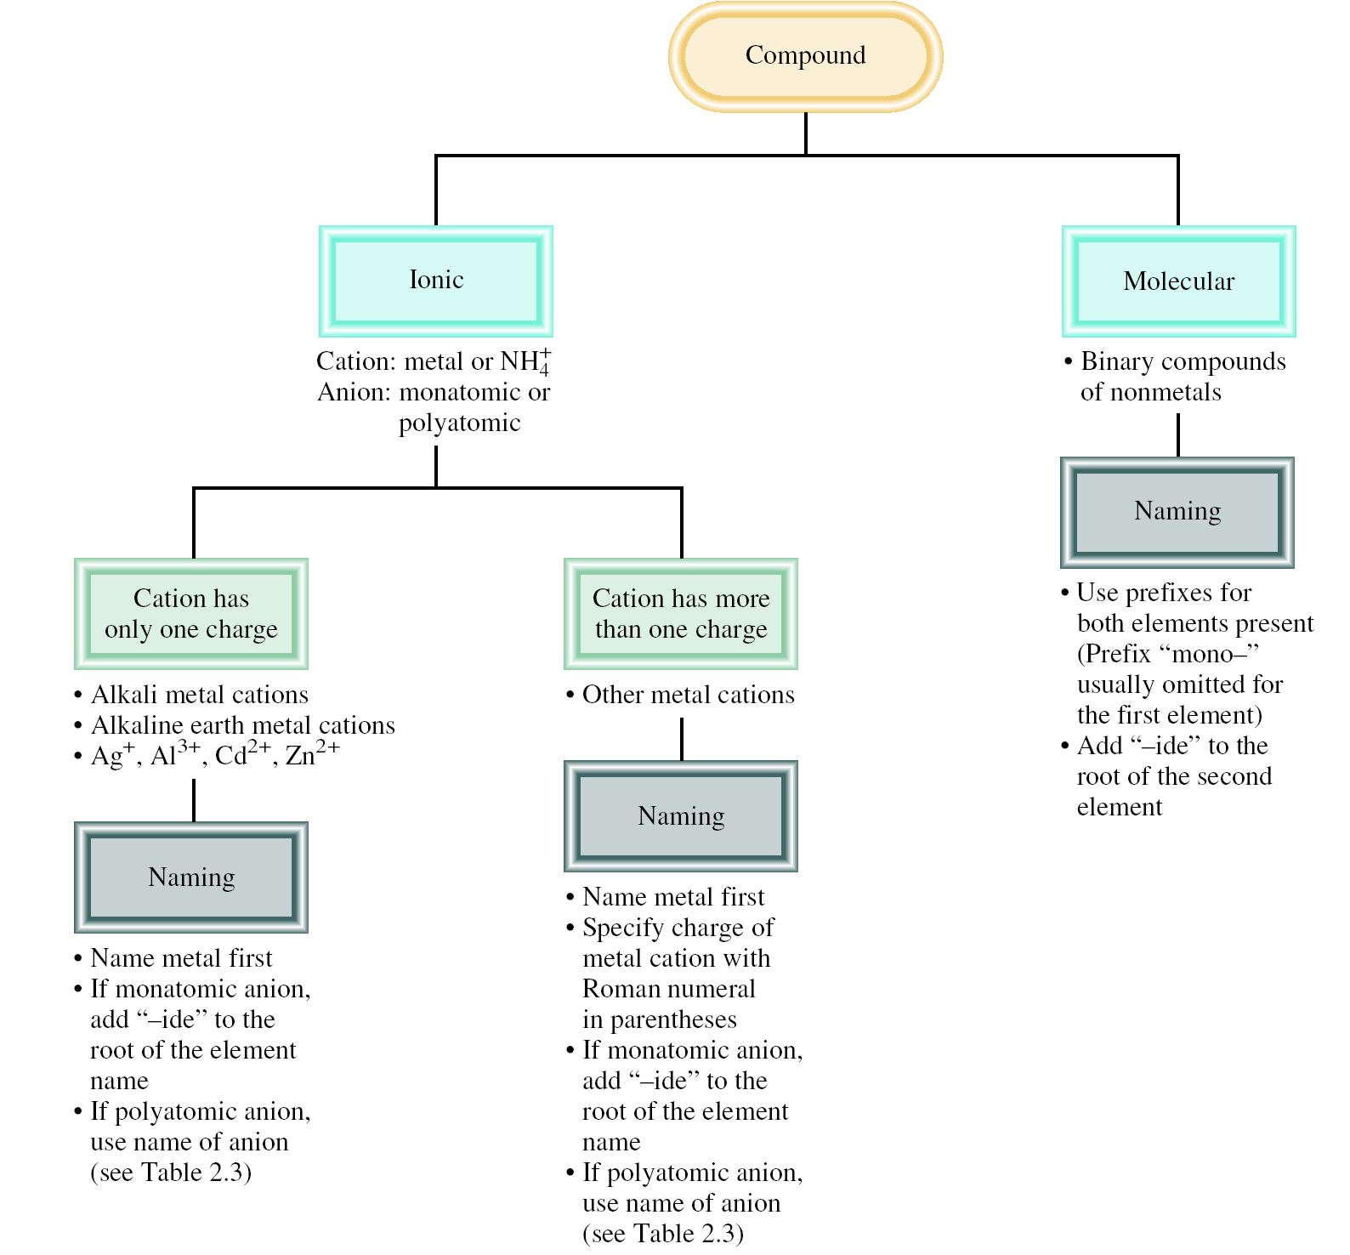

Slide 28
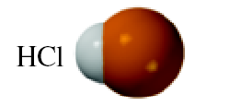
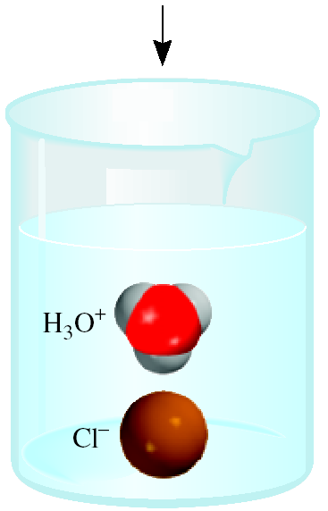
An acid can be defined as a substance that yields
hydrogen ions (H⁺) when dissolved in water.
For example: HCl gas and HCl in water
Pure substance, hydrogen chloride
Dissolved in water (H₃O⁺ and Cl⁻),
hydrochloric acid

Slide 29
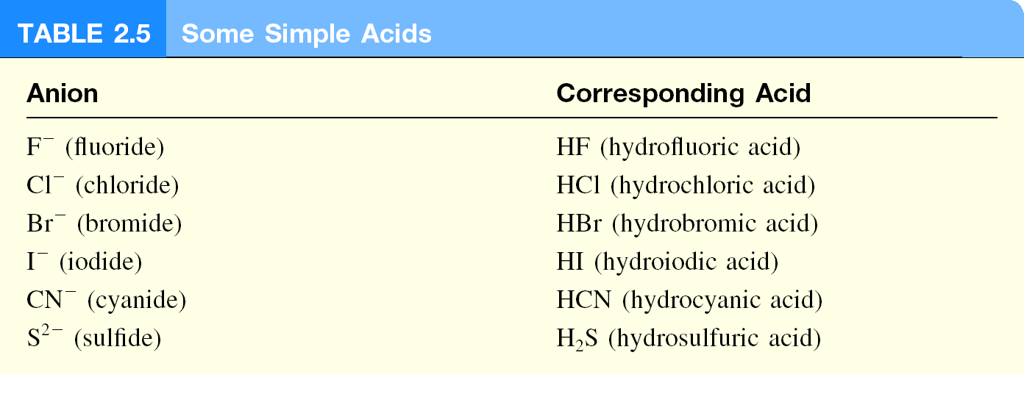

Slide 30
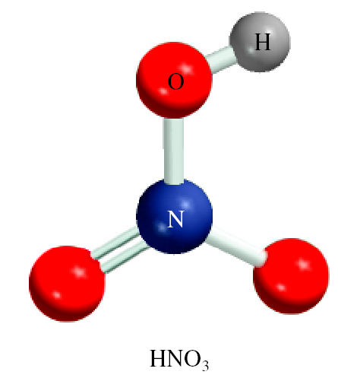
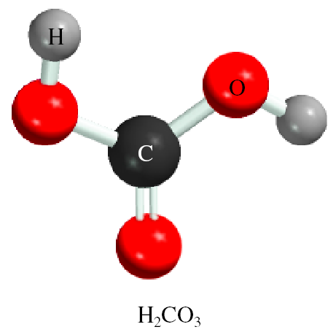
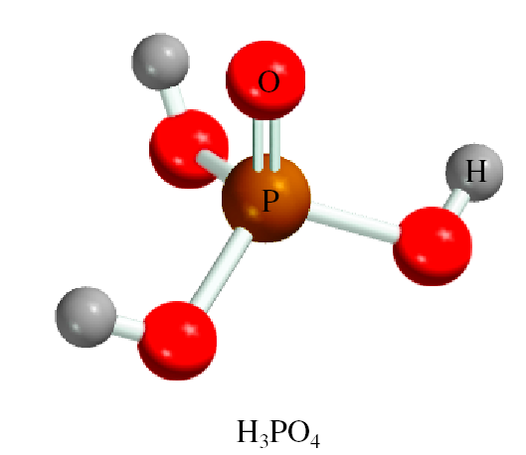
An oxoacid is an acid that contains hydrogen, oxygen, and another element.
HNO₃
nitric acid
H₂CO₃
carbonic acid
H₃PO₄
phosphoric acid

Slide 31
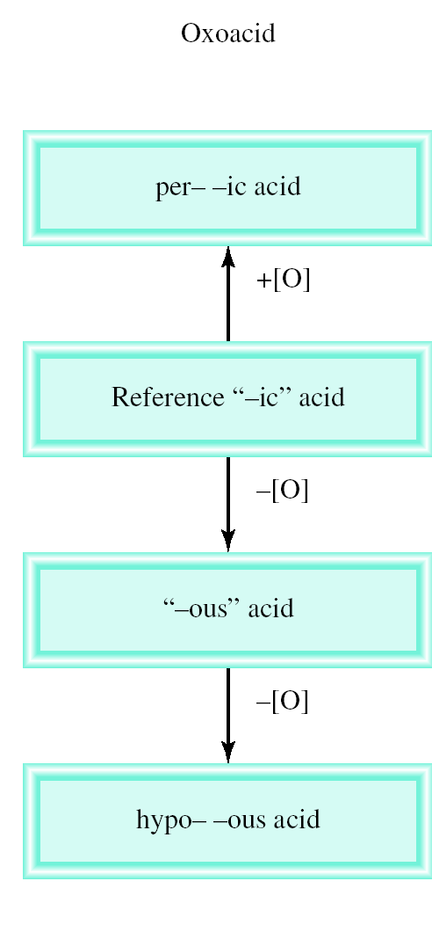
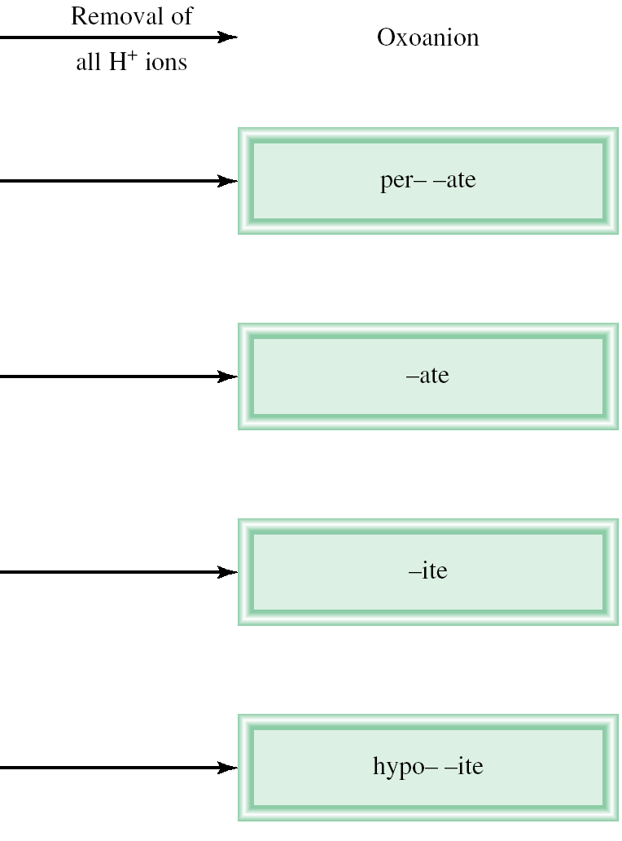
Naming Oxoacids and Oxoanions

Slide 32
The rules for naming oxoanions, anions of
oxoacids, are as follows:
1. When all the H ions are removed from the “-ic” acid, the anion’s name ends with “-ate.”
2. When all the H ions are removed from the “-ous” acid, the anion’s name ends with “-ite.”
3. The names of anions in which one or more but not all the hydrogen ions have been removed must indicate the number of H ions present.
For example:
H₂PO₄⁻ dihydrogen phosphate
HPO₄ ²⁻ hydrogen phosphate
PO₄³⁻ phosphate

Slide 34
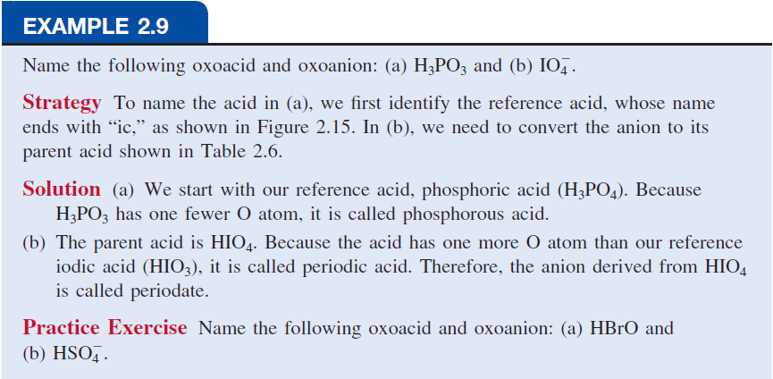

Slide 35
A base can be defined as a substance that yields
hydroxide ions (OH⁻) when dissolved in water.
NaOH
sodium hydroxide
KOH
potassium hydroxide
Ba(OH)₂
barium hydroxide

Slide 36
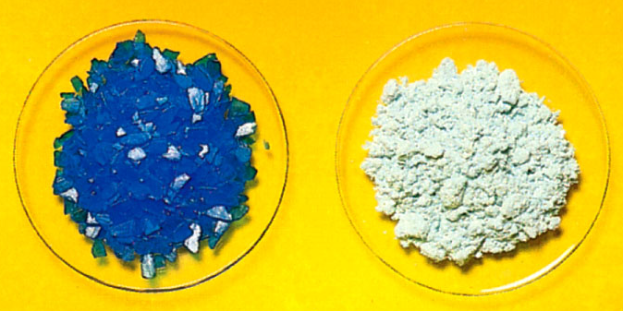
Hydrates are compounds that have a specific number of water molecules attached to them.
BaCl₂•2H₂O
barium chloride dihydrate
LiCl•H₂O
lithium chloride monohydrate
MgSO₄•7H₂O
magnesium sulfate heptahydrate
Sr(NO₃)₂ •4H₂O
strontium nitrate tetrahydrate
CuSO₄•5H₂O
CuSO₄

Slide 37
