Slide 1
Chapter 1
Introduction to Marketing Research

Slide 2
Learning Objectives
To know the relationship of marketing research to marketing, the marketing concept, and marketing strategy
To know how to define marketing research
To understand the function and uses of marketing research

Slide 3
Learning Objectives
To see examples of marketing research for evaluating target markets, product research, pricing research, promotion research, and distribution research
To describe a marketing information system (MIS) and understand why marketing research occupies a place in an MIS

Slide 4
Marketing Reasearch Is Part of Marketing
To establish a solid foundation for studying marketing research, you will need to understand its role in and relationship to marketing, along with its definition ,uses ,forms , and connection to marketing information systems.
What Is Marketing?
Marketing is the activity, set of institutions, and processes for creating, communicating, delivering, and exchanging offerings that have value for customers, clients, partners, and society at large.

Slide 5
We should also mention that marketing thought evolves and , many believe in the principles espoused by what has become known as the service-dominant logic for marketing.
Under this philosophy, firms adopt a service-centered view of marketing that:
Identifies core competencies.
Identifies potential customers who can benfit from these core competencies.
Cultivates relationships with these customers by creating value that meet their specific needs.
Gauges feedback from the market to learn for it.

Slide 6
THE PHILOSOPHY OF THE MARKETING CONCEPT GUIDES MANAGERS DECISIONS
Marketing research is a part of marketing ;it provides the necessary information to enable managers to market ideas, goods, and services properly.
Philosophies are more important to you than you may think; your philosophies dictate how you behave every day.

Slide 7
The marketing concept is a business philosophy that holds that the key to achieving organizational goals consists of the company’s being more effective than competitors in creating, delivering, and communicating customer value to its chosen target markets.
It has long been recognized that the philosophy known as the marketing concept is the “right” philosophy.
Organizations are more likely to achieve their goas if they satisfy consumers’ wants and needs.

Slide 8
THE “RIGHT” Marketing Strategy
A marketing strategy consists of selecting a segment of the market as the company’s target market and designing the proper “mix” of the product/service, price, promotion, and distribution system to meet the wants and needs of the consumers within the target market.
Many decisions must be made to develop the “right” strategy.
To make the right decisions, managers must have :
-objective
-accurate
-timely information

Slide 9
What Is Marketing Research?
Marketing research is the process of designing, gathering, analyzing, and reporting information that may be used to solve a specific marketing problem.

Slide 10
AMA Definition FOR THE
Marketing research: the function that links the consumer, customer, and public to the marketer through information: information used to identify and define marketing opportunities and problems; generate, refine, and evaluate marketing actions; monitor marketing performance; and improve the understanding of marketing as a process

Slide 11
Is it Marketing research or Market Research?
Marketing research: a process used by businesses to collect, analyze, and interpret information used to make sound business decisions and successfully manage the business
Market research: a process used to define the size, location, and/or makeup of the market for a product or service

Slide 12
Some differentiate between them , Marketing research is the broader of two terms, whereas market research refers to applying marketing research to a specific market. However, in practice, the two names are often used interchangeably.
Marketing Research Function
Is to Link the consumer to the marketer by providing information that can be used in making marketing decisions

Slide 13
Uses of Marketing Research
1- Identify marketing opportunities and problems
2-Generate, refine, and evaluate potential marketing actions
3-Monitor marketing performance
4-Improve marketing as a process
5- Marketing research is sometimes wrong

Slide 14
1-Identifying Market Opportunities and Problems
Some marketing research studies are designed to find out what consumers’ problems are and to assess the suitability of different proposed methods of resolving those problems.
Problems are not always easy to identify.

Slide 15
2-Generate, Refine, and Evaluate Potential Marketing Actions
Marketing research can also be used to generate, refine, and evaluate a potential marketing action.
Marketing research is conducted in a variety of areas, including:
a)Selecting target markets
b)Product research
c)Pricing research
d)Promotion research
e)Distribution research

Slide 16
3-Monitor Marketing Performance
Often gathered through :
a)Tracking data collected at point-of-sale terminals as consumer packages goods are scanned in grocery stores, mass merchandisers, and convenience stores
b)Tracking social media

Slide 17
4-Improve Marketing as a Process
Though they represent a very small part of the total marketing research studies, another use of marketing research is for studies that are designed to improve our basic understanding of marketing as opposed to solving a particular problem facing a business.
- Basic research is conducted to expand our knowledge rather than to solve a specific problem.
-Applied research is conducted to solve specific problems.

Slide 18
5- Marketing research is sometimes wrong
Most marketing research studies are trying to understand and predict consumer behavior, which is a difficult task.

Slide 19
The Marketing Information System
A MIS is a structure consisting of people, equipment, and procedures to gather, sort, analyze, evaluate, and distribute needed, timely, and accurate information to marketing decision makers.

Slide 20
Components of an MIS
1-Internal Reports System: gathers information generated by internal reports, which include
a)orders
b)billing
c) receivables
d)inventory level
e) stockouts
2-Marketing Intelligence System: defined as a set of procedures and sources used by managers to obtain everyday information about pertinent developments in the environment.

Slide 21
3- Marketing Decision Support System (DSS): defined as collected data that may be accessed and analyzed using tools and techniques that assist manager in decision making.
4- Marketing Research System: gather information not gathere by other MIS component subsystem.
-Marketing research projects are not continuous; rather, they have a beginning and an end

Slide 22
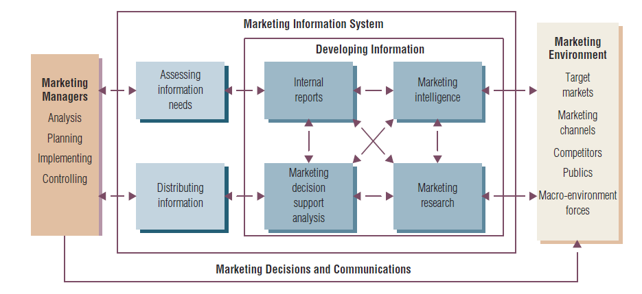
Figure 1.1 The Marketing Information System

