Slide 1
Chapter 1
Introduction to Marketing Research

Slide 2
Learning Objectives
To know the relationship of marketing research to marketing, the marketing concept, and marketing strategy
To know how to define marketing research
To understand the function and uses of marketing research

Slide 3
Learning Objectives
To see examples of marketing research for evaluating target markets, product research, pricing research, promotion research, and distribution research
To describe a marketing information system (MIS) and understand why marketing research occupies a place in an MIS

Slide 4
What Is Marketing?
Marketing is the activity, set of institutions, and processes for creating, communicating, delivering, and exchanging offerings that have value for customers, clients, partners, and society at large.
Notes:
Please change definition to match ED 7

Slide 5
What Is the Marketing Concept?
The marketing concept is a business philosophy that holds that the key to achieving organizational goals consists of the company’s being more effective than competitors in creating, delivering, and communicating customer value to its chosen target markets.

Slide 6
What Is a Marketing Strategy?
A marketing strategy consists of selecting a segment of the market as the company’s target market and designing the proper “mix” of the product/service, price, promotion, and distribution system to meet the wants and needs of the consumers within the target market.

Slide 7
What Is Marketing Research?
Marketing research is the process of designing, gathering, analyzing, and reporting information that may be used to solve a specific marketing problem.

Slide 8
AMA Definition
Marketing research: the function that links the consumer, customer, and public to the marketer through information: information used to identify and define marketing opportunities and problems; generate, refine, and evaluate marketing actions; monitor marketing performance; and improve the understanding of marketing as a process

Slide 9
Marketing or Market Research?
Marketing research: a process used by businesses to collect, analyze, and interpret information used to make sound business decisions and successfully manage the business
Market research: a process used to define the size, location, and/or makeup of the market for a product or service

Slide 10
Marketing Research Function
Link the consumer to the marketer by providing information that can be used in making marketing decisions

Slide 11
Uses of Marketing Research
Identify marketing opportunities and problems
Generate, refine, and evaluate potential marketing actions
Monitor marketing performance
Improve marketing as a process

Slide 12
Identifying Market Opportunities and Problems
Some marketing research studies are designed to find out what consumers’ problems are and to assess the suitability of different proposed methods of resolving those problems.

Slide 13
Generate, Refine, and Evaluate Potential Marketing Actions
Selecting target markets
Product research
Pricing research
Promotion research
Distribution research

Slide 14
Monitor Marketing Performance
Tracking data collected at point-of-sale terminals as consumer packages goods are scanned in grocery stores, mass merchandisers, and convenience stores
Tracking social media

Slide 15
Improve Marketing as a Process
Basic research is conducted to expand our knowledge rather than to solve a specific problem.
Applied research is conducted to solve specific problems.

Slide 16
Can We Determine If Something Is Wrong?
Most marketing research studies are trying to understand and predict consumer behavior, which is a difficult task.

Slide 17
The Marketing Information System
A MIS is a structure consisting of people, equipment, and procedures to gather, sort, analyze, evaluate, and distribute needed, timely, and accurate information to marketing decision makers.

Slide 18
Components of an MIS
Internal Reports System
Marketing Intelligence System
Marketing Decision Support System (DSS)
Marketing Research System

Slide 19
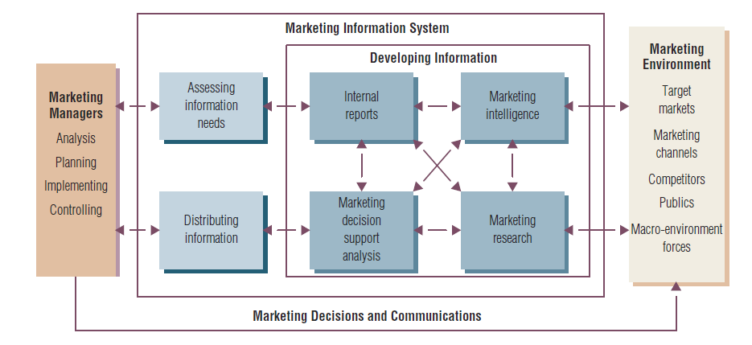
Figure 1.1 The Marketing Information System

Slide 20
Marketing Research System
It gathers information not gathered by the other MIS component subsystems
Marketing research projects are not continuous; rather, they have a beginning and an end

Slide 21
All rights reserved. No part of this publication may be reproduced, stored in a retrieval system, or transmitted, in any form or by any means, electronic, mechanical, photocopying, recording, or otherwise, without the prior written permission of the publisher. Printed in the United States of America.
Copyright © 2014 Pearson Education, Inc.

