Slide 1
E-Marketing/7E Chapter 15
Customer Relationship Management

Slide 2
Chapter 15 Objectives
After reading Chapter 15, you will be able to:
Define customer relationship management (CRM) and identify the major benefits to e-marketers.
Outline the three pillars of relationship marketing for e-marketing.
Describe social CRM and how it relates to traditional CRM.
Discuss the nine major components needed for effective and efficient CRM in e-marketing.
Highlight some of the company-side and client-side tools that e-marketers use to enhance their CRM processes.
Differentiate CRM metrics by customer life cycle stage.

Slide 3
The Best Buy Story
Best Buy is the 11th largest U.S. e-commerce retailer with 1B online visitors and a multichannel strategy.
In 2008 Best Buy initiated the Best Buy Community online.
600,000 customers a quarter post 20,000 messages and view over 22 million pages of content.
The community has yielded $5M in benefits to Best Buy.
Best Buy also uses Twitter to engage customers (@twelpforce).

Slide 4
Relationship Marketing Defined
Relationship marketing is about establishing, maintaining, enhancing, and commercializing customer relationships through promise fulfillment.
A firm using relationship marketing focuses more on wallet share, the amount of sales one customer can generate over time, than on market share.

Slide 5
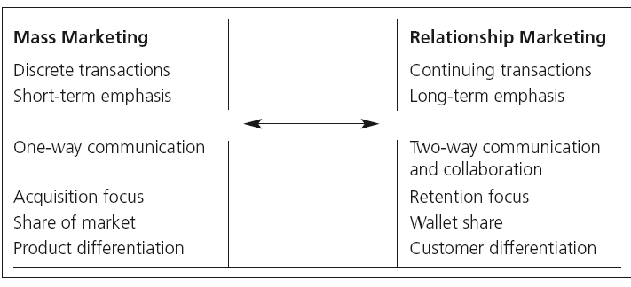
From Mass Marketing To Relationship Marketing

Slide 6
Stakeholders
The four stakeholders most affected by internet technologies include:
Employees who need training and access to data and systems used for relationship management.
Business customers in the supply chain.
Lateral partners, such as other businesses, not-for-profit organizations, or governments.
Consumers who are end users of products and services.

Slide 7
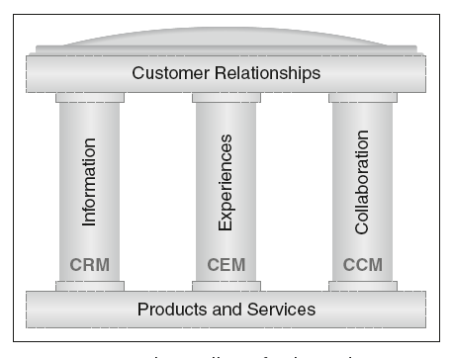
3 pillars of relationship marketing

Slide 8
Customer Relationship Management
CRM is a philosophy, strategy, and process that includes all 3 pillars.
The benefits of CRM 1.0 include:
Increased revenue from better targeting.
Increased wallet share with current customers.
Longer retention of customers.
The cost of acquiring a new customer is typically 5 to 7 times higher than the cost of retaining a current customer.
Satisfied customers recommend Web sites, stores, and products to their friends in social media.

Slide 9
Maximizing Customers Through Retention
Customer acquisition
36% marketers cite acquisition as top priority²
Costs 5-7 times more than retention
Customer retention
68% of customers leave due to poor treatment¹
52% marketers cite retention as top priority²
Databases can decline 50% in 5 years if left dormant³

Slide 10
Social Customer Relationship Management
Social CRM (CRM 2.) adds social media technology and customer collaborative conversations to the process.
Adds benefits such as:
Monitoring and improving reputations.
Learning more about customer needs, wants, and problems.
Improving target market selection and revenue potential.
Gathering data for market research on products and customer service.
Decreasing customer service costs.
Identifying new revenue opportunities.

Slide 11
CRM Evolves Using Social Media
Social CRM (2.0)
Customers
CRM 1.0
MEDIA
Blogs
Social networks
Microblogs
Photo sharing
Forums
Wikis
Reviews/Ratings
Interactive Web sites
Other social media
Live chat
All CRM 1.0 media
MEDIA
Phone
E-mail
In-person
SMS
Website
Paper mail
Traditional media
Company
employee
Customer
Company
employees

Slide 12
9 Building Blocks for Successful CRM

Slide 13
1. CRM Vision
To be successful, the CRM vision must start at the top and filter throughout the company to keep the firm customer focused.
One key aspect of CRM vision is how to guard customer privacy.
The benefits of using customer data must be balanced by the need to satisfy customers and not anger them.
TRUSTe provides its seal and logo to any Web site meeting its privacy philosophies.

Slide 14
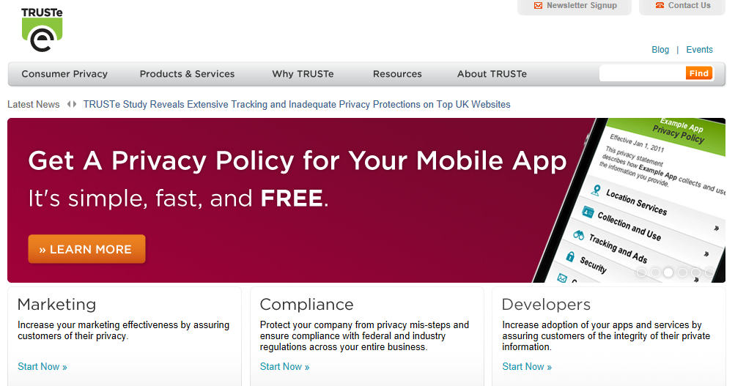
TRUSTe Builds User Trust

Slide 15
2. CRM Strategy
E-marketers must determine their objectives and strategies for initiating CRM programs and buying technology or setting up social media.
Many CRM goals refer to customer loyalty.
An important CRM strategy is to move customers up the relationship intensity pyramid to advocacy.
Another CRM goal involves building bonds with customers on 3 levels: financial, social and structural.

Slide 16
Three Levels of Relationship Marketing

Slide 17
3. Customer Experience Management
Consumers are constantly bombarded by marketing communications and unlimited product choices.
According to Sheth (1995), the basic tenet of CRM is choice reduction.
Many consumers are “loyalty prone,” and will stick with the right product as long as its promises are fulfilled.
Synchronous and asynchronous technologies can provide automated and human communications that solve customer problems.

Slide 18
Relationships Over Multiple Communication Channels

Slide 19
4. Customer Collaboration Management/Marketing (CCM)
CCM is content, people, and interaction driven, while traditional CRM is data-driven.
CCM is about managing customer relationships and experiences by creating and monitoring online content.
Listening the online chatter using technology such as Google Alerts and social media dashboards is more important than talking when a company is selling.

Slide 20
5. Organizational Collaboration
Marketers collaborate within and outside the organization to focus on customer satisfaction to create a CRM culture.
Online retailers can seamlessly link the “back-end” (e.g., inventory and payment) with the “front-end” CRM system and the entire supply chain management system (SCM).
Extranets, two or more intranet networks that share information, allow CRM-SCM integration.

Slide 21
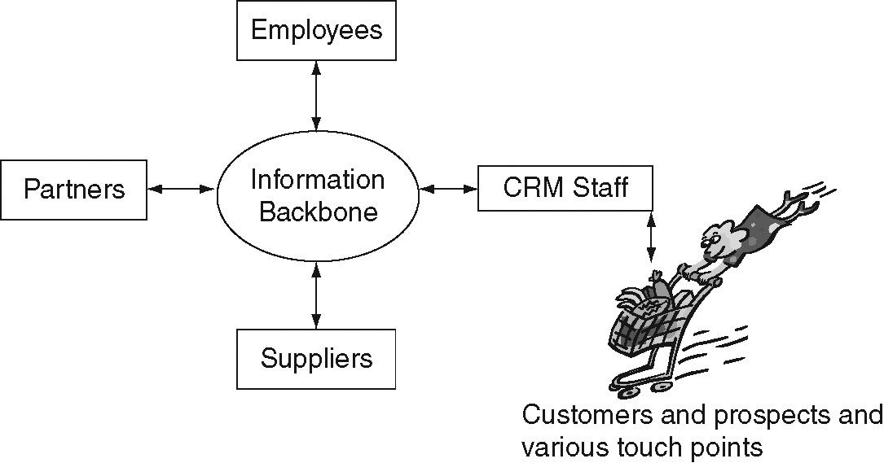
CRM-SCM Integration

Slide 22
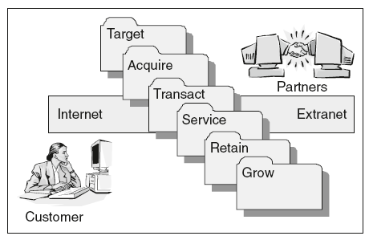
6. CRM Processes
Firms use specific processes to move customers through the customer care life cycle.

Slide 23
Building a Dynamic Customer Profile

Slide 24
Sales Force Automation
Sales force automation allows salespeople to build, maintain, and access customer records, manage leads, and manage their schedules.
Up-to-date customer and prospect records help build customer relationships.
Salesforce.com also has tools to monitor brand conversations in the social media.

Slide 25
Marketing Automation
Marketing automation activities help provide:
Effective targeting.
Efficient marketing communication.
Real-time monitoring of customer and market trends.
SAS, a business intelligence and predictive analytics software provider, offers automation software to aid CRM.

Slide 26
7. CRM Information
The more information a firm has, the better value it can provide to each current or prospective customer.
Firms gain much information by tracking behavior electronically.
Bar code scanner data.
Software that tracks online movement, time spent per page, and purchase behavior.
Databases can provide a 360° customer view across various channels.

Slide 27
8. CRM Technology
The internet forms the centerpiece of a firm’s CRM abilities.
Cookies, Web logs, bar code scanners, social media, and other tools help to collect information about consumers and their behaviors.
Firms use company-side tools to push customized information to users.
Client-side tools allow the customer to pull information that initiates the customized response from the firm.

Slide 28
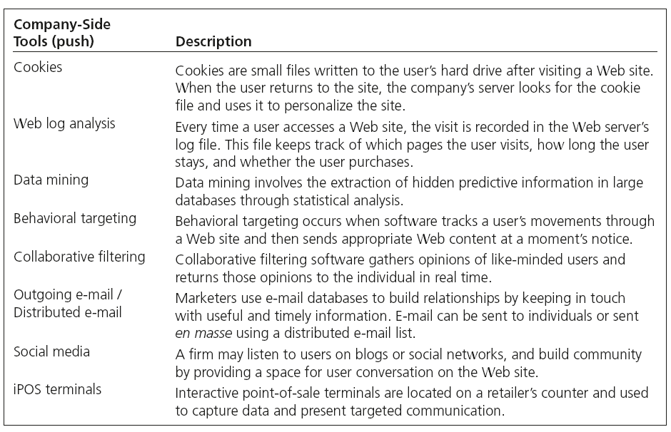
Company-Side Tools (push)

Slide 29
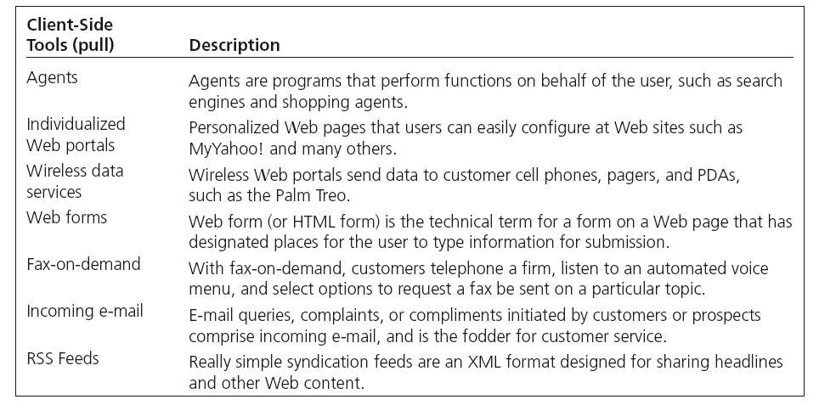
Client-Side Tools (pull)

Slide 30
9. CRM Metrics
E-marketers use numerous metrics to assess the internet’s value in delivering CRM performance.
ROI
Cost savings
Revenues
Customer satisfaction
Customer Lifetime Value (LTV)
Contribution of each CRM tactic to these measures

Slide 31
Metrics Scoreboard by Salesforce.com

Slide 32
10 RULES FOR CRM SUCCESS
Recognize the customer’s role.
Build a business case.
Gain buy-in from end users to executives.
Make every contact count.
Drive sales effectiveness.
Measure and manage the marketing return.
Leverage the loyalty effect.
Choose the right tools and approach.
Build the team.
Seek outside help.

Slide 33
All rights reserved. No part of this publication may be reproduced, stored in a retrieval system, or transmitted, in any form or by any means, electronic, mechanical, photocopying, recording, or otherwise, without the prior written permission of the publisher. Printed in the United States of America.
Copyright © 2014 Pearson Education, Inc.
Publishing as Prentice Hall

