Slide 1
E-Marketing/7E Chapter 14
E-Marketing Communication: Earned Media

Slide 2
Chapter 14 Objectives
After reading Chapter 14, you will be able to:
Describe the five levels of user engagement and explain what each means for earned media.
Explain the role of trust in earned media and its implications for consumer behavior.
List some key techniques for engaging users and discuss the importance of each.
Outline the marketing benefits of engaging consumers in collaborative content creation.

Slide 3
Chapter 14 Objectives, cont.
Highlight seven ways in which companies can attract users and move them up the engagement ladder.
Discuss how a company can build, maintain, monitor, and repair its reputation online.
Identify specific metrics used to monitor, measure, and refine earned media activities.

Slide 4
Dell Starts Listening
A blog post about Dell Computer brought a hailstorm of customer service complaints that lasted for nearly 2 years.
The blogger complained that a laptop and its in-home service he purchased from Dell were inadequate.
The complaint followed Dell’s decision to outsource technical customer service to India, a move which also generated many negative comments.
When the complaints didn’t stop, Dell appointed a media manager to deal with internet chatter who initiated blogs in multiple languages to handle complaints and ideas.
The blog IdeaStorm gathered ideas and endorsements that resulted in numerous changes in the company.

Slide 5
Earned Media
Earned media are like physical word-of-mouth on steroids: a social megaphone.
Can be initiated by the company through branded content, news sites, and press releases.
Companies have little to no control over user-generated content (UGC).

Slide 6
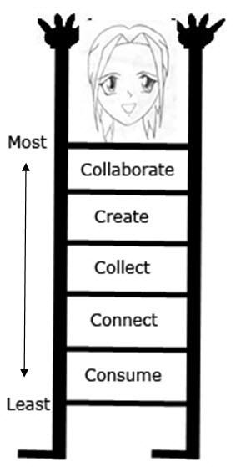
User Engagement Levels
Engagement occurs among and between the company and internet users, who are actively discussing the brand.
There are many levels of user engagement online.
Engagement Level

Slide 7
User Engagement Levels, cont.
Least engaged users consume only online content.
At the next level, users connect with others by creating a profile on a social network, such as by “friending” on Facebook.
Consumers who collect information filter content and tag what they find valuable in social media sites.
Creators write or upload original content.
The most engaged customers collaborate with the company when they engage in discussions to improve products.

Slide 8
Social Media Influencers and Traditional Journalists
Companies identify social media influencers by observing and participating in social media discussions.
They can also find influentials by using a service such as Klout.com.
Companies often include press releases about their brands on their Web sites and send them to media firms for publishing.

Slide 9
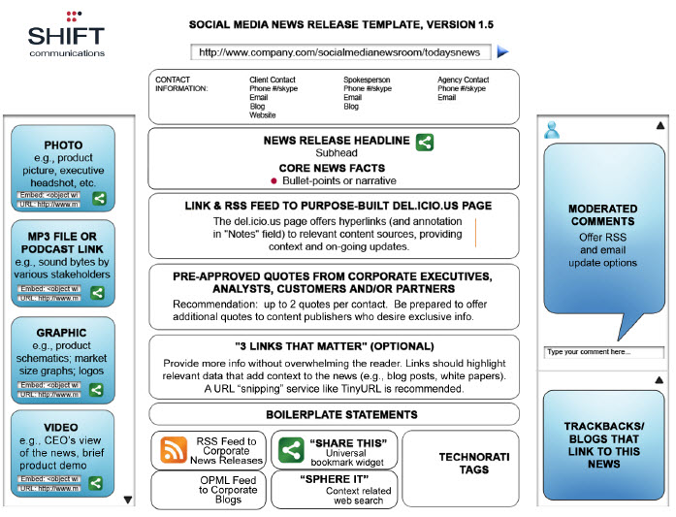
Social Media Friendly Press Release

Slide 10
Techniques for Engaging Users
Successful viral marketing programs involve appealing content that has a high chance of spreading.
Few companies can create content that goes viral, although Old Spice is credited with the fastest-growing online viral video campaign.
Viral blogging via Twitter can also be effective.

Slide 11
Techniques for Engaging Users, cont.
Multimedia sharing of photos, art, video, and music can generate online discussion.
Wikis, Web sites that allow users to post, edit, and organize content, as well as online ratings and reviews can also be effective tools for engaging online users.

Slide 12
Social Recommendations & Referrals
Social bookmarking sites allow users to share their favorite Web sites and comments.
StumbleUpon.com
Delicious.com
Referral programs involve rewards for customers who refer new customers.
Groupon
Gilt
Marketers can integrate email with social media.
Yahoo!, Gmail and Outlook allow integration with Facebook contacts.

Slide 13
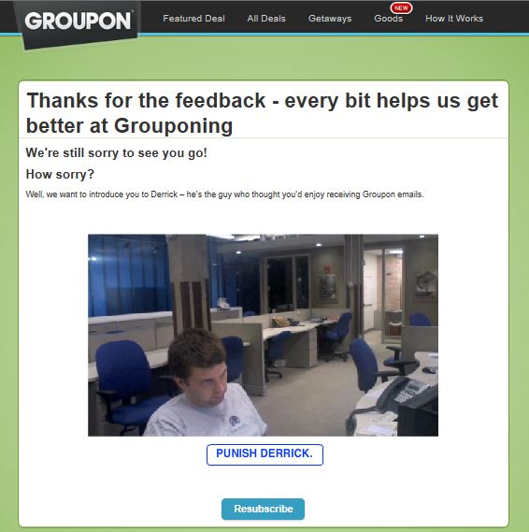
Groupon Encourages E-Mail

Slide 14
Converting Facebook Fans to Customers
10 Reasons Brands Fail to Convert Facebook Fans into Paying Customers
Failure to Get Past the First Step (try to engage visitors immediately)
Poor Text and Visuals (must be relevant to brand and visitors)
Stagnant Page Content (use consistent fresh content)
Inconsistent or Sloppy Branding (Facebook page and Web site with consistent brand elements)
Confused Calls-to-Action (make clear offers on Facebook)
Too Many Clicks (create only a few clicks to target content)
Mystery Visitors (compile Facebook user profiles)
Preconceived Notions (use Facebook specific campaigns)
Ineffective Plugin Use (integrate “like” buttons, recommendation and comment boxes well)
Sticking to Stand-alone Metrics (integrate Facebook with other shopping stats)

Slide 15
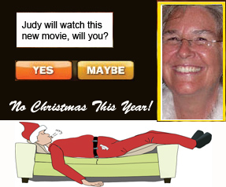
Widgets
Widgets can include brand information in contests or games.
Companies such as Friend2Friend and Product Pulse create widgets for advertisers that allow voting, gaming, and gifting.

Slide 16
Social Apps
Facebook features thousands of software apps on its site that engage users.
Facebook messenger allows users to send messages to mobile phones.
Instagram allows users to take photos and share them on Facebook, Twitter, and Tumblr.

Slide 17
Location-Based Services (LBS)
LBS is a business model for m-commerce.
There are several major players.
Foursquare works via a smartphone app on its mobile Web site.
Yelp published 33 million reviews of local businesses in 2012.
Facebook places can add a location to Facebook text-based or photo posts.

Slide 18
How Do Companies Entice Engagement?
Provide high-quality, timely, unique, and relevant information.
Create entertaining content.
Offer competitions.
Appeal to altruism.
Make an exclusive offer.
Reward influentials and fans.
Incentivize group behavior.

Slide 19
Reputation Management Online
With earned media, there are many opportunities for other people to shape the reputations of a company, its brand, and employees.
According to PR firm Weber Shandwick, 63% of a company’s market value is attributable to reputation.
The reputation management process includes 4 steps:
Build
Maintain
Monitor
Repair

Slide 20
Earned Media Performance Metrics
In addition to metrics such as number of likes and shares on company-owned channels, there are a number of metrics that can be applied to earned media.
General earned media metrics: number of users who interact with an application, time spent viewing a video, social media fan growth, etc.
Actions taken by users: Number of downloads of a white paper, ring tones, number of games played, polls voted, etc.
Conversations on blogs and elsewhere: Tweets/retweets, positive/negative comments, etc.

Slide 21
All rights reserved. No part of this publication may be reproduced, stored in a retrieval system, or transmitted, in any form or by any means, electronic, mechanical, photocopying, recording, or otherwise, without the prior written permission of the publisher. Printed in the United States of America.
Copyright © 2014 Pearson Education, Inc.
Publishing as Prentice Hall

