Slide 1
Chapter 14
Making Use of Associations Tests
Copyright © 2014 Pearson Education, Inc.
1

Slide 2
Learning Objectives
To learn what is meant by an “association” between two variables
To examine various relationships that may be construed as associations
To understand where and how cross-tabulations with Chi-square analysis are applied

Slide 3
Learning Objectives
To become familiar with the use and interpretation of correlations
To learn how to obtain and interpret cross-tabulations, Chi-square findings, and correlations with SPSS

Slide 4
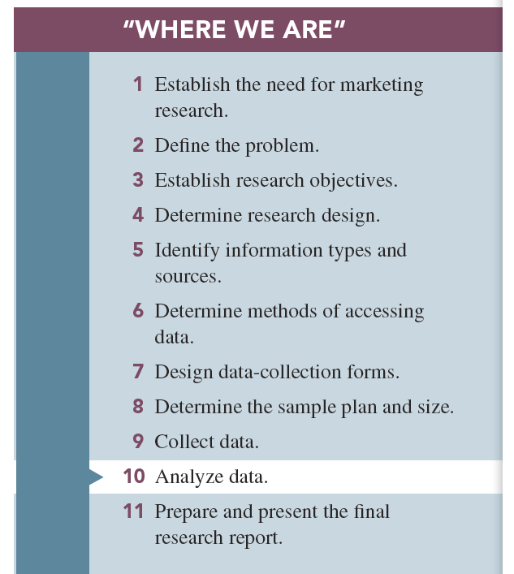

Slide 5
Associative Analyses
Associative analyses: determine where stable relationships exist between two variables

Slide 6
Relationships Between Two Variables
Relationship: a consistent, systematic linkage between the levels or labels for two variables
“Levels” refers to the characteristics of description for interval or ratio scales.
“Labels” refers to the characteristics of description for nominal or ordinal scales.

Slide 7
Relationships Between Two Variables
Nonmonotonic relationship: two variables are associated, but only in a very general sense. The presence (or absence) of one variable is associated with the presence (or absence) of another.

Slide 8
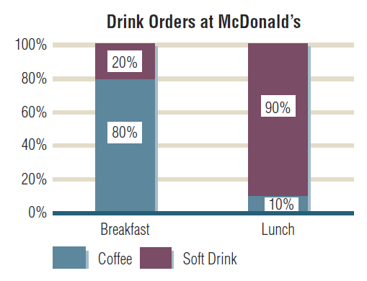
Example Relationship

Slide 9
Relationships Between Two Variables
Monotonic relationship: the general direction of a relationship between two variables is known
Increasing relationship
Decreasing relationship

Slide 10
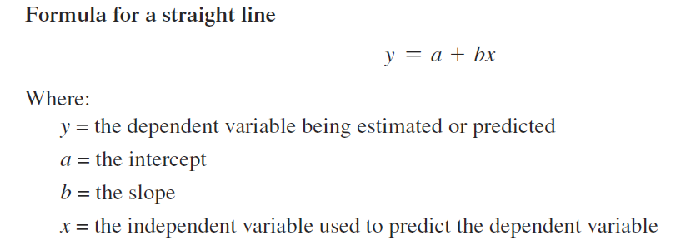
Relationships Between Two Variables
Linear relationship: “straight-linear association” between two variables

Slide 11
Relationships Between Two Variables
Curvilinear: some smooth curve pattern describes the association

Slide 12
Characterizing Relationships Between Variables
Presence: whether any systematic (statistical) relationship exists between two variables
Direction or pattern: whether the relationship is positive or negative
Strength of association: whether the relationship is consistent

Slide 14
Cross-Tabulations
Cross-tabulation: rows and columns defined by the categories classifying each variable; used for nonmonotonic relationships
Cross-tabulation cell: the intersection of a row and a column

Slide 15
Cross-Tabulations
Cross-tabulation table: four types of numbers in each cell
Frequency
Raw percentage
Column percentage
Row percentage

Slide 16
Cross-Tabulations
Frequencies are the raw numbers in the cell.
Raw percentages are cell frequencies divided by the grand total.
Row percentages are the row cell frequencies divided by its row total.
Column percentages are the column cell frequencies divided by its column total.

Slide 17
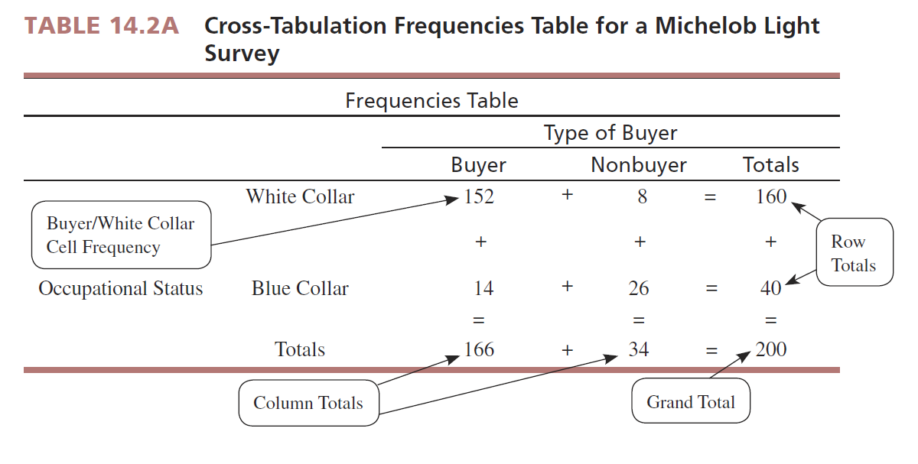

Slide 18
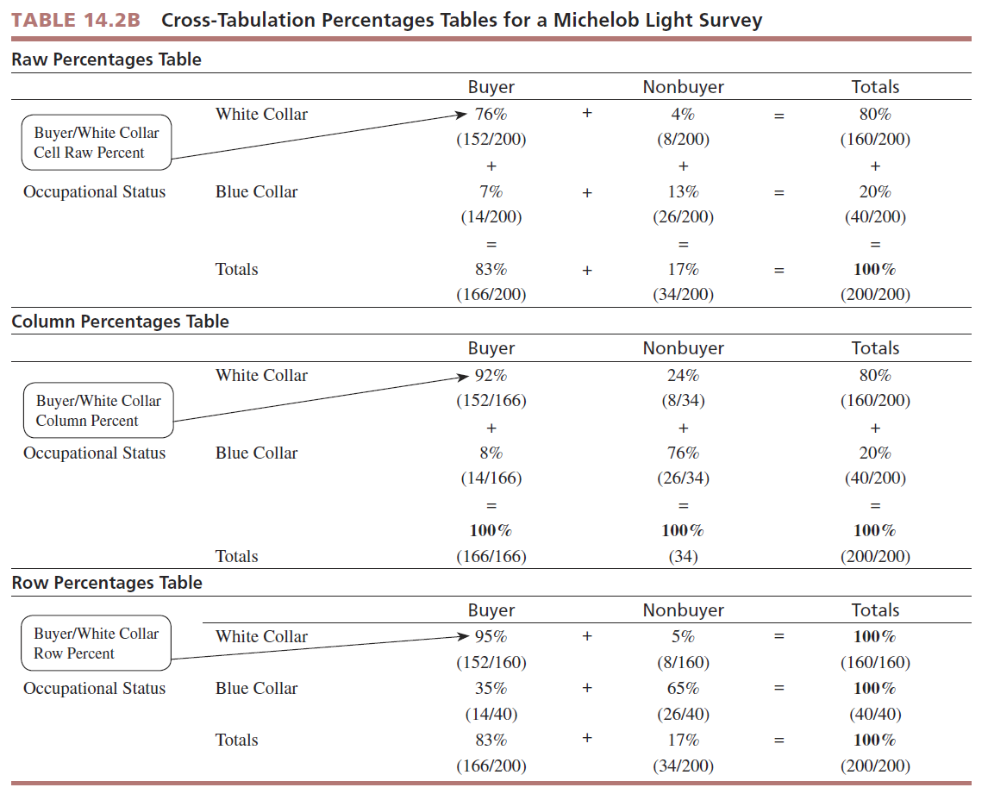

Slide 19
Chi-Square Analysis
Chi-square analysis: the examination of frequencies for two nominal-scaled variables in a cross-tabulation table to determine whether the variables have a significant relationship

Slide 20
Chi-Square Analysis
Assesses non-monotonic association in a cross-tabulation table based upon differences between observed and expected frequencies
The null hypothesis is that the two variables are not related.
Observed frequencies are the actual cell counts in the cross-tabulation table.
Observed frequencies are compared to expected frequencies.

Slide 21
Observed and Expected Frequencies
Expected frequencies are the theoretical frequencies in each cell that are derived from this hypothesis of no association between the two variables

Slide 22
Chi-Square Analysis
Computed Chi-square values:

Slide 23
The Computed Chi-square Value
The computed Chi-square value compares observed to expected frequencies.
The Chi-square statistic summarizes how far away from the expected frequencies the observed cell frequencies are found to be.

Slide 24
Degrees of Freedom

Slide 25
The Chi-square Distribution
The Chi-square distribution is skewed to the right, and the rejection region is always at the right-hand tail of the distribution.
The shape of the distribution is dependent on degrees of freedom.

Slide 26
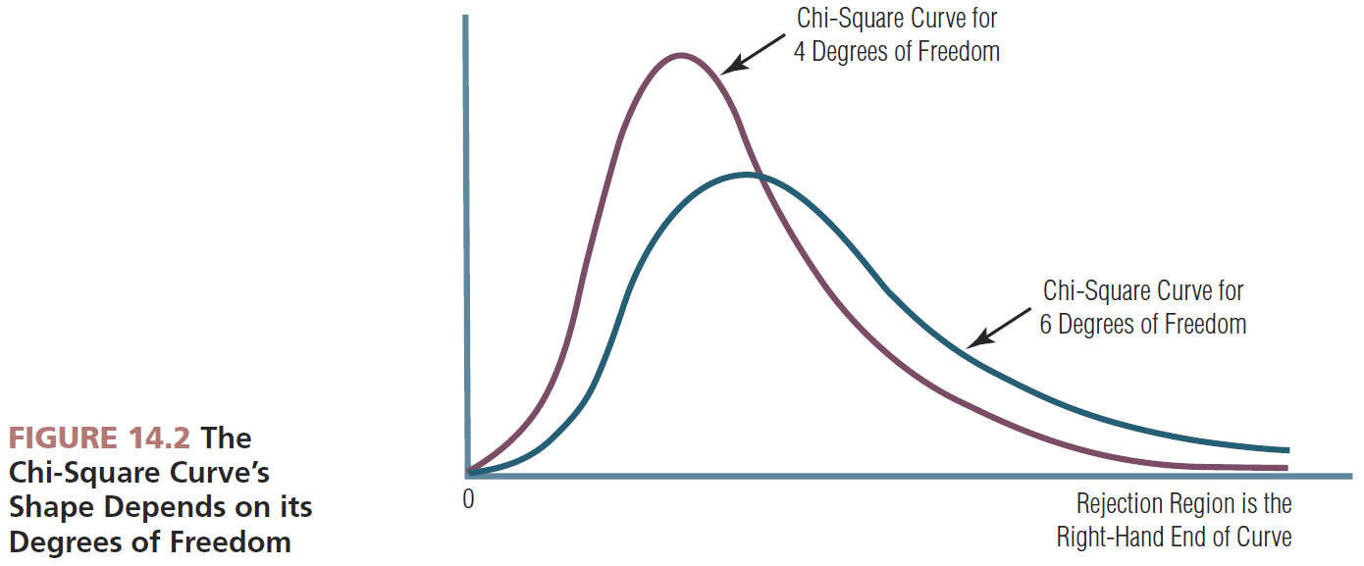

Slide 27
How to Interpret a Chi-square Result
The calculated (computed) value of Chi-square is compared to table value to determine significance.
SPSS and other statistical analysis programs compare calculated to table values and show the probability for support of the null hypothesis.
A significant Chi-square means the researcher should look at the cross-tabulation row and column percentages to “see” the association pattern.

Slide 28
Cross-Tabulations
Using SPSS, commands are ANALYZE, DESCRIPTIVE STATISTICS, CROSSTABS, and within the CROSSTABS dialog box, STATISTICS, CHI-SQUARE.

Slide 29
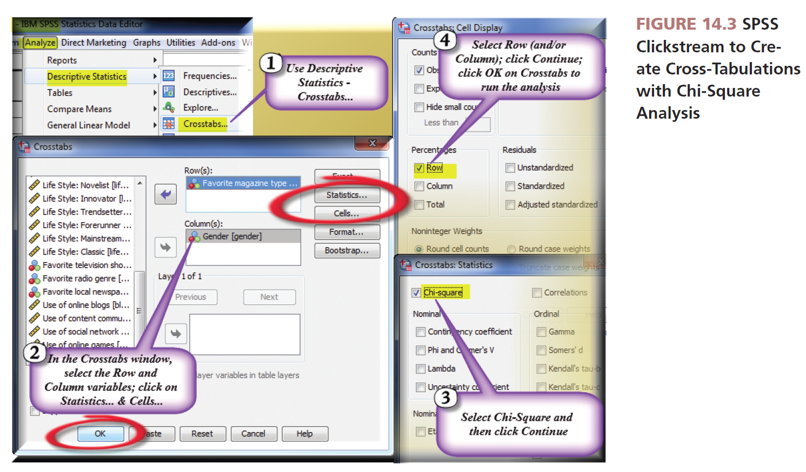
Source: Reprint courtesy of International Business Machines Corporation,©SPSS, Inc., an IBM Company.

Slide 30
SPSS Chi-Square Analysis
Observed frequencies: counts for each cell found in the sample
Expected frequencies: calculated on the null of “no association” between the two variables under examination
SPSS will calculate row, column, or both percentages. See the CELLS box at the bottom of the CROSSTABS dialog box.

Slide 31
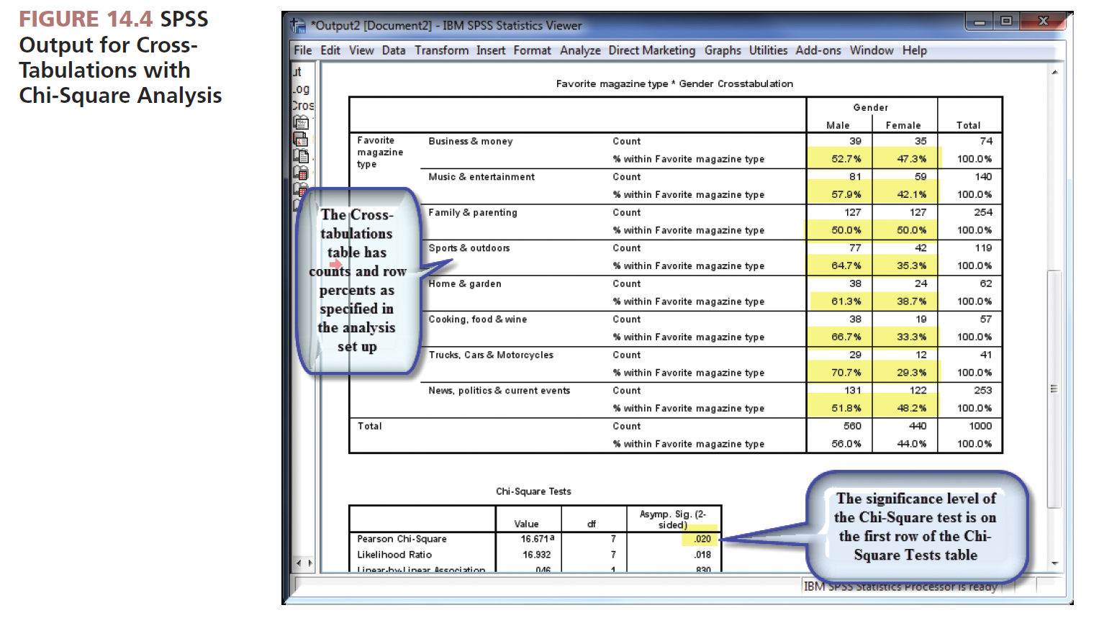
Source: Reprint courtesy of International Business Machines Corporation,©SPSS, Inc., an IBM Company.

Slide 32
Chi-square Analysis
How do I interpret a Chi-square result?
The Chi-square analysis yields the likelihood or probability that the researcher would find evidence in support of the null hypothesis.

Slide 33
Chi-square Analysis
How do I interpret a Chi-square result?
If the P value is ≤ to 0.05, this means there is little support for the null hypothesis (no association).
Therefore, we have a significant association and have the PRESENCE of a systematic relationship between the two variables.

Slide 34
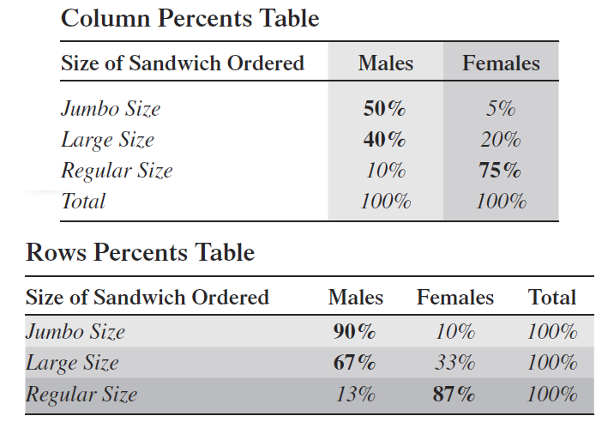
Reporting Findings
Whether to report row or column percents depends on research objectives.

Slide 35
Correlation and Covariation
The correlation coefficient: an index number, constrained to fall between the range of −1.0 and +1.0
The correlation coefficient communicates both the strength and the direction of the linear relationship between two metric variables.
Covariation: the amount of change in one variable systematically associated with a change in another variable

Slide 36
Correlation and Covariation
The amount of linear relationship between two variables is communicated by the absolute size of the correlation coefficient.
The direction of the association is communicated by the sign (+, −) of the correlation coefficient.
Regardless of its absolute value, the correlation coefficient must be tested for statistical significance.

Slide 37
Correlation Coefficients and Covariation
Covariation can be examined with use of a scatter diagram.
FIGURE 14.5 A Scatter
Diagram Showing
Covariation

Slide 38
Graphing Covariation Using Scatter Diagrams

Slide 39
Correlation Coefficient (r)
A correlation coefficient’s size indicates the strength of association between two variables.
The sign (+ or −) indicates the direction of the association.

Slide 40
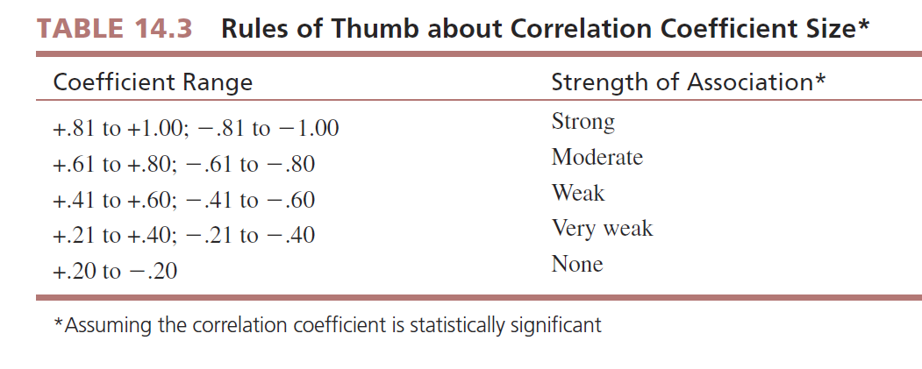

Slide 41
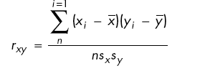
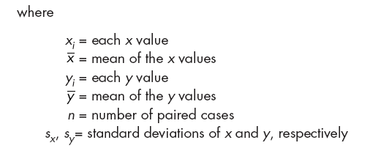
Pearson Product Moment Correlation Coefficient (r)
Pearson product moment correlation: measures the degree of linear association between the two variables

Slide 42
Graphing Covariation Using Scatter Diagrams
A scatter diagram plots the points corresponding to each matched pair of x and y variables.

Slide 43
Example
Using SPSS, commands are ANALYZE, CORRELATE, and BIVARIATE.

Slide 44
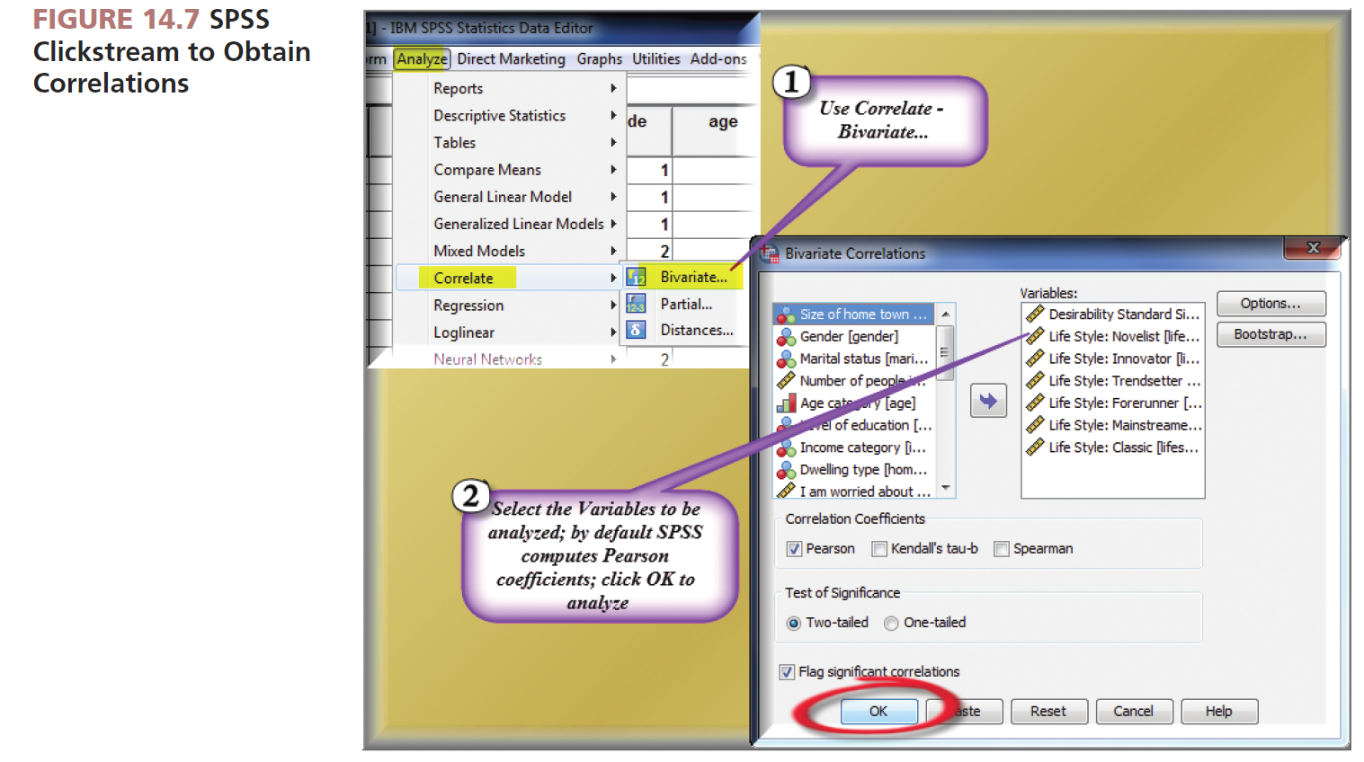
Source: Reprint courtesy of International Business Machines Corporation,©SPSS, Inc., an IBM Company.

Slide 45
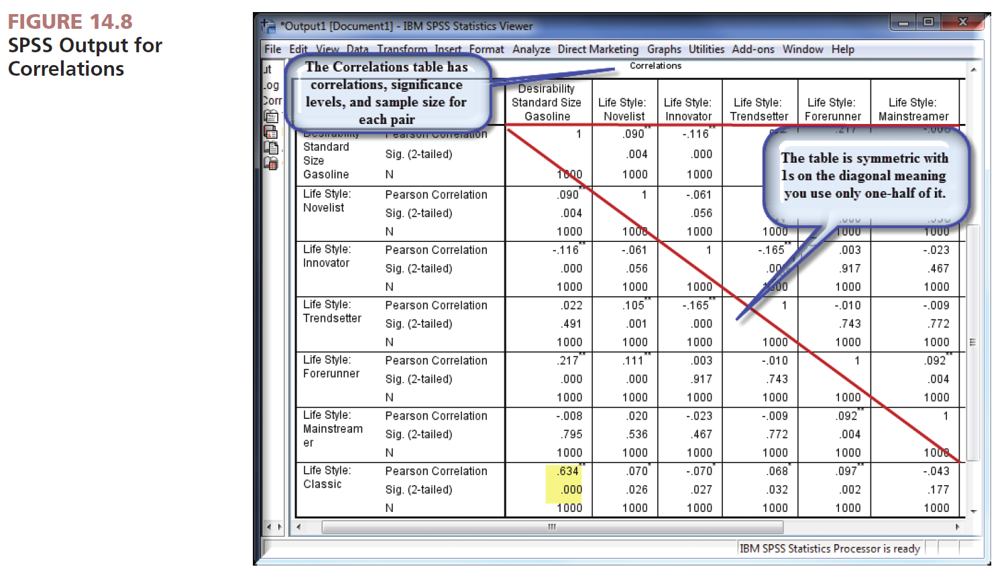
Source: Reprint courtesy of International Business Machines Corporation,©SPSS, Inc., an IBM Company.

Slide 46
Special Considerations
Correlation:
Assumes both variables share interval scaling at minimum.
Only takes into account the relationship between two variables, not interaction with other variables.
Does not demonstrate cause and effect.
Will not detect nonlinear relationships between variables.

Slide 47
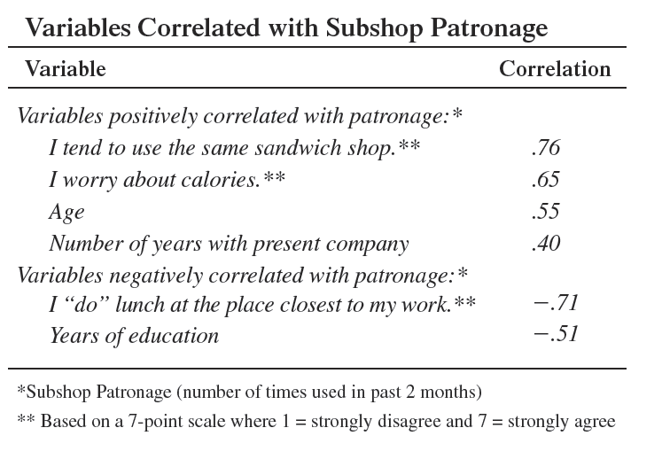
Reporting Example

Slide 48
All rights reserved. No part of this publication may be reproduced, stored in a retrieval system, or transmitted, in any form or by any means, electronic, mechanical, photocopying, recording, or otherwise, without the prior written permission of the publisher. Printed in the United States of America.

