Slide 1
Chapter 14
Economic Analysis in the Public and Regulated Sectors

Slide 2
The Nature of Public Projects
Projects should provide benefits for the greater good of the public that exceed the costs of providing those benefits.
The most frequently used method in evaluating government (local, state, or federal) projects is benefit-cost analysis.
Next most frequent is cost effectiveness analysis.

Slide 3
Build-Operate-Transfer
Build-Operate-Transfer expands the private sector role, allowing public agencies to tap into private sector technical, management and financial resources.
This achieves
greater cost and schedule certainty,
(2) supplements to in-house staff,
(3) innovative technology applications,
(4) specialized expertise, and
(5) access to private capital.

Slide 4
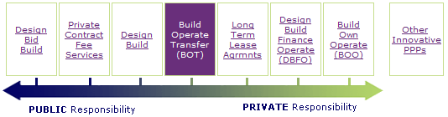
BOT characteristics include:
Responsibility: design, construct, and maintain
Life-cycle costing: more money on maintaining
Procurement process (competitive bid): single price
Standard specifications: great care of the government

Slide 5
Objectives in Public Project Evaluation
Flood Control Act on June 22,1936: “… the Federal Government should improve or participate … if the benefits to whomsoever they may accrue are in excess of the estimated costs ….”
River and Harbor Act of 1902: “required a board of engineers to report on … the amount of commerce benefited and the cost.”
Prest and Turvey on benefit-cost analysis: “ … a practical way of assessing the desirability of projects where it is important to take a long view and a wide view; it implies enumeration and evaluation of all relevant costs and benefits.” (positive VS negative impacts)

Slide 6
Benefit-cost analyses take a “long view” (over time) and a “wide view” (individuals, groups and things) and evaluate monetized benefits, disbenefits, and costs.

Slide 7
Guidelines in Public Sector Evaluation (from Arrow, et al)
B/C analysis is useful to compare favorable and unfavorable effects of a policy
B/C analysis is useful in achieving a desired goal at the lowest possible cost
Agencies should use B/C analysis to set regulatory priorities
B/C analysis should be required for all major decisions
When costs far exceed benefits in an accepted decision, the “other” factors (non-economic benefits e.g. equity) should be stated or weight differently the factors
B/C analysis should be done on major health, safety, and environmental regulations to inform legislators

Slide 8
Example 14.1
Costs and benefits for a public sector investment program are shown on the next slide. The planning horizon is 10 years and TVOM is i = 7%.

Slide 9
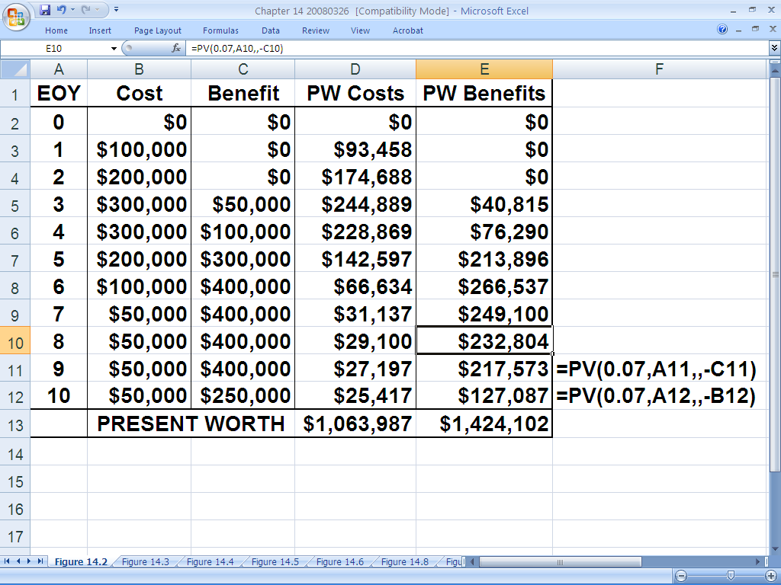
Note that the PW of benefits is $1,424,102, and the PW of costs is $1,063,987,the net PW of benefits minus costs is $360,115 and the B/C ratio =1.33.
So, the program is desirable when considered alone.

Slide 10
Systematic Economic Analysis Technique
Identify the (public-sector) investment alternatives
Define the planning horizon (for the benefit-cost study)
Specify the discount rate
Estimate the (benefit and cost profiles in monetary terms) cash flows
Compare the alternatives (using a measure of worth related to benefits and costs)
Perform supplementary analyses
Select the preferred (alternative) investment

Slide 11
Benefit-Cost and Cost-Effectiveness Calculations
Benefit-cost analysis typically uses:
- B/C benefit-cost ratio
- B-C benefits minus costs
Both B and C are expressed in monetary units as PW or AW (or even FW) where an appropriate discount rate i has been used to calculate PW or AW.

Slide 12

B/C Formula
(14.1)
Where t = end of year,
n = planning horizon,
i = discount rate,
B_{t} is benefits in t, and
C_{t} is costs in t,
where both B_{t} and C_{t} are expressed in monetary units.
$>$1 then it’s desirable

Slide 13

(14.2)
Where t = end of year,
n = planning horizon,
i = discount rate,
B_{t} is benefits in t, and
C_{t} is costs in t,
where both B_{t} and C_{t} are expressed in monetary units.
$>$0 then it’s desirable

Slide 14
Comparing Two Alternatives
When two project alternatives are being compared using a B/C ratio, the analysis should be done on an incremental basis.
Let the alternative with the lower present worth of costs be Alternative 1 and let the other be Alternative 2.
Then , the incremental benefits of the second alternative over the first, ΔB₂₋₁(i), are divided by the incremental costs of the second over the first, ΔC₂₋₁(i).

Slide 15
Incremental B/C Ratio
(14.3)
Incremental B/C analysis is like incremental rate of return analysis. Here, you prefer alternative 2 over 1 as long as the ∆B/C > 1. Then, compare alternative 3 to the winner of 1 and 2, and so on
Do not just select the alternative with the highest overall B/C ratio (similar to IEE and ERR)

Slide 16
Comparing Two Alternatives
When two project alternatives are being compared using B-C, no special incremental procedure is necessary
Just select the alternative that has the highest value of B-C

Slide 17
Cost-Effectiveness Analysis
Use cost-effectiveness analysis whenever each alternative has the same annual benefits or effects. Simply minimize the PW or AW of costs
(14.5)
Or, use C-E analysis when alternatives have the same costs. Maximize the PW or AW of benefits
(14.6)

Slide 18
Example 14.2
Three highway alternatives, A, B, and C
Benefits are assumed to be all equal, so use Cost-Effectiveness analysis
For each alternative,
AW_{total}= AW_{first/resurfacing} + AW_{maintenance}
See next slide for data and calculations
Route A wins with lowest cost!

Slide 19
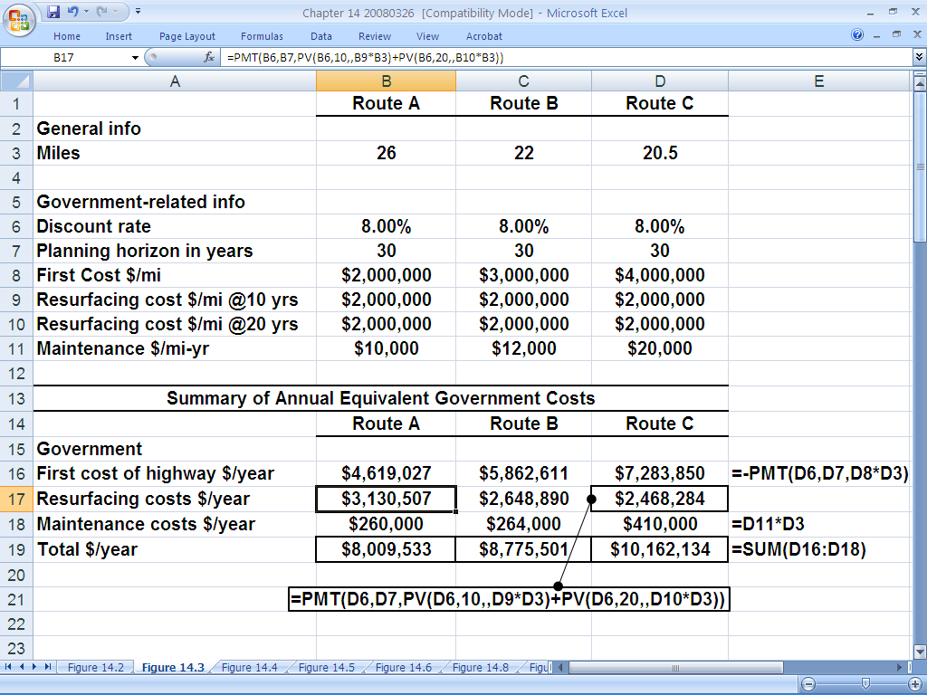
2,000,000*26*(P/F,8,10)(A/P,8,30)+2,000,000*26*(P/F,8,20)(A/P,8,30)
2,000,000*26*(A/P,8,30)
10,000*26
Sum of the annual worth
Route A is the Lowest cost

Slide 20
Example 14.3
Same road project as Example 2, except considering different “benefits” for A, B, and C
Different numbers of vehicle types considered
Cost of operation is considered for each type
Cost of time spent driving, by vehicle, is considered
Cost of accidents on each route is also considered
Relevant government and public costs are given on the next slide, and the incremental B/C analysis follows two slides from here. Note that “benefits” here are expressed as “cost savings”

Slide 21
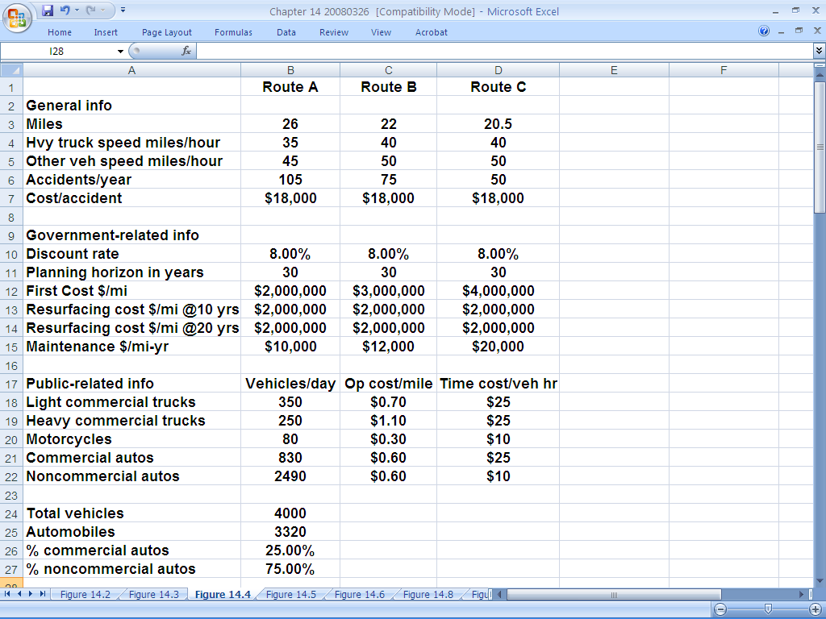
Relevant government and public costs plus other input data.

Slide 22
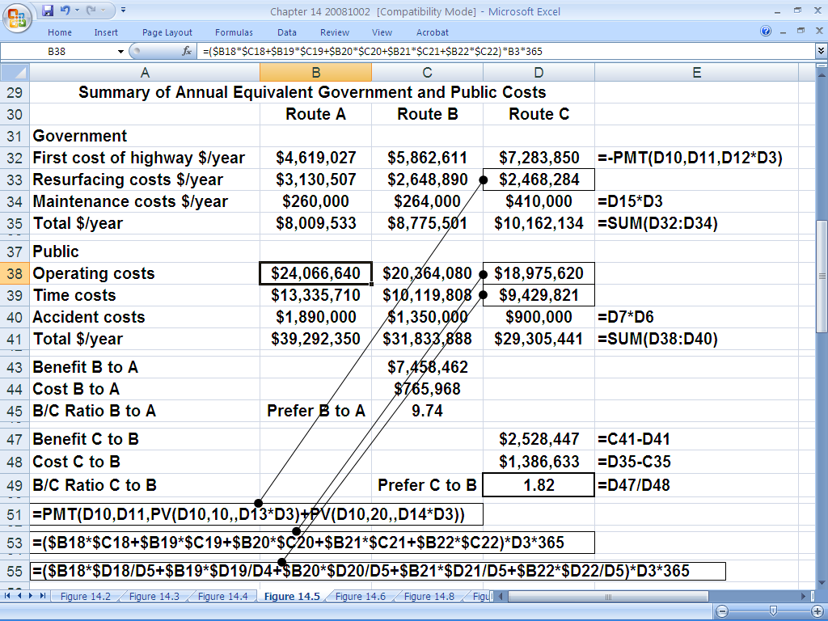
[350*(1/45)*25+250*(1/35)*25+80*0.30+(80*(1/45)*10+3320*0.25*(1/45)*10)*26*365
[350*0.7+250*1.1+80*0.30+(830+2490)*0.6]*26*365
105*18,000

Slide 23
Example 14.3, concluded
Note that government costs are given as:
A: $8,009,533; B: $8,775,501; C: $10,162,134
So, incremental costs B to A = $765,968
and incremental costs C to B = $1,386,633
Note that costs to public are:
A: $39,292,350; B: $31,833,888; C: $29,305,441
So, incremental “Benefit” B to A = $7,458,462
and incremental “Benefit” C to B = $2,528,447
∆B/C _{B to A} = $7,458,462/$765,968 = 9.74 B wins
∆B/C _{C to B} = $2, 528, 447/$1,386,633 = 1.82 C wins

Slide 24
Example 14.4
The difference in incremental benefits and costs may be used for Example 14.3
Δ(B-C)_{B-A} = ΔB_{B-A} - ΔC_{B-A}
= $7,458,462 - $765,968
= $6,692,494/year
So, B is preferred to A
Δ(B-C)_{C-B} = ΔB_{C-B} – ΔC_{C-B} =
= $2,528,447 – 1,386,633
= $1,141,814/year
And, C is preferred to B
C wins overall – same as in Example 14.3

Slide 25
Notes on Ex. 14.2, 14.3, and 14.4
Example 14.2 used Cost Effectiveness Analysis, comparing government costs only, since benefits were assumed equal for each of routes A, B, and C
Examples 14.3 and 14.4 used Benefit-Cost analysis since benefits were assumed different for each of routes A, B, and C
The incremental B/C ratio was used in Example 14.3, and incremental B-C analysis was used in Example 14.4
Incremental benefits and incremental costs were evaluated using annual worth. Of course, the present worth of all costs would have been perfectly fine to use.

Slide 26
B/C analysis is useful for evaluating one project.
Incremental ΔB/ΔC analysis is required when comparing more than one alternative.
B-C analysis is useful for one or many alternatives.
More often than not, the benefit-cost ratio B/C (or incremental B/C ratio) is used. This is unfortunate because, just as in rate of return analyses in the private sector, the benefit-cost ratio B/C is easy to misuse and misinterpret
Also, the B/C ratio is very sensitive to the classification of problem elements as "benefits" or "costs." B-C is not.

Slide 27
A city is considering building a new Public Library to serve its citizens. Three alternatives have been identified with the following data:
Government | Alternative A | Alternative B | Alternative C
Initial Cost (SR) | 6,000,000 | 4,000,000 | 9,000,000
Annual Maintenance Cost (SR/year) | 180,000 | 210,000 | 260,000
Public | Alternative A | Alternative B | Alternative C
Benefits (SR/year) | 1,000,000 | 900,000 | 1,500,000
Dis-benefits(Cost) (SR/year) | 150,000 | 400,000 | 500,000
Using 8% interest rate, 15-year study period, a salvage value of 50% of the initial cost, and B/C ratio, determine which alternative should be selected.

Slide 28
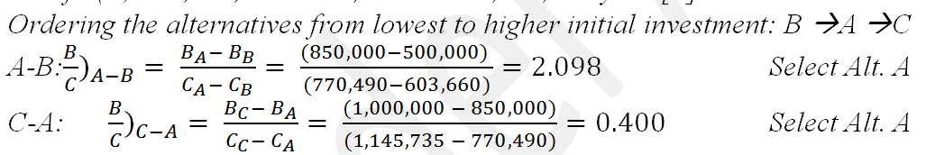
A_{W} analysis
Costs to the city:
Cost (A) = 6,000,000 (A/P 8, 15) + 180,000 - 6,000,000 X 0.5 (A/F 8, 15)
= SR 770,490/year
Cost (B) = 4,000,000 (A/P 8, 15) + 210,000 - 4,000,000 X 0.5 (A/F 8, 15)
= SR 603,660/year
Cost (C) = 9,000,000 (A/P 8, 15) + 260,000 - 9,000,000 X 0.5 (A/F 8, 15)
= SR 1,145,735/year
Benefit to the users:
Benefit (A) = 1,000,000 - 150,000 = SR 850,000/year
Benefit (B) = 900,000 - 400,000 = SR 500,000/year
Benefit (C) = 1,500,000 - 500,000 = SR 1,000,000/year

Slide 29
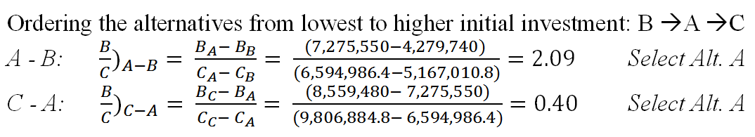
P_{W} analysis
Costs to the city:
Cost (A) = 6,000,000 + 180,000 (P/A 8, 15) - 6,000,000 X 0.5 (P/F 8, 15)
= SR 6,594,986.4
Cost (B) = 4,000,000 + 210,000 (P/A 8, 15) - 4,000,000 X 0.5 (P/F 8, 15)
= SR 5,167,010.8
Cost (C) = 9,000,000 + 260,000 (P/A 8, 15) - 9,000,000 X 0.5 (P/F 8, 15)
= SR 9,806,884.8
Benefit to the users:
Benefit (A) = (1,000,000 - 150,000) (P/A 8, 15) = SR 7,275,550
Benefit (B) = (900,000 - 400,000) (P/A 8, 15) = SR 4,279,740
Benefit (C) = (1,500,000 - 500,000) (P/A 8, 15) = SR 8,559,480

Slide 30
Pit Stop #14 – Same Thing; Different Look
True or False: Benefit-cost analysis is primarily used by regulated utilities. False. It is used in the public sector. Revenue Requirements analysis is used by regulated utilities.
True or False: Build-Operate-Transfer (BOT) makes use of a public-private partnership. True, in order to utilize the strengths of both public and private sectors.
True or False: Benefits and disbenefits must be converted to monetary values to use benefit-cost analysis. True. Then, the PW or AW values are used in the benefit-cost analyses.
True or False: OMB’s Circular No. A-94, Revised is the definitive document for benefit-cost analysis. True in the United States of America.
True or False: The seven step SEAT is only applicable to public sector evaluation after extensive modification. False. SEAT is applicable as-is, and explanation is facilitated by only minor modification to some wording.
True or False: The B/C ratio is directly applicable to evaluation of one or many alternatives. False. The B/C ratio is applicable to evaluation of one alternative, but multiple alternatives require incremental B/C analysis.
True or False: The B-C evaluation is directly applicable to evaluation of one or many alternatives. True. B-C analysis is very robust. Unfortunately, the B/C ratio is more often used.
True or False: Some in the public sector recommend using an interest rate of 0% on any money from outside sources. True, unfortunately. This can lead to acceptance of projects that should never see the light of day.
True or False: The Revenue Requirements method is not economically equivalent to the industrial ATCF approach. False. While it follows a different analysis format, both methods are completely equivalent .
True or False: The Revenue Requirements method determines the income that exactly “pays” for costs, depreciation, interest on borrowed money, taxes, and a desirable return to owners. True. This is known as the minimum revenue requirement.

Slide 31
Pit Stop #14 – Same Thing; Different Look
True or False: Benefit-cost analysis is primarily used by regulated utilities. False. It is used in the public sector. Revenue Requirements analysis is used by regulated utilities.
True or False: Build-Operate-Transfer (BOT) makes use of a public-private partnership. True, in order to utilize the strengths of both public and private sectors.
True or False: Benefits and disbenefits must be converted to monetary values to use benefit-cost analysis. True. Then, the PW or AW values are used in the benefit-cost analyses.
True or False: OMB’s Circular No. A-94, Revised is the definitive document for benefit-cost analysis. True in the United States of America.
True or False: The seven step SEAT is only applicable to public sector evaluation after extensive modification. False. SEAT is applicable as-is, and explanation is facilitated by only minor modification to some wording.
True or False: The B/C ratio is directly applicable to evaluation of one or many alternatives. False. The B/C ratio is applicable to evaluation of one alternative, but multiple alternatives require incremental B/C analysis.
True or False: The B-C evaluation is directly applicable to evaluation of one or many alternatives. True. B-C analysis is very robust. Unfortunately, the B/C ratio is more often used.
True or False: Some in the public sector recommend using an interest rate of 0% on any money from outside sources. True, unfortunately. This can lead to acceptance of projects that should never see the light of day.
True or False: The Revenue Requirements method is not economically equivalent to the industrial ATCF approach. False. While it follows a different analysis format, both methods are completely equivalent .
True or False: The Revenue Requirements method determines the income that exactly “pays” for costs, depreciation, interest on borrowed money, taxes, and a desirable return to owners. True. This is known as the minimum revenue requirement.

