Slide 1
Chapter 12
Using Descriptive Analysis, Performing
Population Estimates, and Testing Hypotheses
Copyright © 2014 Pearson Education, Inc.
1

Slide 2
Learning Objectives
To learn about the concept of data analysis and the functions it provides
To appreciate the five basic types of statistical analysis used in marketing research
To use measures of central tendency and dispersion customarily used in describing data
To learn how to obtain descriptive statistics with SPSS

Slide 3
Learning Objectives
To understand the concept of statistical inference
To learn how to estimate a population mean or percentage
To test a hypothesis about a population mean or percentage
To learn how to perform and interpret statistical inference with SPSS

Slide 4
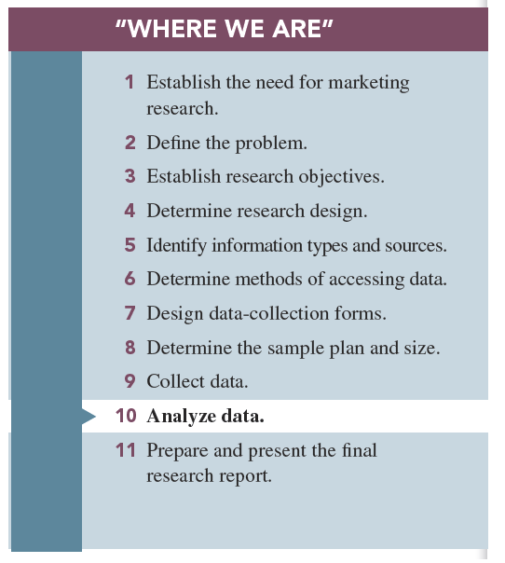

Slide 5
Types of Statistical Analyses Used in Marketing Research
Descriptive analysis
Inferential analysis
Differences analysis
Associative analysis
Predictive analysis

Slide 6
Descriptive Analysis
Used by marketing researchers to describe the sample dataset in such a way as to portray the “typical” respondent and to reveal the general pattern of responses

Slide 7
Inference Analysis
Used when marketing researchers use statistical procedures to generalize the results of the sample to the target population it represents

Slide 8
Difference Analysis
Used to determine the degree to which real and generalizable differences exist in the population to help the manager make an enlightened decision on which advertising theme to use

Slide 9
Association Analysis
Investigates if and how two variables are related

Slide 10
Predictive Analysis
Statistical procedures and models to help make forecasts about future events

Slide 11
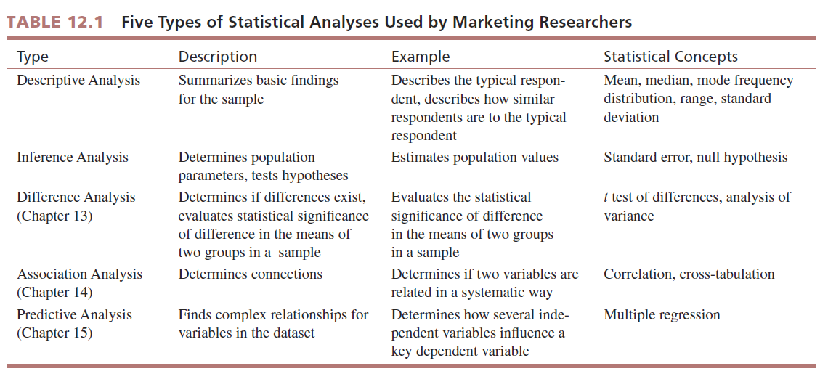

Slide 12
Understanding Data via Descriptive Analysis
Two sets of measures are used extensively to describe the information obtained in a sample.
Measures of central tendency or measures that describe the “typical” respondent or response
Measures of variability or measures that describe how similar (dissimilar) respondents or responses are to (from) “typical” respondents or responses

Slide 13
Measures of Central Tendency: Summarizing the “Typical” Respondent
The basic data analysis goal involved in all measures of central tendency is to report a single piece of information that describes the most typical response to a question.
Central tendency applies to any statistical measure used that somehow reflects a typical or frequent response.

Slide 14
Measures of Central Tendency: Summarizing the “Typical” Respondent
Measures of central tendency:
Mode: a descriptive analysis measure defined as that value in a string of numbers that occurs most often
Median: expresses that value whose occurrence lies in the middle of an ordered set of values
Mean (or average):

Slide 15
Measures of Variability: Visualizing the Diversity of Respondents
All measures of variability are concerned with depicting the “typical” difference between the values in a set of values.
There are three measures of variability:
Frequency distribution
Range
Standard deviation

Slide 16
Measures of Variability: Visualizing the Diversity of Respondents
A frequency distribution is a tabulation of the number of times that each different value appears in a particular set of values.
The conversion is accomplished simply through a quick division of the frequency for each value by the total number of observations for all values, resulting in a percent, called a percentage distribution.

Slide 17
Measures of Variability: Visualizing the Diversity of Respondents
Range: identifies the distance between lowest value (minimum) and the highest value (maximum) in an ordered set of values
Standard deviation: indicates the degree of variation or diversity in the values in such a way as to be translatable into a normal or bell-shaped curve distribution

Slide 18
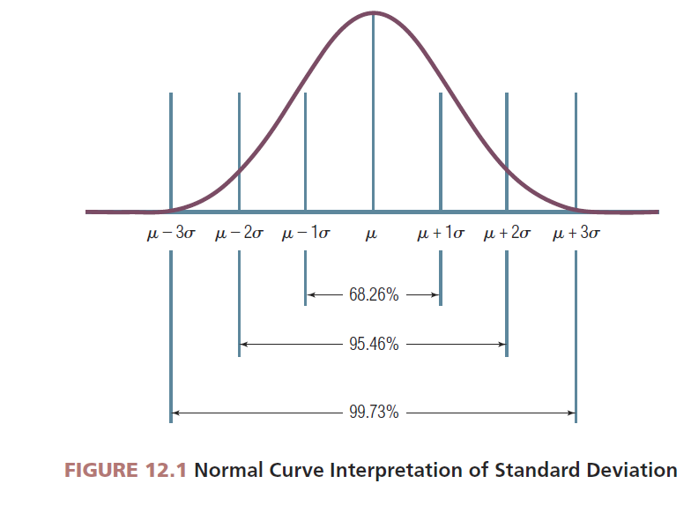

Slide 19
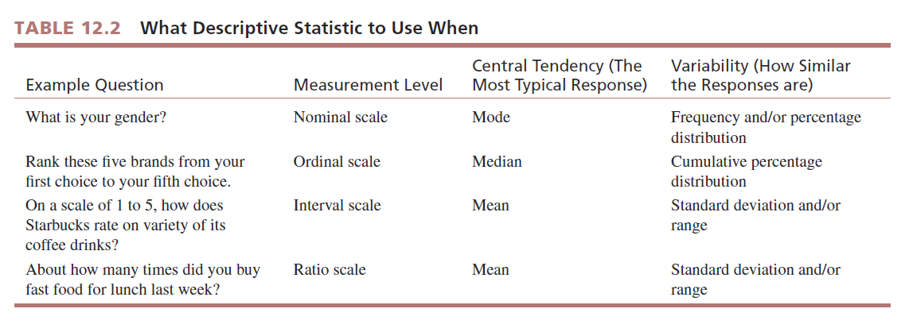

Slide 20
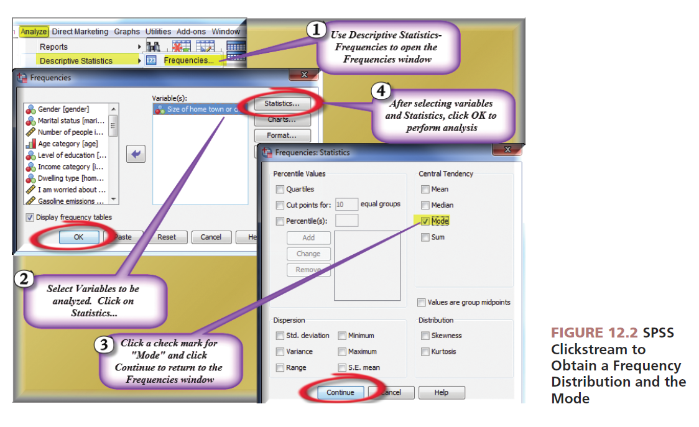
Reprinted courtesy of International Business Machines Corporation, © SPSS, Inc., an IBM Company

Slide 21
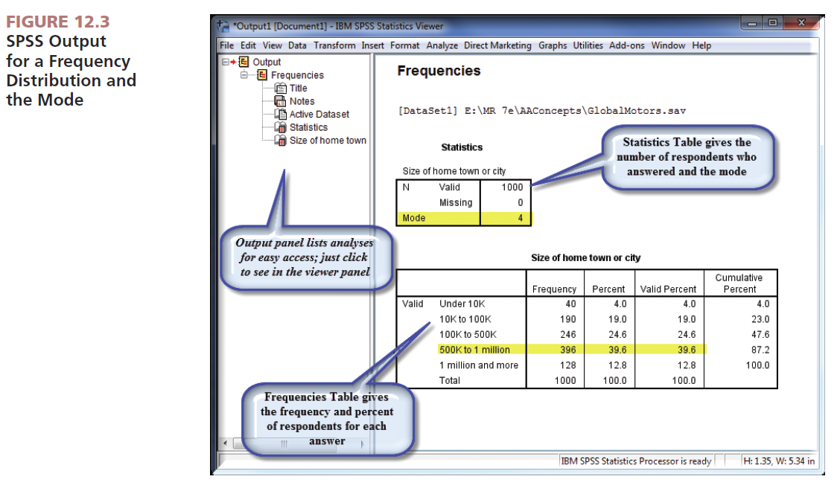
Reprinted courtesy of International Business Machines Corporation, © SPSS, Inc., an IBM Company

Slide 22
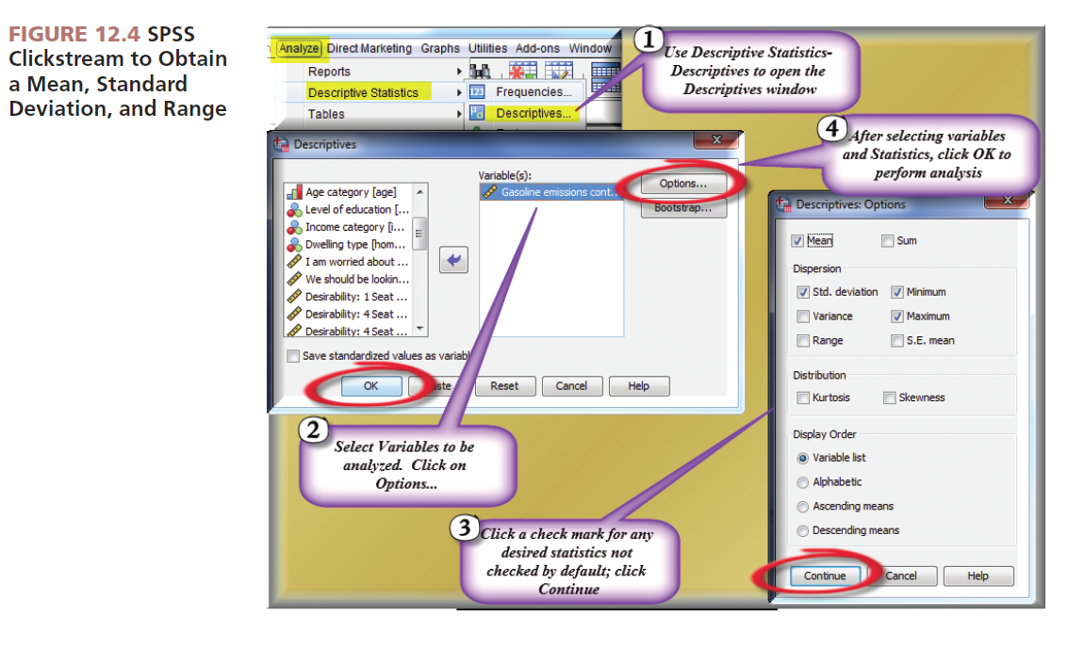
Reprinted courtesy of International Business Machines Corporation, © SPSS, Inc., an IBM Company

Slide 23
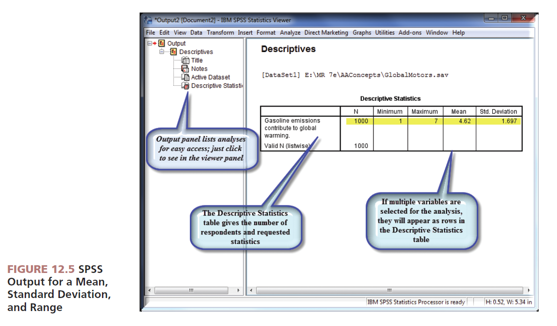
Reprinted courtesy of International Business Machines Corporation, © SPSS, Inc., an IBM Company

Slide 24
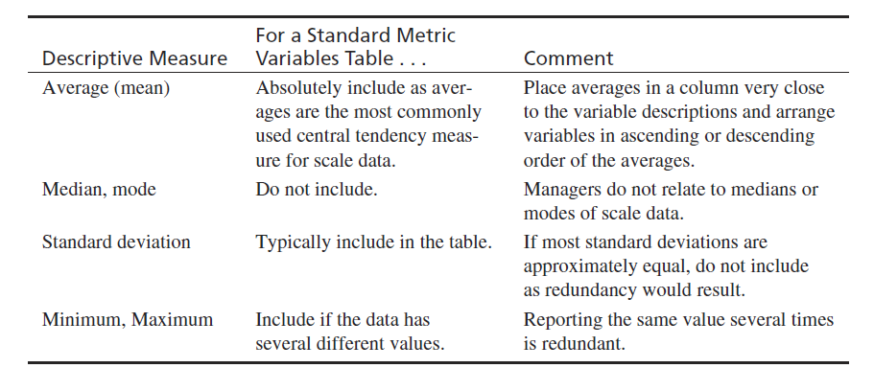
Recommendations for Scale Variable Table

Slide 25
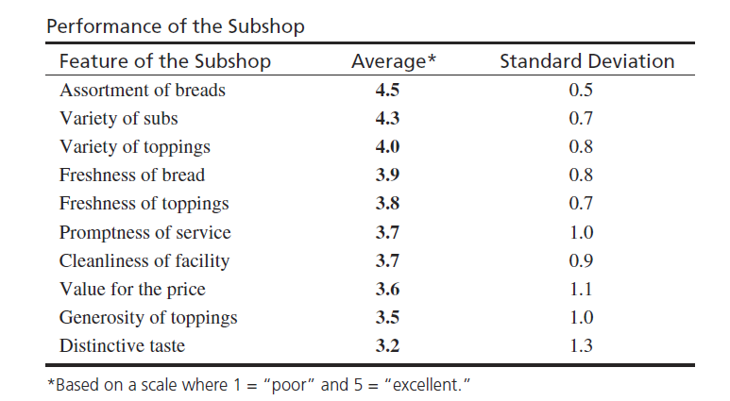
Example Scale Variables Table

Slide 26
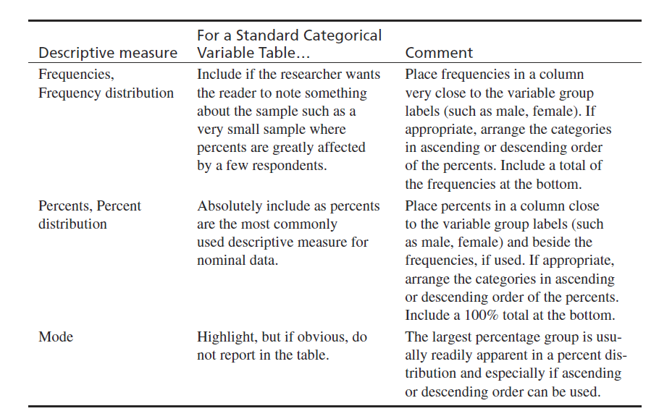
Recommendations for Categorical Data Table

Slide 27
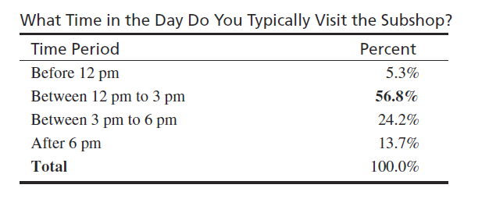
Sample Nominal or Categorical Variable Table

Slide 28
Parameter Estimation: Estimating the Population Percent or Mean
Parameter estimation is the process of using sample information to compute an interval that describes the range of a parameter such as the population mean or the population percentage.
It involves the use of three values:
The sample statistic
The standard error of the statistic
The desired level of confidence

Slide 29
Statistical Inference: Sample Statistics and Population Parameters
Values that are computed from information provided by a sample are referred to as the sample’s statistics.
Values that are computed from a complete census, which are considered to be precise and valid measures of the population, are referred to as parameters.

Slide 30
Statistical Inference: Sample Statistics and Population Parameters
Inference is a form of logic in which you make a general statement (a generalization) about an entire class based on what you have observed about a small set of members of that class.

Slide 31
Statistical Inference: Sample Statistics and Population Parameters
Statistical inference is a set of procedures in which the sample size and sample statistic are used to make an estimate of the corresponding population parameter.

Slide 32
Statistical Inference: Sample Statistics and Population Parameters
Two types of statistical inferences:
Parameter estimate is used to approximate the population value (parameter) through the use of confidence intervals.
Hypothesis testing is used to compare the sample statistic with what is believed (hypothesized) to be the population value prior to undertaking the study.

Slide 33
Statistical Inference: Sample Statistics and Population Parameters
A sample statistic is usually a mean or percentage.
Standard error is the measure of variability in the sampling distribution.
A confidence interval is the degree of accuracy desired by the researcher stated in the form of a range with an upper and lower boundary.

Slide 34
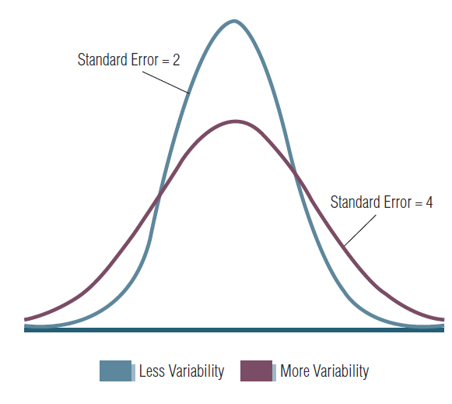
FIGURE 12.6 Variability Found in the Sample DirectlyAffects the Standard Error

Slide 35
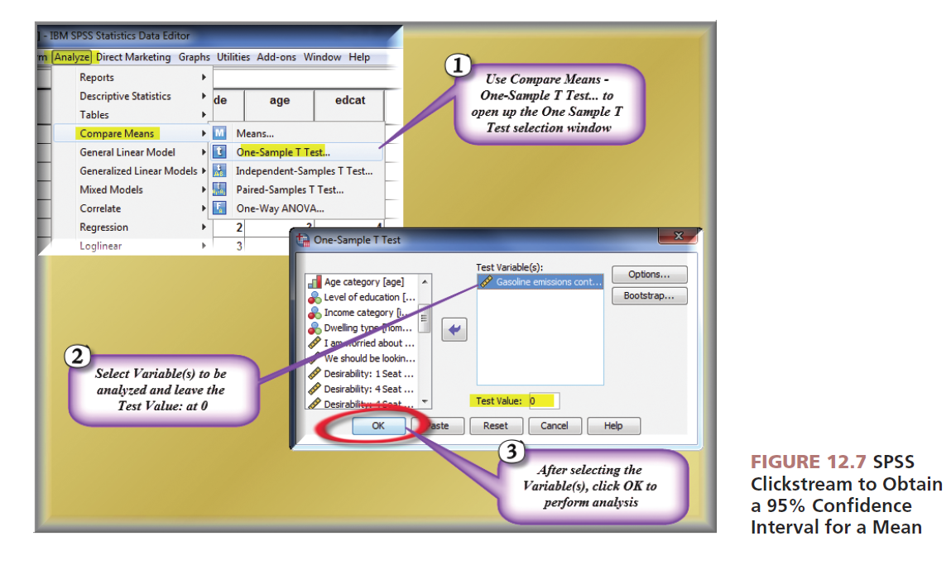
Reprinted courtesy of International Business Machines Corporation, © SPSS, Inc., an IBM Company

Slide 36
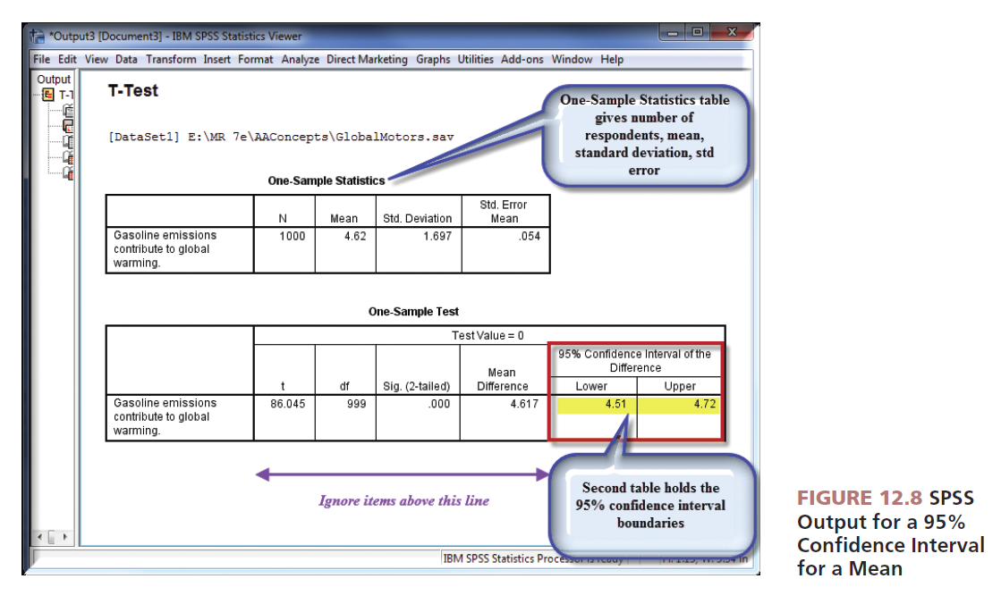
Reprinted courtesy of International Business Machines Corporation, © SPSS, Inc., an IBM Company

Slide 37
Hypothesis Tests
Tests of an hypothesized population parameter value:
Test of an hypothesis about a percent
Test of an hypothesis about a mean
The crux of statistical hypothesis testing is the sampling distribution concept.

Slide 38
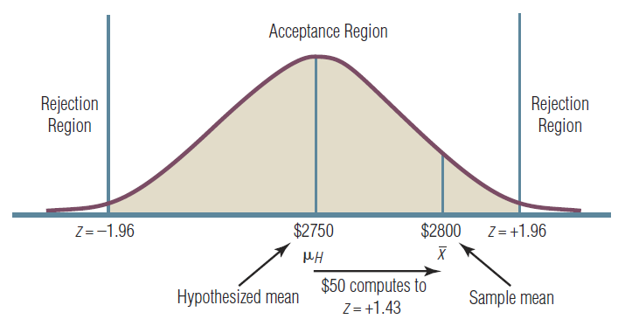
FIGURE 12.9 Sample Findings Support the Hypothesis in This Example

Slide 40
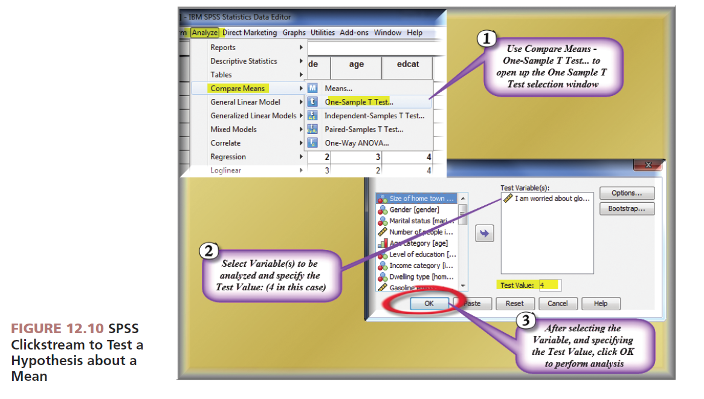
Reprinted courtesy of International Business Machines Corporation, © SPSS, Inc., an IBM Company

Slide 41
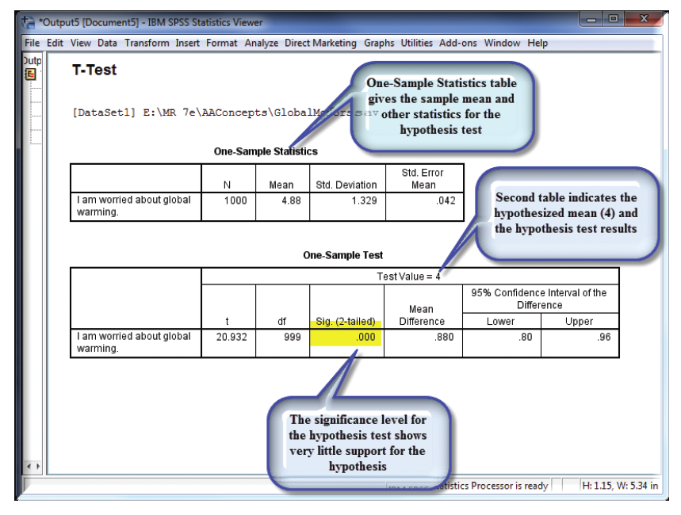
FIGURE 12.11 SPSS Output for the Test of a Hypothesis About a Mean
Reprinted courtesy of International Business Machines Corporation, © SPSS, Inc., an IBM Company

Slide 43
All rights reserved. No part of this publication may be reproduced, stored in a retrieval system, or transmitted, in any form or by any means, electronic, mechanical, photocopying, recording, or otherwise, without the prior written permission of the publisher. Printed in the United States of America.

