Slide 1
Systems Analysis and Design 11th Edition
Chapter 11 – Managing Systems Implementation

Slide 2
Chapter Objectives
Explain the importance of software quality assurance and software engineering
Describe application development using structured, object-oriented, and agile methods
Draw a structure chart showing top-down design, modular design, cohesion, and coupling
Explain the coding process
Explain unit, integration, and system testing

Slide 3
Chapter Objectives (Cont.)
Differentiate between program, system, operations, and user documentation
List the main steps in system installation and evaluation
Develop training plans for various user groups, compare in-house and vendor training options, and describe effective training techniques
Describe data conversion and changeover methods
Explain post-implementation evaluation and the final report to management

Slide 4
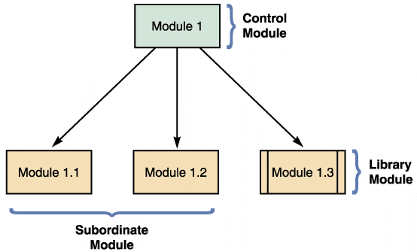
Structured Application Development
Structure Charts
Display program modules and the relationships among them
Module - Represented by a rectangle
Types of modules
Control: Higher-level module
Subordinate: Lower-level modules
Library: Reusable code that can be invoked from more than one point in the chart
FIGURE 11-8 An example of structure chart modules.

Slide 5
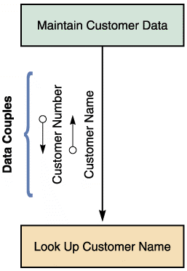
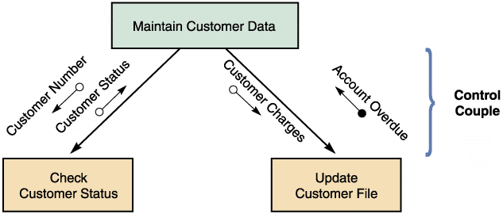
Structured Application Development (Cont. 1)
Data couple: Represented by an arrow with an empty circle
Shows data that one module passes to another
Control couple
Represented by an arrow
with a filled circle
Shows a status flag
FIGURE 11-9 An example of a structure chart data.
FIGURE 11-10 An example of a structure chart control couple.

Slide 6
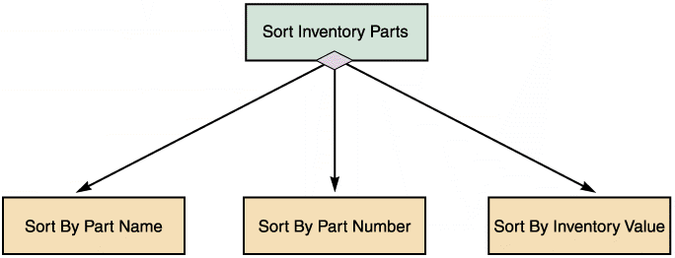
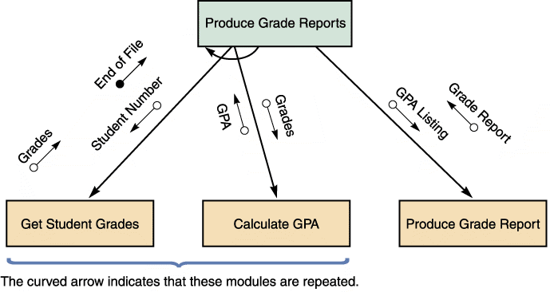
Structured Application Development (Cont. 2)
Condition: Indicates that a control module determines which subordinate modules will be invoked
Represented by a line with a diamond on one end
Loop: Indicates that one or more modules are repeated
Represented by a curved arrow
FIGURE 11-11 The diagram shows a control module that triggers three subordinate modules.
FIGURE 11-12 The diagram shows a structure chart loop with two repeating modules.

Slide 7
Structured Application Development (Cont. 3)
Cohesion and Coupling
Cohesion measures a module’s scope and processing characteristics
A module that performs a single function or task has a high degree of cohesion
FIGURE 11-13 Two examples of cohesion. Notice that the single module on the left is less cohesive than the two modules on the right.

Slide 8
Structured Application Development (Cont. 4)
Coupling describes the degree of interdependence among modules
Modules that are independent are loosely coupled
Loosely coupled modules are easier to maintain and modify
In tightly coupled modules, one module is linked to internal logic contained in another module

Slide 9
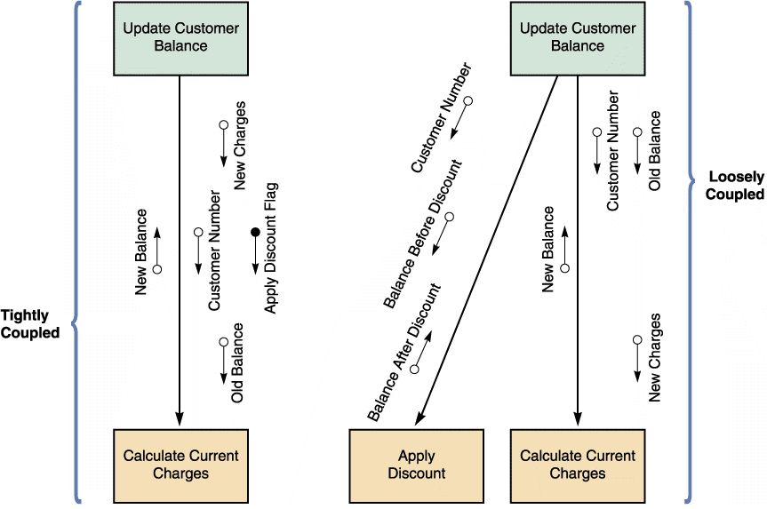
Structured Application Development (Cont. 5)
FIGURE 11-14 An example of tightly coupled and loosely coupled structure charts.

Slide 10
Structured Application Development (Cont. 6)
Drawing a Structure Chart
Step 1 - Review DFDs for accuracy and completeness
Step 2 - Identify the program modules and determine control-subordinate relationships
Step 3 - Add couples, loops, and conditions
Step 4 - Analyze the structure chart and ensure that it is consistent with all previous documentation

Slide 11
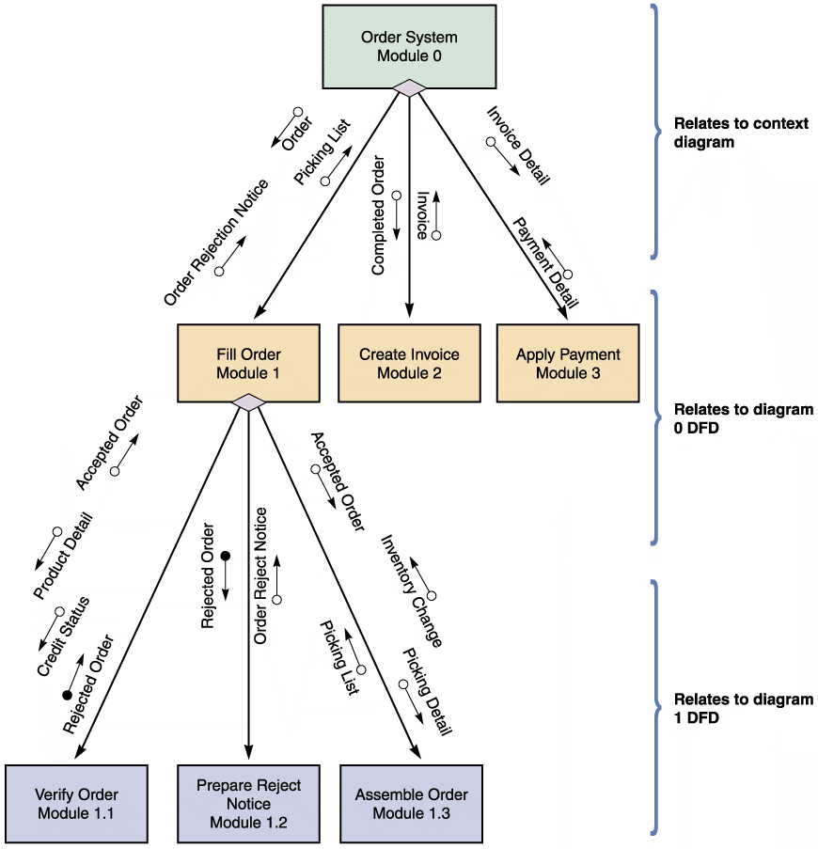
Structured Application Development (Cont. 7)
FIGURE 11-15 A structure chart based on the order system DFDs in Chapter 5. The three-level structure chart relates to the three DFD levels.

Slide 12
Object-Oriented Application Development
Characteristics of Object-Oriented Application Development
Individual object instances belong to classes of objects with similar characteristics
The relationship and interaction among classes are described using a class diagram
Class diagrams include class attributes and methods
Object relationship diagrams provide an overview of object interaction

Slide 13
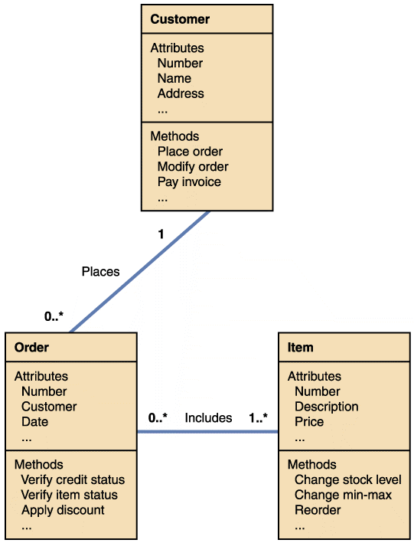
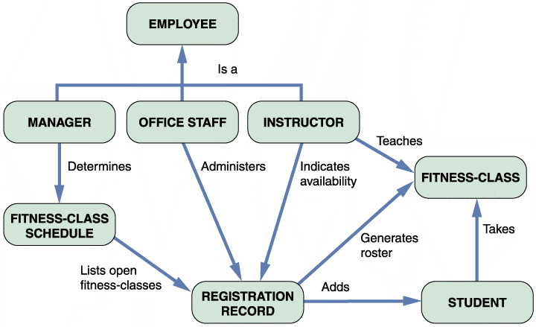
Object-Oriented Application Development (Cont. 1)
FIGURE 11-17 An object-relationship diagram for a fitness center.
FIGURE 11-16 A simplified class diagram for a customer order processing system.

Slide 14
Object-Oriented Application Development (Cont. 2)
Implementation of Object-Oriented Designs
Objective - To translate object methods into program code modules and determine what event or message will trigger the execution of each module
Object-Oriented Cohesion and Coupling
Classes should be as loosely coupled as possible
An object’s methods should also be loosely coupled and highly cohesive

Slide 15
Agile Application Development
Uses a highly iterative process
Development team is in constant communication with the primary user (customer)
Based on a quick and nimble development process that easily adapts to change
Focuses on small teams, intense communication, and rapid development iterations

Slide 16
Agile Application Development (Cont. 1)
FIGURE 11-19 The five core values of extreme programming (XP).
Source: ©2009, Don Wells

Slide 17
Agile Application Development (Cont. 2)
Extreme Programming (XP)
Uses pair programming
Pair programming: Involves two programmers working on the same task on the same computer, where one programs while the other watches
Test-driven development (TDD)
Focuses on end results from the beginning
Prevents programmers from straying from their goals
User Stories
Short, simple requirements definitions
Programmers review user stories to determine the project’s requirements, priorities, and scope

Slide 18
Agile Application Development (Cont. 3)
Iterations and Releases
Release plans are to be developed by teams
User stories are implemented in a series of iteration cycles
An iteration planning meeting is held at the beginning of each cycle
Iteration cycles continue until all user stories have been implemented, tested, and accepted

Slide 19
Agile Application Development (Cont. 4)
The Future of Agile Development
Agile methodology is becoming popular for software projects
Supporters claim that it speeds up software development and delivers precisely what the customer wants
Critics claim that it lacks discipline and produces systems of questionable quality
Agile methodology does not work as well for larger projects because of their complexity and the lack of focus on a well-defined end product

Slide 20
Testing The System
Each program is tested to ensure that it functions correctly
Program is compiled using a CASE tool or language compiler, which helps detect syntax errors
Desk checking helps spot logic errors
Organizations require a structured walkthrough or code review
Groups of three to five IT staff members participate
A design walkthrough is held to review the interface along with people who will work with the new system and ensure that all necessary features have been included

Slide 21
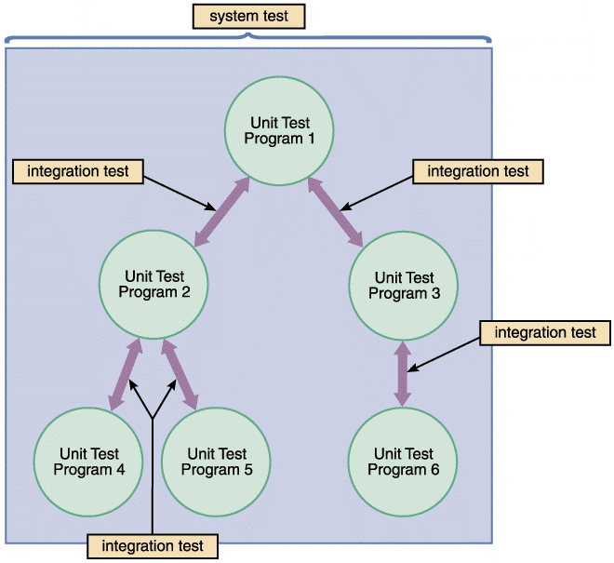
Testing The System (Cont. 1)
Unit testing
Testing of an individual program or module
Aims to identify and eliminate:
Execution errors
Logic errors
Test data should contain both accurate and erroneous data
FIGURE 11-20 The first step in testing is unit testing, followed by integration testing, and then system testing.

Slide 22
Testing The System (Cont. 2)
Stub testing is required
The programmer:
Simulates each program outcome or result
Displays a message to indicate whether the program has executed successfully
A test plan is created during the systems design phase
Contains details regarding testing procedures
Integration Testing
Testing two or more programs that depend on each other to make sure that the programs work together properly

Slide 23
Testing The System (Cont. 3)
System Testing (Acceptance Tests)
Objectives
Perform a final test of all programs
Verify that the system will handle all data properly
Ensure that the IT staff has the documentation and instructions needed to operate the system properly
Demonstrate that users can interact with the system successfully
Verify that all system components are integrated properly
Confirm that the information system can handle predicted volumes of data in a timely and efficient manner

Slide 24
Documentation
Program Documentation
Describes the inputs, outputs, and processing logic for all program modules
Process starts in the systems analysis phase and continues during systems implementation
Overall documentation is prepared early in the SDLC
Defect tracking software or bug tracking software
Used to document and track program defects, code changes, and patches

Slide 25
Documentation (Cont. 1)
System Documentation
Describes the system’s functions and how they are implemented
Operations Documentation
Contains the information needed for processing and distributing online and printed output
User Documentation
Consists of instructions and information for users who will interact with the system

Slide 26
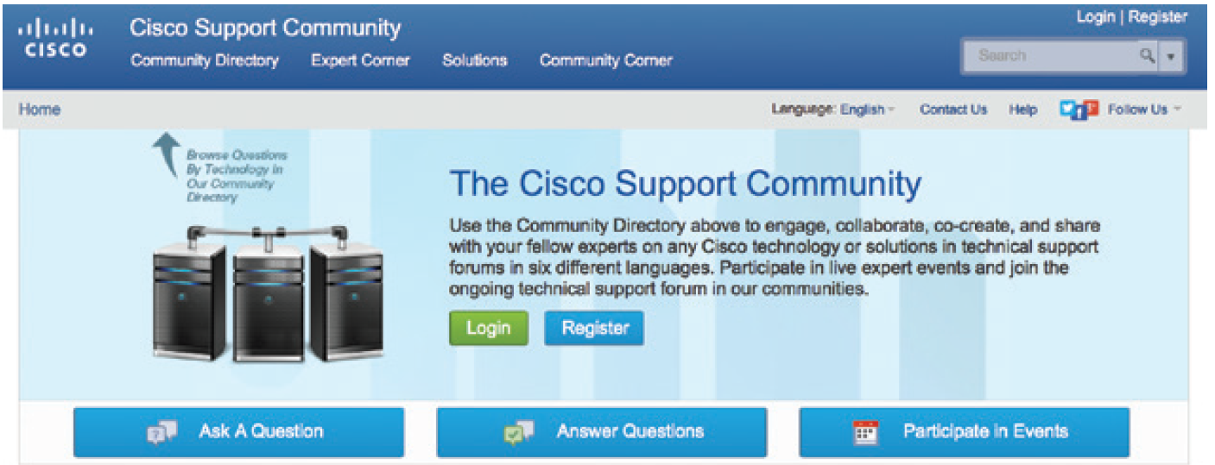
Documentation (Cont. 2)
Online Documentation
Provides immediate help when users have questions or encounter problems
FIGURE 11-23 The Cisco Support Community invites users to contribute valuable experience and documentation using social media.
Source: Cisco Support Community

Slide 27
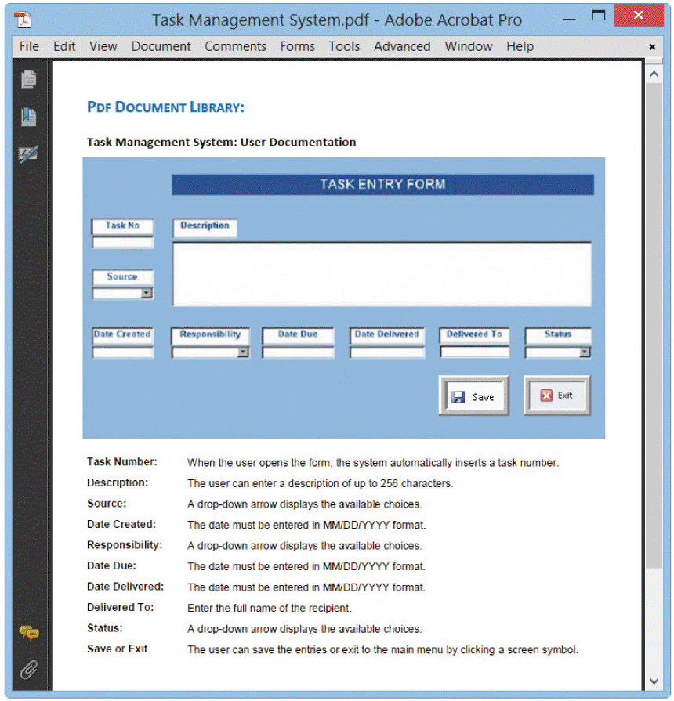
Documentation (Cont. 3)
FIGURE 11-24 A sample page from a user manual. The instructions explain how to add a new task to the system.

Slide 28
System Installation and Evaluation
Prepare a separate operational and test environment
Provide training for users, managers, and IT staff
Perform data conversion and system changeover
Carry out a post-implementation evaluation of the system
Present a final report to management

Slide 29
Operational and Test Environments
Operational or production environment
Environment for the actual system operation
Test environment
Environment that analysts and programmers use to develop and maintain programs
A separate test environment is necessary to maintain system security and integrity and protect the operational environment

Slide 30
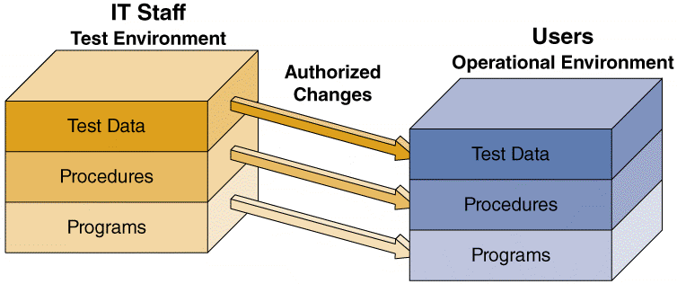
Operational and Test Environments (Cont.)
FIGURE 11-25 The test environment versus the operational environment. Notice that access to the test environment is limited to IT staff, while the operational environment is
restricted to users.

Slide 31
Training
Training Plan
Identify who should receive training and what training is required
Organization should be observed carefully to determine how the system will support business operations, and who will be involved or affected
Main groups for training
Users
Managers
IT staff

Slide 32
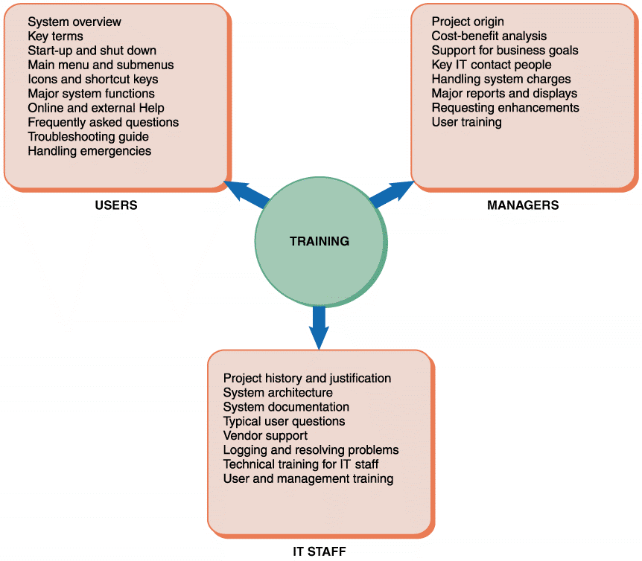
Training (Cont. 1)
FIGURE 11-26 Examples of training topics for three different groups. Users, managers, and IT staff members have different training needs.

Slide 33
Training (Cont. 2)
Vendor Training
Required if the system includes the purchase of hardware or software
Scope is limited to a standard version of the vendor’s software or hardware
Webinars, Podcasts, and Tutorials
Web-based training options
Outside Training
Viable alternative if vendor training is not practical
Figure 11-27 Udemy is one of many sources of online training.
Source: Udemy.com

Slide 34
Training (Cont. 3)
Training Tips
Train people in groups, with separate training programs for distinct groups
Select the most effective place to conduct the training
Provide for learning by hearing, seeing, and doing
Rely on previous trainees
Interactive Training
Effective training is interactive, self-paced, and multimedia-based

Slide 35
Training (Cont. 4)
Online training
Effective when it is more realistic
Sophisticated training systems offer interactive sessions
Training material should include a reference section that summarizes all options and commands, lists all possible error messages, and what actions the user should take when a problem arises
A full-scale test, or simulation must be conducted after the training is complete

Slide 36
Training (Cont. 5)
FIGURE 11-29 A sample lesson on Android app development in an online tutorial from lynda.com.
Source: lynda.com, Inc.

Slide 37
Data Conversion
Process in which existing data is loaded on to a new system
Data Conversion Strategies
Automate the data conversion process if possible
Old systems may be able to export data in ASCII or ODBC (Open Database Connectivity) formats
ODBC drivers are a form of middleware
If a standard format is not available, develop a program to extract the data and convert it to an acceptable format

Slide 38
Data Conversion (Cont.)
Data Conversion Security and Controls
Maintain strict input controls during the conversion process
Ensure that all system control measures are in place and operational to protect data from unauthorized access and to help prevent erroneous input
Ensure that error-free data is fed into the new system

Slide 39
System Changeover
Process of putting the new information system online and retiring the old system
Can be rapid or slow, depending on the method
Types
Direct cutover
Parallel operation
Pilot operation
Phased operation

Slide 40
System Changeover (Cont. 1)
Direct Cutover
Enables changeover when the new system becomes operational
Least expensive changeover method
IT group has to operate and maintain only one system at a time
FIGURE 11-30 The four system changeover methods.

Slide 41
System Changeover (Cont. 2)
Parallel Operation
Both the old and the new information systems operate fully for a specified period
Advantage - Lower level of risk
The old system can be used as a backup
Not practical if the old and new systems are incompatible
FIGURE 11-30 The four system changeover methods.

Slide 42
System Changeover (Cont. 3)
Pilot Operation
Implements the complete new system at a selected location of the company
Pilot site: Group that uses the new system first
Reduces the risk of system failure
Less expensive than a parallel operation
FIGURE 11-30 The four system changeover methods.

Slide 43
System Changeover (Cont. 4)
Phased Operation
Implements the new system in stages, or modules
Combines direct cutover and parallel operation to reduce risks and costs
Only a part of the system is given to all users
Risk of errors or failures is limited to the implemented module only
Less expensive than full parallel operation
FIGURE 11-30 The four system changeover methods.

Slide 44
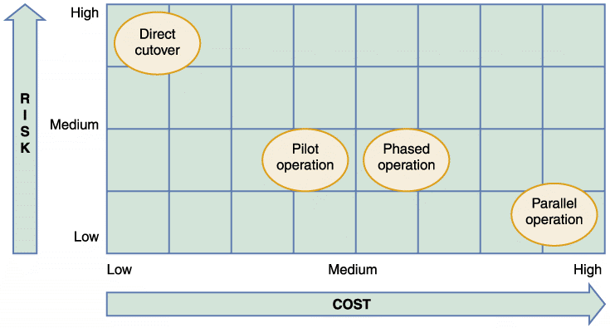
System Changeover (Cont. 5)
FIGURE 11-31 Relative risk and cost characteristics of the four changeover methods.

Slide 45
Chapter Summary
Systems implementation phase consists of application development, testing, installation, and evaluation of the new system
Each systems development approach has its own set of tools
System developers can use more generic tools to help them translate the system logic into properly functioning program modules

Slide 46
Chapter Summary (Cont. 1)
In agile development, the customer creates user stories describing required features and priority levels
Cohesion measures a module’s scope and processing characteristics
Coupling measures relationships and interdependence among modules
There are four steps used to create a structure chart

Slide 47
Chapter Summary (Cont. 2)
Programmers perform desk checking, code review, and unit testing tasks during application development
In addition to system documentation, analysts and technical writers also prepare operations documentation and user documentation
During the installation process, an operational environment for the new information system is established separate from the test environment

Slide 48
Chapter Summary (Cont. 3)
Everyone who interacts with the new information system should receive training appropriate to their skills
Data conversion often is necessary when installing a new information system
System changeover is the process of putting the new system into operation

Slide 49
Chapter Summary (Cont. 4)
A post-implementation evaluation assesses and reports on the quality of the new system and the work done by the project team
The final report to management includes the final system documentation, describes any future system enhancements that already have been identified, and details the project costs

