Slide 1
Chapter 11
Dealing with Field Work
Copyright © 2014 Pearson Education, Inc.
1

Slide 2
Learning Objectives
To learn about total error and how nonsampling error is related to it
To understand the sources of data collection errors and how to minimize them
To learn about the various types of nonresponse error and how to calculate response rate to measure nonresponse error
To become acquainted with data quality errors and how to handle them

Slide 3
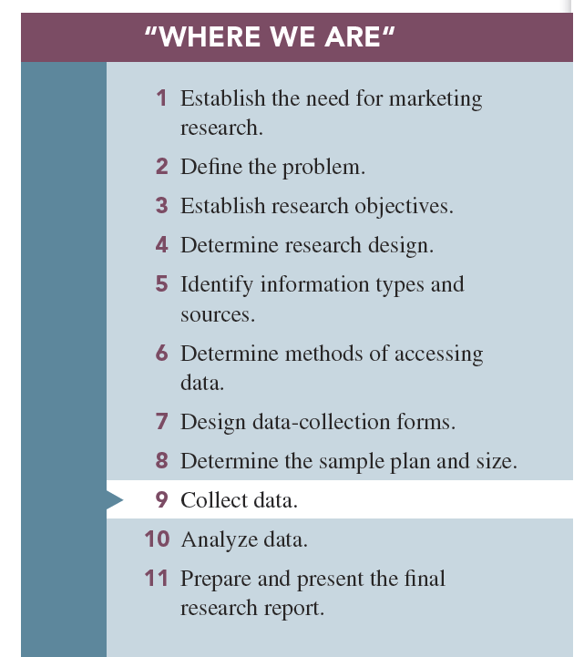

Slide 4
Dealing with Field Work
There are two main types of errors in survey research:
Sampling error
Nonsampling error
Nonsampling error includes all errors in a survey except those due to the sampling plan or sample size.

Slide 5
Nonsampling Error
Nonsampling error includes:
All types of nonresponse error
Data gathering errors
Data handling errors
Data analysis errors
Interpretation errors

Slide 6
Data Collection
Data collection is the phase of the marketing research process during which respondents provide their answers or information to inquiries posed to them by the researcher.

Slide 7
Possible Errors in Field Data Collection
Fieldworker error: errors committed by the persons who administer the questionnaires
Respondent error: errors committed on the part of the respondent
Errors may be either intentional or unintentional.

Slide 8
Intentional Fieldworker Errors
Intentional fieldworker error: errors committed when a data collection person willfully violates the data collection requirements set forth by the researcher

Slide 9
Intentional Fieldworker Errors
Interviewer cheating occurs when the interviewer intentionally misrepresents respondents.
Leading respondents occurs when the interviewer influences respondent’s answers through wording, voice inflection, or body language.

Slide 10
Unintentional Fieldworker Error
Unintentional fieldworker error: errors committed when an interviewer believes he or she is performing correctly

Slide 11
Unintentional Fieldworker Error
Interviewer personal characteristics occurs because of the interviewer’s personal characteristics such as accent, sex, and demeanor.
Interviewer misunderstanding occurs when the interviewer believes he or she knows how to administer a survey but instead does it incorrectly.
Fatigue-related mistakes occur when the interviewer becomes tired.

Slide 12
Intentional Respondent Error
Intentional respondent error: errors committed when there are respondents who willfully misrepresent themselves in surveys

Slide 13
Intentional Respondent Error
Falsehoods occur when respondents fail to tell the truth in surveys.
Nonresponse occurs when the prospective respondent fails to take part in a survey or to answer specific questions on the survey.

Slide 14
Unintentional Respondent Error
Unintentional respondent error: errors committed when a respondent gives a response that is not valid but that he or she believes is the truth

Slide 15
Unintentional Respondent Error
Respondent misunderstanding occurs when a respondent gives an answer without comprehending the question and/or the accompanying instructions.
Guessing occurs when a respondent gives an answer when he or she is uncertain of its accuracy.

Slide 16
Unintentional Respondent Error
Attention loss occurs when a respondent’s interest in the survey wanes.
Distractions (such as interruptions) may occur while questionnaire administration takes place.
Fatigue occurs when a respondent becomes tired of participating in a survey.

Slide 17
How to Control Data Collection Errors: Fieldworkers
Table 11.2 How to Control Data-Collection Errors
Notes:
NOT INCLUDED IN CHAPTER

Slide 18
How to Control Data Collection Errors: Fieldworkers
Table 11.2, cont. How to Control Data-Collection Errors

Slide 19
Field Data Collection Quality Controls
Control of intentional fieldworker error
Supervision uses administrators to oversee the work of field data collection workers.
Validation verifies that the interviewer did the work.

Slide 20
Field Data Collection Quality Controls
Control of unintentional fieldworker error
Orientation sessions are meetings in which the supervisor introduces the survey and questionnaire administration.
Role-playing sessions are dry runs or dress rehearsals of the questionnaire with the supervisor or some other interviewer playing the respondent’s role.

Slide 21
Field Data Collection Quality Controls
Control of intentional respondent error
Anonymity occurs when the respondent is assured that his or her name will not be associated with his or her answers.
Confidentiality occurs when the respondent is given assurances that his or her answers will remain private. Both assurances are believed to be helpful in forestalling falsehoods.

Slide 22
Field Data Collection Quality Controls
Control of intentional respondent error
One tactic for reducing falsehoods and nonresponse error is the use of incentives, which are cash payments, gifts, or something of value promised to respondents in return for their participation.

Slide 23
Field Data Collection Quality Controls
Control of intentional respondent error
Another approach for reducing falsehoods is the use of validation checks, in which information provided by a respondent is confirmed during the interview.
A third-person technique can be used in a question, in which instead of directly quizzing the respondent, the question is couched in terms of a third person who is similar to the respondent.

Slide 24
Control of Unintentional Respondent Error
Well-drafted questionnaire instructions and examples are commonly used as a way of avoiding respondent confusion.

Slide 25
Control of Unintentional Respondent Error
The researcher can switch the positions of a few items on a scale, called reversals of scale end- points, instead of putting all of the negative adjectives on one side and all the positive ones on the other side.
Prompters are used to keep respondents on task and alert.

Slide 26
Data Collection Errors with Online Surveys
Multiple submissions by the same respondent
Bogus respondents and/or responses
Misrepresentation of the population

Slide 27
Nonresponse Error
Nonresponse: failure on the part of a prospective respondent to take part in a survey or to answer specific questions on the survey

Slide 28
Nonresponse Error
Refusals to participate in survey
Break-offs during the interview
Refusals to answer certain questions (item omissions)

Slide 29
Refusals to Participate
A refusal occurs when a potential respondent declines to take part in the survey. Refusal rates differ by area of the country as well as by demographics.

Slide 30
Break-Offs During the Interview
A break-off occurs when a respondent reaches a certain point and then decides not to answer any more questions in the survey.

Slide 31
Refusals to Answer Specific Questions
Item omission is the phrase sometimes used to identify the percentage of the sample that did not answer a particular question.

Slide 33
What Is a Completed Interview?
The marketing researcher must define what is a “completed” interview.
A completed interview is often defined as one in which all the primary questions have been answered.

Slide 34
Measuring Nonresponse Error
The marketing research industry has an accepted way to calculate a survey’s response rate.

Slide 35
Nonresponse Error
CASRO response rate formula:

Slide 36
Nonresponse Error
CASRO response rate formula:

Slide 37
Dataset, Coding Data, and the Data Code Book
A dataset is an arrangement of numbers (mainly) in rows and columns.
The dataset is created by an operation called data coding, defined as the identification of code values that are associated with the possible responses for each question on the questionnaire.

Slide 38
Dataset, Coding Data, and the Data Code Book
In large-scale projects, and especially in cases in which the data entry is performed by a subcontractor, researchers use a data code book which identifies the following:
The questions on the questionnaire
The variable name or label that is associated with each question or question part
The code numbers associated with each possible response to each question

Slide 39
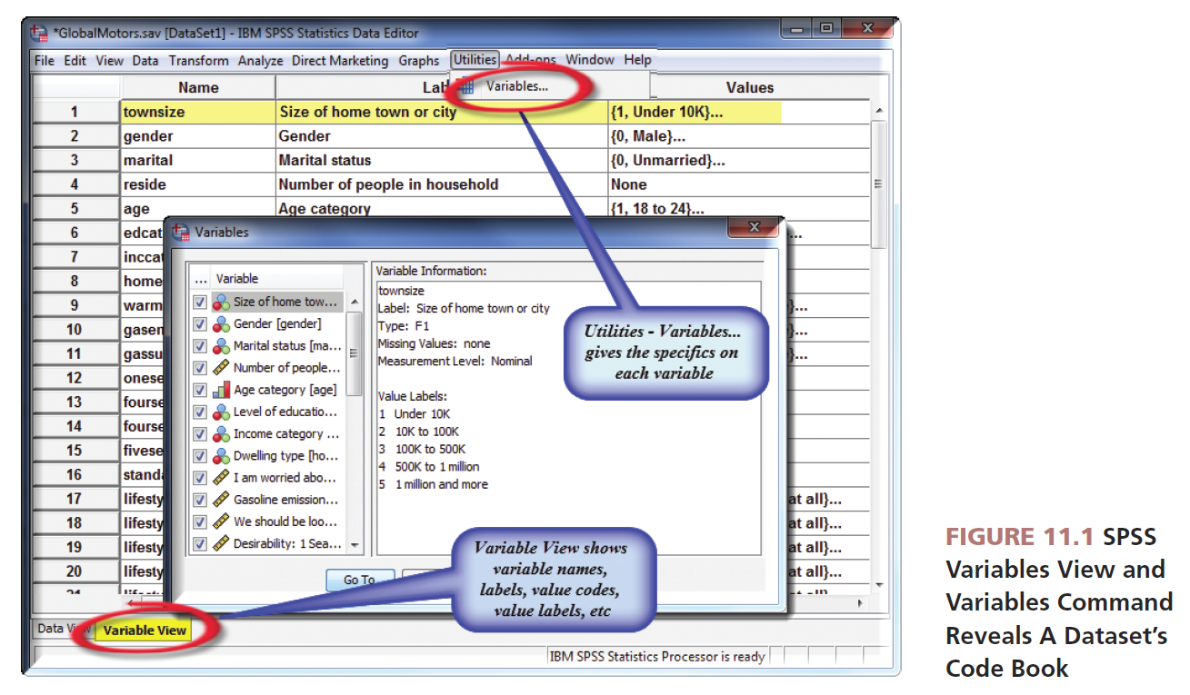

Slide 40
Data Quality Issues
What to look for in raw data inspection:
Incomplete response: an incomplete response is a break-off where the respondent stops answering in the middle of the questionnaire.
Nonresponses to specific questions (item omissions)

Slide 41
Data Quality Issues
What to look for in raw data inspection:
Yea-saying or nay-saying:
A yea-saying pattern may be evident in the form of all “yes” or “strongly agree” answers.
The negative counterpart to the yea-saying is nay-saying, identifiable as persistent responses in the negative, or all “1” codes.
Middle-of-the-road patterns: the middle-of-the-road pattern is seen as a preponderance of “no opinion” responses or “3” codes.

Slide 43
All rights reserved. No part of this publication may be reproduced, stored in a retrieval system, or transmitted, in any form or by any means, electronic, mechanical, photocopying, recording, or otherwise, without the prior written permission of the publisher. Printed in the United States of America.

