Slide 1
E-Marketing/7E Chapter 11
The Internet for Distribution

Slide 2
Chapter 11 Objectives
After reading Chapter 11, you will be able to:
Describe the three major functions of a distribution channel.
Explain how the internet is affecting distribution channel length.
Discuss trends in supply chain management and power relationships among channel players.
Outline the major models used by online channel members.
Distinguish among e-commerce, m-commerce, social commerce, and F-commerce.
Highlight how companies can use distribution channel metrics.

Slide 3
The Zappos Story
Zappos is the world’s largest online shoe store.
Sales over $1 billion in 2009.
Part of amazon.com since November 2009.
Operates as a wholly owned subsidiary in Henderson, NV.
Success factors include a culture of outstanding customer service.
Other success factors: great search engine marketing, strong word of mouth, astute competitiveness, and repeat customers.

Slide 4
Distribution Channel Overview
A distribution channel is a group of interdependent firms that transfer product and information from the supplier to the consumer.
Producers
Intermediaries
Buyers
The structure of the channel can make or impede opportunities for marketing on the internet.

Slide 5
Online Channel Intermediaries
Wholesalers buy products from the manufacturer and resell them to retailers.
Retailers buy products from manufacturers or wholesalers and sell to consumers.
Brokers facilitate transactions between buyers and sellers.
Agents may represent either the buyer or seller.
Manufacturer’s agents represent the seller.
Purchasing agents represent the buyer.

Slide 6
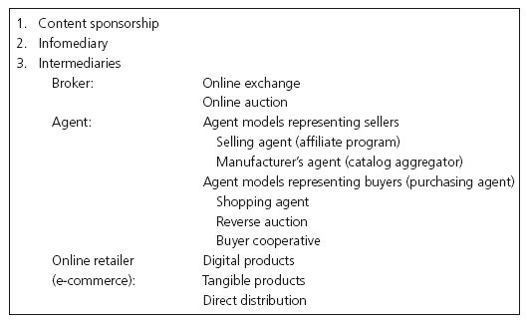
E-Business Models

Slide 7
Content Sponsorship
In this model firms create Web sites, attract traffic, and sell advertising.
All the major portals, Google, Yahoo!, and MSN, utilize this model.
Online magazines, newspapers, Pandora Radio, and Craigslist use the content sponsorship model.
Content sponsorship is often used in combination with other models to generate multiple revenue streams.

Slide 8
Infomediary
An infomediary is an online organization that aggregates and distributes information.
Market research firms and product review sites are examples of infomediaries.
Some infomediaries compensate consumers for sharing demographic and psychographic information and receiving ads targeted to their interests.

Slide 9
Intermediary Models
Three intermediary models are in common use on the internet.
Brokerage models.
Online exchange
Online auction
Agent models for sellers and buyers.
Online retailing.

Slide 10
Brokerage Models
The broker creates a market in which buyers and sellers negotiate and complete transactions.
Online Exchanges, E*Trade, Schwab and Ameritrade, allow customers to place trades online without a broker.
Autobytel.com is a vehicle exchange and alibaba.com is a global marketplace.
The B2B market has also spawned brokerages.
Converge is the leading anonymous exchange for global electronics.
Guru.com is an exchange for professional talent.
Online auctions are available in the B2B (uBid), B2C (priceline), and C2C (ebay) markets.

Slide 11
Agent Models
May represent sellers or buyers, depending on who pays their fee.
Agent models that represent sellers include:
Selling agents, such as affiliate programs.
Manufacturer’s agents represent more than one seller.
Metamediaries: Edmunds.com and TheKnot.com.
Virtual malls: Yahoo! Shopping, Amazon.

Slide 12
Affiliate Programs
Affiliate.com
2. Consumer clicks
and buys at seller
Seller.com
Buy now!
Books
Electronics
Music
Buy now!
Books
Electronics
Music
Great products
3. Seller pays affiliate
About us
Contact
About us
Contact
1. Consumer shops

Slide 13
Agent Models, cont.
Agent models that represent buyers include:
Shopping agents
BizRate, PriceScan, and CNET Shopper.
Reverse auctions
Priceline was the first major player in reverse auctions.
Buyer Cooperatives (buyer aggregators) pool many buyers together to drive down prices.
Groupon and LivingSocial.

Slide 14
Online Retailing: E-Commerce
In the e-commerce model, merchants, such as Zappos, set up storefronts online and sell to businesses and consumers.
Online companies can sell a wider and deeper assortment of products in smaller quantities than offline stores because they are not bound by space constraints.
The “long tail” refers to the ability to increase revenue by selling small quantities of large numbers of products profitably online.

Slide 15
What Do U.S. Consumers Buy Online?

Slide 16
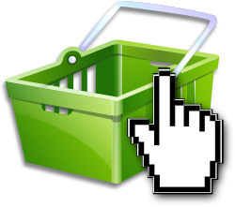
Shopping Cart Abandonment
Why?
65% - 75% average
shopping cart abandonment¹
High shipping prices (44% - 72%) ¹
Comparison shopping (61%)
Product prices too high (25% - 43%)
Site requires a lot of personal information (35%)
Site requires registration first (34%)
Complex/confusing checkout process (11% - 27%)
Not ready to purchase (41% -56%)
Slow Web site/long process (11%/41%)
2.2 average conversion rate²

Slide 17
M-Commerce
Mobile commerce occurs when consumers make a transaction with a smartphone or other mobile device.
M-commerce is a subset of e-commerce.
77% of U.S. population has a mobile phone; half are smartphones that enable m-commerce.
M-commerce was projected to reach $11.6 billion in 2012, 5.9% of all e-commerce sales.

Slide 18
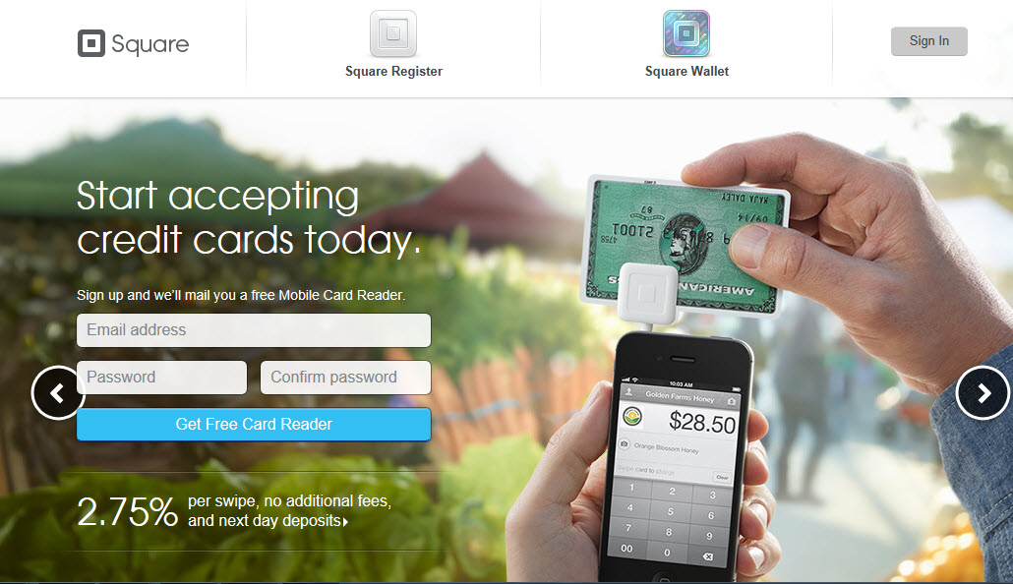
Square Card Facilitates M-Commerce

Slide 19
Social Commerce
Social commerce uses social media and consumer interactions to facilitate online sales.
Product rating, recommendation and review sites allow for the sharing aspect critical to social commerce.
18-23% of Pinterest users also visited online retailers.
Social sign-in
Over half of social media users prefer to use Facebook to sign into a Web site.

Slide 20
Distribution Channel Length and Functions
Channel length refers to the number of intermediaries between the supplier and the consumer.
Direct distribution channels have no intermediaries.
Indirect distribution channels have one or more intermediaries.
Eliminating intermediaries can potentially reduce costs.
Disintermediation describes the process of eliminating traditional intermediaries.

Slide 21
Functions of a Distribution Channel
Channel functions can be characterized as follows:
Transactional
Logistical
Facilitating

Slide 22
Transactional Functions
Transactional Functions include:
Making contact with buyers.
Marketing communication strategies.
Matching products to buyer’s needs.
Negotiating price.
Processing transactions.

Slide 23
Logistical Functions
Logistical functions include physical distribution activities, such as:
Transportation
Inventory storage
Aggregation of products
Logistical functions are often outsourced to third-party specialists such as UPS or FedEx.
Radio frequency identification (RFID) tags are used to transmit a signal to scanners.
Third-party logistics providers such as UPS or FedEx can provide value-added services.

Slide 24
The Last Mile Problem
25% of deliveries require multiple delivery attempts.
30% of packages are left on doorsteps, with possibilities for theft.
Innovative firms are introducing solutions.
Smart box.
Retail aggregator model: delivery at convenience stores or service stations.
E-stops, storefronts for customer package pickups.
Order online for offline retail delivery.

Slide 25
Market Research
Market research is a major function of the distribution channel.
There are costs and benefits of internet-based market research.
Some information is free.
Employees can conduct research from their desks.
Internet-based information tends to be timelier.
Web-based information is in digital form.
E-marketers can receive detailed reports.

Slide 26
Financing
Intermediaries want to make it easy for customers to pay in order to close the sale.
Credit card companies have formed Secure Electronic Transaction (SET).
Legitimizes merchants and consumers.
Protects consumers’ credit card numbers.
U.S. customers have a maximum $50 liability for purchases made with a stolen card.

Slide 27
Distribution System
There are 3 ways to define the scope of the channel as a system.
Distribution functions that are downstream from the manufacturer to the consumer.
The supply chain, upstream from the manufacturer, working backward to raw materials.
Consider the supply chain, manufacturer, and distribution channel as an integrated system called the value chain or integrated logistics.

Slide 28
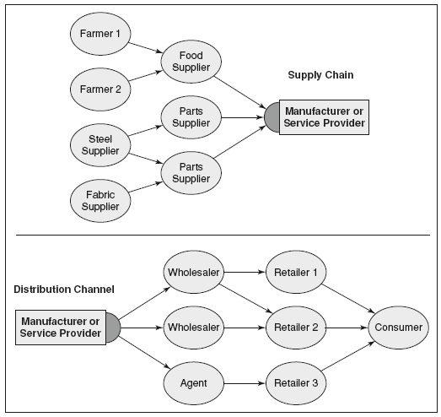
New Definition of Supply chain

Slide 29
Supply Chain Management
Supply chain management (SCM) refers to the coordination of the flow of material, information, and finance.
Key functions of supply chain management are continuous replenishment and build to order to help eliminate inventory.
Supply chain participants use enterprise resource planning (ERP) systems to manage inventory and processes.

Slide 30
Channel Management and Power
Channel management requires coordination, communication, and control to avoid conflict among channel members.
Electronic data interchange (EDI) is effective for establishing structural relationships among businesses.
The goal is to create an internet-based, open system so that suppliers and buyers can seamlessly integrate their systems.

Slide 31
Distribution Channel Metrics: B2C Market
U.S. consumers spent $194.3 billion online during 2011, only 4.6% of all retail sales.
Besides revenue, B2C performance metrics may include:
ROI.
Customer satisfaction levels.
Customer acquisition costs.
Conversion rates.
Average order values.

Slide 32
Distribution Channel Metrics: B2B Market
It is impossible to measure B2B revenue because it happens behind company walls.
B2B metrics may include:
Time from order to delivery.
Order fill levels.
Other activities that reflect functions performed by channel participants.

Slide 33
All rights reserved. No part of this publication may be reproduced, stored in a retrieval system, or transmitted, in any form or by any means, electronic, mechanical, photocopying, recording, or otherwise, without the prior written permission of the publisher. Printed in the United States of America.
Copyright © 2014 Pearson Education, Inc.
Publishing as Prentice Hall

