Slide 1
Developing and Maintaining Long-Term Customer Relationships

Slide 2
Introduction
All of the activities involved in developing and implementing the marketing program have one key purpose: to develop and maintain long-term customer relationships.
Implementing a marketing strategy that can effectively satisfy customers' needs and wants has proven difficult in today's rapidly changing business environment.
In times past, developing and implementing the "right" marketing strategy was all about creating a large number of transactions with customers in order to maximize the firm's market share.
In today's economy, the emphasis has shifted to developing strategies that attract and retain customers over the long term.

Slide 3
Managing Customer Relationships
Customer relationship management is defined as a business philosophy aimed at defining and increasing customer value in ways that motivate customers to remain loyal. In essence, CRM is about retaining the right customers.
CRM involves a number of different groups, including:
1- customers
2-employees
3-supply chain partners
4-external stakeholders.

Slide 4
1-Customers They are the end users of a product, whether they are businesses or individual consumers.
2-Employees Firms must manage relationships with their employees if they are to have any hope of fully serving customers’ needs. This is especially true in service firms where employees are the service in the eyes of customers. Retaining key employees is a vital part of CRM.
3- Supply Chain Partners Virtually all firms buy and sell products upstream and/or downstream in the supply chain. This involves the procurement of materials from,or the sale of finished products to, other firms. Either way, maintaining relationships with key supply chain partners is critical to satisfying customers.
4-External Stakeholders Relationships with key stakeholders must also be managed effectively. These include government agencies, nonprofit organizations, or facilitating firms that provide goods or services that help a firm achieve its goals.

Slide 5
A full appreciation of CRM requires a new perspective on the customer that shifts from "acquiring customers" to "maintaining clients." [Exhibit 10.1]
Firms that are exceptionally good at developing customer relationships possess “relationship capital”—a key asset that stems from the value generated by the trust, commitment, cooperation, and interdependence among relationship partners.

Slide 6
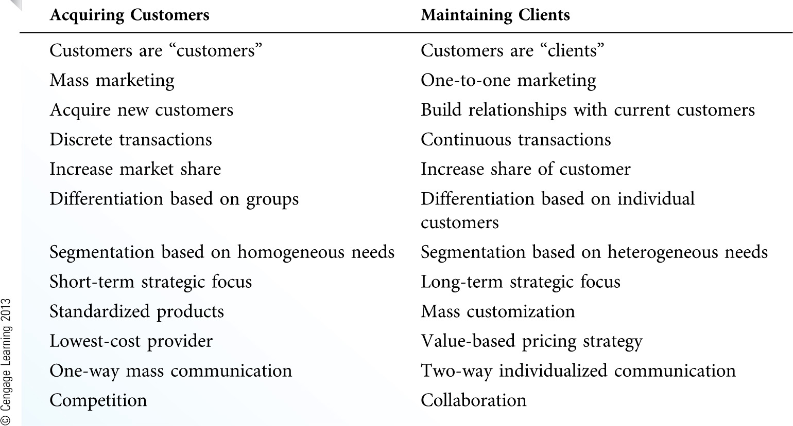
Shift from Acquiring Customers to Maintaining Clients (Exhibit 10.1)

Slide 7
Developing Relationships in Consumer Markets[Exhibit 10.2]
The objective of CRM is to move customers from having a simple awareness of the firm and its product offering, through levels of increasing relationship intensity, to the point where the customer becomes a true advocate for the firm and/or its products.
One of the most viable strategies to build customer relationships is to increase the firm’s share of customer by focusing more fully on serving the needs of current customers.

Slide 8
Focusing on share of customer requires an understanding that customers have different needs and that not all customers have equal value to a firm.
Some customers—those that require considerable handholding or that frequently return products—are simply too expensive to keep given the low level of profits they generate.
The firm’s top-tier customers are the most obvious candidates for retention strategies. [Exhibit 10.3]

Slide 9
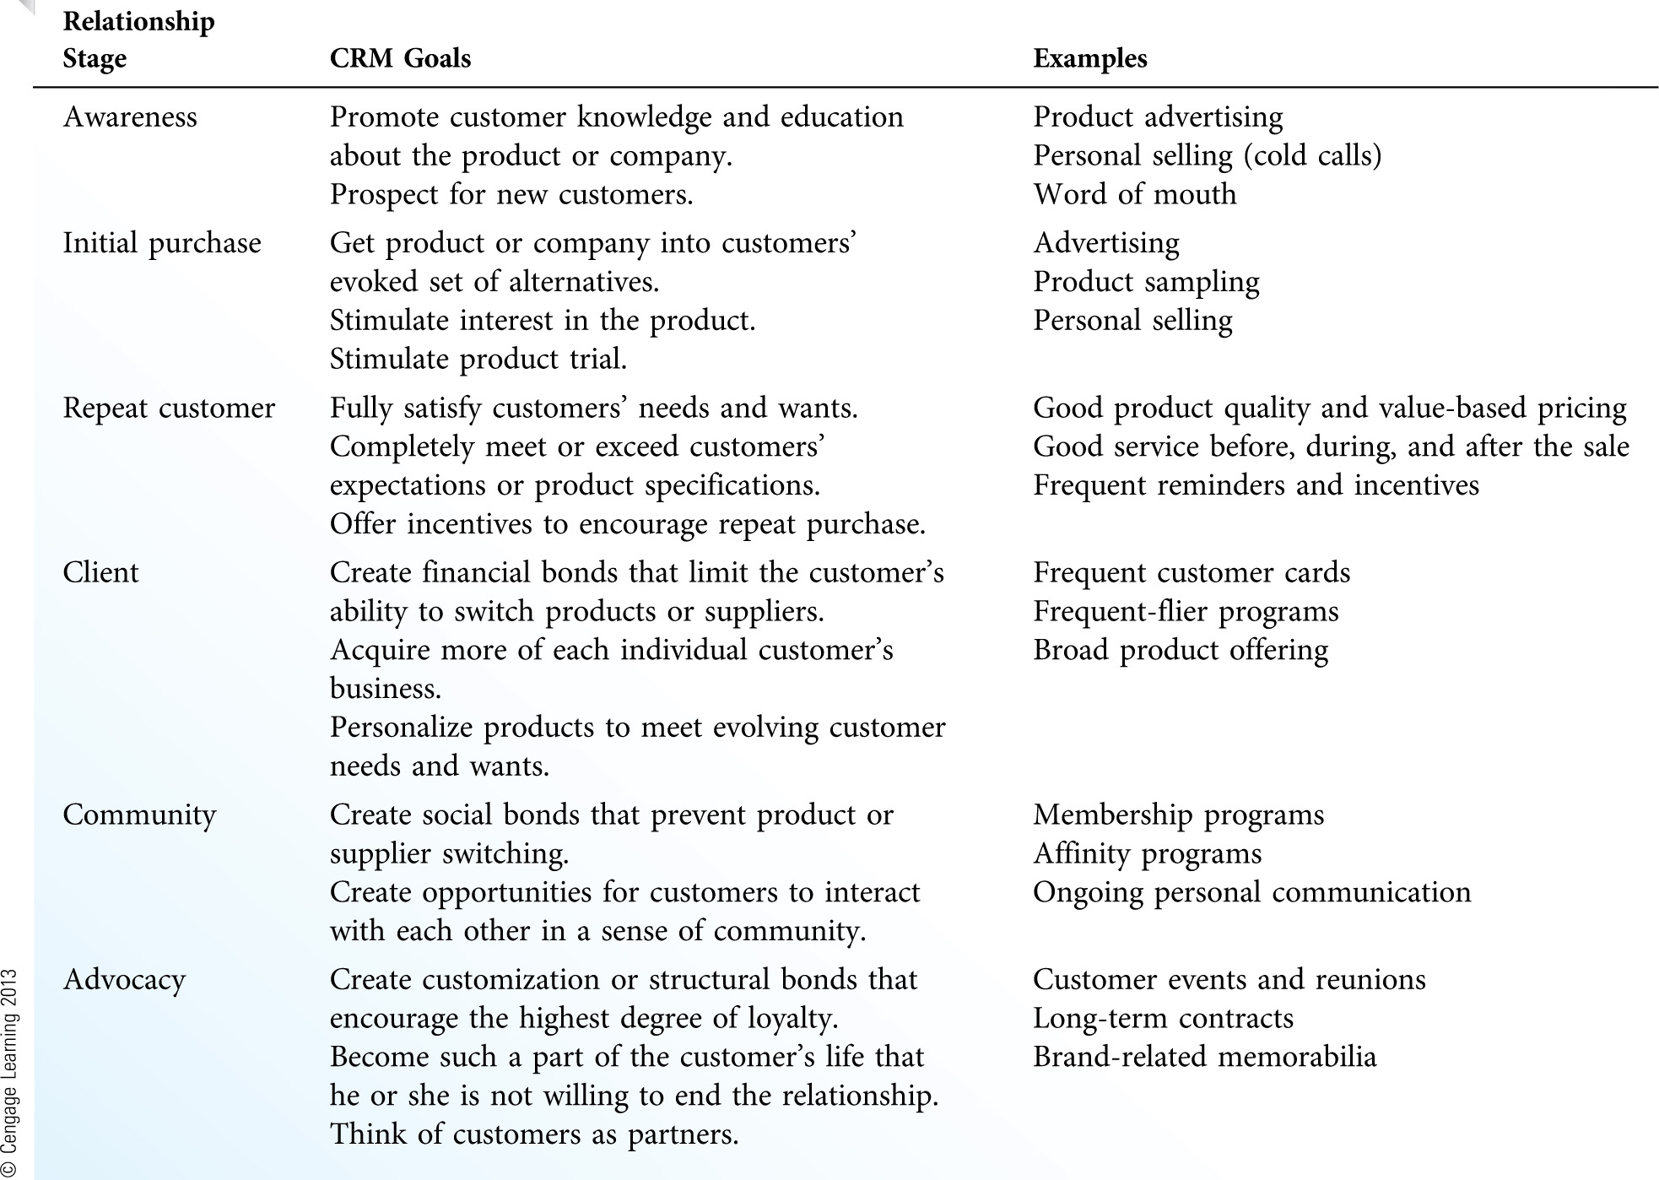
Stages of Customer Relationship Development (Exhibit 10.2)

Slide 10
EXHI B I T 12.3
STRATEGIES FOR ENHANCING AND MAINTAINING CUSTOMER RELATIONSHIPS
Increasing Relationship Intensity

Slide 11
Developing Relationships in Business Markets
Business relationships rarely approach the cult-like, emotional involvement found in some consumer markets. Nonetheless, businesses can become structurally bound to their supply chain partners.
Relationship development in business markets can be more involving, more complex, and much riskier than relationships in consumer markets.
Business relationships must be built on win-win strategies that focus on cooperation and improving the value of the exchange for both parties, not on strict negotiation where one side wins and the other side loses.

Slide 12
Over the past several years, a number of changes have occurred in business relationships:
a)a change in buyers' and sellers' roles
b)an increase in sole sourcing
c)an increase in global sourcing
d)an increase in team-based buying decisions
e)an increase in productivity through better integration

Slide 13
A number of changes have occurred in business relationships, including these:
A Change in Buyers’ and Sellers’ Roles To build stronger relationships, buyers and sellers have shifted away from competitive negotiation (trying to drive prices up or down) to focus on true collaboration.
An Increase in Sole Sourcing Supplier firms will continue to sell directly to large customers or move to selling through systems suppliers that put together a set of products from various suppliers to deliver a comprehensive solution.
An Increase in Global Sourcing More than ever, buyers and sellers scan the globe in search of suppliers or buyers that represent the best match with their specific needs and requirements.

Slide 14
An Increase in Team-Based Buying Decisions Increasingly, teams from both buying and supplying firms make purchase decisions. These teams consist of employees from different areas of expertise that are central to the success of both firms.
An Increase in Productivity Through Better Integration Firms that closely align their buying and selling operations have the capacity to identify and remove any inefficiency in the process.

Slide 15
Quality and Value: The Keys to Developing Customer Relationships
To build relationship capital, a firm must be able to fulfill the needs of its customers better than its competitors.
1.If the quality of a good or service is poor, the firm obviously has little chance of satisfying customers or maintaining relationships with them.
2.Good quality is not an automatic guarantee of success—it is a necessary but insufficient condition of customer relationship management.

Slide 16
Understanding the Role of Quality
Quality is a relative term that refers to the degree of superiority of a firm's goods or services. Quality is relative because it can only be judged in comparison to competing products, or when compared to an internal standard of excellence.

Slide 17
The total product offering of any firm consists of at least three interdependent components: [Exhibit 10.4]
a)Core product—the part of the offering that delivers the core benefits desired by customers.
1)If the core product is inferior, the firm has little chance of success because the product will not meet customer needs.
2)Customers expect the core product to be of high quality. When the core product meets this level of expected quality, the customer begins to take it for granted.
3)In service offerings, the core product is typically composed of three interrelated dimensions: people, processes, and physical evidence.

Slide 18
- People The interaction among the customer, the firm’s employees, and other customers present during service delivery.
- Processes The operational flow of activities or steps in the service delivery process.Processes can be done through technology or face-to-face interaction.
- Physical Evidence Any tangible evidence of the service, including written materials,the service facility, people, or equipment; includes the environment in which the service is delivered.

Slide 19
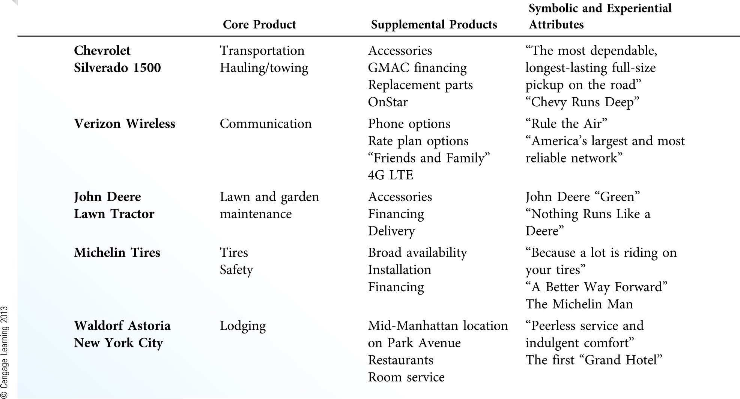
Components of the Total Product Offering (Exhibit 10.4)

Slide 20
b)Supplemental products—goods or services that add value to the core product, there by differentiating the core product from competing product offerings.
1)In many product categories, the true difference between competing products lies in the supplemental products.
2)Most companies do not market products with the core product in mind. Instead, they focus on supplemental product attributes.
c)Symbolic and experiential attributes—attributes associated with image, prestige, and brand.

Slide 21
Delivering Superior Quality
Delivering superior quality day in and day out is one of the most difficult things that any organization can do with regularity. In essence, it is difficult to get everything right all or even most of the time.
Four key issues in improving quality:
a)Understand customers' expectations
b)Translate expectations into quality standards
c)Uphold quality standards
d)Don’t overpromise

Slide 22
a)Understand customers’ expectations. It is not surprising that the basis of improving quality is also the starting point for effective customer relationship management.
b)Translate expectations into quality standards. Firms that can successfully convert customer information into quality standards ensure that they hear the voice of the customer.
c)Uphold quality standards. The best quality standards are of little use if they are not delivered accurately and consistently. At issue is the ability of managers and employees to deliver quality that is consistent with established standards
d)Don’t overpromise. It goes without saying that customers will be disappointed if an organization fails to deliver on its promises.

Slide 23
Understanding the Role of Value
Offering exceptionally high product quality is of little use to the firm or its customers if the customers cannot afford to pay for it or if the product is too difficult to obtain.
Value is critical to maintaining long-term customer relationships because it allows for a balance among the five types of utility (form, time, place, possession, psychological) and the elements of the marketing program.

Slide 24
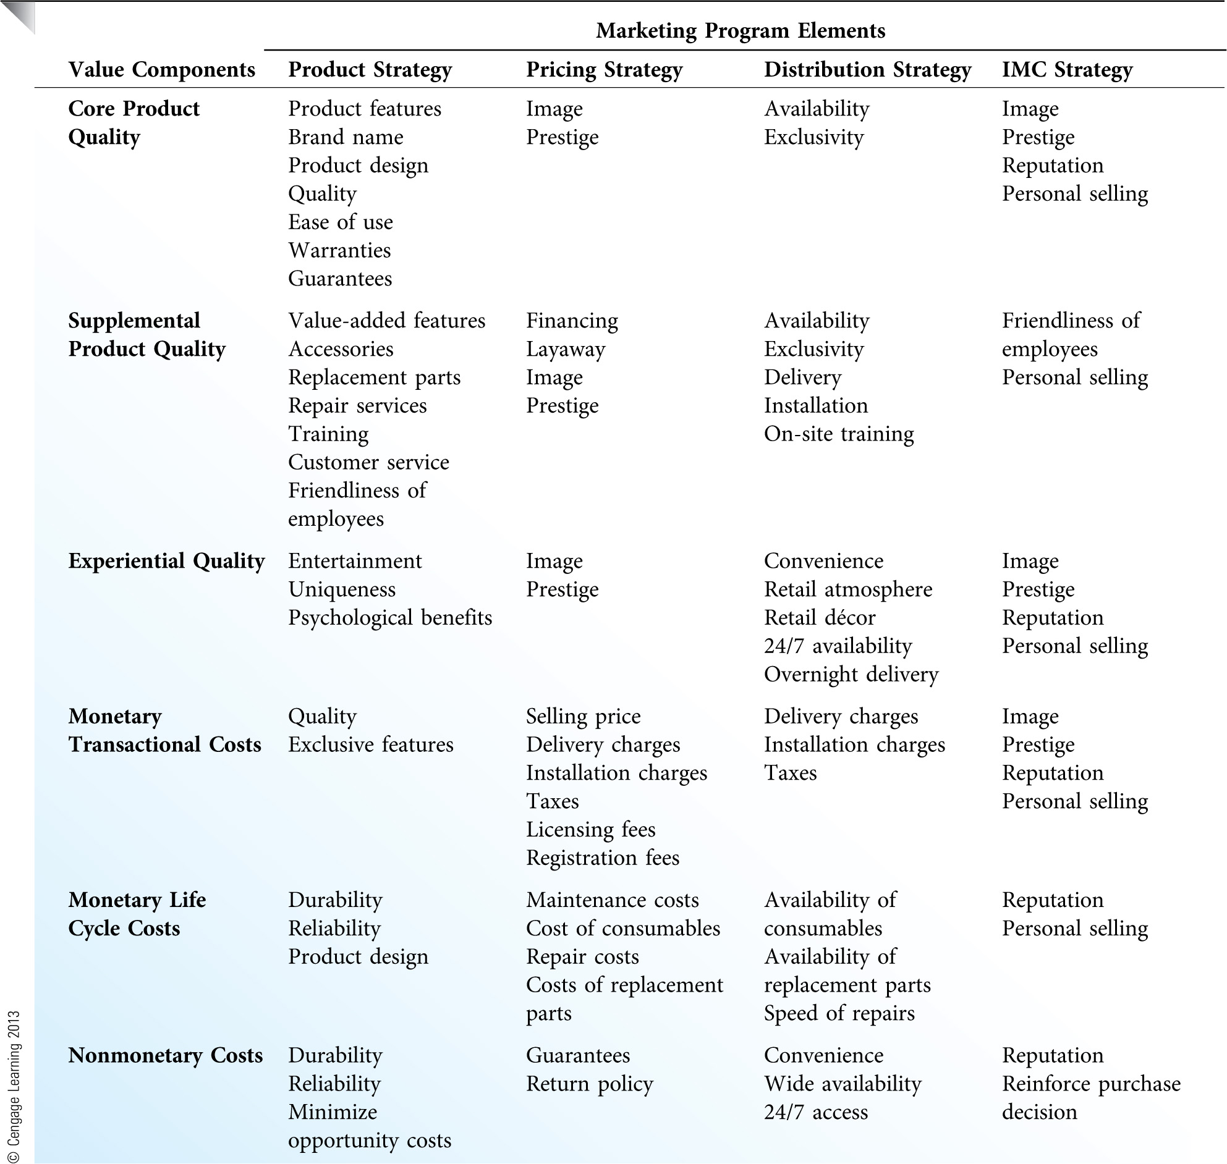
Connections Between Value and the Marketing Program (Exhibit 10.5)

Slide 25
Core Product, Supplemental Product, and Experiential Quality
Good value depends on a holistic assessment of the quality of the core product, supplemental products, and experiential attributes. Although each can be judged independently, most customers look at the collective benefits provided by the firm in their assessments of value.
Firms can create unique combinations of core, supplemental, and experiential benefits that help drive value perceptions.

Slide 26
Monetary and Nonmonetary Costs
Customer costs include anything that the customer must give up to obtain the benefits provided by the firm.
The most obvious cost is the monetary cost of the product:
1)Transactional costs include the immediate financial outlay or commitment that must be made to purchase the product.
2)Life-cycle costs include any additional costs that customers will incur over the life of the product.
Nonmonetary costs are not quite as obvious as monetary costs, and customers sometimes ignore them. These costs include time, effort, risk, and opportunity costs.

Slide 27
Competing on Value
By altering each element of the marketing program, the firm can enhance value by increasing core, supplemental, or experiential quality and/or reducing monetary or nonmonetary costs.
In consumer markets, retailers compete by altering one or more parts of the value equation.
In business markets, value is often defined in terms of product specifications, availability, and conformity to a delivery schedule, rather than in terms of price or convenience.
Each marketing program element is vital to delivering value. Strategic decisions about one element alone can change perceived value for better or worse.

Slide 28
Customer Satisfaction: The Key to Customer Retention
To maintain and manage customer satisfaction from a strategic point of view, managers must understand customer expectations and the differences between satisfaction, quality, and value.
They must also make customer satisfaction measurement a long-term, continuous commitment of the entire organization.

Slide 29
Understanding Customer Expectations
Customer satisfaction is typically defined as the degree to which a product meets or exceeds the customer’s expectations about that product.
Customers can hold many different types of expectations. [Exhibit 10.6]

Slide 30
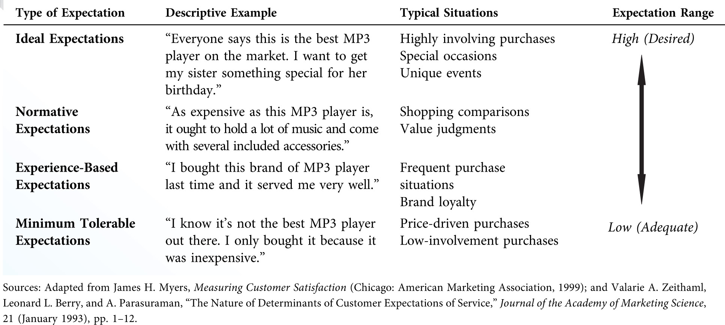
Range of Customer Expectations (Exhibit 10.6)

Slide 31
The Zone of Tolerance
The zone of tolerance is the difference between the upper (desired expectations) and lower (adequate expectations) end of the range of possible customer expectations.
The width of the zone of tolerance represents the degree to which customers recognize and are willing to accept variability in performance.
Performance can fall above the zone of tolerance, within the zone of tolerance, or below it: [Exhibit 10.7]
1)Customer delight occurs when actual performance exceeds the desired performance expectation

Slide 32
2)Customer satisfaction occurs when actual performance falls within the zone of tolerance.
3)Customer dissatisfaction occurs when actual performance falls below the adequate performance expectation.
If the zone of tolerance is narrow, the marketer will have a relatively more difficult time matching performance to customer expectations.
Customers will typically hold different expectation levels and zones of tolerance for different factors of performance.

Slide 33
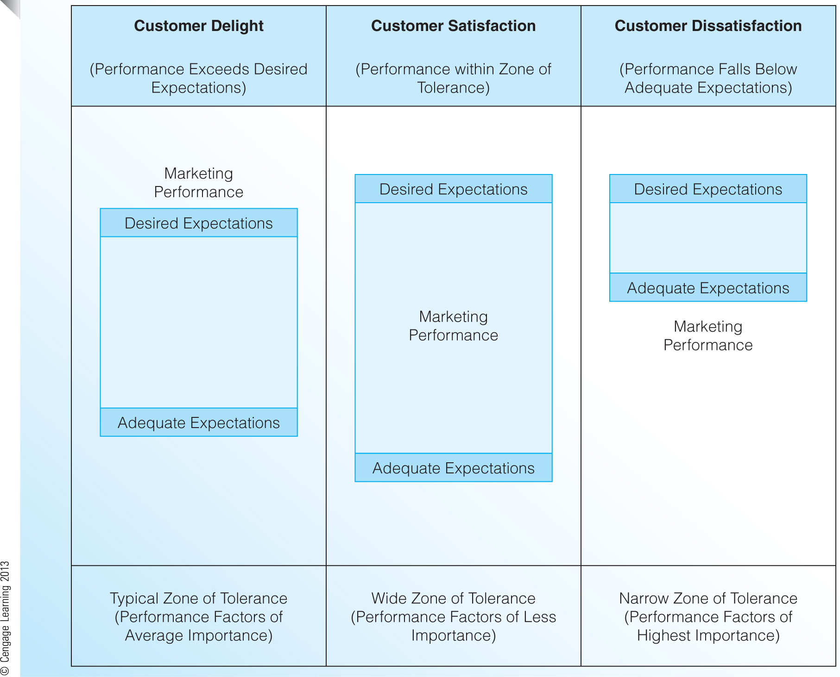
The Zone of Tolerance (Exhibit 10.7)

Slide 34
Managing Customer Expectations
As they work toward managing customer expectations, many marketers ask two key questions:
1)Why are customer expectations unrealistic?
2)Should we strive to delight our customers by consistently exceeding their desired expectations?

Slide 35
Satisfaction versus Quality versus Value
The difficulty in separating satisfaction from quality and value involves the word expectations. Customers can hold expectations about any part of the product offering, including quality, value, or both.
The most narrowly defined concept is quality, which customers judge on an attribute-by-attribute basis.
When a customer considers the broader issue of value, they include things other than quality: price, time and effort, risk, and opportunity costs.
Customers tend to think of satisfaction based on his or her expectations of the item in question.

Slide 36
Customers think of satisfaction based on the totality of their experience without overtly considering issues like quality or value:
a)Customers think of satisfaction in more abstract terms than they do quality or value.
b)This happens because customers' expectations—hence their satisfaction—can be based on any number of factors, even factors that have nothing to do with quality or value.

Slide 37
Customer Satisfaction and Customer Retention
Customer satisfaction is the key to customer retention.
How can a firm control the uncontrollable factors that affect customer satisfaction?
a)Understand what can go wrong
b)Focus on controllable issues
c)Manage customer expectations
d)Offer satisfaction guarantees [Exhibit 10.8]
e)Make it easy for customers to complain
f)Create relationship programs
g)Make customer satisfaction measurement an ongoing priority

Slide 38
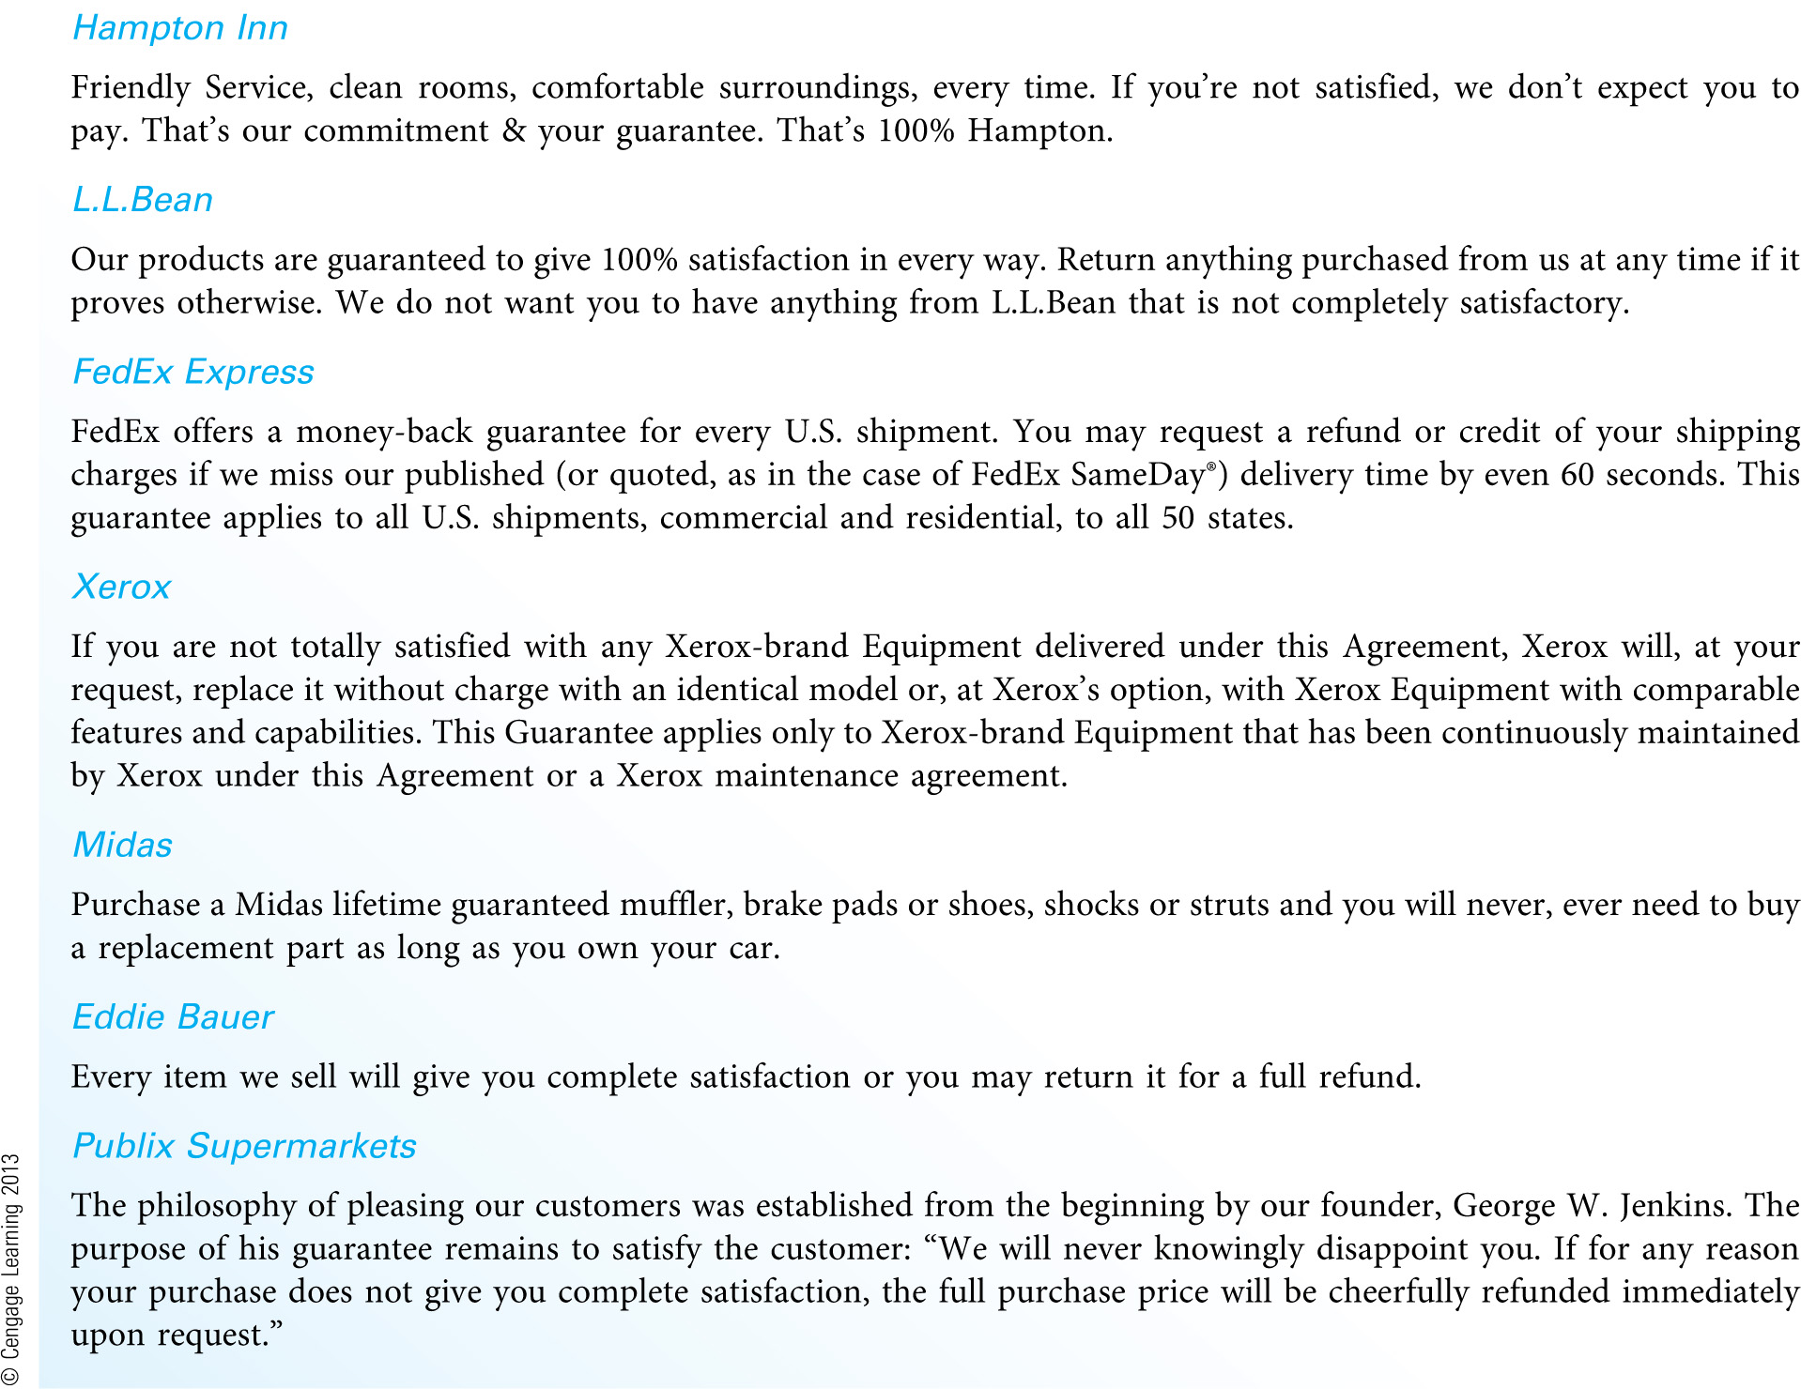
Examples of Customer Satisfaction Guarantees (Exhibit 10.8)

Slide 39
1)Understand what can go wrong. Managers, particularly those on the front line,must understand that an endless number of things can and will go wrong in meeting customers’ expectations.
2)Focus on controllable issues. The key is to keep an eye on the uncontrollable factors but focus more on things that can be controlled. Core product quality, customer service, atmosphere, experiences, pricing, convenience, distribution, and promotion must all be managed in an effort to increase share of customer and maintain loyal relationships.

Slide 40
3)Manage customer expectations. As we have seen already, managing customer expectations is more than promising only what you can deliver. To manage expectations well, the marketer must educate customers on how to be satisfied bythe firm and its products.
4)Offer satisfaction guarantees. Companies that care about customer satisfaction back up their offerings by guaranteeing customer satisfaction or product quality. Exhibit 12.8 provides several examples of customer satisfaction guarantees.
5)Make it easy for customers to complain. Over 90 percent of dissatisfied customers never complain—they just go elsewhere to meet their needs. To counter this customer defection, marketers must make it easy for customers to complain.

Slide 41
6)Create relationship programs. As we discussed earlier in the chapter, firms can use relationship strategies to increase customer loyalty. Today, loyalty or membership programs are everywhere: banks, restaurants, supermarkets, and evenbookstores.
7)Make customer satisfaction measurement an ongoing priority. If you don’t know what customers want, need, or expect, everything else is a waste of time.

Slide 42
Customer Satisfaction Measurement
The simplest method of measuring customer satisfaction involves the direct measurement of performance across various factors using simple rating scales.
To determine how satisfaction varies over time, the firm should measure expectations and performance at the same time. [Exhibit 10.9]
Based on advances in technology, many new satisfaction metrics are being used today:
a)Lifetime value of a customer (LTV)—The net present value of the revenue stream generated by a customer over a period of time.

Slide 43
b)Average order value (AOV)—A customer's purchase dollars divided by the number of orders over a period of time.
c)Customer acquisition/retention costs—It is typically less expensive to retain current customers than to acquire new customers. As long as this holds true, a company is better off keeping its current customers satisfied.
d)Customer conversion rate—The percentage of visitors or potential customers that actually buy.
e)Customer retention rate—The percentage of customers who are repeat purchasers.

Slide 44
f)Customer attrition rate—The percentage of customers who do not repurchase (sometimes called the churn rate).
g)Customer recovery rate—The percentage of customers who leave the firm (through attrition) that can be lured back using various offers or incentives.
h)Referrals—Dollars generated from customers referred to the firm by current customers.
i)Social communication—Companies can track satisfaction by monitoring customers’ online commentary in blogs, newsgroups, chat rooms, and general websites.

Slide 45
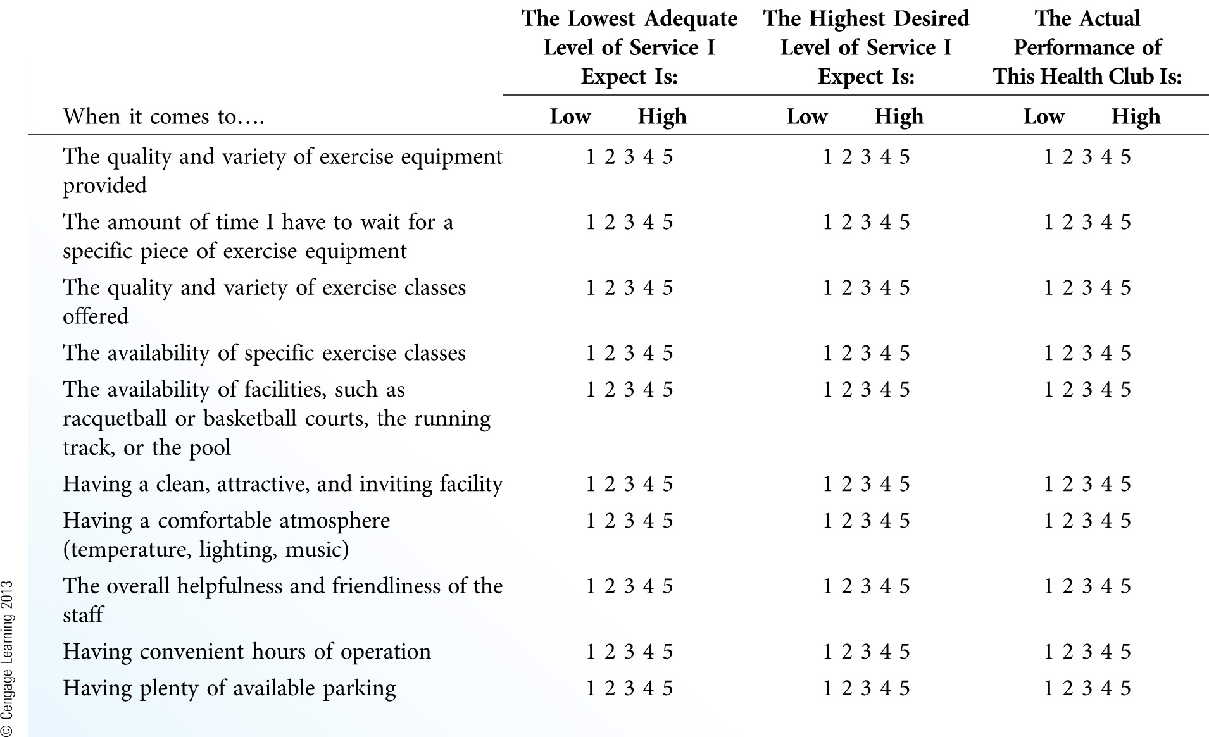
Measuring Expectations and Performance (Exhibit 10.9)

