Slide 1
Chapter 10
Determining the Size of a Sample
Copyright © 2014 Pearson Education, Inc.
1

Slide 2
Learning Objectives
To understand the eight axioms underlying sample size determination with a probability sample
To know how to compute sample size using the confidence interval approach
To become aware of practical considerations in sample size determination
To be able to describe different methods used to decide sample size, including knowing whether a particular method is flawed

Slide 3
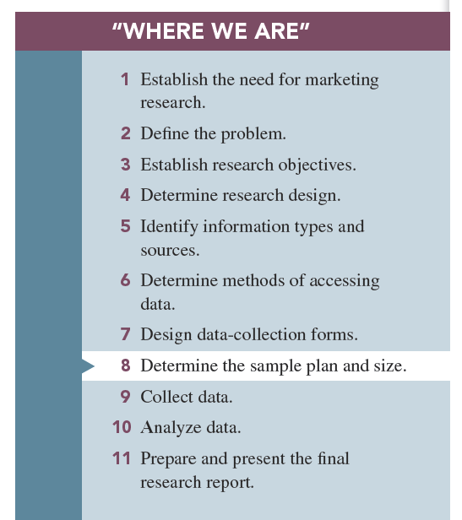

Slide 4
Key Point
Many managers falsely believe that sample size and sample representativeness are related, but they are not.

Slide 5
Key Point
A sample size decision is usually a compromise between what is theoretically perfect and what is practically feasible.

Slide 6
Key Point
Many practitioners have a large sample bias, which is the false belief that sample size determines a sample’s representativeness.

Slide 7
Important Points about Sampling
Sampling method (not sample size) is related to representativeness.
Only a probability sample (random sample) is truly representative of a population.
Sample size determines accuracy of findings.

Slide 8
Sample Accuracy
Sample accuracy: refers to how close a random sample’s statistic is to the true population’s value it represents

Slide 10
Two Types of Error
Nonsampling error: pertains to all sources of error other than sample selection method and sample size
Sampling error: involves sample selection and sample size

Slide 11
Sample Size and Accuracy
Which is of these is more accurate?
A large probability sample or
A small probability sample?
The larger a probability sample is, the more accurate it is (less sample error).

Slide 13
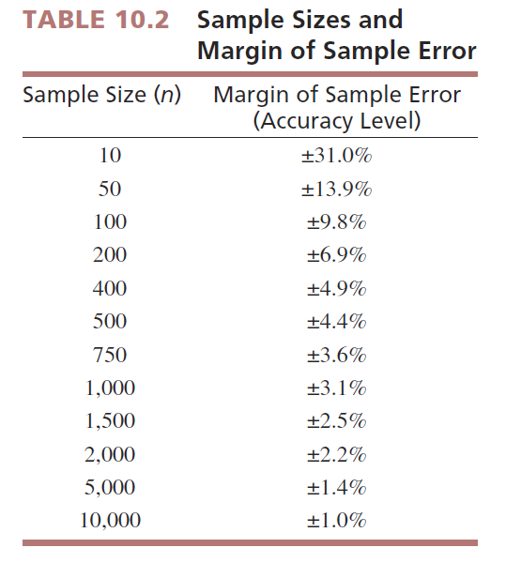

Slide 14
Sample Error

Slide 15
Variability
Variability refers to how similar or dissimilar responses are to a given question.

Slide 16
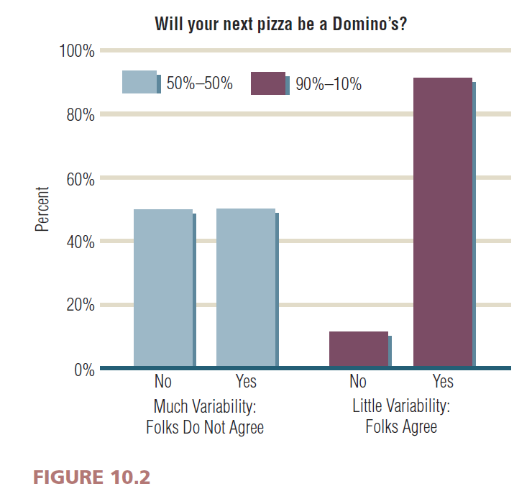

Slide 17
The Confidence Interval Method of Determining Sample Size
Confidence interval approach: applies the concepts of accuracy, variability, and confidence interval to create a “correct” sample size

Slide 18
Confidence Interval Approach
The confidence interval approach is based upon the normal curve distribution.
We can use the normal distribution because of the Central Limit Theorem.

Slide 19
Central Limit Theorem
Since 95% of samples drawn from a population will fall within + or – 1.96 × sample error (this logic is based upon our understanding of the normal curve), we can make the following statement . . .

Slide 20
Central Limit Theorem
If we conducted our study over and over, 1,000 times, we would expect our result to fall within a known range. Based upon this, we say that we are 95% confident that the true population value falls within this range.

Slide 21
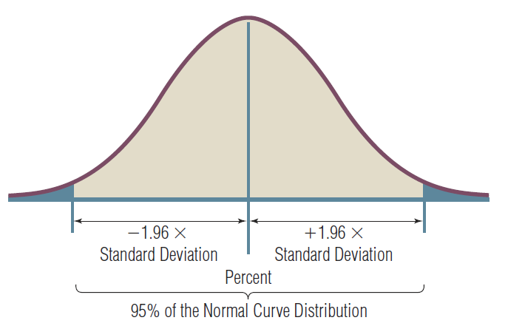
FIGURE 10.3 Normal Curves with its 95% Properties

Slide 22
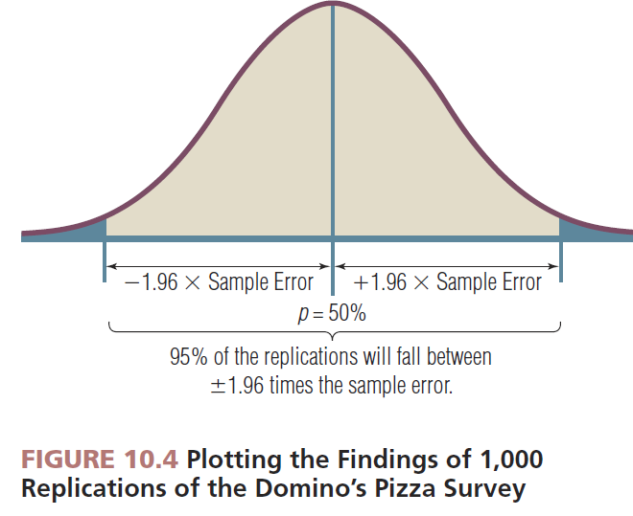

Slide 23
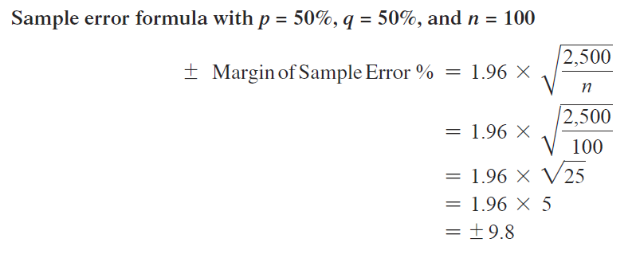
Example - Page 243

Slide 24
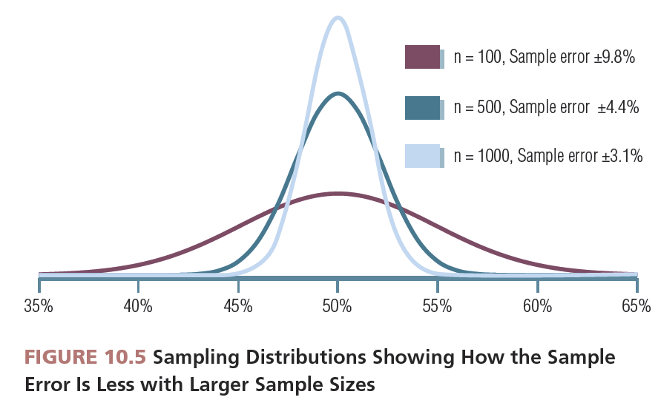

Slide 25
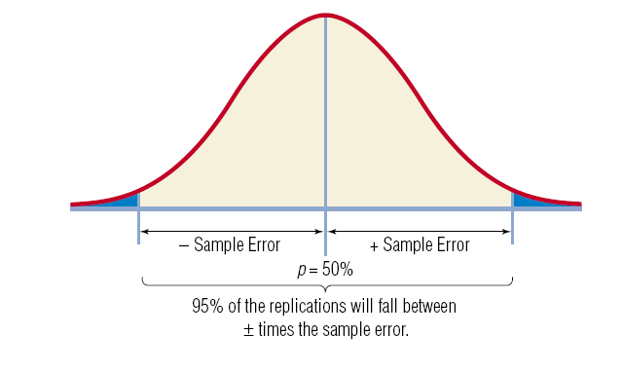
Confidence Interval Method of Determining Sample Size
1.96 × SD defines the end points of the distribution.

Slide 26
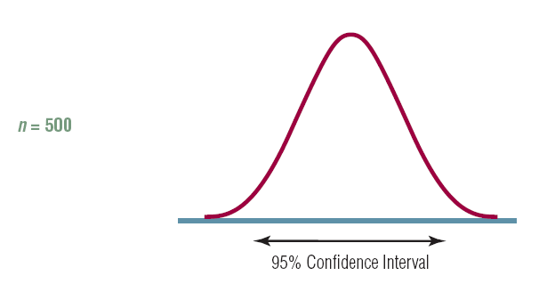
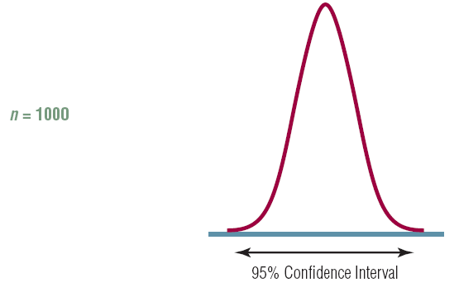
Confidence Interval Method of Determining Sample Size
Given the amount of variability in the population, the sample size will affect the size of the confidence interval.

Slide 27
Sample Size Formula
Need to know
Variability: p × q
Acceptable margin of sample error: e
Level of confidence: z

Slide 28
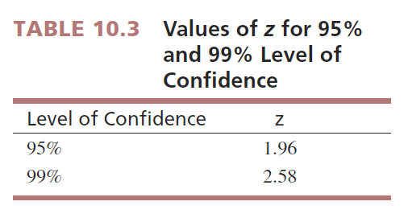

Slide 30
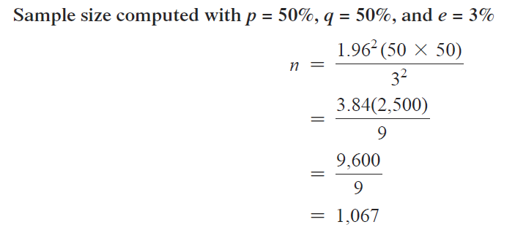
Example 1: Page 247

Slide 31
Example 2: Page 247

Slide 32
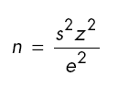
Sample Size for Estimating a Mean
Sample size for estimating a mean requires a different formula (see MRI, p. 248)
z is determined the same way (typically 1.96 or 2.58)
s = variability indicated by an estimated standard deviation

Slide 33
Estimating s
How to estimate s
Use standard deviation from a previous study on the target population
Conduct a pilot study of the target population

Slide 34
Estimating s
How to estimate s
Estimate the range that the value you are estimating can take (minimum and maximum value) and divide the range by 6

Slide 35
Estimating s
How to estimate s
Why divide the range by 6?
The range covers the entire distribution, and ± 3 (or 6) standard deviations cover 99.9% of the area under the normal curve. Since we are estimating one standard deviation, we divide the range by 6.

Slide 36
Practical Considerations
How to estimate variability (p times q) in the population?
Expect the worst cast (p = 50; q = 50)
Estimate variability
Previous studies?
Conduct a pilot study?

Slide 37
Practical Considerations
How to determine the amount of acceptable sample error.
Researchers should work with managers to make this decision. How much error is the manager willing to tolerate?

Slide 38
Practical Considerations
How to decide on the level of confidence to use.
Researchers typically use 95% or 99%.

Slide 39
Practical Considerations
How to balance sample size with cost of data collection.
Researchers should work with managers to take cost into consideration in this decision.

Slide 40
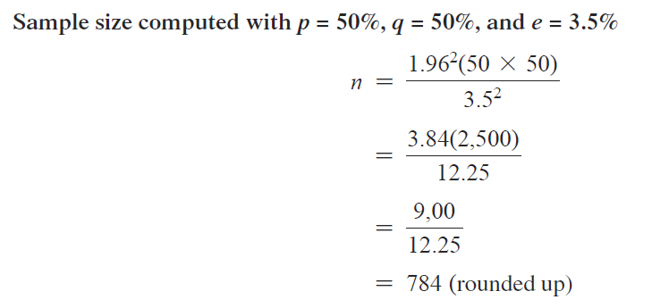
Example, Page 250: What Cost?

Slide 41
Other Methods of Sample Size Determination
Arbitrary “percentage rule of thumb”
Conventional sample size
Statistical analysis approach requirements
Cost basis

Slide 42
Sampling from Small Populations
With small populations, use the finite population multiplier to determine small size.

Slide 43
Sample Size for Small Population

Slide 44
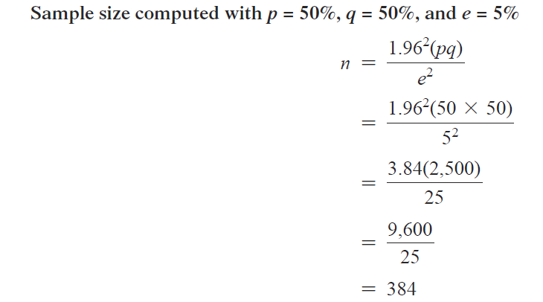
Example: Page 255

Slide 45
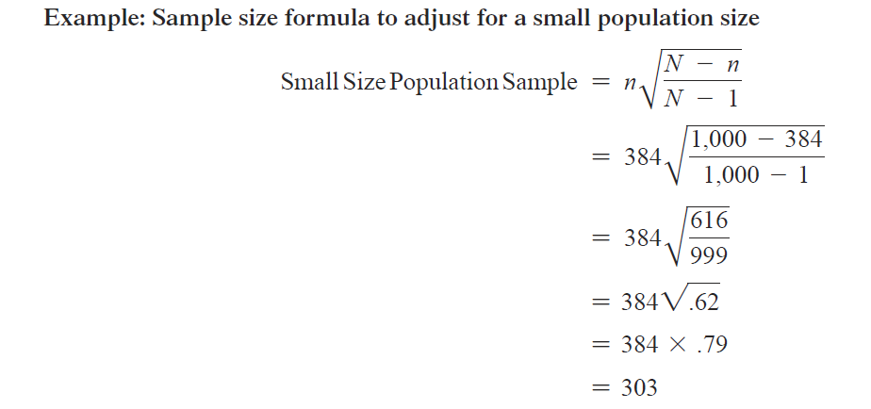
Example: Page 255

Slide 46
All rights reserved. No part of this publication may be reproduced, stored in a retrieval system, or transmitted, in any form or by any means, electronic, mechanical, photocopying, recording, or otherwise, without the prior written permission of the publisher. Printed in the United States of America.

