Slide 1
Chemistry: The Study of Change
Chapter 1
Copyright © The McGraw-Hill Companies, Inc. Permission required for reproduction or display.

Slide 2
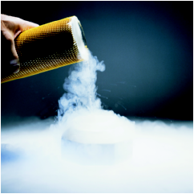
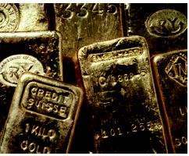
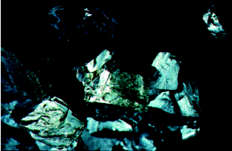
Chemistry is the study of matter and the
changes it undergoes
Matter is anything that occupies space and has mass.
A substance is a form of matter that has a definite composition and distinct properties.
liquid nitrogen
gold ingots
silicon crystals

Slide 3
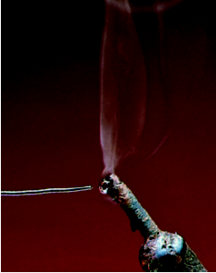
A mixture is a combination of two or more substances in which the substances retain their distinct identities.
Homogenous mixture – composition of the mixture is the same throughout.
soft drink, milk, solder
Heterogeneous mixture – composition is not uniform throughout.
cement,
iron filings in sand

Slide 4
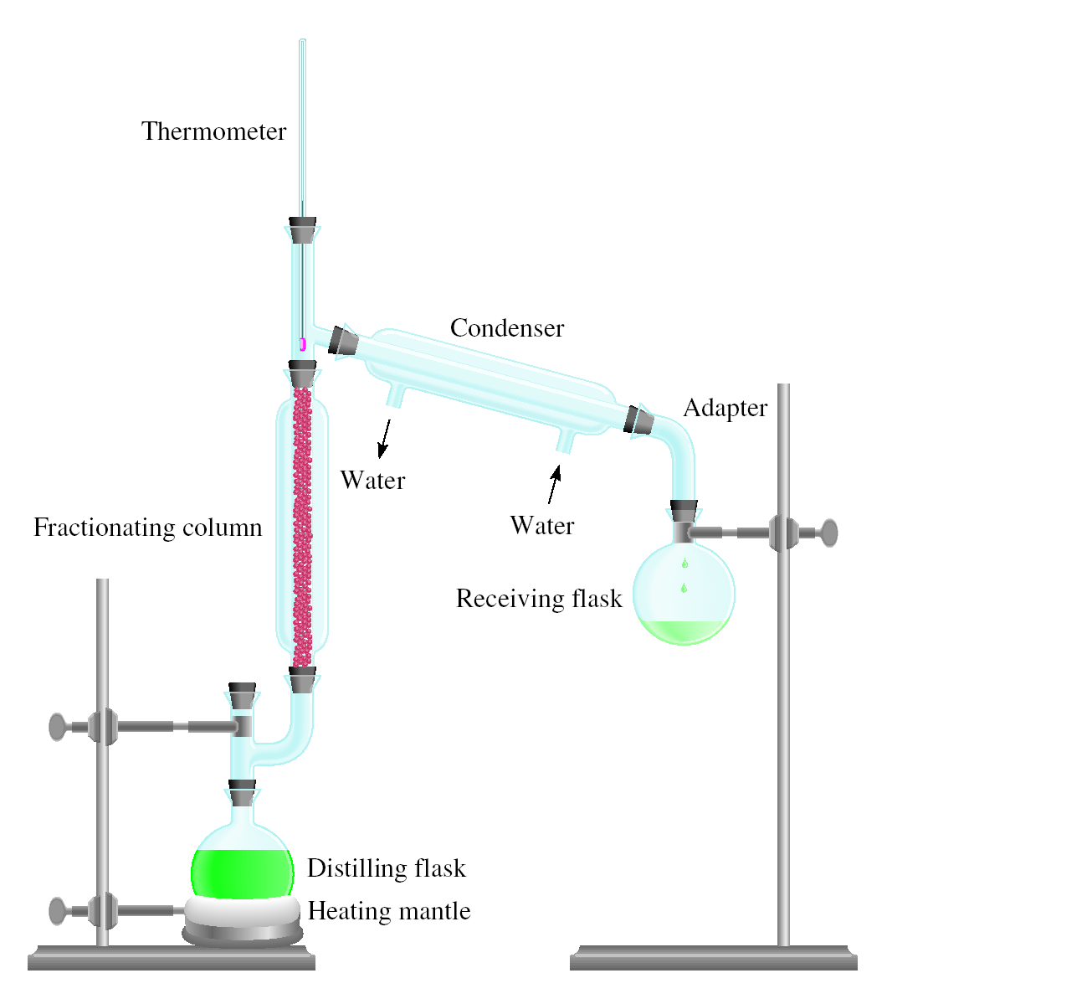
Physical means can be used to separate a mixture into its pure components.
magnet
distillation

Slide 5
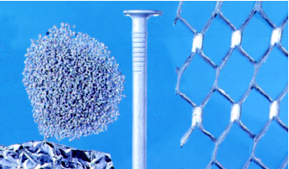
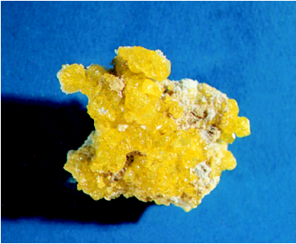
An element is a substance that cannot be separated into simpler substances by chemical means.
114 elements have been identified
82 elements occur naturally on Earth
gold, aluminum, lead, oxygen, carbon, sulfur
32 elements have been created by scientists
technetium, americium, seaborgium

Slide 6
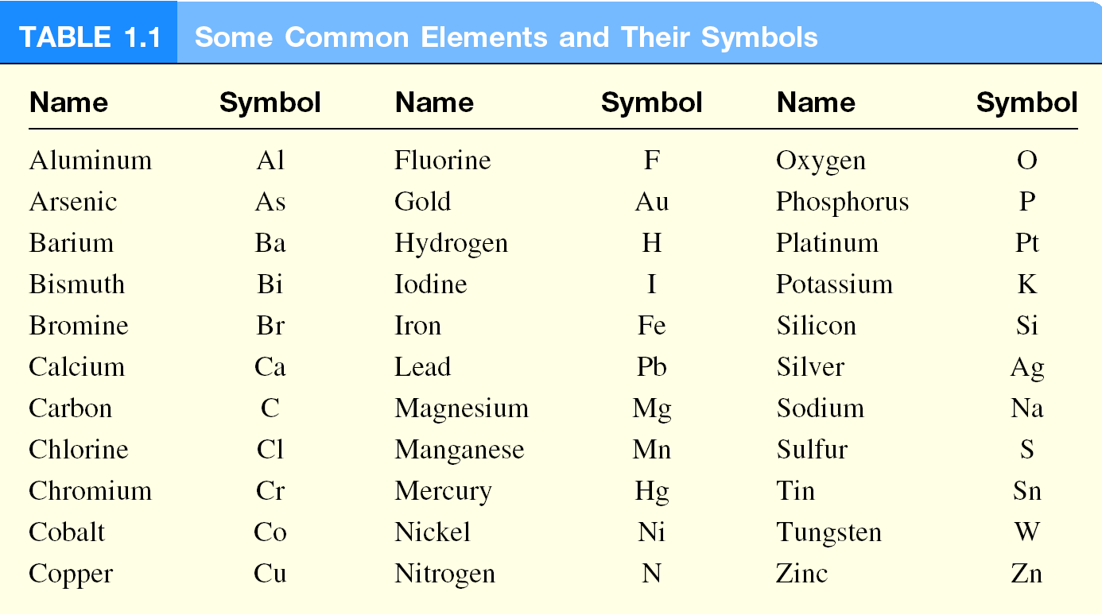

Slide 7
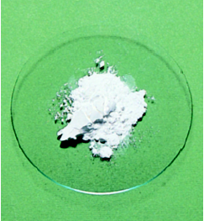
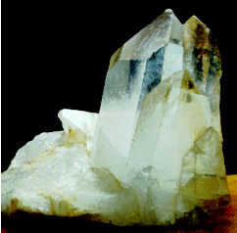
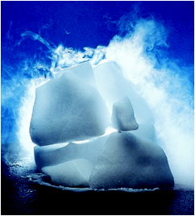
A compound is a substance composed of atoms of two or more elements chemically united in fixed proportions.
Compounds can only be separated into their pure components (elements) by chemical means.
lithium fluoride
quartz
dry ice – carbon dioxide

Slide 8
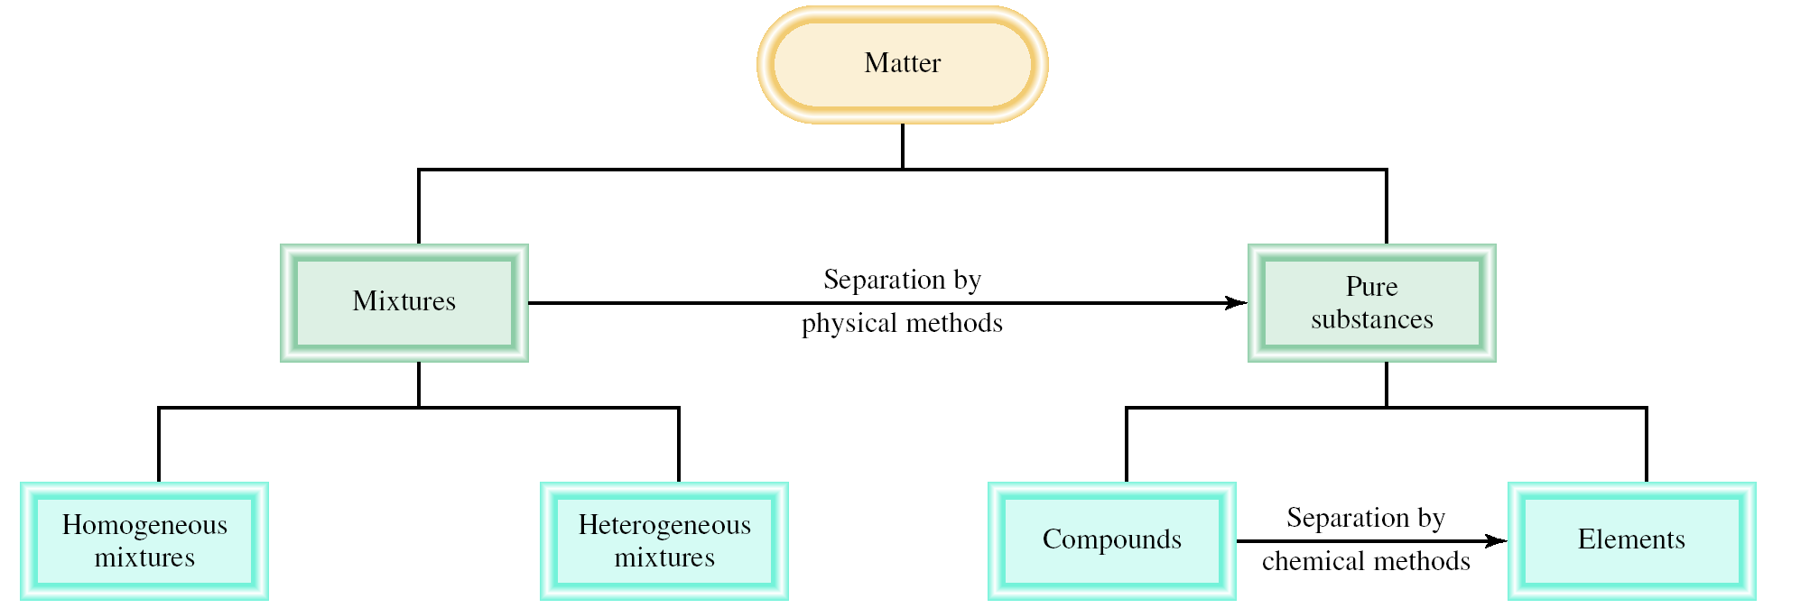
Classifications of Matter

Slide 9
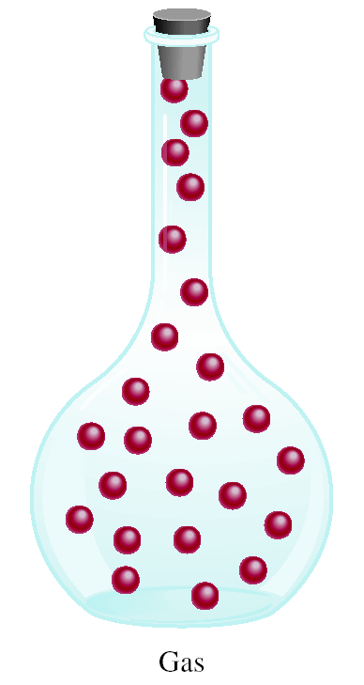
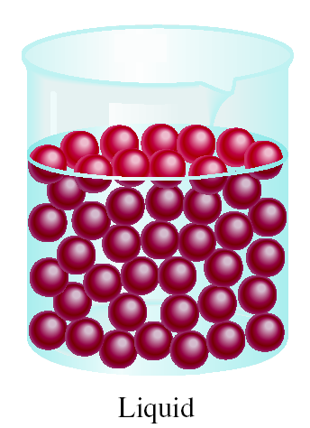
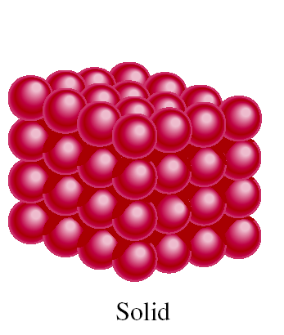
A Comparison: The Three States of Matter

Slide 10
The Three States of Matter: Effect of a Hot Poker on a Block of Ice
GAS
Vaporization
(heat or reduce pressure)
Condensation
(cool or increase pressure)
LIQUID
Liberates Energy
Requires Energy
Melting
(heat)
Freezing
(cool)
SOLID

Slide 11
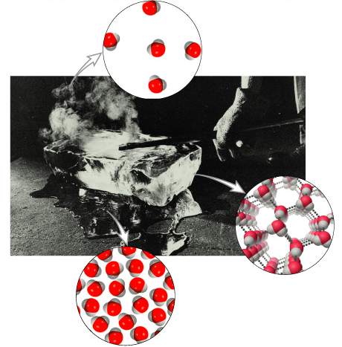
The Three States of Matter: Effect of a Hot Poker on a Block of Ice
gas
liquid
solid

Slide 12
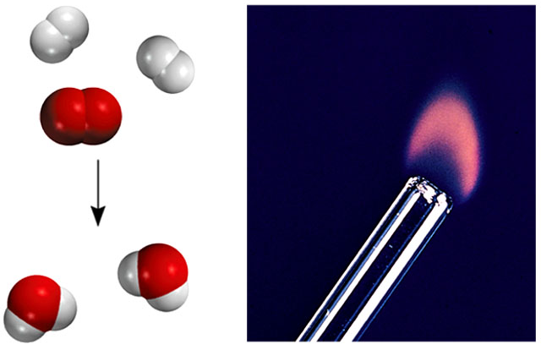
Types of Changes
A physical change does not alter the composition or identity of a substance.
sugar dissolving
in water
ice melting
A chemical change alters the composition or identity of the substance(s) involved.
hydrogen burns in air to form water

Slide 13
PROBLEM: Decide whether each of the following process is primarily a physical or a chemical change, and explain briefly.
Frost forms as the temperature drops on a humid winter night.
(b) Dynamite explodes to form a mixture of gases.
(c) Dissolving sugar and water.
(d) A silver fork tarnishes in air.
Criteria: “Does the substance change composition or just change form?”

Slide 14
SOLUTION:
physical change
(b) chemical change
(c) physical change
(d) chemical change

Slide 15
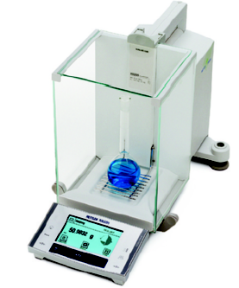
Extensive and Intensive Properties
An extensive property of a material depends upon how much matter is is being considered.
mass
length
volume
An intensive property of a material does not depend upon how much matter is is being considered.
density
temperature
color

Slide 16
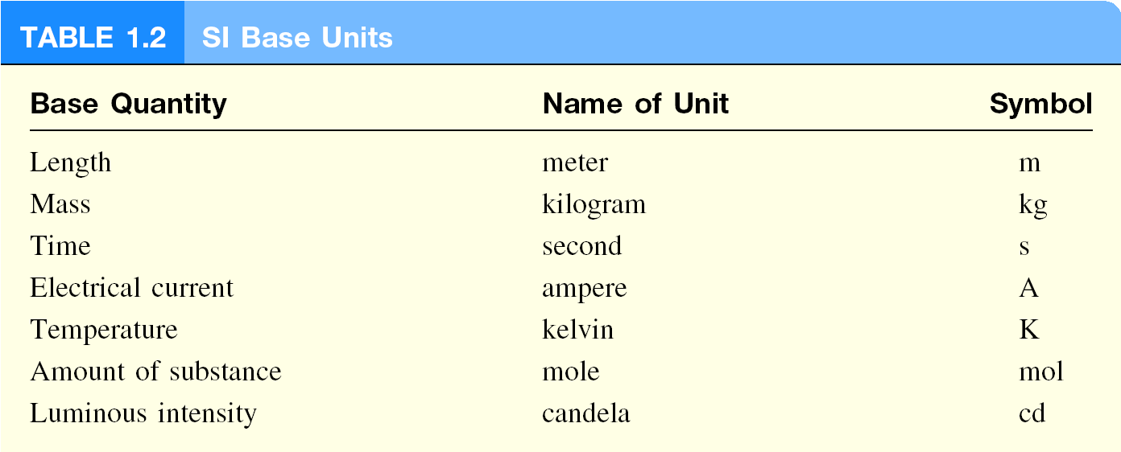
International System of Units (SI)

Slide 18
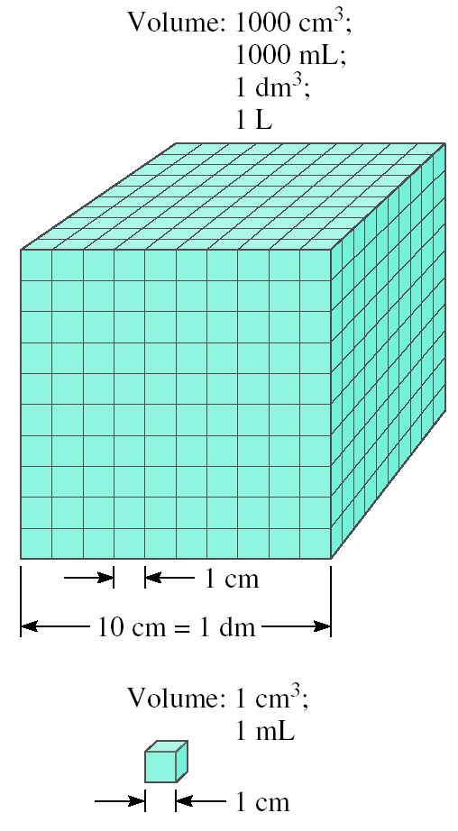
Volume – SI derived unit for volume is cubic meter (m³)
1 cm³ = (1 x 10⁻² m)³ = 1 x 10⁻⁶ m³
1 dm³ = (1 x 10⁻¹ m)³ = 1 x 10⁻³ m³
1 L = 1000 mL = 1000 cm³ = 1 dm³
1 mL = 1 cm³

Slide 19
Density
The density a substance is its mass per unit volume (the volumetric mass).
SI derived unit for density is kg/m³
1 g/cm³ = 1 g/mL = 1000 kg/m³
mass
m
density =
d =
volume
V

Slide 22
A piece of platinum metal with a density of 21.5 g/cm³ has a volume of 4.49 cm³. What is its mass?
m
d =
V
m = d x V
= 21.5 g/cm³ x 4.49 cm³ = 96.5 g

Slide 23
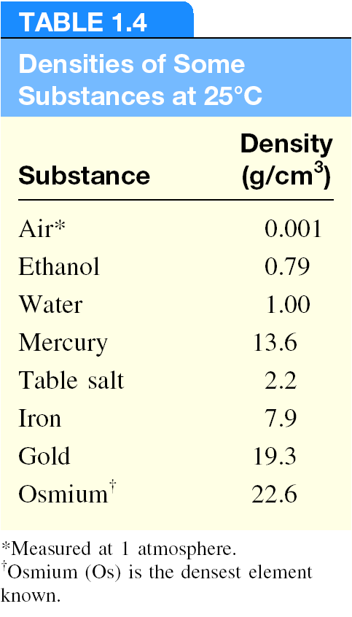

Slide 24
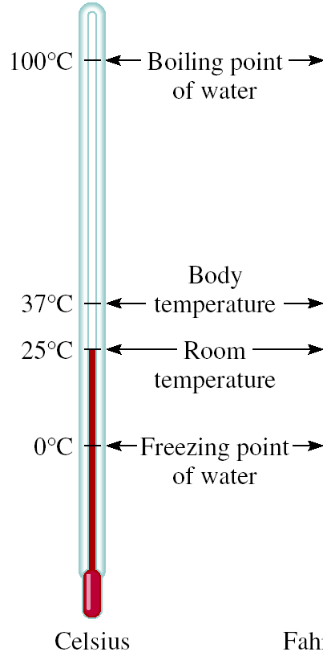
A Comparison of Temperature Scales
K = ⁰C + 273.15
273 K = 0 ⁰C
373 K = 100 ⁰C
9
⁰F = x ⁰C + 32
5
32 ⁰F = 0 ⁰C
212 ⁰F = 100 ⁰C

Slide 25
Convert 172.9 ⁰F to degrees Celsius.
9
⁰F = x ⁰C + 32
5
9
⁰F – 32 = x ⁰C
5
5
x (⁰F – 32) = ⁰C
9
5
⁰C = x (⁰F – 32)
9
5
⁰C = x (172.9 – 32) = 78.3
9

Slide 27
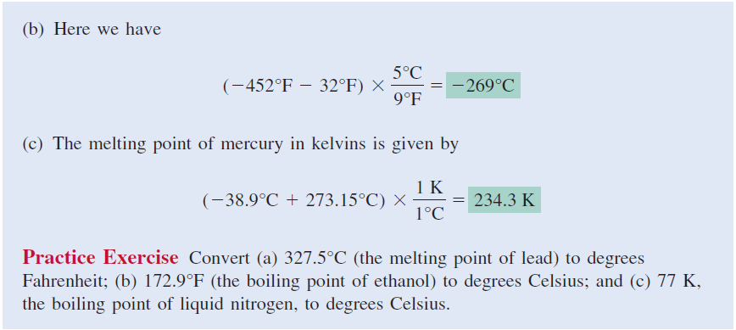

Slide 28
Scientific Notation
The number of atoms in 12 g of carbon:
602,200,000,000,000,000,000,000
6.022 x 10²³
The mass of a single carbon atom in grams:
0.0000000000000000000000199
1.99 x 10⁻²³
N x 10^{n}
N is a number
between 1 and 10
n is a positive or
negative integer

Slide 29
Scientific Notation
568.762
0.00000772
move decimal left
move decimal right
n > 0
n < 0
568.762 = 5.68762 x 10²
0.00000772 = 7.72 x 10⁻⁶
Addition or Subtraction
Write each quantity with the same exponent n
Combine N₁ and N₂
The exponent, n, remains the same
4.31 x 10⁴ + 3.9 x 10³ =
4.31 x 10⁴ + 0.39 x 10⁴ =
4.70 x 10⁴

Slide 30
Scientific Notation
Multiplication
(4.0 x 10⁻⁵) x (7.0 x 10³) =
(4.0 x 7.0) x (10⁻⁵⁺³) =
28 x 10⁻² =
2.8 x 10⁻¹
Multiply N₁ and N₂
Add exponents n₁ and n₂
Division
8.5 x 10⁴ ÷ 5.0 x 10⁹ =
(8.5 ÷ 5.0) x 10⁴⁻⁹ =
1.7 x 10⁻⁵
Divide N₁ and N₂
Subtract exponents n₁ and n₂

Slide 31
Significant Figures
Any digit that is not zero is significant
1.234 kg 4 significant figures
Zeros between nonzero digits are significant
606 m 3 significant figures
Zeros to the left of the first nonzero digit are not significant
0.08 L 1 significant figure
If a number is greater than 1, then all zeros to the right of the decimal point are significant
2.0 mg 2 significant figures
If a number is less than 1, then only the zeros that are at the end and in the middle of the number are significant
0.00420 g 3 significant figures

Slide 32
How many significant figures are in each of the following measurements?
24 mL
2 significant figures
3001 g
4 significant figures
0.0320 m³
3 significant figures
6.4 x 10⁴ molecules
2 significant figures
560 kg
2 significant figures

Slide 33
Significant Figures
Addition or Subtraction
The answer cannot have more digits to the right of the decimal
point than any of the original numbers.
89.332
+
1.1
one significant figure after decimal point
90.432
round off to 90.4
3.70
two significant figures after decimal point
-2.9133
0.7867
round off to 0.79

Slide 34
Significant Figures
Multiplication or Division
The number of significant figures in the result is set by the original number that has the smallest number of significant figures
4.51 x 3.6666 = 16.536366
= 16.5
3 sig figs
round to
3 sig figs
6.8 ÷ 112.04 = 0.0606926
= 0.061
2 sig figs
round to
2 sig figs

Slide 35
Significant Figures
Exact Numbers
Numbers from definitions or numbers of objects are considered
to have an infinite number of significant figures
The average of three measured lengths; 6.64, 6.68 and 6.70?
6.64 + 6.68 + 6.70
= 6.67333 = 6.67
= 7
3
Because 3 is an exact number

Slide 36
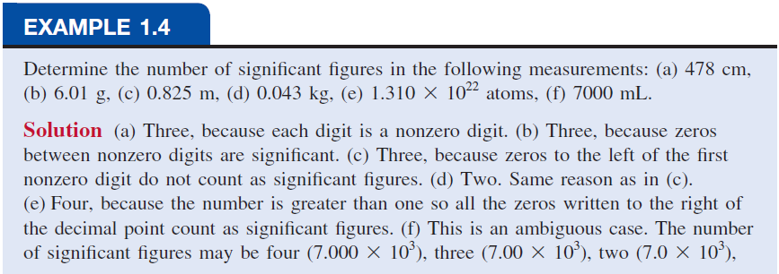

Slide 37
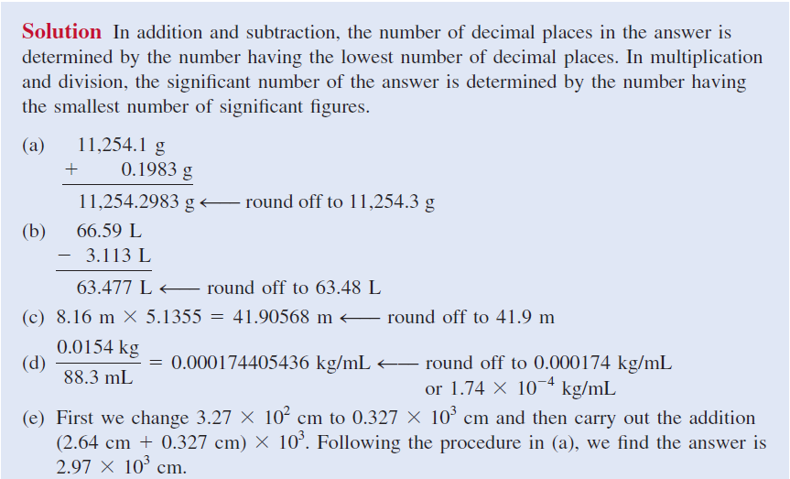

Slide 38
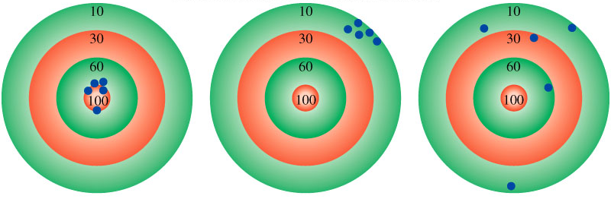
Accuracy – how close a measurement is to the true value
Precision – how close a set of measurements are to each other
accurate
&
precise
precise
but
not accurate
not accurate
&
not precise

Slide 39
Dimensional Analysis Method of Solving Problems
Determine which unit conversion factor(s) are needed
Carry units through calculation
If all units cancel except for the desired unit(s), then the problem was solved correctly.
given quantity x conversion factor = desired quantity
desired unit
given unit x
= desired unit
given unit

Slide 40
Dimensional Analysis Method of Solving Problems
How many mL are in 1.63 L?
Conversion Unit 1 L = 1000 mL
1000 mL
1.63 L x
= 1630 mL
1L
1L
L²
1.63 L x
= 0.001630
1000 mL
mL

Slide 41
The speed of sound in air is about 343 m/s. What is this speed in miles per hour?
conversion units
meters to miles
seconds to hours
1 mi = 1609 m
1 min = 60 s
1 hour = 60 min
m
1 mi
60 s
60 min
mi
343
x
x
x
= 767
s
1609 m
1 min
1 hour
hour

