Slide 1
Systems Analysis and Design 11th Edition
Chapter 5
Data and Process Modeling
Copyright ©2017 Cengage Learning. All Rights Reserved. May not be scanned, copied or duplicated, or posted to a publicly accessible website, in whole or in part.

Slide 2
Chapter Objectives
Describe data and process modeling concepts and tools, including data flow diagrams, a data dictionary, and process descriptions
Describe the symbols used in data flow diagrams and explain the rules for their use
Draw data flow diagrams in a sequence, from general to specific
Copyright ©2017 Cengage Learning. All Rights Reserved. May not be scanned, copied or duplicated, or posted to a publicly accessible website, in whole or in part.

Slide 3
Chapter Objectives (Cont.)
Explain how to level and balance a set of data flow diagrams
Copyright ©2017 Cengage Learning. All Rights Reserved. May not be scanned, copied or duplicated, or posted to a publicly accessible website, in whole or in part.

Slide 4
Introduction
Logical Model: Shows what the system must do, regardless of how it will be implemented physically
Physical Model: Describes how the system will be constructed
Copyright ©2017 Cengage Learning. All Rights Reserved. May not be scanned, copied or duplicated, or posted to a publicly accessible website, in whole or in part.

Slide 5
Overview of Data and Process Modeling Tools
Systems analysts use graphical techniques to describe an information system
Data flow diagram (DFD) - Uses various symbols to show how the system transforms input data into useful information
Copyright ©2017 Cengage Learning. All Rights Reserved. May not be scanned, copied or duplicated, or posted to a publicly accessible website, in whole or in part.

Slide 6
Data Flow Diagrams
A data flow diagram (DFD) shows how data moves through an information system but does not show program logic or processing steps
A set of DFDs provides a logical model that shows what the system does, not how it does it
Copyright ©2017 Cengage Learning. All Rights Reserved. May not be scanned, copied or duplicated, or posted to a publicly accessible website, in whole or in part.

Slide 7
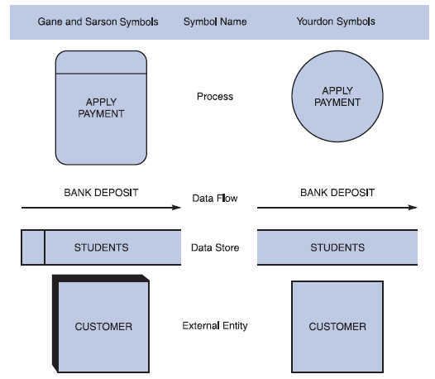
Data Flow Diagrams (Cont. 1)
DFD Symbols
  Four basic symbols represent processes, data flows, data stores, and entities
  Gane and Sarson: Used in data
  flow diagrams
    Processes, data flows,
    data stores, and external
    entities all have a unique symbol
  Yourdon: Used in data flow
  diagrams
    Processes, data flows, data stores, and external entities each have a unique symbol
FIGURE 5-1 Data flow diagram symbols, symbol names, and examples of the Gane and Sarson and Yourdon symbol sets
Copyright ©2017 Cengage Learning. All Rights Reserved. May not be scanned, copied or duplicated, or posted to a publicly accessible website, in whole or in part.

Slide 8
Data Flow Diagrams (Cont. 2)
Process Symbol
Must have at least one input and at least one output
Contains business logic that transforms the data
Process name identifies its function (verb)
Examples” : “apply rent payment” or “calculate commission
In DFDs, a process symbol can be referred to as a black box
Copyright ©2017 Cengage Learning. All Rights Reserved. May not be scanned, copied or duplicated, or posted to a publicly accessible website, in whole or in part.

Slide 9
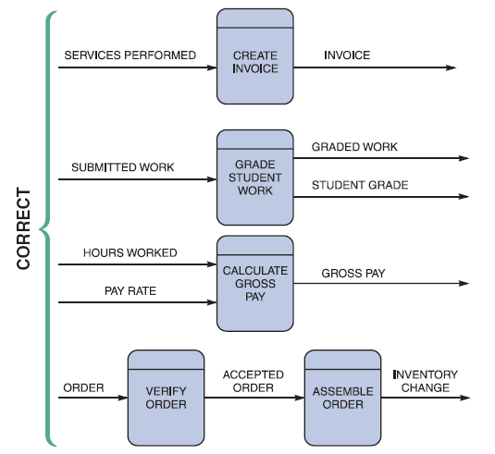
Data Flow Diagrams (Cont. 3)
Data Flow Symbol
  Represents one or more data items
  The symbol for a data flow is a line with a single or double arrowhead
FIGURE 5-3 Examples of correct combinations of data flow and process symbols
Copyright ©2017 Cengage Learning. All Rights Reserved. May not be scanned, copied or duplicated, or posted to a publicly accessible website, in whole or in part.

Slide 10
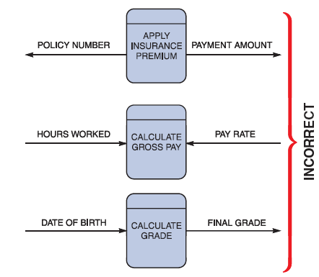
Data Flow Diagrams (Cont. 4)
Data Flow Symbol
  Following data flow and process combinations must be avoided
    Spontaneous generation
    Black holes
    Gray holes
FIGURE 5-4 Examples of incorrect combinations of data flow and process symbols. APPLY INSURANCE PREMIUM has no input and is called a spontaneous generation process. CALCULATE GROSS PAY has no outputs and is called a black hole process. CALCULATE GRADE has an input that is obviously unable to produce the output. This process is called a gray hole
Copyright ©2017 Cengage Learning. All Rights Reserved. May not be scanned, copied or duplicated, or posted to a publicly accessible website, in whole or in part.

Slide 11
Data Flow Diagrams (Cont. 5)
  Data Store symbol
    Represent data that the system stores
    A DFD does not show the detailed contents of a data store — the specific structure and data elements are defined in the data dictionary
    A data store must be connected to a process with a data flow
Copyright ©2017 Cengage Learning. All Rights Reserved. May not be scanned, copied or duplicated, or posted to a publicly accessible website, in whole or in part.

Slide 12
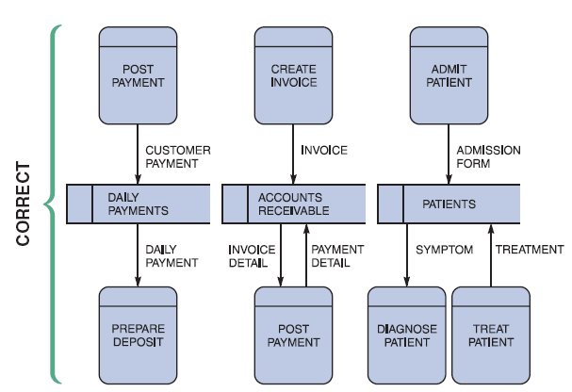
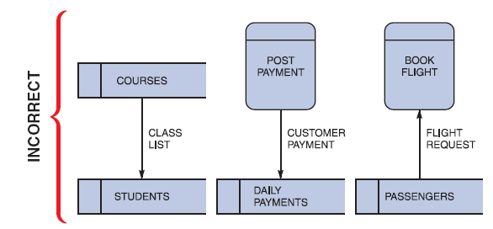
Data Flow Diagrams (Cont. 6)
FIGURE 5-6 Examples of incorrect uses of data store symbols: Two data stores cannot be connected by a data flow without an intervening process, and each data store should have an outgoing and incoming data flow
FIGURE 5-5 Examples of correct uses of data store symbols in a data flow diagram
Copyright ©2017 Cengage Learning. All Rights Reserved. May not be scanned, copied or duplicated, or posted to a publicly accessible website, in whole or in part.

Slide 13
Data Flow Diagrams (Cont. 7)
Entity Symbol
Shows how the system interfaces with the outside world
A DFD shows only external entities that provide data to the system or receive output from the system
DFD entities also are called terminators because they are data origins or final destinations
Each entity must be connected to a process by a data flow
Copyright ©2017 Cengage Learning. All Rights Reserved. May not be scanned, copied or duplicated, or posted to a publicly accessible website, in whole or in part.

Slide 14
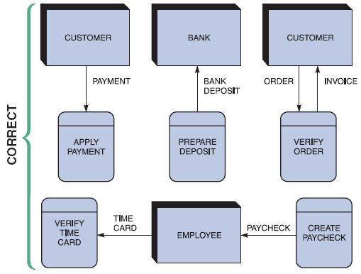
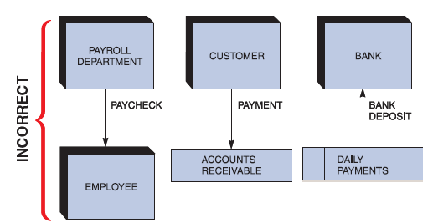
Data Flow Diagrams (Cont. 8)
FIGURE 5-8 Examples of incorrect uses of external entities. An external entity must be connected by a data flow to a process, and not directly to a data store or to another external entity
FIGURE 5-7 Examples of correct uses of external entities in a data flow diagram
Copyright ©2017 Cengage Learning. All Rights Reserved. May not be scanned, copied or duplicated, or posted to a publicly accessible website, in whole or in part.

Slide 15
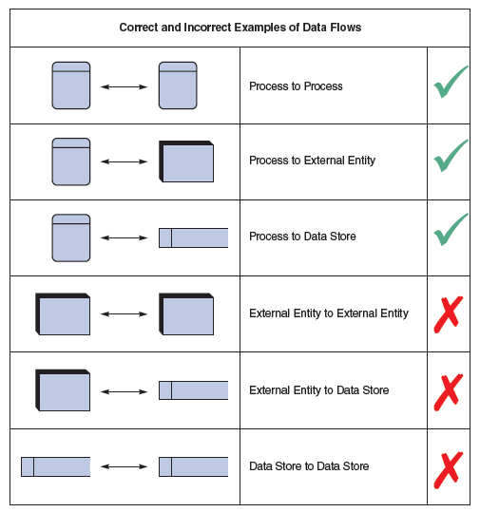
Data Flow Diagrams (Cont. 9)
Keep in mind:
  All flow lines must be labeled
  Large processes can be broken down into smaller components
FIGURE 5-9 Examples of correct and incorrect uses of data flows
Copyright ©2017 Cengage Learning. All Rights Reserved. May not be scanned, copied or duplicated, or posted to a publicly accessible website, in whole or in part.

Slide 16
Creating a Set of DFDs
Create a graphical model of the information system based on your fact-finding results
  First, you will review a set of guidelines for drawing DFDs
  Then you will learn how to apply these guidelines and create a set of DFDs using a three-step process
Copyright ©2017 Cengage Learning. All Rights Reserved. May not be scanned, copied or duplicated, or posted to a publicly accessible website, in whole or in part.

Slide 17
Creating a Set of DFDs (Cont. 1)
Guidelines for Drawing DFDs
  Draw the context diagram so that it fits on one page
  Use the name of the information system as the process name in the context diagram
  Use unique names within each set of symbols
  Do not cross lines
  Provide a unique name and reference number for each process
  Ensure that the model is accurate, easy to understand, and meets the needs of its users
Copyright ©2017 Cengage Learning. All Rights Reserved. May not be scanned, copied or duplicated, or posted to a publicly accessible website, in whole or in part.

Slide 18
Creating a Set of DFDs (Cont.2)
FIGURE 5-10 Context diagram DFD for grading system
Copyright ©2017 Cengage Learning. All Rights Reserved. May not be scanned, copied or duplicated, or posted to a publicly accessible website, in whole or in part.

Slide 19
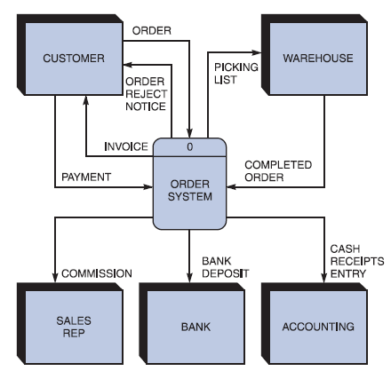
Creating a Set of DFDs (Cont. 3)
Step 1: Draw a Context Diagram
FIGURE 5-11 Context diagram DFD for an order system
Copyright ©2017 Cengage Learning. All Rights Reserved. May not be scanned, copied or duplicated, or posted to a publicly accessible website, in whole or in part.

Slide 20
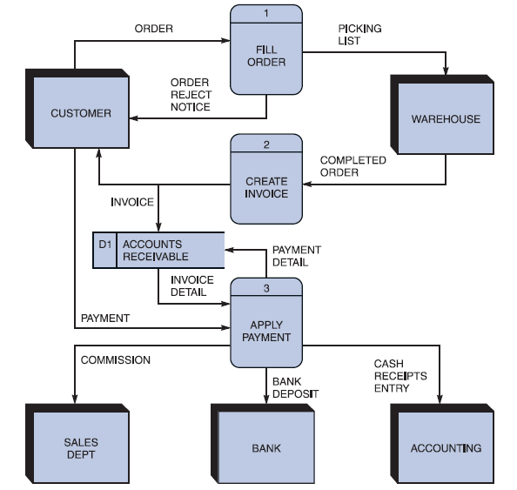
Creating a Set of DFDs (Cont. 4)
Step 2: Draw a Diagram 0 DFD
  If same data flows in both directions, you can use a double-headed arrow
  Diagram 0 is an exploded view of process 0
  Parent diagram
  Child diagram
  Functional primitive
FIGURE 5-13 Diagram 0 DFD for the order system
Copyright ©2017 Cengage Learning. All Rights Reserved. May not be scanned, copied or duplicated, or posted to a publicly accessible website, in whole or in part.

Slide 21
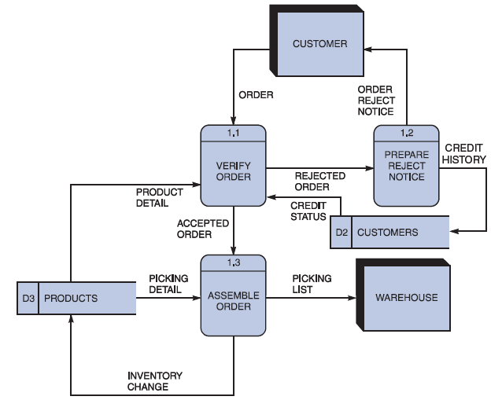
Creating a Set of DFDs (Cont. 5)
Step 3: Draw the Lower Level Diagrams
FIGURE 5-14 Diagram 1 DFD shows details of the FILLORDER process in the order system
Copyright ©2017 Cengage Learning. All Rights Reserved. May not be scanned, copied or duplicated, or posted to a publicly accessible website, in whole or in part.

Slide 22
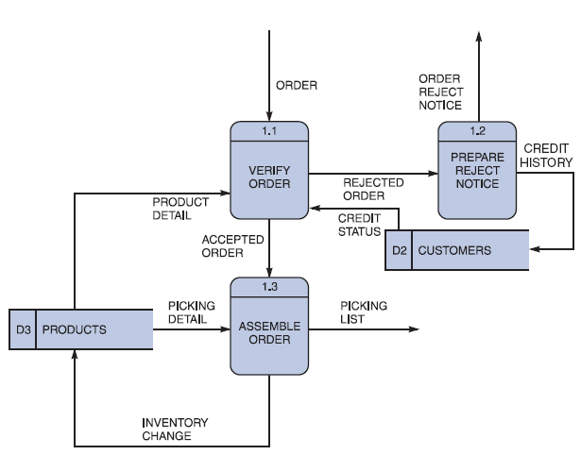
Creating a Set of DFDs (Cont. 6)
Must use leveling and balancing techniques
Leveling examples
  Uses a series of increasingly detailed DFDs to describe an information
  system
  Exploding, partitioning, or decomposing
FIGURE 5-15 This diagram does not show the symbols that connect to data flows entering or leaving FILL ORDER on the context diagram
Copyright ©2017 Cengage Learning. All Rights Reserved. May not be scanned, copied or duplicated, or posted to a publicly accessible website, in whole or in part.

Slide 23
Creating a Set of DFDs (Cont. 7)
FIGURE 5-16 The order system diagram 0 is shown at the top of the figure, and exploded diagram 3 DFD (for the APPLY PAYMENT process) is shown at the bottom. The two DFDs are balanced because the child diagram at the bottom has the same input and output flows as the parent process 3 shown at the top
Copyright ©2017 Cengage Learning. All Rights Reserved. May not be scanned, copied or duplicated, or posted to a publicly accessible website, in whole or in part.

Slide 24
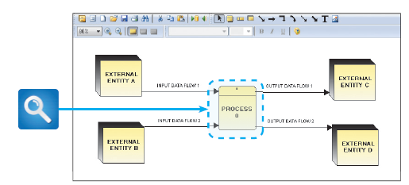
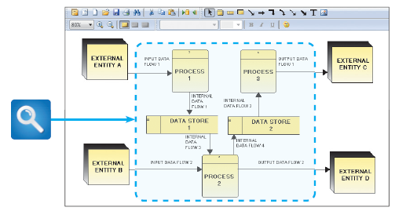
Creating a Set of DFDs (Cont. 8)
FIGURE 5-17 Example of a parent DFD diagram, showing process 0 as a black box
FIGURE 5-18 In the next level of detail, the process 0 black box reveals three processes, two data stores, and four internal data flows — all of which are shown inside the dashed line
Copyright ©2017 Cengage Learning. All Rights Reserved. May not be scanned, copied or duplicated, or posted to a publicly accessible website, in whole or in part.

Slide 25
Chapter Summary
During data and process modeling, a systems analyst develops graphical models to show how the system transforms data into useful information
The end product of data and process modeling is a logical model that will support business operations and meet user needs
Data and process modeling involves three main tools: data flow diagrams, a data dictionary, and process descriptions
Copyright ©2017 Cengage Learning. All Rights Reserved. May not be scanned, copied or duplicated, or posted to a publicly accessible website, in whole or in part.

Slide 26
Chapter Summary (Cont. 1)
Data flow diagrams (DFDs) graphically show the movement and transformation of data in the information system
DFDs use four symbols
A set of DFDs is like a pyramid with the context diagram at the top
Copyright ©2017 Cengage Learning. All Rights Reserved. May not be scanned, copied or duplicated, or posted to a publicly accessible website, in whole or in part.

