Slide 1
Systems Analysis and Design 11th Edition
Chapter 2
Analyzing the Business Case

Slide 2
Chapter Objectives
Explain the concept of a business case and how a business case affects an IT project
List reasons for systems projects and factors that affect such projects
Describe systems requests and the role of the systems review committee
Define operational, technical, economic, and schedule feasibility

Slide 3
What Is a Business Case?
Business case: Justification for a proposal
Requires consideration of the organization’s:
Overall mission
Objectives
IT needs
Systems development process
Systems request
Preliminary investigation
Findings are submitted to management

Slide 4
What Is a Business Case?
A business case should:
Be comprehensive and easy to understand
Describe the project clearly, provide the justification to proceed, and estimate the project’s financial impact
Questions answered by a business case
Why are we doing this project?
How much will it cost and how long will it take?
Are there any risks involved?
How will we measure success?
What alternatives exist?
Notes:
Search online for business case sample and compare.
Will we suffer productivity loss during the transition process?
How this solution address key business issue ?

Slide 5
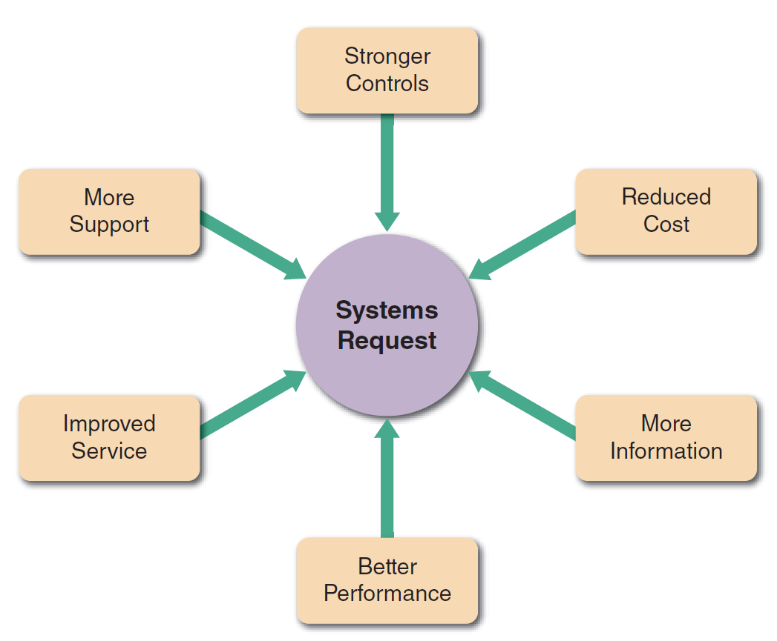
Information Systems Projects
FIGURE 2-4 Six main reasons for systems requests.

Slide 6
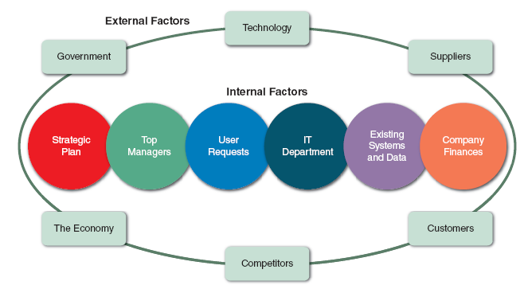
Information Systems Projects(Cont.)
FIGURE 2-6 Internal and external factors that affect IT projects.

Slide 7
Evaluation of Systems Requirements
Systems requests are evaluated by a systems review committee or a computer resources committee
Systems Request Forms
Streamline the request process
Ensure consistency
Easy to understand
Include clear instructions
Indicate the required supporting documents
Submitted electronically

Slide 8
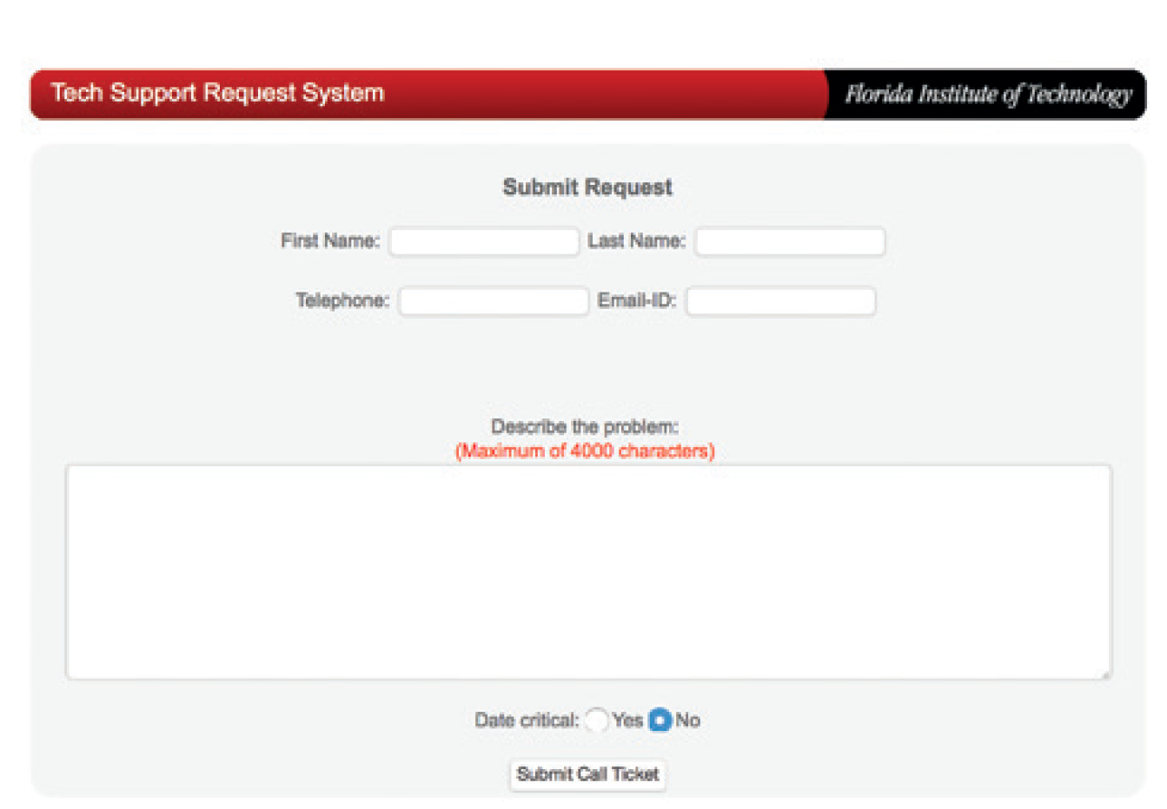
Evaluation of Systems Requirements (Cont. 1)
FIGURE 2-10 Example of an online systems request form.
Source: Florida Institute of Technology

Slide 9
Evaluation of Systems Requirements (Cont. 2)
Systems Review Committee
A broader viewpoint enables a committee to establish priorities more effectively than an individual
One person’s bias is less likely to affect decisions
Disadvantages
Action on requests must wait until the committee meets
Members might favor projects requested by their own departments
Internal political differences could delay important decisions

Slide 10
Overview of Feasibility
Feasibility studies can be simple or exhaustive
Effort required depends on the nature of the request
Initial fact-finding involves:
Studying organizational charts
Performing interviews
Reviewing current documentation
Observing operations
Surveying users

Slide 11
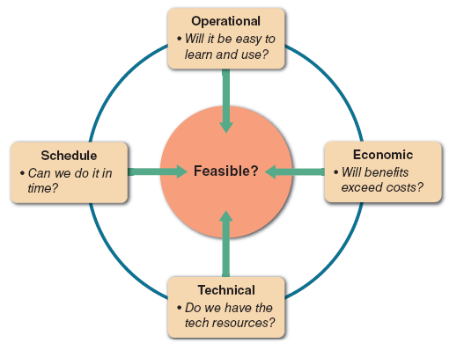
Overview of Feasibility (Cont. 1)
FIGURE 2-11 A feasibility study examines operational, technical, economic, and schedule factors.

Slide 12
Overview of Feasibility (Cont. 2)
Operational Feasibility
A proposed system will be used effectively after it has been developed
Can be affected by organizational culture
Cannot be accurately measured but requires careful study
Questions that can help predict a system’s operational feasibility
Is the project supported by management and users?
Will the new system result in a workforce reduction?
Do legal or ethical issues need to be considered?

Slide 13
Overview of Feasibility (Cont. 3)
Economic Feasibility
Projected benefits of a proposed system out-weigh total cost of ownership (TCO)
Determination of TCO requires cost analysis of:
People, including IT staff and users
Hardware and equipment
Software
Formal and informal training
Licenses and fees
Consulting expenses
Facility costs

Slide 14
Overview of Feasibility (Cont. 4)
Tangible costs are measured in dollars
Intangible costs can significantly affect organizational performance
Tangible benefits can result from a decrease in expenses or an increase in revenues
Intangible benefits are important to the company despite the inability to measure them in dollars

Slide 15
Overview of Feasibility (Cont. 5)
Technical Feasibility
Technical resources required to acquire and use the system
Questions analysts should ask
Does the company have the necessary hardware, software, and network resources?
Does the company have the required technical expertise?
Does the proposed platform have sufficient capacity for future needs?
Will a prototype be required?

Slide 16
Overview of Feasibility (Cont. 6)
Schedule Feasibility
A project can be implemented in an acceptable time frame
Issues that can affect schedule feasibility
Interaction between time and costs
Can the company or the IT team control the factors that affect schedule feasibility?
Has management established a firm timetable for the project?
What conditions must be satisfied during the development of the system?
Will an accelerated schedule pose any risks?

Slide 17
Chapter Summary
Systems planning is the first phase of the systems development life cycle
A business case should:
Describe the project clearly
Provide the justification to proceed
Estimate the project’s financial impact
Factors that affect systems projects
User requests, top management directives, existing systems, the IT department, software and hardware vendors, technology, customers, competitors, the economy, and government

Slide 18
Chapter Summary (Cont.)
Analysts evaluate the systems request and determine whether the project is feasible from an operational, technical, economic, and schedule standpoint

