Slide 1
Chapter Four
Managing Marketing Information to Gain Customer Insights(visions, understandings)

Slide 2
Learning Objectives
Topic Outline
Marketing Information and Customer Insights
Assessing Marketing Information Needs
Developing Marketing Information
Marketing Research

Slide 3

Marketing Information and Customer Insights
Customer Insights are:
Fresh and deep insights into customers needs and wants
Difficult to obtain(get)
  Not obvious(not clear)
  Customer’s unsure of their behavior
Better information and more effective use of existing information
Notes:
Note to instructor

Slide 4

Marketing Information and Customer Insights
Customer Insights
Companies are forming customer insights teams
  Include all company functional areas
  Collect information from a wide variety of sources
  Use insights to create more value for their customers
Notes:
The real value of marketing research and marketing information lies in how it is used—
in the customer insights that it provides.
Customer insights Fresh understandings of customers and the marketplace derived from marketing information that become the basis for creating customer value and relationships.

Slide 5
Marketing Information and Customer Insights
Marketing Information Systems (MIS)
Marketing information system (MIS) consists of people and procedures for:
  Assessing the information needs (To measure the information)
  Developing needed information (To develop the information they need)
  Helping decision makers use the information for customer

Slide 6
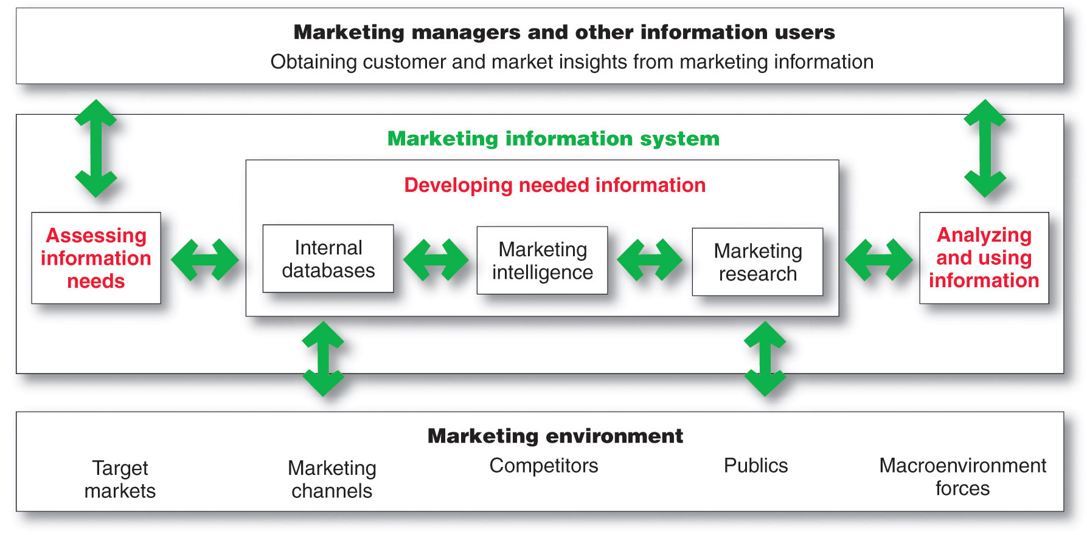
Marketing Information System

Slide 7
Assessing Marketing Information Needs
MIS provides information to the company’s marketing and other managers and external partners such as suppliers, resellers, and marketing service agencies

Slide 8
Developing Marketing Information
Marketers obtain information from
Internal data
Marketing intelligence
Marketing research
Notes:
The problem isn’t finding
information; the world is
bursting with information from a glut
of sources. The real challenge is to find
the right information—from inside and
outside sources—and turn it into
customer insights.

Slide 9
Developing Marketing Information
Internal Data
Internal databases are electronic collections of consumer and market information obtained from data sources within the company network
Notes:
Note to Instructor
Internal data can provide strong competitive advantage.
Key information on customers
sales
websites visited
demographics
psychographics
service and satisfaction measures
Source of customer insights about buying patterns.

Slide 10

Developing Marketing Information
Competitive Marketing Intelligence
The systematic collection and analysis
of publicly available information
about consumers, competitors
and developments in the marketplace
Notes:
Note to Instructor
This Web link brings you to AC Nielsen’s homepage. This includes not just their online division but their entire company. It is very interesting to explore the area called trends an insights.
In slideshow view, click on movie icon to launch Meredith video snippet. See accompanying DVD for full video segment.
Discussion Question
Ask students what Nielsen might have learned about customers in these insights.

Slide 11
Developing Marketing Information
Marketing Research
Marketing research is the systematic design, collection, analysis, and reporting of data relevant to a specific marketing situation facing an organization
Notes:
Whereas marketing
intelligence involves
actively scanning the general
marketing environment, marketing
research involves more focused studies
to gain customer insights relating to
specific marketing decisions.

Slide 12
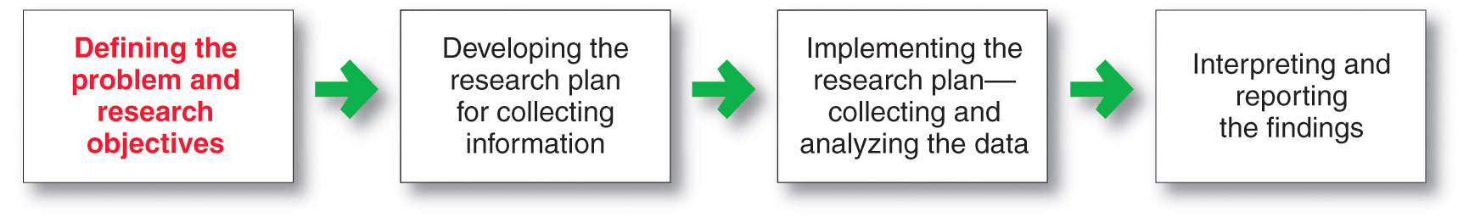
Developing Marketing Information
Steps in the Marketing Research Process
Notes:
This first step is probably the most
difficult but also the most important
one. It guides the entire research
process. It’s frustrating to reach the
end of an expensive research project
only to learn that you’ve addressed the
wrong problem!

Slide 13
Developing Marketing Information
Marketing Research
Defining the Problem and Research Objectives
Exploratory research
Descriptive research
Causal research
Notes:
Note to Instructor
These can be explained in more depth:
Exploratory research—objective is to gather preliminary information that will help define the problem and suggest hypotheses.
Descriptive research—describes things.
Causal research—tests hypothesis about cause and effect relationships.
Discussion Question
Consider a local business near campus. . .
How would they conduct exploratory research?
What might they want to find out in descriptive research?
What relationships might they explore in causal research?
Students will have the following responses for the above questions: exploratory research (focus groups, interviews); descriptive research (who, when, how, why);causal research (price/demand, environment/purchase rate).

Slide 14
Developing Marketing Information
Marketing Research
Developing the Research Plan
Secondary data consists of information that already exists somewhere, having been collected for another purpose

Slide 15
Developing Marketing Information
Secondary Data
Advantages
Disadvantages
Current
Relevant
Speed
Cost
Could not get data otherwise
Accuracy
Impartial

Slide 16
Developing Marketing Information
Marketing Research
Developing the Research Plan
Primary data consists of information gathered for the special research plan

Slide 17
Developing Marketing Information
Marketing Research
Planning Primary Data Collection
Research approaches
Contact methods
Sampling plan
Research instruments

Slide 18
Planning Primary Data Collection
Research Approaches | Contact methods | Sampling Plan | Research Instruments
Observation Survey Experiment | Mail Telephone Personal Online | Sampling Unit Sample size Sampling procedure | Questionnaires Mechanical Instruments

Slide 19
Developing Marketing Information
Market Research
Research Approaches
Observational research involves gathering primary data by observing relevant people, actions, and situations
Ethnographic research involves sending trained observers to watch and interact with consumers in their natural environment
Notes:
Note to Instructor
Discussion Question
Ask students how a company like Chiquita can use observational research for their banana sales.
Students should mention sending teams to stores to watch how people choose bananas, who purchases, who influences the sale, how many do they buy in a bunch, do they break a bunch, do they prefer green or ripe? How might the results influence Chiquita when marketing bananas (4P’s).

Slide 20
Developing Marketing Information
Market Research
Research Approaches
Survey research is the most widely used method and is best for descriptive information—knowledge, attitudes, preferences, and buying behavior
Flexible
People can be unable or unwilling to answer
Gives misleading or pleasing answers
Privacy concerns

Slide 21
Developing Marketing Information
Market Research
Research Approaches
Experimental research is best for gathering causal information—cause-and-effect relationships
Notes:
Note to Instructor
Discussion Question
Ask how a catalog marketer like Victoria’s Secret might run an experiment on a direct mail offer.
Students will realize they might change the copy, offer, envelope, and other parts of the direct mail piece.

Slide 22
Developing Marketing Information
Marketing Research
Implementing the Research Plan
Collecting the information
Processing the information
Analyzing the information
Interpret findings
Draw conclusions
Report to management

