Slide 1
Corporate Finance Thirteenth Edition
Stephen A. Ross / Randolph W. Westerfield / Jeffrey F. Jaffe / Bradford D. Jordan
Chapter 5
Net Present Value and Other Investment Rules
© McGraw Hill LLC. All rights reserved. No reproduction or distribution without the prior written consent of McGraw Hill LLC.

Slide 2
Key Concepts and Skills
  Be able to compute payback and discounted payback and understand their shortcomings.
  Be able to compute the internal rate of return and profitability index, understanding the strengths and weaknesses of both approaches.
  Be able to compute net present value and understand why it is the best decision criterion.

Slide 3
Chapter Outline
5.1 Why Use Net Present Value?
5.2 The Payback Period Method
5.3 The Discounted Payback Period Method
5.4 The Internal Rate of Return
5.5 Problems with the I R R Approach
5.6 The Profitability Index
5.7 The Practice of Capital Budgeting

Slide 4
5.1 Why Use Net Present Value?
Accepting positive N P V projects benefits stockholders.
  N P V uses cash flows.
  N P V uses all the cash flows of the project.
  N P V discounts the cash flows properly.
Notes:
Note that the NPV recognizes the magnitude, risk, and timing of cash flows, which was an important description of why stock price maximization should be the primary corporate goal.

Slide 5
The Net Present Value (N P V) Rule
Net present value (N P V) = Total PV of future CFs + Initial investment
Estimating N P V:
Estimate future cash flows: How much? And when?
Estimate discount rate.
Estimate initial costs.
Minimum acceptance criteria: Accept if N P V > 0
Ranking criteria: Choose the highest N P V
Notes:
Note that although we add the initial investment, this value is a negative number.

Slide 6
Calculating N P V with Spreadsheets
Spreadsheets are an excellent way to compute N P V s, especially when you have to compute the cash flows as well.
Using the NPV function:
  The first component is the required return entered as a decimal.
  The second component is the range of cash flows beginning with Year 1.
  Add the initial investment after computing the N P V.
Year | 0 | 1 | 2 | 3
Cash Flows | −$165,000 | $63,120 | $70,800 | $91,080
Required Return | .12
NPV—Incorrect | $11,274.48
NPV—Correct | $12,627.41
Notes:
Again, note that when we add the initial investment, this is a negative number.

Slide 7
5.2 The Payback Period Method
How long does it take the project to “pay back” its initial investment?
Payback Period = number of years to recover initial costs
Minimum Acceptance Criteria:
  Set by management.
Ranking Criteria:
  Set by management.

Slide 8
The Payback Period Method
Disadvantages:
  Ignores the time value of money.
  Ignores cash flows after the payback period.
  Biased against long-term projects.
  Requires an arbitrary acceptance criteria.
  A project accepted based on the payback criteria may not have a positive N P V.
Advantages:
  Easy to understand.
  Biased toward liquidity.
Notes:
Cash flows prior to the cutoff are implicitly discounted at a rate of zero, and cash flows after the cutoff are discounted using an infinite discount rate.

Slide 9
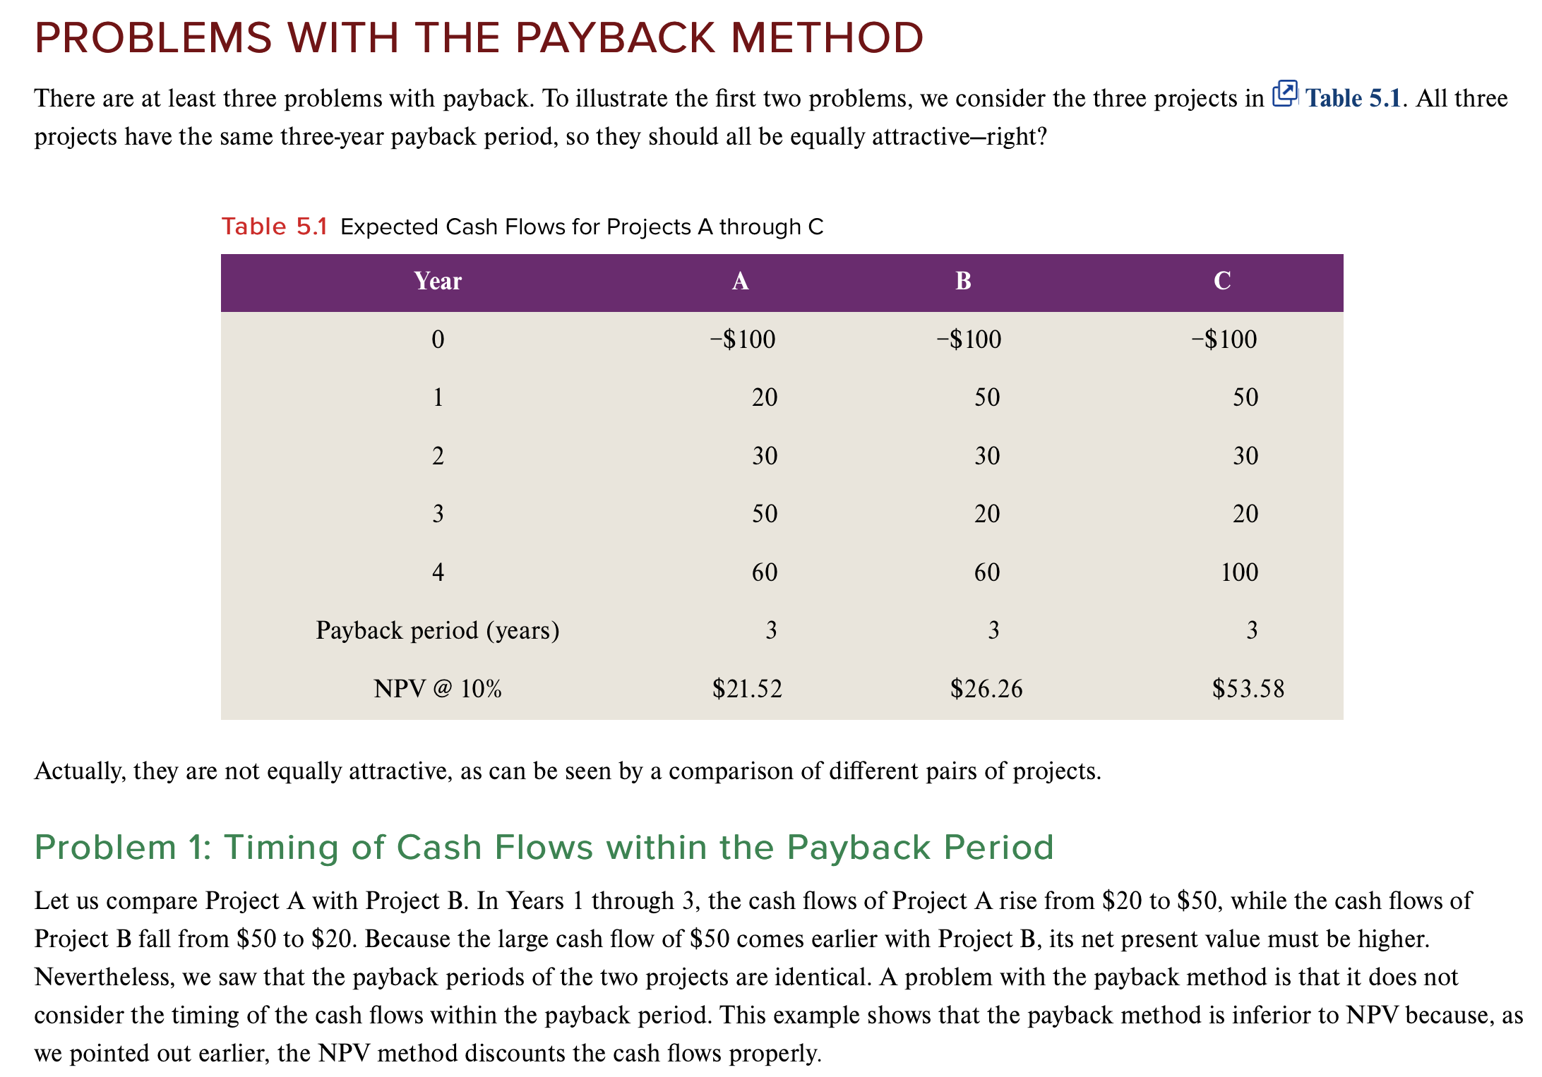
Notes:
Cash flows prior to the cutoff are implicitly discounted at a rate of zero, and cash flows after the cutoff are discounted using an infinite discount rate.

Slide 10
5.3 The Discounted Payback Period
How long does it take the project to “pay back” its initial investment, taking the time value of money into account?
Decision rule: Accept the project if it pays back on a discounted basis within the specified time.
By the time you have discounted the cash flows, you might as well calculate the N P V.
Notes:
Similar advantages and disadvantages as standard payback method, with the exception that cash flows prior to the cutoff are not discounted at zero.

Slide 11
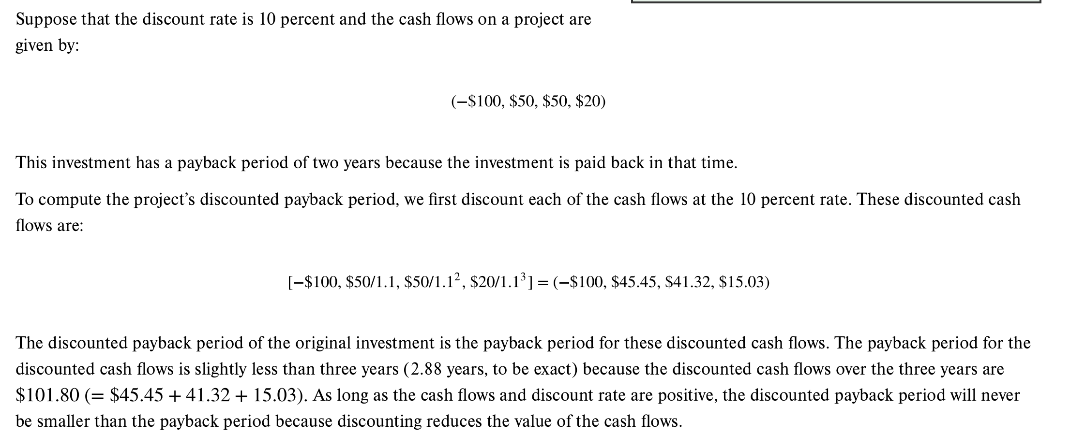

Slide 12
5.4 The Internal Rate of Return
IRR: the discount rate that sets N P V to zero
Minimum Acceptance Criteria:
  Accept if the I R R exceeds the required return.
Ranking Criteria:
  Select alternative with the highest I R R.
Reinvestment assumption:
  All future cash flows are assumed to be reinvested at the I R R.

Slide 13
Internal Rate of Return (I R R)
Disadvantages:
  Does not distinguish between investing and borrowing.
  I R R may not exist, or there may be multiple I R R s.
  Problems with mutually exclusive investments.
Advantages:
  Easy to understand and communicate.

Slide 14
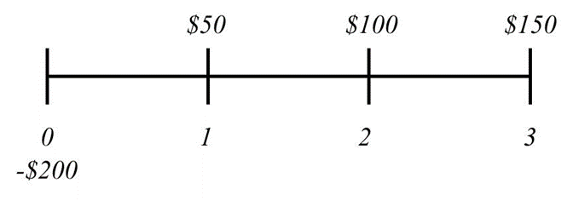
I R R: Example
Consider the following project:
The internal rate of return for this project is 19.44 percent.

Slide 15
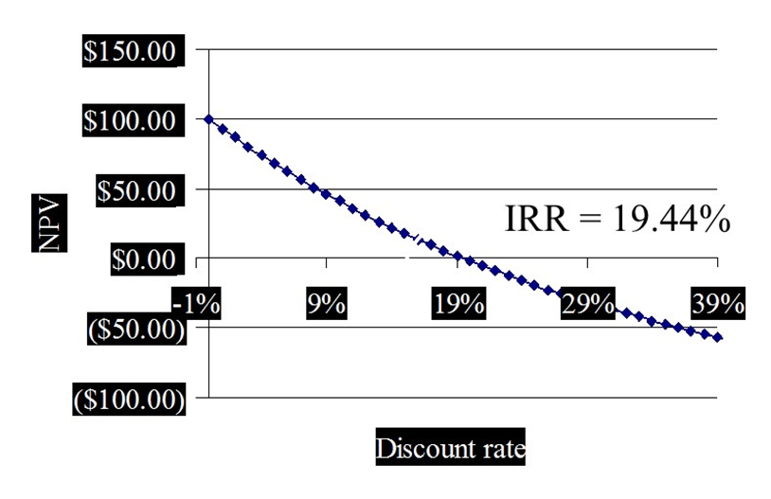
N P V Payoff Profile
If we graph N P V versus the discount rate, we can see the I R R as the x-axis intercept.
0% | $100.00
4% | 73.88
8% | 51.11
12% | 31.13
16% | 13.52
20% | −2.08
24% | −15.97
28% | −28.38
32% | −39.51
36% | −49.54
40% | −58.60
44% | −66.82

Slide 16
Calculating I R R with Spreadsheets
You start with the same cash flows as you did for the N P V.
You use the IRR function:
  You first enter your range of cash flows, beginning with the initial cash flow.
  You can enter a guess, but it is not necessary.
  The default format is a whole percent—you will normally want to increase the decimal places to at least two.
Year | 0 | 1 | 2 | 3
Cash Flows | −$165,000 | $63,120 | $70,800 | $91,080
Required Return | .12
NPV—Incorrect | $11,274.48
NPV—Correct | $12,627.41
IRR | 16% | 16.13%
 | Default Format

Slide 17
5.5 Problems with I R R
Multiple I R R s
Are We Borrowing or Lending?
The Scale Problem
The Timing Problem

Slide 18
Mutually Exclusive versus Independent
Independent projects: accepting or rejecting one project does not affect the decision of the other projects.
  Must exceed a MINIMUM acceptance criteria.
Mutually exclusive projects: only ONE of several potential projects can be chosen, e.g., acquiring an accounting system.
  RANK all alternatives, and select the best one.
Notes:
IRR>>mutually exclusive projects, you are comparing two or more projects to determine which one should be selected. The problem arises because the IRR assumes that any positive cash flows generated by a project will be reinvested at the project's IRR.
When you have mutually exclusive projects, it means that you can only choose one of the projects, and the cash flows from the rejected projects cannot be reinvested in those projects
If you have mutually exclusive projects, you cannot simply choose the one with the highest IRR, because it may not be the one with the highest NPV. This is because IRR assumes that the cash flows are reinvested at the same rate as the IRR, which may not be realistic. For example, suppose you have two projects, A and B, with the following cash flows:
Project A: -$10,000, $5,000, $5,000, $5,000
Project B: -$10,000, $0, $0, $20,000
The IRR of project A is 16.41%, while the IRR of project B is 14.87%. However, if your hurdle rate is 10%, the NPV of project A is $6,284, while the NPV of project B is $8,513. Therefore, project B is more valuable than project A, even though it has a lower IRR.

Slide 19
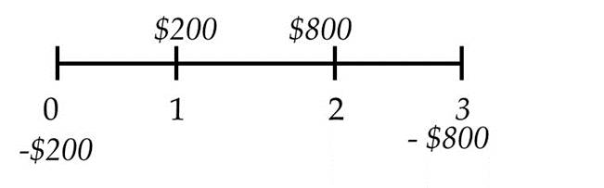
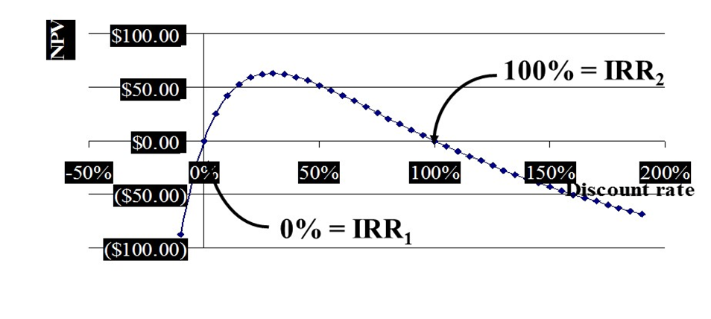
Multiple I R R s
There are two I R R s for this project:
Which one should we use?
Notes:
It is good to mention that the number of IRRs is equivalent to the number of sign changes in the cash flows.
Discount Rates:
0% = IRR1: At a discount rate of 0%, the NPV is equal to the total cash inflows, indicating one possible IRR (IRR1) at this point.
100% = IRR2: As the discount rate increases to 100%, the NPV drops to another point where it crosses zero again, indicating a second IRR (IRR2).
Multiple IRRs: The graph highlights the issue of multiple IRRs. The investment can yield different IRRs at different discount rates due to the shape of the NPV curve. This occurs when cash flows switch signs (from positive to negative or vice versa), resulting in more than one point where the NPV equals zero

Slide 20
Modified I R R
Calculate the net present value of all cash outflows using the borrowing rate.
Calculate the net future value of all cash inflows using the investing rate.
Find the rate of return that equates these values.
Benefits: single answer and specific rates for borrowing and reinvestment
Notes:
The alternative approach discussed in the text is to discount cash flows over a single period (or subset of time), then combine them as necessary to eliminate any sign differences. The approach presented in the slide is more generalized.

Slide 21
The Scale Problem
Would you rather make 100 percent or 50 percent on your investments?
What if the 100 percent return is on a $1 investment, while the 50 percent return is on a $1,000 investment?

Slide 22
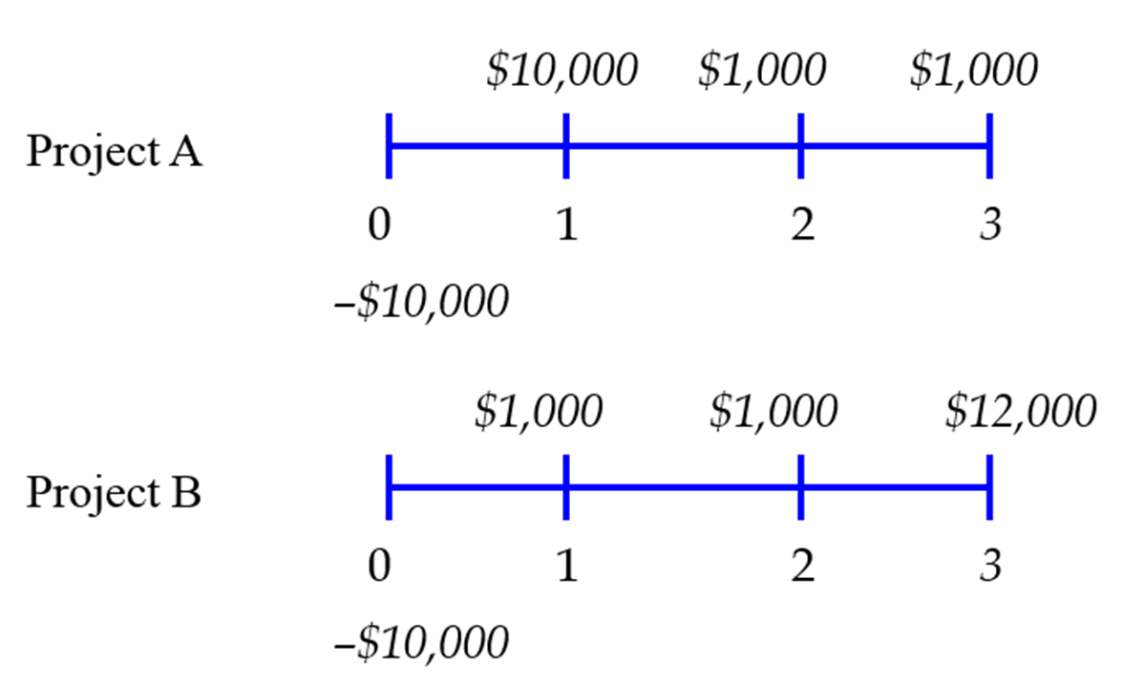
The Timing Problem - I
Notes:
The preferred project in this case depends on the discount rate, not the IRR due to reinvestments assumption.

Slide 23
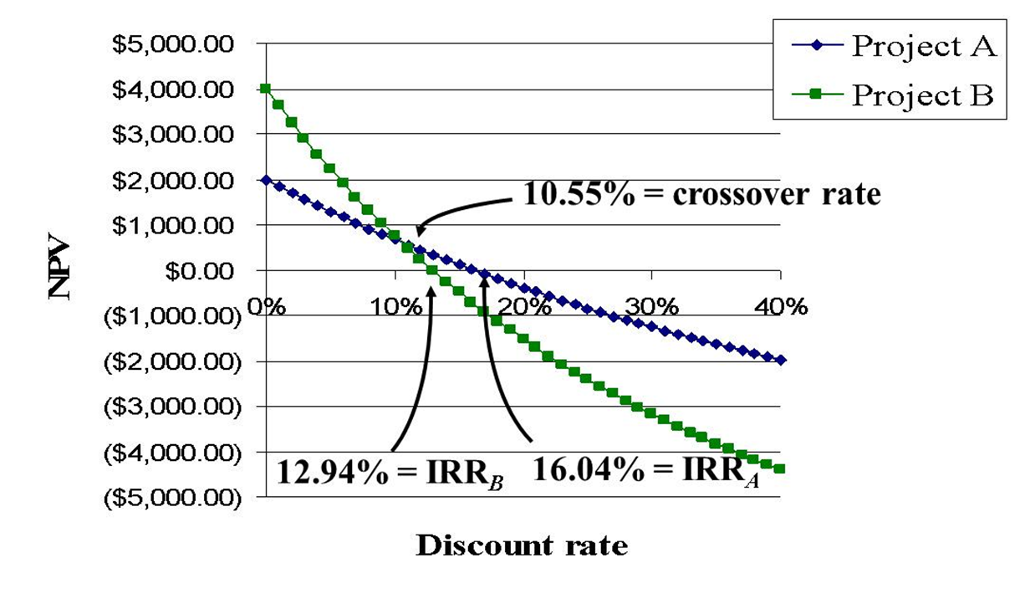
The Timing Problem - II
Access the text alternative for slide images
Notes:
The crossover rate is the IRR of Project A-B

Slide 24
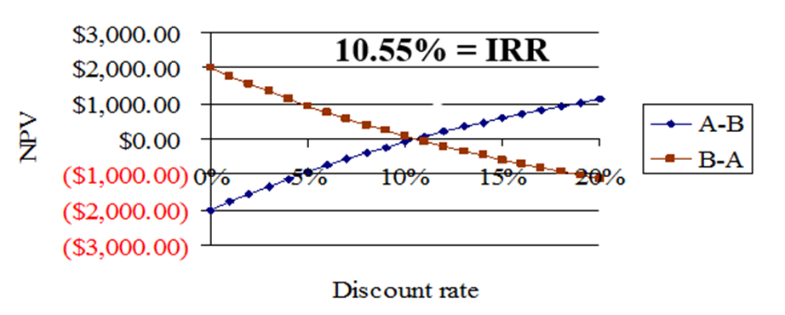
Calculating the Crossover Rate
Compute the I R R for either Project A minus B or B minus A
Year | Project A | Project B | Project A-B | Project B-A
0 | −$10,000 | −$10,000 | $0 | $0
1 | 10,000 | 1,000 | 9,000 | −9,000,00
2 | 1,000 | 1,000 | 0 | 0
3 | 1,000 | 12,000 | −11,000,00 | 11,000
Access the text alternative for slide images

Slide 25
N P V versus I R R
NPV and IRR will generally give the same decision.
Exceptions:
Nonconventional cash flows—cash flow signs change more than once.
Mutually exclusive projects.
  Initial investments are substantially different.
  Timing of cash flows is substantially different.

Slide 26
5.6 The Profitability Index
Minimum Acceptance Criteria:
  Accept if PI > 1
Ranking Criteria:
  Select alternative with highest PI.

Slide 27
The Profitability Index (P I)
Disadvantages:
  Problems with mutually exclusive investments.
Advantages:
  May be useful when available investment funds are limited.
  Easy to understand and communicate.
  Correct decision when evaluating independent projects.
Notes:
Example in the book

Slide 28
5.7 The Practice of Capital Budgeting
Varies by industry:
  Some firms may use payback, while others choose an alternative approach.
The most frequently used technique for large corporations is either I R R or N P V.

Slide 29
Example of Investment Rules – I
Compute the I R R, N P V, P I, and payback period for the following two projects. Assume the required return is 10 percent.
Year | Project A | Project B
0 | −$200 | −$150
1 | 200 | 50
2 | 800 | 100
3 | −800 | 150

Slide 30
Example of Investment Rules - II
 | Project A | Project B
C F₀ | −$200.00 | −$150.00
P V₀ of C F₁₋₃ | $241.92 | $240.80
N P V = | $41.92 | $90.80
I R R = | 0%, 100% | 36.19%
P I = | 1.2096 | 1.6053

Slide 31
Example of Investment Rules - III
Payback Period:
Time | Project A CF | Project A Cum. CF | Project B CF | Project B Cum. CF
0 | −$200 | −$200 | −$150 | −$150
1 | 200 | 0 | 50 | −100
2 | 800 | 800 | 100 | 0
3 | −800 | 0 | 150 | 150
Payback period for Project B = 2 years.
Payback period for Project A = 1 or 3 years?

Slide 32
N P V and I R R Relationship
Discount rate | NPV for A | NPV for B
−10% | −$87.52 | $234.77
0% | 0 | 150.00
20% | 59.26 | 47.92
40% | 59.48 | −8.60
60% | 42.19 | −43.07
80% | 20.85 | −65.64
100% | 0.00 | −81.25
120% | −18.93 | −92.52

Slide 33
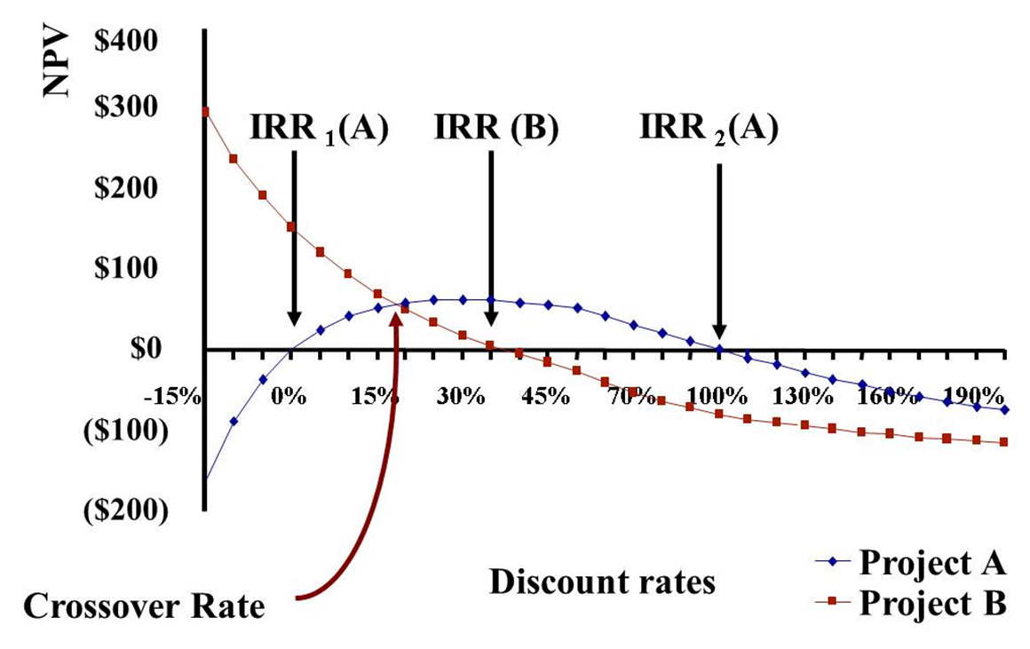
N P V Profiles
Access the text alternative for slide images

Slide 34
Summary—Discounted Cash Flow
Net present value
  Difference between market value and cost.
  Accept the project if the N P V is positive.
  Has no serious problems.
  Preferred decision criterion.
Internal rate of return
  Discount rate that makes N P V = 0.
  Take the project if the I R R is greater than the required return.
  Same decision as N P V with conventional cash flows.
  IRR is unreliable with nonconventional cash flows or mutually exclusive projects.
Profitability Index
  Benefit-cost ratio.
  Take investment if PI > 1.
  Cannot be used to rank mutually exclusive projects.
  May be used to rank projects in the presence of capital rationing.

Slide 35
Summary—Payback Criteria
Payback period
  Length of time until initial investment is recovered.
  Take the project if it pays back in some specified period.
  Does not account for time value of money, and there is an arbitrary cutoff period.
Discounted payback period
  Length of time until initial investment is recovered on a discounted basis.
  Take the project if it pays back in some specified period.
  There is an arbitrary cutoff period.

Slide 36
Quick Quiz
Consider an investment that costs $100,000 and has a cash inflow of $25,000 every year for 5 years. The required return is 9 percent, and payback cutoff is 4 years.
  What is the payback period?
  What is the discounted payback period?
  What is the N P V?
  What is the I R R?
  Should we accept the project?
What method should be the primary decision rule?
When is the IRR rule unreliable?
Notes:
Payback period = 4 years
The project does not pay back on a discounted basis.
NPV = –2758.72
IRR = 7.93%

Slide 37
End of Main Content
© McGraw Hill LLC. All rights reserved. No reproduction or distribution without the prior written consent of McGraw Hill LLC.

Slide 38
Accessibility Content: Text Alternatives for Images

Slide 39
The Timing Problem – II – Text Alternative
Return to parent-slide containing images
The x-axis of this line graph is labeled Discount rate. The y-axis is labeled N P V. Project A has a N P V of $2,000 when the discount rate is zero, while project B has a NPV of $4,000 at a discount rate of zero. Both projects have decreasing N P R values as the discount rate increases, but project B has a greater N P R until the two lines intersect at a discount rate of 10.55 percent. From that point on, the N P V for project A is greater than the N P V for project B. The N P V of project B is zero when the discount rate is 12.94% and the NPV for project A is zero when the discount rate is 16.04%.
Return to parent-slide containing images

Slide 40
Calculating the Crossover Rate – Text Alternative
Return to parent-slide containing images
Blue line on graph shows N P Vs for Project A's cash flows minus Project B's cash flows. Red line on graph shows NPVs for Project B's cash flows minus Project A's cash flows
Graph shows incremental I R R of 10.55% where red and blue lines intersect.
Return to parent-slide containing images

Slide 41
N P V Profiles – Text Alternative
Return to parent-slide containing images
Vertical line shows N P V, and horizontal line shows discount rate. Blue line represents Project A, and red line represents Project B. Intersection of red and blue lines shows cross-over rate or incremental I R R (17.68%)
Project A has 2 I R R s: I R R1 (A) = 0% and I R R2 (A) = 100%. Project B has one I R R: I R R (B) =36.19%
Return to parent-slide containing images

