Slide 1
Management of Translation Exposure
Chapter Ten
Copyright © 2021 by the McGraw-Hill Companies, Inc. All rights reserved.

Slide 2
Chapter Outline
Translation Methods
FASB Statement 8
FASB Statement 52
International Accounting Standards
Management of Translation Exposure
Empirical Analysis of the Change from FASB 8 to FASB 52
Copyright © 2021 by the McGraw-Hill Companies, Inc. All rights reserved.
10-2

Slide 3
Translation Exposure
Translation exposure, frequently referred to as accounting exposure, refers to the effect that an unanticipated change in exchange rates will have on the consolidated financial reports of a MNC
  When exchange rates change, the value of a foreign subsidiary’s assets and liabilities denominated in a foreign currency change when they are viewed from the perspective of the parent firm
Copyright © 2021 by the McGraw-Hill Companies, Inc. All rights reserved.
10-3

Slide 4
Translation Methods
Four methods of foreign currency translation have been used in recent years:
  Current/noncurrent method
  Monetary/nonmonetary method
  Temporal method
  Current rate method
Copyright © 2021 by the McGraw-Hill Companies, Inc. All rights reserved.
10-4

Slide 5
Current/Noncurrent Method
The idea that current assets and liabilities are converted at the current exchange rate while noncurrent assets and liabilities are translated at the historical exchange rates is the current/noncurrent method
  Under this method, a foreign subsidiary with current assets in excess of current liabilities will cause a translation gain (loss) if the local currency appreciates (depreciates)
  This method of foreign currency translation was generally accepted in the United States from the 1930s until 1975, at which time FASB 8 became effective
Copyright © 2021 by the McGraw-Hill Companies, Inc. All rights reserved.
10-5

Slide 6
Monetary/Nonmonetary Method
The idea that monetary balance sheet accounts (e.g., accounts receivable) are translated at the current exchange rate while nonmonetary balance sheet accounts (e.g., stockholder’s equity) are converted at the historical exchange rate is the monetary/nonmonetary method
  Compared to current/noncurrent method, this approach differs substantially with respect to accounts like inventory, long-term receivables, and long-term debt
  Classifies accounts based on similarity of attributes rather than similarly of maturities
Copyright © 2021 by the McGraw-Hill Companies, Inc. All rights reserved.
10-6
Notes:
This method classifies accounts on the basis of similarity of attributes rather than similarity of maturities.
Under this method, most income statement accounts are translated at the average exchange rate for the period. However, revenue and expense items associated with nonmonetary accounts, such as cost of goods sold and depreciation, are translated at the historical rate associated with the balance sheet account.

Slide 7
Temporal Method
The idea that current and noncurrent monetary accounts as well as accounts that are carried on the books at current value are converted at the current exchange rate is the temporal method
  Accounts carried on the books at historical costs are translated at the historical exchange rate
  Fixed assets and inventory are usually carried at historical costs, and as a result, the temporal method and the monetary/nonmonetary method will typically provide the same translation
Copyright © 2021 by the McGraw-Hill Companies, Inc. All rights reserved.
10-7

Slide 8
Current Rate Method
The idea that all balance sheet accounts are translated at the current exchange rate except stockholder’s equity, which is translated at the exchange rate on the date of issuance, is the current rate method
  Simplest of all translation methods to apply
  A “plug” equity account named cumulative translation adjustment (CTA) is used to make the balance sheet balance, since translation gains or losses do not go through the income statement according to this method
Copyright © 2021 by the McGraw-Hill Companies, Inc. All rights reserved.
10-8

Slide 9
FASB Statement 8
FASB 8 became effective on January 1, 1976
Objective was to measure in dollars an enterprise’s assets, liabilities, revenues, or expenses that are denominated in a foreign currency according to GAAP
Essentially the temporal method of translation, with few subtleties
  Temporal method requires taking foreign exchange gains or losses through the income statement.
  Therefore reported earnings could (and did) fluctuate substantially from year to year, irritating executives
Copyright © 2021 by the McGraw-Hill Companies, Inc. All rights reserved.
10-9

Slide 10
FASB Statement 52
Due to controversary surrounding FASB 8, FASB 52 was issued in December 1981
Stated objectives of FASB 52:
  Provide information that is generally compatible with the expected economic effects of a rate change on an enterprise’s cash flows and equity
  Reflect in consolidated statements the financial results and relationship of the individual consolidated entities as measured in their functional currencies in conformity with U.S. GAAP
Copyright © 2021 by the McGraw-Hill Companies, Inc. All rights reserved.
10-10

Slide 11
Functional Currency versus
Reporting Currency
The method of translation prescribed by FASB 52 depends upon the functional currency used by the foreign subsidiary whose statements are to be translated
  Functional currency is the currency of the primary economic environment in which the entity operates
  Reporting currency is the currency in which the MNC prepares its consolidated financial statements
Copyright © 2021 by the McGraw-Hill Companies, Inc. All rights reserved.
10-11

Slide 12
The Mechanics of FASB 52 Translation Process
Two-stage process:
  First, determine in which currency the foreign entity keeps its books
    If the local currency in which the foreign entity keeps its books is not the functional currency, remeasurement into the functional currency is required
    Temporal method used to accomplish remeasurement
  Second, when the foreign entity’s functional currency is not the same as the parent’s currency, the foreign entity’s books are translated using the current rate method
Copyright © 2021 by the McGraw-Hill Companies, Inc. All rights reserved.
10-12

Slide 13
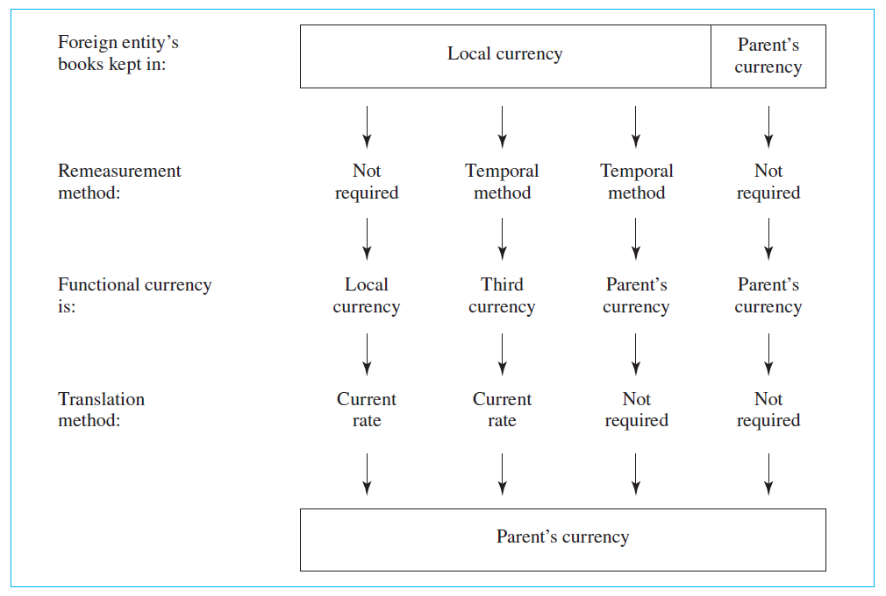
FASB 52 Two-Stage Process
Copyright © 2021 by the McGraw-Hill Companies, Inc. All rights reserved.
10-13

Slide 14
Highly Inflationary Economies
In highly inflationary economies, FASB 52 requires foreign entities to remeasure financial statements using the temporal method “as if the functional currency were the reporting currency”
Highly inflationary economy is defined as, “one that has cumulative inflation of approximately 100 percent or more over a 3-year period”
Copyright © 2021 by the McGraw-Hill Companies, Inc. All rights reserved.
10-14

Slide 15
International Accounting Standards
Since January 2005, all companies doing business in the European Union must use the accounting standards distributed by the International Accounting Standards Board (IASB)
Similar to the FASB, the IASB publishes its standards in a series of pronouncements called International Financial Reporting Standards
It also adopted and maintains the pronouncements of the IASC, the IASC, called International Accounting Standards (IAS)
Copyright © 2021 by the McGraw-Hill Companies, Inc. All rights reserved.
10-15

Slide 16
Translation versus Transaction Exposure
Some items that are a source of transaction exposure are also a source of translation exposure, while others are not
Generally, it is not possible to eliminate both translation and transaction exposure
  Because transaction exposure involves real cash flows, it would be prudent to consider it the more important of the two
  A recent survey found 83% of MNCs placed a “significant” or the “most” emphasis on transaction exposure relative to 37% for translation exposure
Copyright © 2021 by the McGraw-Hill Companies, Inc. All rights reserved.
10-16

Slide 17
Hedging Translation Exposure
If one desires to attempt to control accounting changes in the historical value of net investment, there are two methods for dealing with residual translation exposure:
  Balance sheet hedge
  Derivatives hedge
Copyright © 2021 by the McGraw-Hill Companies, Inc. All rights reserved.
10-17

Slide 18
Balance Sheet Hedge
Note that translation exposure is currency specific, not entity specific
  Source is a mismatch of net assets and net liabilities denominated in the same currency
A balance sheet hedge is intended to reduce translation exposure of an MNC by eliminating the mismatch of exposed net assets (and exposed net liabilities) denominated in the same currency
  However, it may create transaction exposure
Copyright © 2021 by the McGraw-Hill Companies, Inc. All rights reserved.
10-18

Slide 19
Derivatives Hedge
A derivative product, such as a forward contract, can be used to attempt to hedge
  A derivatives hedge to control translation exposure involves speculation about foreign exchange rates
FASB 133 establishes accounting and reporting standards for derivative instruments and hedging activities
  To quality for hedge accounting under FASB 133, a company must identify a clear link between an exposure and a derivative instrument
Copyright © 2021 by the McGraw-Hill Companies, Inc. All rights reserved.
10-19

Slide 20
Translation Exposure versus
Operating Exposure
Depreciation of the local currency may, under certain circumstances, have a favorable operating effect
  For example, a currency depreciation may allow the affiliate to raise its sales price because the prices of imported competitive goods are now relatively higher
  If costs do not rise proportionately and unit demand remains the same, the affiliate would experience an operating profit as a result of the currency depreciation
Copyright © 2021 by the McGraw-Hill Companies, Inc. All rights reserved.
10-20

Slide 21
Empirical Analysis of the Change from FASB 8 to FASB 52
Garlicki, Fabozzi, and Fonfeder (1987)
  Researchers found no significant positive reaction to the change or perceived change in the foreign currency translation process
  Findings suggest market agents do not react to cosmetic earnings changes that do not affect value
  Results underline the futility of attempting to manage translation gains and losses
Copyright © 2021 by the McGraw-Hill Companies, Inc. All rights reserved.
10-21

