Slide 1
Complement Fixation Test
Principle
Procedure
Disadvantages

Slide 2
Introduction:
Complement is a protein (globulin) present in normal serum.
Whole complement system is made up of nine components: C1 to C9
Complement proteins are heat labile and are destroyed by heating at 56°C for 20 – 30 min in a process called heat inactivation.
Complement binds to Ag-Ab complex
When the Ag is complexed with Ab on surface of cell ,Complement causes lysis of cell.

Slide 3
Components of CFT
Test System
Antigen: It may be any Ag, soluble or particulate.
Antibody: Human serum (May or may not contain Antibody towards specific Antigen).
Paired sera are used to detect recent infection( one at acute stage of disease, the other taken 2 weeks later(convalescent stage)
Complement: It is pooled serum obtained from 4 to 5 guinea pigs. It should be fresh or specially preserved as the complement activity is heat labile (stored at -30 °C in small fractions). The complement activity should be initially standardized before using in the test.
Indicator System (Hemolytic system)
Erythrocytes: Sheep RBC ct as Ag
Hemolysin: Rabbit antibody to sheep red cells prepared by inoculating sheep erythrocytes into rabbit under standard immunization protocol.

Slide 4
Principle
Complement fixation
Components of the test system : Patient serum, test known Ag.
Components of the indicator system :
It contains sheep erythrocytes RBC and its corresponding antibody and is used as an indicator which shows the utilization or availability of the complement.

Slide 5
Principle
Complement binds to Ag-Ab complex and gets absorbed during the combination of antigens and antibody.
This property of antigen–antibody complex to fix the complement is used in complement fixation test for the identification of specific antibodies.
If the complement is fixed on test system(Ag + Ab), then there will be no lysis of sheep erythrocytes, thus denoting a positive test.
If the complement is available not bound to test system, it will be free to combine with indicator system resulting in hemolysis denoting a negative test.

Slide 6
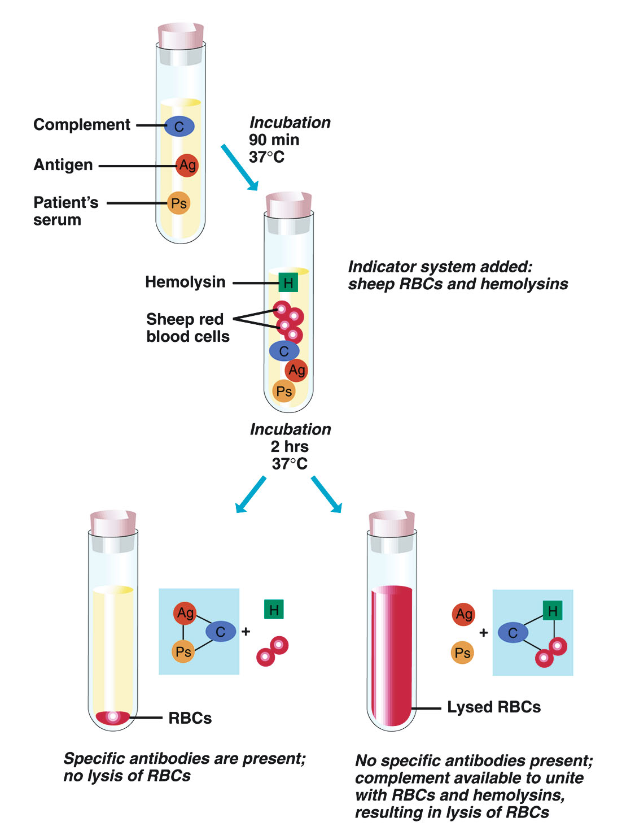

Slide 7
CFT
Ab present
No Ab
Test system+ C
Indicator system
Y
indicator system+ C
Ag
Ag
Y
Y
Y
Y
Y
Y
Y
C
Y
Y
NO lysis
Lysis

Slide 8
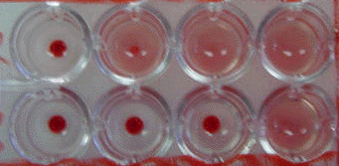
Results and Interpretations:
No hemolysis is considered as a positive test.
Hemolysis of erythrocytes is indicative of a negative test.
1 2 3 4
A
B
Microtiter plate showing
Hemolysis (Well A2, A3 A4, B4)
No Hemolysis (Well A1,B1,B2,B3 )

Slide 9
Determination of Ab titer of patient serum against Mycoplasma Ag
Procedure:
1. Add 25ul of CFD to wells 2 through 10 in row A, and to wells 2, 3, 4 of row G, H.
2. Add 50ul of CFD to wells 11, 12 of row A, and to well 1 in rows G, H.
3. Add 75ul of CFD to well 12 in rows G, H (cell control wells).
4. Add 25ul of 1:8 diluted patient serum (I or II) to wells 1, 2 and 11, 12 of row A
5. Make doubling dilution from well2 through 9, transferring 25ul each time.
6. Discard 25ul from well 9
7. Add 25ul of mycoplasma Ag to wells 1 to 10 in row A.
8. Add 25ul of negative Ag to well 12.
9. Add 25ul of complement to all wells 1-12 in row A.
10. Add 25 ul of complement to wells 1, 2 of rows G, H (complement control wells)
11. Make doubling dilution in rows G, H transferring 25ul from 2 to3 then from 3 to 4, discarding 25ul fromwell4.
12. Add 50ul of CFD to wells 2, 3, and 4 of rows G, H (C' control wells).
12. Mix and incubate overnight at 4c.
13. Add 25ul of sensitized sheep red blood cells to all wells; incubate 1 hour at room temperature .Then read results.

Slide 10
Procedure outline
1 2 3 4 5 6 7 8 9 10 11 12
50ul CFD | 50ul CFD |  |  |  |  |  |  |  |  | 25ul CFD
50ul CFD | 50ul CFD |  |  |  |  |  |  |  |  | 25ul CFD
25ul | 25ul |  |  |  |  |  |  |  |  | 25ul | Ser I 25ul
25ul | 25ul |  |  |  |  |  |  |  |  | 25ul | Ser II25ul
 |  |  |  |  |  |  |  |  |  |  | Myco Ag
 |  |  |  |  |  |  |  |  |  |  | Comple
-ve Ag
 |  |  |  |  |  |  |  |  |  |  | Indicator System

Slide 11
Cell and Complement Control Wells Complement wells: 1-4 cell wells :12
12 | 11 | 10 | 9 | 8 | 7 | 6 | 5 | 4 | 3 | 2 | 1
75ul CFD |  |  |  |  |  |  |  |  |  | 25ul CFD | 50ul ASO buffer
75ul CFD |  |  |  |  |  |  |  |  |  | 25ul CFD | 50ul ASO buffer
25ul Indicator system |  |  |  |  |  |  |  |  |  | 25ul C | 25ul C
 |  |  |  |  |  |  |  |  |  | 25ul C | 25ul C
 |  |  |  |  |  |  |  |  |  |  | 50ul CFD
 |  |  |  |  |  |  |  |  |  |  | Indicator system

Slide 12
CFT Reading results
Ab titer: Read 4 fold rise in Ab titer( 2 well diff) or more to be clinically significant.
Starting Ab dilution will be 1:8 ,then doubling dilution, so it will become 1:16,1:32, 1:64 ,etc.
Controls well10,11,12 result: lysis( well 10: no Ab, well11: no Ag, well12: –ve Ag)
Cell control wells( wellG12,H12: no lysis)
Complement control wells G and H:1,2,3,4
Wells 1,2 lysis .Wells 3,4 no lysis

Slide 13
Advantages and disadvantages
Advantages
large variety of test antigens can be used
Reading is easy ( lysis, no lysis)
More sensitive than other 2 serological tests
Disadvantages:
Demand on equipment and reagents is large
Some of components need to be fresh( RBC’s, Complement)
Less sensitive than 1 serological tests ( IFA, Elisa)

