Slide 1
Lecture 2: Cell membrane structure and transport across cell membrane.
At the end of this session, the students should be able to:
Describe the fluid mosaic model of membrane structure and function.
Define permeability and list factors influencing permeability.
Identify and describe carried-mediated transport processes: Primary active transport, secondary active transport, facilitates diffusion.
Dr. Mouaadh Abdelkarim
Assistant professor
Department of physiology
mabdelkarim@ksu.edu.sa

Slide 2
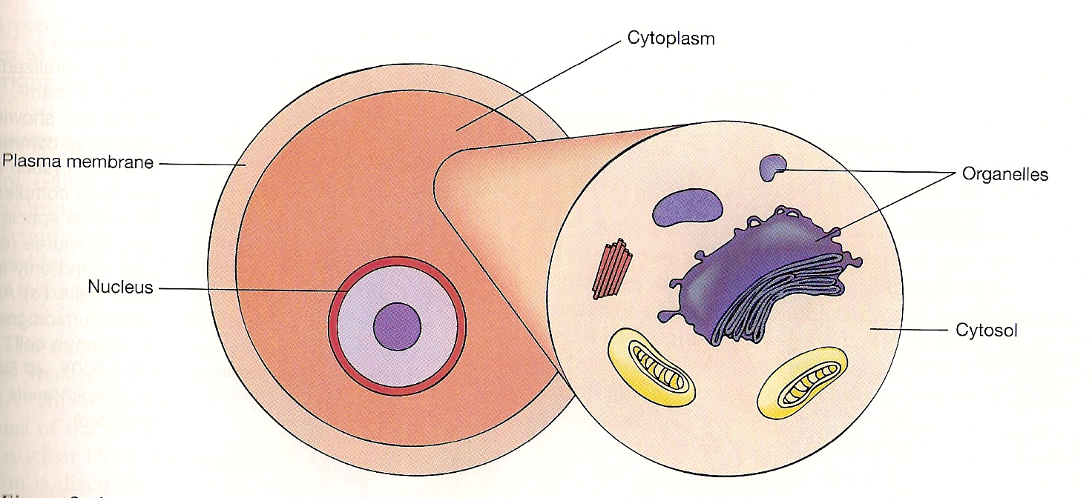
General Cell structure:
3 principal parts:
Plasma (cell) membrane.
Cytoplasm & organelles.
Nucleus.
The cell has two major compartments: the nucleus & the cytoplasm.
The cytoplasm contains the major cell organelles & a fluid called cytosol.

Slide 3
General Cell Structure & Function
Function | Structure | Component
Surrounds, holds cell together & gives its form; controls passage of materials into & out of cell | Membrane composed of double layer of phospholipids in which proteins are embedded | Plasma (cell) membrane
Serves as matrix substance in which chemical reactions occur. | Fluid, jellylike substance b/w cell membrane & nucleus in which organelles are suspended | Cytoplasm
Supports nucleus & controls passage of materials b/w nucleus & cytoplasm Produces ribosomal RNA for ribosomes Contains genetic code that determines which proteins (including enzymes) will be manufactured by the cell | Double-layered membrane that surrounds nucleus, composed of protein & lipid molecules Dense nonmembranous mass composed of protein & RNA molecules Fibrous strands composed of protein & DNA | Nucleus: - Nuclear envelope - Nucleolus - Chromatin

Slide 4
Plasma (Cell) Membrane
Composed of:
Double layer of phospholipids (hydrophobic/ hydrophilic parts).
Proteins span, or partially span the membrane.
Negatively charged carbohydrates attach to the outer surface.

Slide 6
Cell Membrane
It covers the cell.
It is a fluid and not solid.
It is 10 nanometer thick.
It is also referred to as the plasma membrane .

Slide 7
General composition of cell membrane
Proteins ……………………. 55%
Lipids ……………………….. 41%
- Phospholipids … 25%
- Cholesterol ……. 12% Lipids
- Glycolipids …….. 4%
Carbohydrates …………… 3%

Slide 8
The Cell Membrane Phospholipids Consist Of :
Glycerol head (hydrophilic).
Two fatty acid ‘’tails’’ (hydrophobic).

Slide 9
Transport through the cell membrane
Cell membrane is selectively permeable to some molecules & ions.
Not permeable to proteins, nucleic acids, & other molecules.
Lipid or fat-soluble substances, e.g. O₂, CO₂, OH; enter directly into cell membrane through the lipid bilayer.
Water-soluble substances, e.g. ions, glucose, water; enter through proteins of the cell membrane.

Slide 10
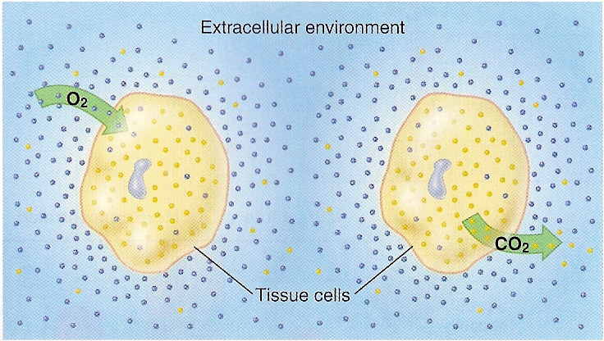
Gas exchange occurs by diffusion. The color dots, which represent oxygen & carbon dioxide molecules, indicate relative concentrations inside the cell & in the extracellular environment. Gas exchange between the intracellular & extracellular compartments thus occur by diffusion.

Slide 11
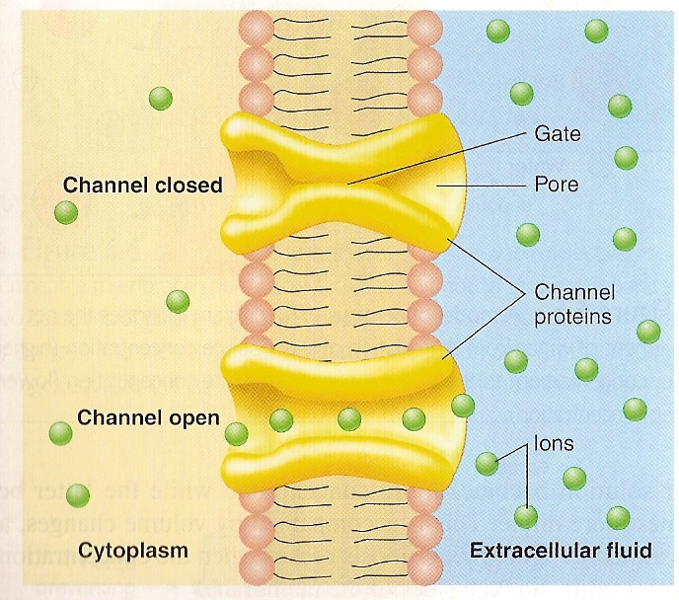
Ions pass through membrane channels. These channels are composed of integral proteins that span the thickness of the membrane. Although some channels are always open, many others have structures known as ‘gates’ that can open or close the channel. This figure depicts a generalized ion channel; most, however, are relatively selective – they allow only particular ions to pass.

Slide 12
Categories of transport through cell Membrane
categorized into:
Carrier mediated transport:
Non-carrier mediated transport.
also categorized by their energy requirements:
Passive transport:
Does not require metabolic energy (ATP).
Active transport:
Requires ATP.

Slide 13
Types of membrane transport
1. Diffusion
(passive transport)
net movement of
molecules & ions across
a membrane from higher
to lower conc.
(down conc gradient)
doesn’t require
metabolic energy.
2. Active transport
net movement across
a membrane that occurs
against conc gradient.
(to region of higher conc)
Requires metabolic energy (ATP), & involves specific carrier proteins.

Slide 14
Types of membrane transport _{(continued)}
1. Diffusion
(passive transport)
a. Simple diffusion.
b. Facilitated diffusion. (Carrier-mediated)
c. Osmosis.
2. Active transport
a. Primary active transport.
b. Secondary active transport.

Slide 15
1. Diffusion
(passive transport)

Slide 16
a. Simple diffusion
Non-Carrier mediated transport.
Involves net transport down an electrochemical gradient (from higher to lower conc).
Does not need cellular metabolism energy. However, it’s powered by thermal energy of the diffusing molecules.
Net diffusion stops when the conc is equal on both sides of the membrane.

Slide 17
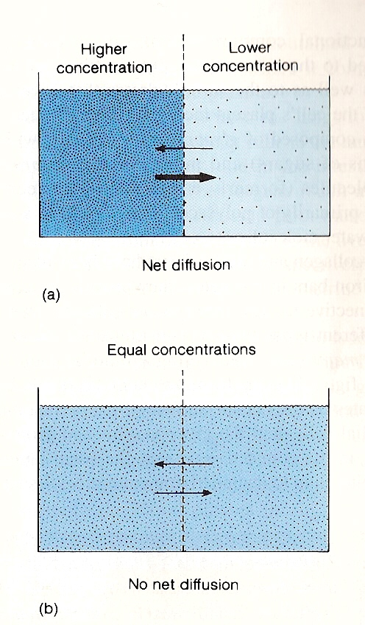
Diffusion of a solute. (a) Net diffusion occurs when there is a concentration difference (or concentration gradient) between two regions of a solution, provided that the membrane separating these regions is permeable to the diffusing substance. (b) Diffusion tends to equalize the concentrations of these regions, & thus to eliminate the concentration differences.

Slide 18
a. Simple diffusion _{(continued)}
Cell membrane is permeable to:
Non-polar molecules (0₂).
Lipid soluble molecules (steroids).
Small polar covalent bonds (C0₂).
H₂0 (small size, lack charge).
Cell membrane impermeable to:
Large polar molecules (glucose).
Charged inorganic ions (Na⁺).

Slide 19
Rate of Diffusion
Speed at which diffusion occurs depends on:
Magnitude of conc gradient across the 2 sides of the membrane.
Higher gradient drives the force of diffusion.
Permeability of the membrane to the diffusing substances.
Depending on size & shape of the molecules.
Temperature of the solution.
Higher temperature, faster diffusion rate.
Surface area of the membrane.
Microvilli increase surface area.

Slide 20
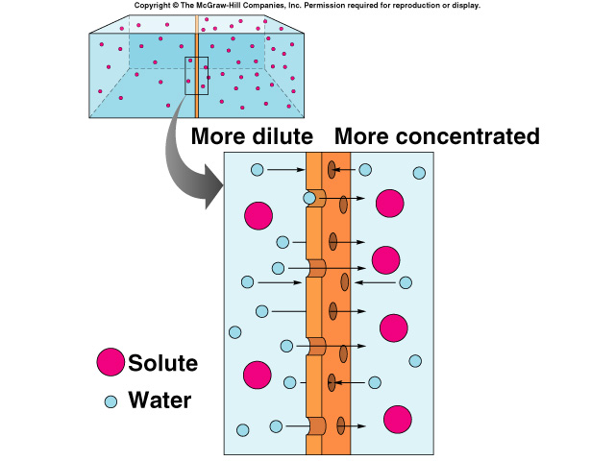
b. Osmosis
Net diffusion of H₂0 across a selectively permeable membrane.
Movement of H₂0 from a high [H₂0] to lower [H₂0] until equilibrium is reached.
2 requirements for osmosis:
Must be difference in [solute] on the 2 sides of the membrane.
Membrane must be impermeable to the solute.

Slide 21
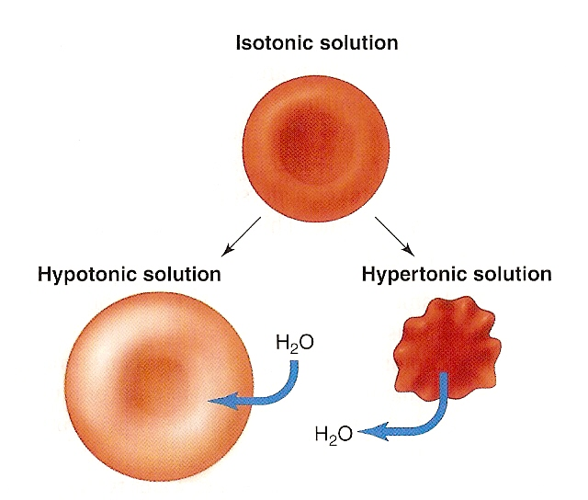
Red blood cells in isotonic, hypotonic, & hypertonic solutions. In each case, the external solution has an equal, lower, or higher osmotic pressure, respectively, than the intracellular fluid, As a result, water moves by osmosis into the red blood cells placed in hypotonic solutins, causing them to swell and even to burst. Similarly, water moves out of red blood cells placed in a hypertonic solution, causing them to shrink & become crenated.

Slide 22
c. Facilitated diffusion
Protein-Carrier mediated transport, within the membrane.
Involves net transport down an electrochemical gradient
(from higher to lower conc).
Does not need cellular metabolic energy. However, it’s
powered by thermal energy of diffusing molecules.
Molecules that are too large & polar to diffuse are transported
across plasma membrane by protein carriers.
e.g. Glucose, most of amino acids, & other organic molecules.

Slide 23
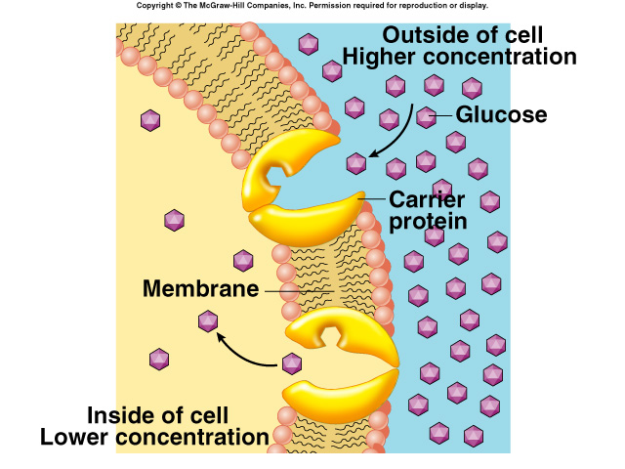
Facilitated Diffusion _{(continued)}
Passive transport:
ATP not needed.
Involves transport of substance through cell membrane down conc gradient by carrier proteins.
Transport carriers for glucose in intestines & in kidney’s basal membrane.

Slide 24
2. Active transport

Slide 25
2. Active transport:
Protein-Carrier mediated transport.
Involves net transport, i.e. against electrochemical gradient (from lower to higher conc).
Requires metabolic energy (ATP).

Slide 26
Types of active transport
I. Primary active transport
II. Secondary active transport

Slide 27
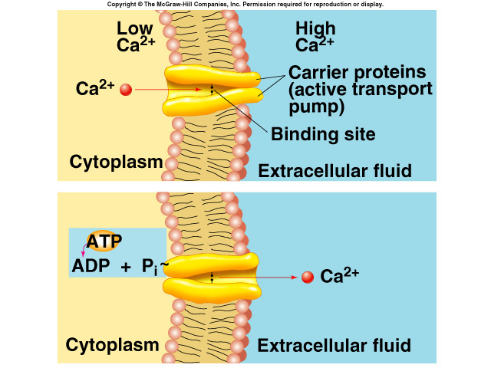
I. Primary Active Transport
Energy is supplied directly from hydrolysis of ATP for the fx of the protein carriers.
Molecule or ion binds to “recognition site” on one side of carrier protein.
Binding stimulates phosphorylation (breakdown of ATP) of carrier protein.
Carrier protein undergoes conformational change.
Some of these carriers transport only one molecule or ion for another.

Slide 28
Primary active transport _{(continued)}
Examples:
a. Sodium-Potassium pump (Na⁺/K⁺ pump).
b. Primary active transport of calcium (Ca²⁺ ATPase).
c. Primary active transport of hydrogen ions
(H⁺/K⁺ ATPase)

Slide 29
Sodium-Potassium pump (Na⁺/K⁺ pump):
Present in most cell membranes.
e.g. in basolateral membrane of the kidneys, & in
intestines.
Energy dependent transport, because both ions are moved against their conc gradient.

Slide 30
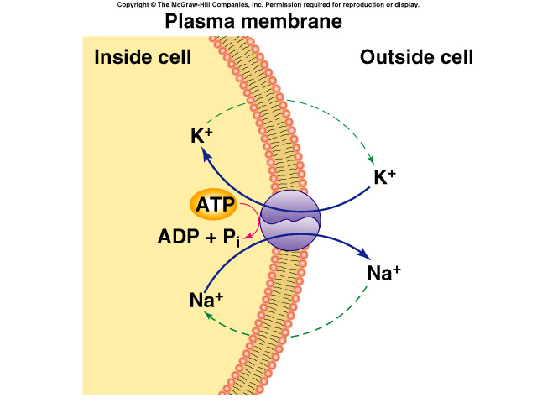
Na⁺/K⁺ Pump
Is also an ATP enzyme that converts ATP to ADP and Pi.
Actively extrudes 3 Na⁺ & transports 2 K⁺ inward against conc gradient.
Steep gradient serves differents fxs:
Provides energy for “coupled transport” of other molecules.
Involvement in electrochemical impulses.
Promotes osmotic flow.
2
3

Slide 31
II. Secondary active transport: (Coupled Transport)
Transport of one or more solutes against an electrochemical gradient, coupled to the transport of another solute down an electrochemical gradient.
Energy needed for “uphill” movement obtained from “downhill” transport of Na⁺.
Hydrolysis of ATP by Na⁺/K⁺ pump required indirectly to maintain [Na⁺] gradient.

Slide 32
Secondary Active Transport _{(continued)}
If the other molecule or ion is moved in the same direction as Na⁺ (into the cell), the coupled transport is called either: ‘cotransport’ or ‘symport’.
If the other molecule or ion is moved in the opposite direction as Na⁺ (out of the cell), the process is called either: ‘countertransport’ or ‘antiport’.

Slide 33
a. Co-transport (Symport)
All solutes move in the same direction → “to the inside of the cell”
e.g.
- Na⁺– glucose Co transport
- Na⁺– amino acid Co transport
In the intestinal tract, & kidney’s brush borders.

Slide 34
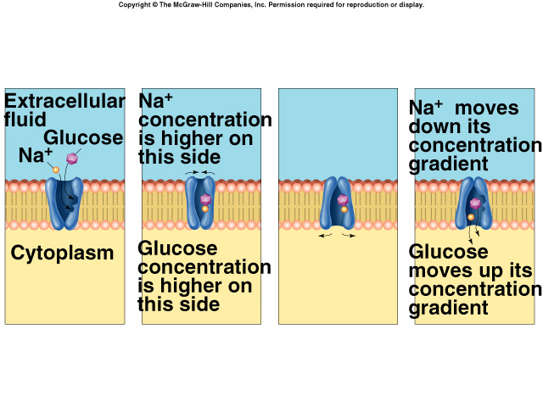
Na⁺– glucose Co transport

Slide 35
b. Counter transport (Antiport)
Na⁺ is moving to the interior causing other substance to move out.
e.g.
- Ca²⁺– Na⁺ exchange
… (present in many cell membranes)
- Na⁺– H⁺ exchange in the kidney
- Cl⁻– HCO₃⁻ exchange across RBCs.

