Slide 1
Cell physiology
Areej Aloufi, MSc BSc

Slide 2
Cell Physiology: Membrane Transport
Membrane transport—movement of substances into and out of the cell
Two basic methods of transport
Passive transport
No energy is required
Active transport
Cell must provide metabolic energy (Adenosine Tri Phosphate, ATP)

Slide 3
Intracellular fluid—nucleoplasm and cytosol
Interstitial fluid—fluid on the exterior of the cell

Slide 4
Selective Permeability
The plasma membrane allows some materials to pass while excluding others
This permeability influences movement both into and out of the cell

Slide 5
Passive Transport
Passive transport is the movement of molecules across the cell membrane and does not require energy.
It is dependent on the permeability of the cell membrane.
There are three main kinds of passive transport - Diffusion, Osmosis and Facilitated Diffusion.

Slide 6
Passive Transport Processes
Diffusion
Particles tend to distribute themselves evenly within a solution
Movement is from high concentration to low concentration, or down a concentration gradient
As molecule diffuse a state of equilibrium occurs
Speed is affected by size and temp
Simple Diffusion
An unassisted process
Solutes are lipid-soluble materials or small enough to pass through membrane pores
Figure 3.9

Slide 7
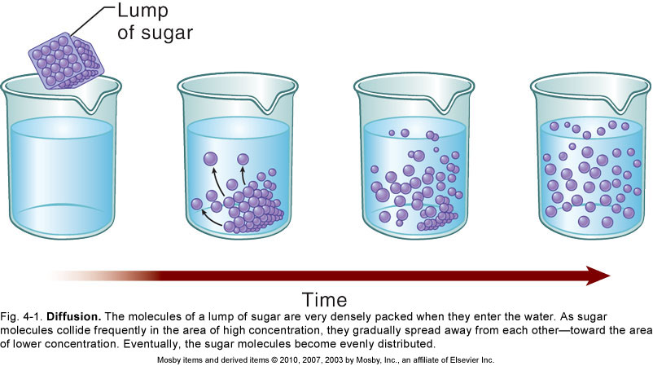

Slide 9
Facilitated diffusion
This process does not require ATP but does require cell membrane proteins which are called carrier proteins to carry the molecules across the cell membrane from an area of higher concentration to an area of lower concentration

Slide 10
Osmosis
The movement of water across a semi permeable membrane.
Osmosis is the movement of water (red dots) through a semipermeable membrane to a higher concentration of solutes (blue dots).
Osmotic pressure: force required to prevent water from moving across a membrane by osmosis

Slide 11
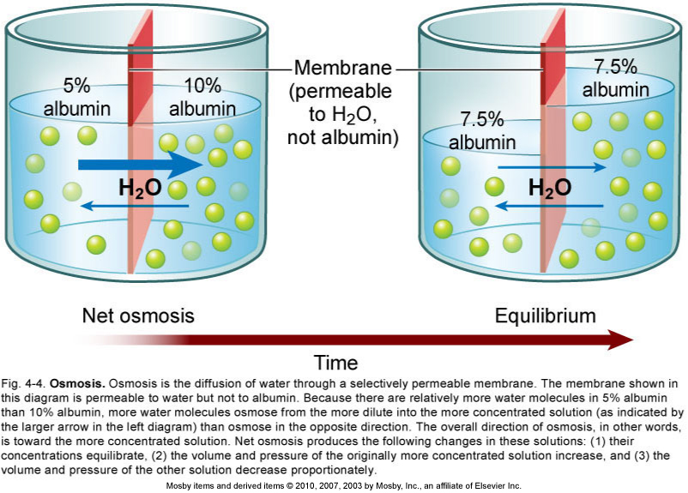
Osmosis
Figure 3.10d

Slide 12
Osmosis
Allows water to move across membranes
Results in a change in volume
Causes a change in pressure

Slide 13
Passive Transport Processes
Filtration
Water and solutes are forced through a membrane by fluid, or hydrostatic pressure
A pressure gradient must exist
Solute-containing fluid (filtrate) is pushed from a high-pressure area to a lower pressure area
- Example: urine formation in the kidneys. Water and small molecules move through the membrane while large molecules remain in the blood

Slide 14
Passive Transport
Role of passive transport processes
Move substances down a concentration gradient, thus maintaining equilibrium and homeostatic balance
Types of passive transport: simple and facilitated diffusion (channels and carriers); osmosis is a special example of channel-mediated passive transport of water, and Filtration.

Slide 15
Active Transport Processes
Substances are transported that are unable to pass by diffusion
Substances may be too large
Substances may not be able to dissolve in the fat core of the membrane
Substances may have to move against a concentration gradient
ATP is used for transport

Slide 16
Active Transport Processes
Two common forms of active transport
Transport by Pumps
Vesicular transport
Exocytosis
Endocytosis
Phagocytosis
Pinocytosis

Slide 17
Active Transport Processes
Transport by pumps
Amino acids, some sugars, and ions are transported by protein carriers called solute pumps
ATP energizes protein carriers
In most cases, substances are moved against concentration gradients
Example: Na+/K+ pumps

Slide 19
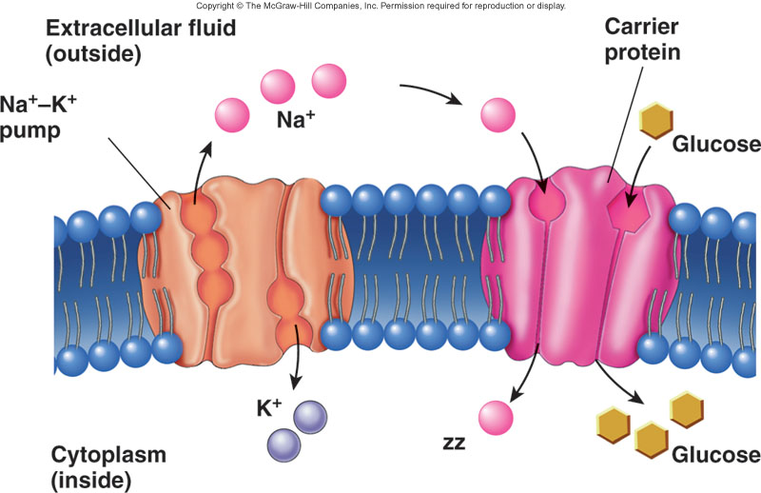
Secondary Active Transport
Ions or molecules move in same (symport) or different (antiport) direction.
Is the movement of glucose a symporter example or an antiporter example?
This example shows cotransport of Na⁺ and glucose.
A sodium-potassium exchange pump maintains a concentration of Na that is higher outside the cell than inside. Active transport.
Na moves back into the cell by a carrier protein that also moves glucose. The concentration gradient for Na provides the energy required to move glucose against its concentration gradient.

Slide 20
Vesicular Transport
Transport by vesicles allows substances to enter or leave the interior of a cell without moving through its plasma membrane
Endocytosis: the plasma membrane “traps” some extracellular material and brings it into the cell in a vesicle
Two basic types of endocytosis
Phagocytosis (“condition of cell eating”): large particles are engulfed by the plasma membrane and enter the cell in vesicles; the vesicles fuse with lysosomes, which digest the particles
Pinocytosis (“condition of cell drinking”): fluid and the substances dissolved in it enter the cell
Receptor-mediated endocytosis: membrane receptor molecules recognize substances to be brought into the cell

Slide 21
Vesicular Transport
Exocytosis
Moves materials out of the cell
Material is carried in a membranous vesicle
Vesicle migrates to plasma membrane
Vesicle combines with plasma membrane
Material is emptied to the outside
Examples
Secretion of digestive enzymes by pancreas
Secretion of mucous by salivary glands
Secretion of milk by mammary glands

Slide 22
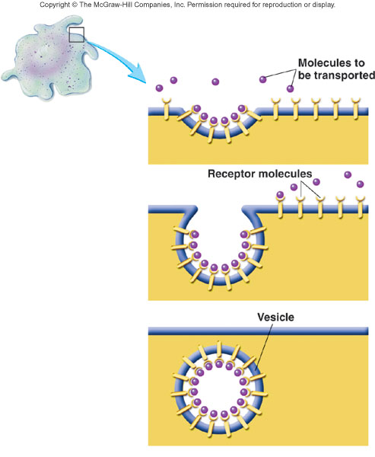
Endocytosis and Exocytosis

Slide 23
Active Transport
Role of active transport processes
Active transport requires energy use by the membrane
Pumps concentrated substances on one side of membrane, such as when storing an ion inside an organelle
Vesicle-mediated (endocytosis, exocytosis): move large volumes of substances at once, such as in secretion of hormones and neurotransmitters

Slide 24
Active Transport
Active Transport requires the cell to use energy, usually in the form of ATP.
Active Transport creates a charge gradient in the cell membrane. For example in the mitochondrion, hydrogen ion pumps pump hydrogen ions into the intermembrane space of the organelle as part of making ATP.
Active Transport keeps unwanted ions or other molecules out of the cell that are able to diffuse through the cell membrane.
Active transport uses energy to send substances against the direction they would travel by simple diffusion: that is from a region of low concentration to a region of high concentration.

Slide 25
Cell Growth and Reproduction

Slide 26
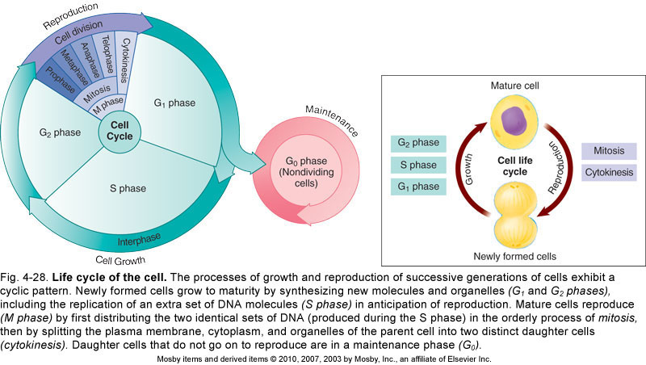
Cell growth and reproduction of cells are the most fundamental of all living functions and together constitute the cell life cycle
Cell growth: depends on using genetic information in DNA to make the structural and functional proteins needed for cell survival
Cell reproduction: ensures that genetic information is passed from one generation to the next

Slide 27
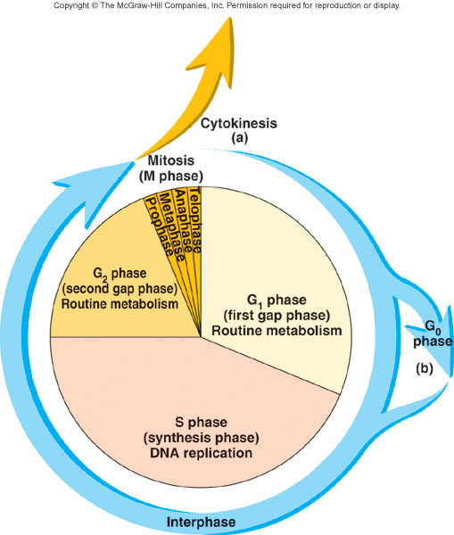
Cell Life Cycle
Interphase: phase between cell divisions
Replication of DNA
Ongoing normal cell activities
Mitosis: series of events that leads to the production of two cells by division of a mother cell into two daughter cells. Cells are genetically identical.
Prophase
Metaphase
Anaphase
Telophase
Cytokinesis: division of cell cytoplasm

Slide 28
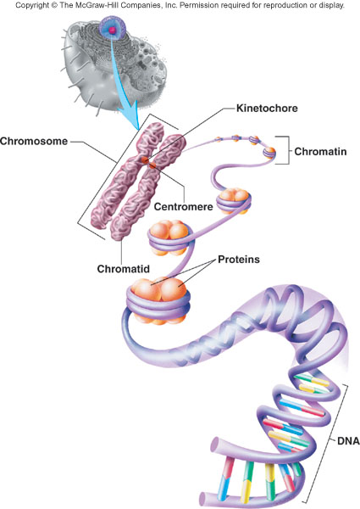
Chromosome Structure
Chromatin: DNA complexed with proteins (histones)
During cell division, chromatin condenses into pairs of chromatids called chromosomes. Each pair of chromatids is joined by a centromere

Slide 29
Mitosis and meiosis
Mitosis occurs in the rest of the body’s tissues
Meiosis occur in ovaries and testis
Meiosis reduces the chromosome number from 46 to 23
Fertilization fuses two gametes together & returns the number to 46

Slide 30
Mitosis
Results in → 2 daughter cells with the same genes as the mother
Mitosis stages
Prophase
metaphase
Anaphase
Telophase

Slide 31
Prophase
Chromatine coil and shorten forming cromosmes
Each consist of 2 chromatid held together by centromere

Slide 32
Prophase
Chromatine coil and shorten forming cromosmes
Each consist of 2 chromatid held together by centromere
Centriole separate and move to opposite sides
Miotic spindle –composed of microtubules) are assembled
Nuclear envelope and nucleoli break down
Chromosomes attach to spindles fibers by their centromeres

Slide 33
Metaphase
Chromosomes align at the center of the spindle

Slide 34
Anaphase
Centromeres split
Chromatides( now known as cromosomes again) move apart

Slide 35
Telophase
Chromosomes uncoil to become cromatine again
Spindle break
Nuclear envelope and nucleoli form again

Slide 36
Meiosis

Slide 37
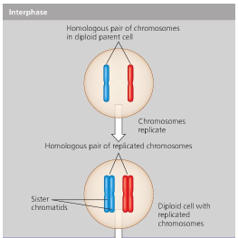
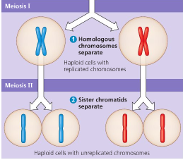
Meiosis
meiosis occurs only in reproductive organs
A diploid cell replicate in preparation for cell division
Then, it undergoes two divisions producing four haploid cells (Half the chromosomes)

Slide 38
Meiosis
meiosis occurs only in reproductive organs
A diploid cell replicate in preparation for cell division
Then, it undergoes two divisions producing four haploid cells (Half the chromosomes)

Slide 39
http://safeshare.tv/w/lPisihyhzE

