Slide 1
CE 445 Wastewater Reclamation and Reuse
Dr. Mohab Kamal

Slide 2
Introduction to Risk Assessment
When health effects can occur as the result of an environmental action, risk analysis is used to quantify the corresponding risks.
Typically, a complete risk analysis is divided into two parts:
Risk assessment
Risk management
Risk assessment involves the study and analysis of potential effect of certain hazards to human health. Using statistical information on cause and effect, risk assessment is intended to be a tool for making informed decisions.
Risk management is the process of reducing risks that are determined to be unacceptable.

Slide 3
Risk Assessment
Environmental risk analysis takes place in four discrete steps:
Hazard identification
Exposure assessment
Dose response assessment
Risk characterization

Slide 4
Risk Identification
This step involves weighing the available evidence and determining whether a substance or constituent exhibits a particular adverse health hazard.
As a part of hazard identification, evidence is gathered on the potential for a substance to cause health effects in humans or unacceptable environmental impacts.
For humans, the principal sources for this information are clinical studies, controlled epidemiological studies, experimental animal studies and from evidence gathered from accidents and natural disasters.

Slide 5
Exposure Assessment
Exposure is the process by which an organism comes into contact with hazard.
For humans, exposure can occur through different pathways including inhalation of air, ingestions of water or food, absorption through the skin via dermal contact, or absorption through the skin via radiation.
The key steps in exposure assessment are identification of a potential receptor population, evaluation of exposure pathways and routes, and quantification of exposures.

Slide 6
Dose-Response Assessment
The fundamental goal of a dose-response assessment is to define a relationship (typically mathematical) between the amount of a toxic constituents to which a human is exposed and the risk that there will be an unhealthy response to that dose in humans.
Typically dose-response relationships for carcinogenic and non-carcinogenic constituents are shown in this figure.
It should be noted that it is assumed that there is no threshold for potentially carcinogenic constituents.

Slide 7
Dose-Response Assessment
Although the dose-response curve for a carcinogenic constituent is shown passing through the origin, data are not available at extremely low concentrations.
Therefore, mathematical models have been developed to define the dose-response at low concentrations.
Typical dose-response models that have been proposed are used for human exposure include:
The single-hit model
The multistage model
The linear multistage model
The multi-hit model
The probit model

Slide 8
Dose-Response Assessment

Slide 9
Dose-Response Assessment
The mathematical function used to describe the relationship between risk ad dose for the single-hit model is
P(d) = 1 – exp [-(q_{o} – q_{i} d)]
where P(d) = lifetime risk (probability) of developing cancer
q_{o} and q_{i} = empirical parameters picked to fit the data
d = dose
The mathematical formulation used to describe the relationship between risk and dose for multistage model is
P(d) = 1 – exp $\left[ −\sum_{i=0}^{n}{ q_{i}d^{i}}\right]$
where P(d) = lifetime risk (probability) of developing cancer
q_{i} = empirical parameters picked to fit the data
d = dose

Slide 10
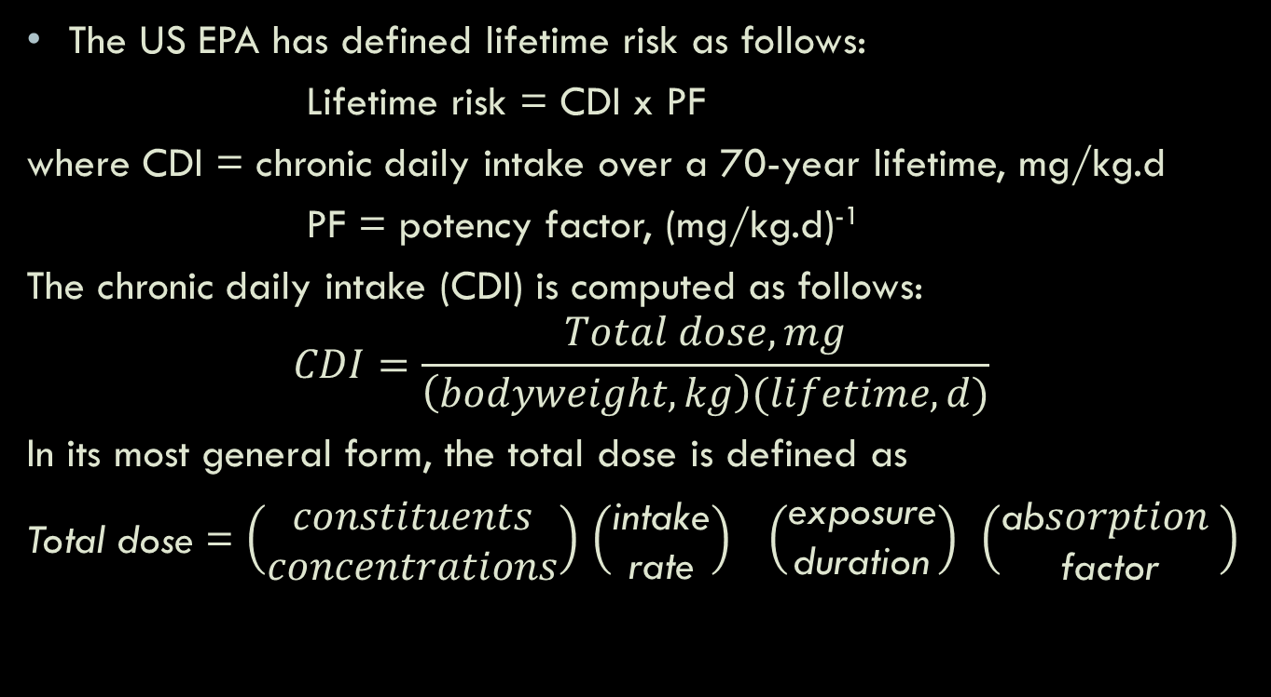
Dose-Response Assessment
The US EPA has defined lifetime risk as follows:
Lifetime risk = CDI x PF
where CDI = chronic daily intake over a 70-year lifetime, mg/kg.d
PF = potency factor, (mg/kg.d)⁻¹
The chronic daily intake (CDI) is computed as follows:
$$CDI=\frac{Total dose, mg}{\left(bodyweight, kg\right)(lifetime, d)}$$
In its most general form, the total dose is defined as
Total dose = $\left(\begin{aligned}constituents \\ concentrations\end{aligned}\right)$ $\left(\begin{aligned}\text{intake} \\ \text{rate}\end{aligned}\right)$ $\left(\begin{aligned}\text{exposure} \\ \text{duration}\end{aligned}\right)$ $\left(\begin{aligned}\text{ab}sorption \\ \text{factor}\end{aligned}\right)$

Slide 11
Dose-Response Assessment
Recommended standard values for daily intake calculations have also been developed by EPA. The average body weights used for an adult and child are 70 and 10 kg, respectively and the corresponding rates of water ingestion are 2 and 1 liters per day.
The potency factor, PF, often identified as the slope factor, is the slope of the dose-response curve, at very low doses.
The US EPA has selected the linear multistage model as basis for assessing risk.

Slide 12
Dose-Response Assessment
Typical toxicity data for several chemical constituents are reported in the table below.

Slide 13
Dose-Response Assessment
Example 13 – 1: Risk Assessment for drinking groundwater containing trace amounts of N-Nitrosodimethylamine (NDMA)
Estimate the incremental cancer risk for an adult associated with drinking 2 L per day of groundwater containing 2.0 µg/L of NDMA using data from the integrated risk information system. To limit NDMA exposure to acceptable cancer risk of 1 to 100,000, determine the concentration of NDMA that can be allowed in extracted groundwater.

Slide 14
Dose-Response Assessment
Example 13 – 1: Risk Assessment for drinking groundwater containing trace amounts of N-Nitrosodimethylamine (NDMA)
Solution:
1. Compute CDI = (average daily dose, mg/d)/(body weight, kg)
= ( 2.0 µg/L) (2 L/d) (1 mg/10³ µg) / 70 kg
= 0.57 x 10⁻⁴ mg/kg.d
2. Compute the lifetime risk,
Incremental lifetime risk = CDI x PF
PF for NDMA (oral route) = 5.1 x 10 (mg/kg.d)⁻¹
Incremental lifetime risk = 0.57 x 10⁻⁴ x 5.1 x 10
= 2.9 x 10⁻³
From the results of this analysis, estimated probability of developing elevated cancer risk as a result of drinking the groundwater containing 2.0 µg/L of NDMA is 2.9 per 1000 person.

Slide 15
Dose-Response Assessment
Example 13 – 1: Risk Assessment for drinking groundwater containing trace amounts of N-Nitrosodimethylamine (NDMA)
Solution:
3. Determine the concentration of NDMA to limit the acceptable cancer risk to 1 in 100,000
Estimate the CDI
10⁻⁵ = CDI x 5.1 x 10, therefore, CDI = 1.96 x 10⁻⁷ mg/kg.d
Estimate the concentration of NDMA
(C) (2 L/d) (1 mg/10³ µg) / 70 kg = 1.96 x 10⁻⁷ mg/kg.d
C = 0.0069 µg/L = 6.9 ng/L

Slide 16
Risk Characterization
The final step in risk assessment is risk characterization, in which the question of who is affected and what are the likely effects are defined to the extent they are known.
Risk characterization involves the integration of exposure and dose-response assessments to arrive at the quantitative probabilities that effects will occur in humans for a given set of exposure conditions.

Slide 17
Risk Assessment in Standard Setting
An acceptable risk of 1 in 10,000 is often used in environmental risk assessment.
Risks of less than 1 in 10,000 are considered minimal.

Slide 18
Risk Management
Risk management involves the development of standards and guidelines and management strategies for specific constituents including both toxic constituents and infectious agents.
For example, if a toxic constituent or infectious microorganisms are present at higher than the maximum allowable concentration based on the risk assessment, risk management involves the determination of what management and /or technology is necessary to limit the risk to an acceptable level.
Thus, the development and screening of alternatives; selection, design, and implementation; and monitoring and review are important elements of health risk management.

Slide 19
Ecological Risk Assessment
Ecological risk assessment is similar to risk assessment for humans in that the ecological effects of exposure to one or more stressors are assessed.
A stressor is defined as a substance, circumstance, or energy field that can cause an adverse effect on a biological system.
It should be noted that ecological risk assessments are undertaken for a variety of reasons such as to assess the potential impacts of the discharge of treated effluent to an existing wetland or applying bio-solids on land.

Slide 20
Ecological Risk Assessment
The framework for ecological risk assessment involving:
Problem formulation, in which the characteristics of the stressor are identified
Identification and characterization of the ecosystem at risk and the exposure modes.
Identification of likely ecological risks
Risk characterization, in which all of the information and data are integrated along with input from risk manager.

Slide 21
Environmental Impact Assessment of Various Pollutants on Public Health and the Environment
Pathogenic Microorganisms and Trace Organics
Public Health – dysentery, salmonellosis, infectious hepatitis, cholera, typhoid
Infiltration into potable water supplies
Irrigation of crops that are eaten uncooked
Aerosols – from specific irrigation processes
Environmental Impact – Effect on terrestrial life
Heavy Elements
Public Health – nervous system disorders, mutagenesis, teratogens, carcinogenesis
Bioaccumulation (food chain on crops and animals)
Surface water pollution
Environmental Impact – acute and chronic toxicity for plant and animal life, chronic degradation effect on soil.

Slide 22
Environmental Impact Assessment of Various Pollutants on Public Health and the Environment
Nutrients
Public Health – blue-baby syndrome (form NO₃)
Infiltration into potable water supplies
Environmental Health – Eutrophication, crop yield effects (+ve & -ve)
Surface water pollution
Irrigation practices
Dissolved Solids (Salinity)
Environmental Health
Induce problems for the crops yield selection and quantity
Accumulation in soil
Effect on soil permeability
Clogging drip-irrigation systems

Slide 23
Environmental Impact Assessment of Various Pollutants on Public Health and the Environment
Emerging Pollutants
Public Health
Acute and chronic health effects – effect on growth, reproduction problems
Inadequate, or no information

Slide 24
Environmental Impact Assessment of Agricultural Irrigation on Public Health and Environmental Issues
Eutrophication
Increased nutrients in surface waters
Groundwater contamination
Nitrate contamination on private drinking wells
Biological Aerosols
Gastrointestinal problems in nearby communities
Antibiotics
Odor
Public health of neighboring communities
Aesthetic concern – reduced land values

Slide 25
Environmental Impact Assessment of Agricultural Irrigation on Public Health and Environmental Issues
Marketability
Public acceptance
Effect on Soil Regarding
Salinity
Increased osmotic pressure on plants
Specific Ion Toxicity
Worse in hot and arid regions (due to high evapotranspiration)
Nutrients
Water infiltration Rate

Slide 26
Environmental Impact Assessment of Industrial Reuse and Non-potable Urban Uses on Public Health and Environmental Issues
Public Health Concerns
Aerosol transmission of organics
Pathogens in cooling
Pathogens in boiler feed water
Concerns with Industrial Processes
Scaling
Corrosion
Biological growth and fouling

Slide 27
Environmental Impact Assessment of Groundwater Recharge on Public Health Issues
Organic Chemicals
Toxicological effects
TDS
Metals
Pathogens
Nitrates
Methemoglobinemia

