Slide 1
CE417: Construction Methods and Management
Tutorial #9
CH13: Concrete Form Design

Slide 2
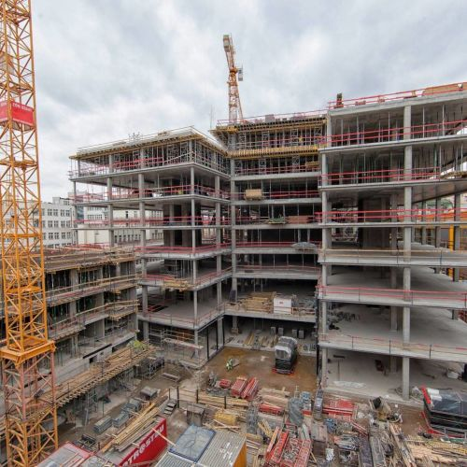
Introductions:
The Timber Formwork Design is design to supported the Plastic concrete mix during construction in the site.
The fresh concrete will be reach the full design strength after 28 days for cement type I.
As shown in Photo below , During constructions of the last floor, the floors which are located down are not removed the shore , because the concrete doesn’t reach the design strength .

Slide 3
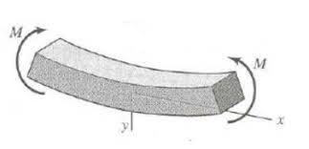
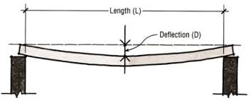
In timber formwork design should be not exceed allowable limit of :
Bending Moment : is the reaction induced in a structural element when an external force or moment is applied to the element causing the element to bend.
Shear force: A force acting in a direction parallel to a surface or to a planar cross section of a body.
Deflection: The deformation of a beam is usually expressed in terms of its deflection from its original unloaded position. The deflection is measured from the original neutral surface of the beam to the neutral surface of the deformed beam.

Slide 4
Q1\ Determine the reactions forces and draw the Shear force diagram , moment force diagram
For a simply supported beam with a cross section 20cm×30cm, the beam supported uniform 2KN/m live load and 2.5 KN/m dead load excluded the self weights . The unite weight of normal concrete is 24${kN/m}^{3}$ . (U=1.4D+1.7L)
W dead = 2.5+ (0.2×0.3×24)=3.94 kN/m
U=1.4(3.94)+1.7(2)=8.92 kN/m = 8.92×6= 53.52 kN
6m
53.52kN
8.92kN/m
=
Ax
Ay
By
Take ,∑M at A = 0 to find By
By(6)-53.52(3)= 0 , then By=26.76kN
Take , ∑Fy=0 to find Ay
Ay+By-53.52=0 , then Ay= 26.76kN
Take , ∑Fx=0 to find Ax
Ax=0 kN

Slide 5
8.92kN/m
0kN
26.76kN
26.76kN
S.F.D
26.76kN
+
-
M.F.D
By using Area methods
26.76×0.5×3= 40.14 kN.m
-26.76kN
40.14kN.m
+

Slide 6
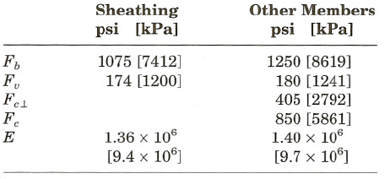
Q2\Design the formwork for an elevated concrete floor slab (200 mm) thick unit weight 24 ${kN/m}^{3}$
Sheathing will be nominal 1 in. (25-mm) lumber while 2 x 8 in. (50 x 200 mm) lumber will be used for joists.
Stringers will be 4 x 8 in. (100 x 200 mm) lumber.
Assume that all members are continuous over three or more spans.
Commercial (26-kN) shores will be used.
It is estimated that the weight of the formwork will be (0.24 kPa).
The adjusted allowable stresses for the lumber being used are as follows:
Maximum deflection of form members will be limited to l/180.
Use the minimum value of live load permitted by ACI.
Determine joist spacing, stringer spacing, and shore spacing.
Design Load per $m^{2}$:
Concrete= 24×0.2=4.8${kN/m}^{2}$
Formwork= 0.24 = 0.24 ${kN/m}^{2}$
Min. Live Load (ACI)= 2.4 ${kN/m}^{2}$
Design Load=7.44 ${kN/m}^{2}$

Slide 7
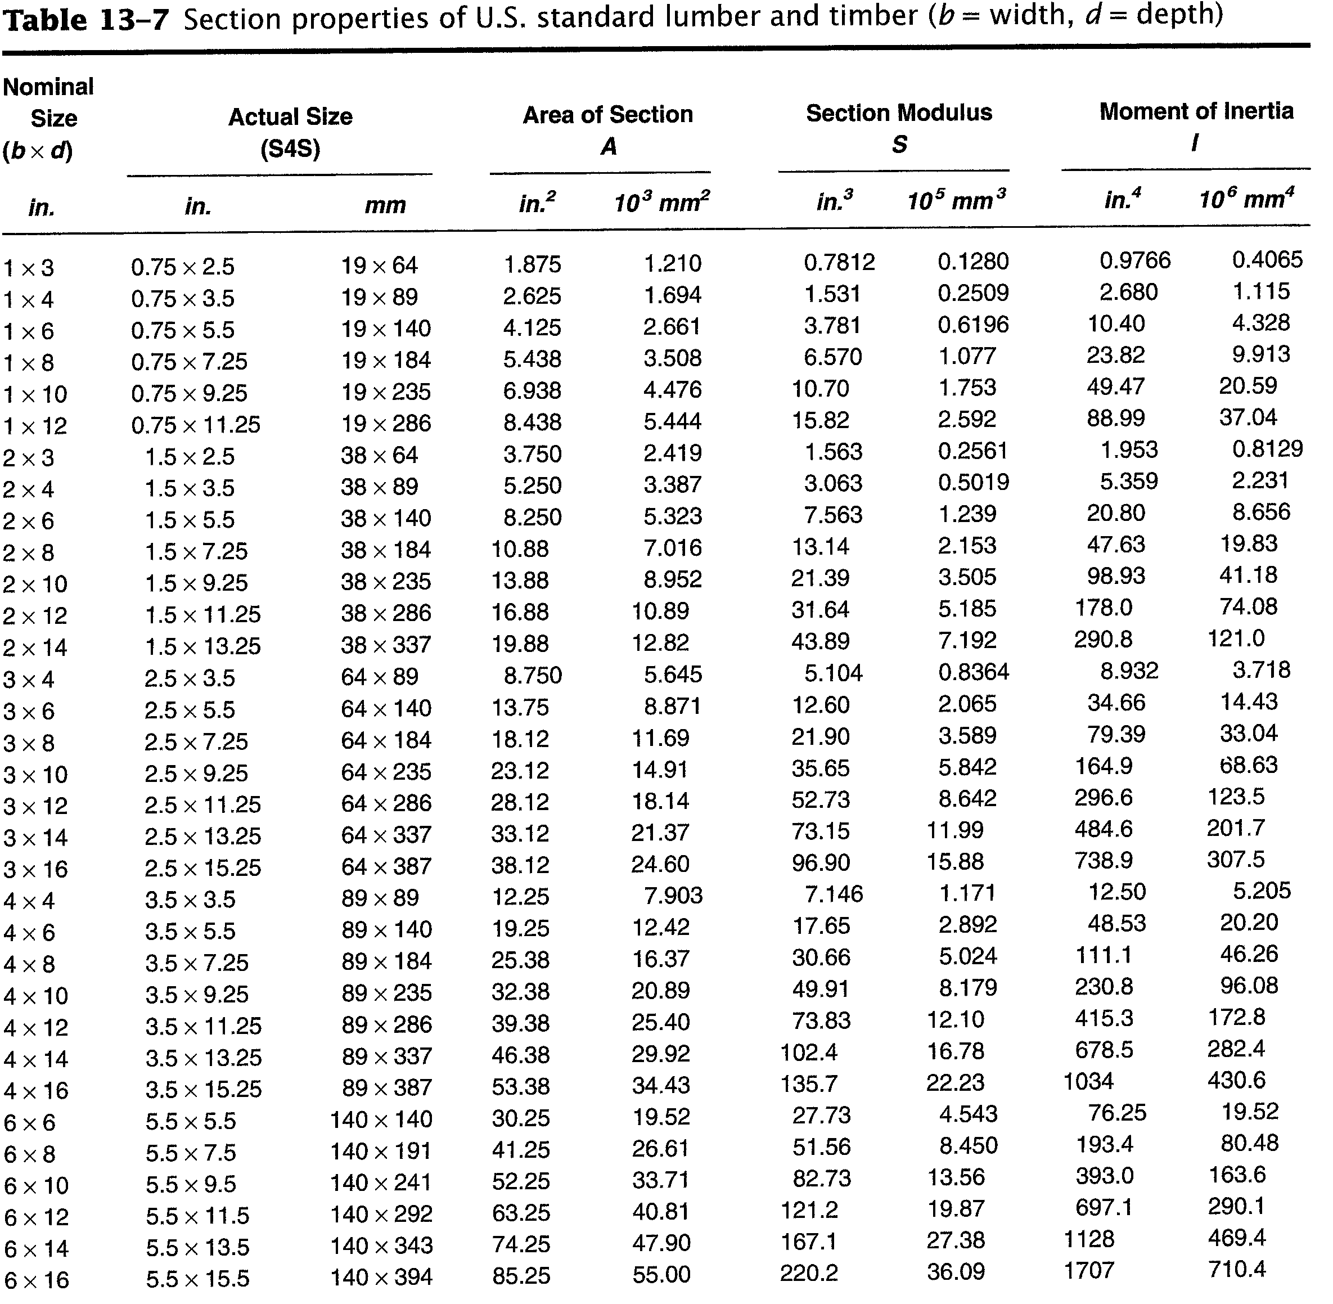

Slide 8
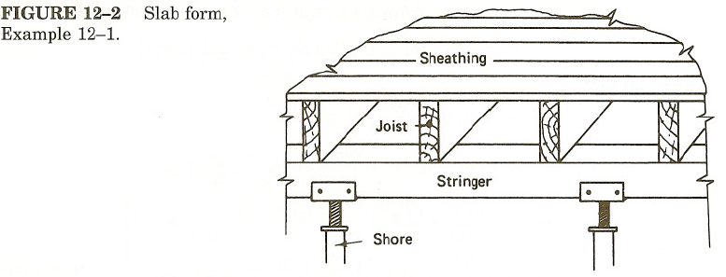
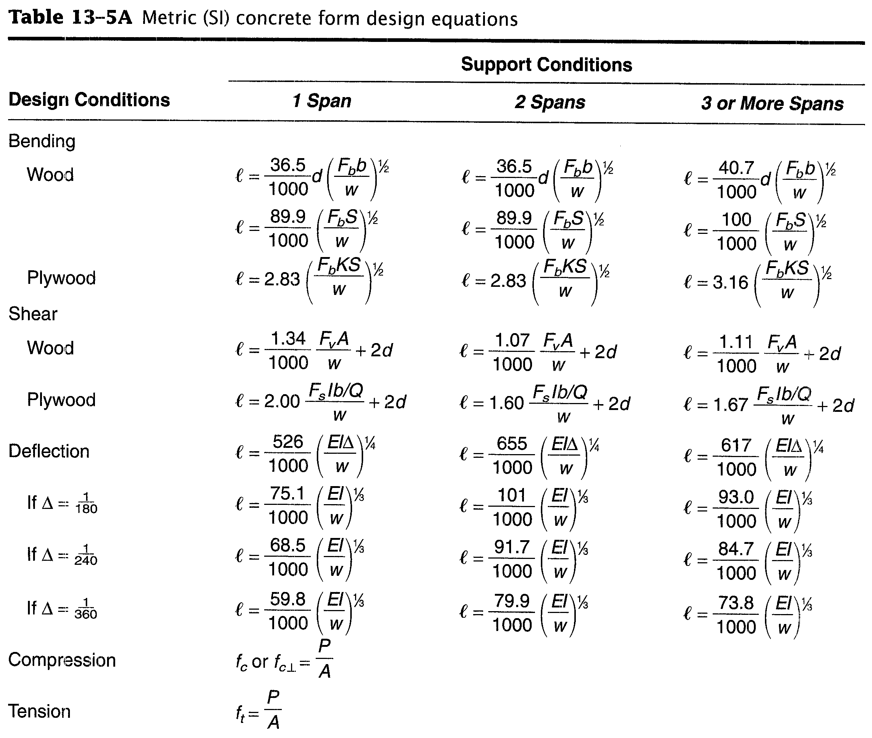
Consider the load will be uniformly on design strip with a width of 1m
W=7.44 ${kN/m}^{2}$×1m= 7.44 kN/m
Sheathing Design
Bending
${l=\frac{40.7}{1000}d(\frac{Fb b}{w})}^{1/2}$
${l=\frac{40.7}{1000}(19) (\frac{(7412) (1000)}{7.44})}^{1/2}$=771.84mm
Shear
${l=\frac{1.11}{1000} \frac{Fv A}{w}}^{}$+2d
${l=\frac{1.11}{1000} \frac{(1200) (1000×19)}{7.44}}^{}$+2(19)=3439.61mm
Deflection
${l=\frac{93}{1000}({\frac{E bd}{w 12}}^{3}) }^{1/3}$=
$l={\frac{93}{1000}({\frac{9.4×{10}^{6} (1000)(19)}{(7.44) 12}}^{3}) }^{1/3}$=834.37mm
Then, bending governs design of sheathing
771.84 (30.38 in) we will select a 24in (610mm) joist
Spacing as a modular value.

Slide 9
Joist Design (50×200mm)
W= 7.44 (0.610)=4.54 kN/m
Bending
${l=\frac{100}{1000} (\frac{Fb S}{w})}^{1/2}$
${l=\frac{100}{1000} (\frac{(8619) (2.153×{10}^{5})}{4.54})}^{1/2}$=1830.2mm
Shear
${l=\frac{1.11}{1000} \frac{Fv A}{w}}^{}$+2d
${l=\frac{1.11}{1000} \frac{(1241) (7016)}{4.54}}^{}$+2(184)=2112.5mm
Deflection
${l=\frac{93}{1000}(EI/w) }^{1/3}$=
$l={\frac{93}{1000}(\frac{(9.7×{10}^{6}) (19.83×{10}^{6})}{4.54}) }^{1/3}$=3242.1mm
Then, bending governs design of joist
1830.2 (72.05 in) we will select a 72in (1829mm) stringer Spacing as a modular value.

Slide 10
Stringer Design (100×200mm)
W= 7.44 (1.829)=13.6 kN/m
Bending
${l=\frac{100}{1000} (\frac{Fb S}{w})}^{1/2}$
${l=\frac{100}{1000} (\frac{(8619) (5.024×{10}^{5})}{13.6})}^{1/2}$=1784.36mm
Shear
${l=\frac{1.11}{1000} \frac{Fv A}{w}}^{}$+2d
${l=\frac{1.11}{1000} \frac{(1241) (16.37×{10}^{3})}{13.6}}^{}$+2(184)=2026mm
Deflection
${l=\frac{93}{1000}(EI/w) }^{1/3}$=
$l={\frac{93}{1000}(\frac{(9.7×{10}^{6}) (46.26×{10}^{6})}{13.6}) }^{1/3}$=2982.8mm
Then, bending governs design of stringer
1784.36 (70.25 in) we will select a 66in (1676mm) shore Spacing as a modular value.

Slide 11
Check for shore strength
L=$\frac{26 kN}{13.6kN/m}=1.91 m >1.676$ o.k safe
Check for Crushing
P= (4.54×1.829)=8.3 kN
Bearing Area= 38×89= 3382 ${mm}^{2}$
Fc=$\frac{8.3}{3382×10^{−6}}$=2454.16 ${kN/m}^{2}$ < 2792 ${kN/m}^{2}$ o.k safe
Final Design
Sheathing will use lumber with a nominal size (25mm)
Joist (50×200mm) at 24 in (610mm)
Stringers (100×200mm) at 72in (1828.8mm)
Shore (26kN) commercial shores at 66in (1676mm)

Slide 12
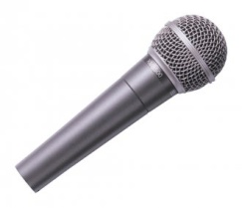
Thank You
Questions Please

