Slide 1


CE417: Construction Methods and Management
Tutorial #7

Slide 2
Q1\Find the production if You are given the following data for a scraper job: number of scraper are seven single engines overhauling, only one single pusher will be used, the scraper will carry 28BCY (full load), same route will be used for haul and return, chain loading method, efficiency factor is 0.85 and job conditions are average, section of the haul route as follows:
section | Distance(ft) | Grade(%) | Rolling res. Factor(lb/ton) | Eff. Grade(%) | Max. speed (mph) | Avg. speed factor | Avg. speed (mph) | Travel time (min)
1 | 500 | -3 | 100
2 | 3000 | -1 | 140
3 | 1000 | +1 | 180
4 | 700 | 0 | 200
Note: Use average speed method.

Slide 3
Cycle time= fixed time + variable time
Fixed time from table 4-7 page.65
Fixed time=0.3+0.6+0.7=1.6min
same route will be used for haul and return
section | Distance(ft) | Grade(%) | Rolling res. Factor(lb/ton) | Eff. Grade(%) | Max. speed (mph) | Avg. speed factor | Avg. speed (mph) | Travel time (min)
1 | 500 | -3 | 100 | +2
2 | 3000 | -1 | 140 | +6
3 | 1000 | +1 | 180 | +10
4 | 700 | 0 | 200 | +10
5 | 700 | 0 | 200 | +10
6 | 1000 | -1 | 180 | +8
7 | 3000 | +1 | 140 | +8
8 | 500 | +3 | 100 | +8
Sample of calculations for section1:
Eff. Grade (%)= -3 + 100/20= +2

Slide 4
By using performance curve Figer4-2 Page.51

Slide 5

section | Distance(ft) | Grade(%) | Rolling res. Factor(lb/ton) | Eff. Grade(%) | Max. speed (mph) | Avg. speed factor | Avg. speed (mph) | Travel time (min)
1 | 500 | -3 | 100 | +2 | 31 | 0.65 | 21.15 | 0.269
2 | 3000 | -1 | 140 | +6 | 14 | 1.08 | 15.12 | 2.255
3 | 1000 | +1 | 180 | +10 | 8 | 1.19 | 9.52 | 1.194
4 | 700 | 0 | 200 | +10 | 8 | 0.7 | 5.6 | 1.42
5 | 700 | 0 | 200 | +10 | 16 | 0.7 | 11.2 | 0.71
6 | 1000 | -1 | 180 | +8 | 21 | 0.89 | 18.69 | 0.608
7 | 3000 | +1 | 140 | +8 | 21 | 0.95 | 19.95 | 1.709
8 | 500 | +3 | 100 | +8 | 21 | 0.65 | 13.65 | 0.416
Avg. speed= Max. speed × Avg. speed Factor
Travel time=$\frac{Distance(ft)}{88×avg. speed}$

Slide 6

Total travel time= 8.581 minutes
Fixed time= 1.6 min
Total cycle time of scraper= 8.581+ 1.6= 10.181 min
From table 4-8 Page.68
Cycle time of the pusher=1min
Number of scraper served=$\frac{10.181}{1.6}=6.363 scrapers$
Number of pusher required=$\frac{7}{6.363}=1.1 pusher , then will be use 2 pusher$
Production for one scraper= 28 × 60/10.181 ×0.85= 140.26 BCY/h
Production for seven scraper=$\frac{1×7×140.26}{1.1}$=892.56 BCY/h

Slide 7
Q2\ the load growth date for a scraper can be represented by an equation Y=500 [ 1-exp(-0.2x)]
Where:
x is the load time in minutes , Y is the scraper average load in BCM
If the scraper’s total cycle minus load time is 10min , Find:
Scraper optimum load time.
Scraper cycle time.
Point | Load time(x) (min) | Avg. load (BCM)
1 | 0 | 0
2 | 1 | 90
3 | 2 | 164.83
4 | 3 | 225.59
5 | 6 | 349.4
6 | 10 | 432.33
7 | 15 | 475.1
8 | 30 | 498.76

Slide 8
A) Optimum load time =7.5min
B)
Total scraper cycle time – load time = 10 min
Total scraper cycle time= 10 +7.5 = 17.5 min

Slide 9
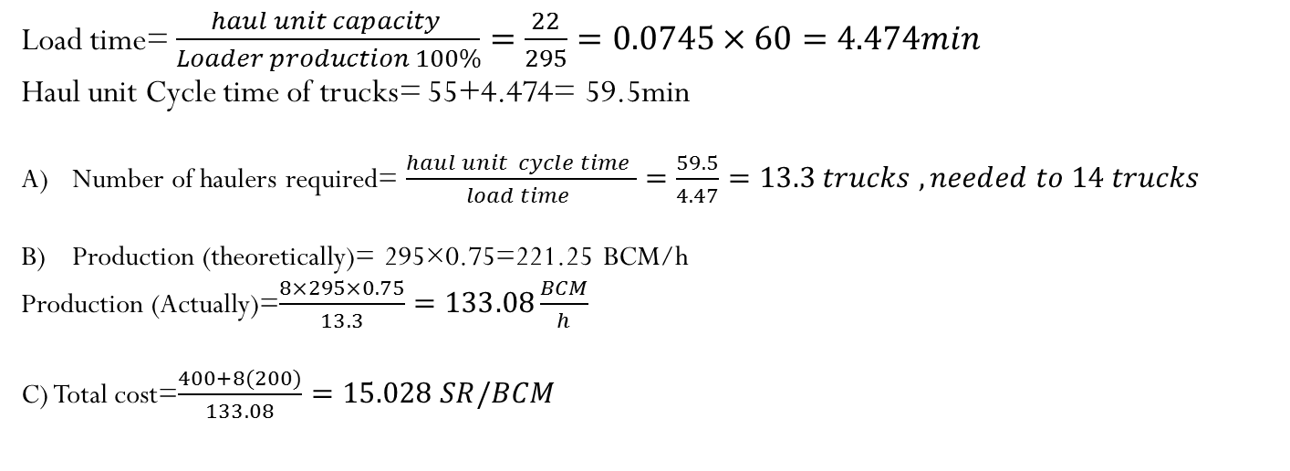
Q3\Rear dump trucks and a shovel are needed to excavate earth material which is favorable condition . The shovel production at 100% efficiency is estimated to be 295 BCM/h and job efficiency is 75%. Truck capacity is 22BCM, truck cycle time excluding loading is 55min. Equipment costs are 400SR/hr for the shovel and 200SR/hr for the truck.
How many trucks are theoretically required to obtain maximum production?
What is expected production (theoretically) of the system in BCM and by using number 8 of trucks only?
What the expected unite loading and hauling costs in SR/BCM in part b based on 8 trucks ?
Load time= $\frac{haul unit capacity }{Loader production 100\%}=\frac{22}{295}=0.0745×60=4.474min$
Haul unit Cycle time of trucks= 55+4.474= 59.5min
Number of haulers required= $\frac{haul unit cycle time }{load time }=\frac{59.5}{4.47}=13.3 trucks , needed to 14 trucks$
Production (theoretically)= 295×0.75=221.25 BCM/h
Production (Actually)=$\frac{8×295×0.75}{13.3}=133.08\frac{BCM}{h}$
C) Total cost=$\frac{400+8(200)}{133.08}=15.028 SR/BCM$

Slide 10


Thank You
Questions Please

