Slide 1
CE417: Construction Methods and Management
Tutorial #3

Slide 2
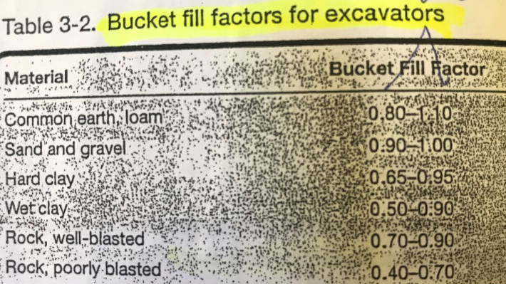
CH3: Excavating and Lifting
Q1\Estimate the actual volume of common earth in bank measured carried by a hydraulic excavator bucket whose heaped capacity is 2.5 cu M?
From table 3-2 Page.26 ,
Bucket fill factor = $\frac{0.8+1.1}{2}$=0.95
Bucket Load= 2.5 × 0.95= 2.38 LCM
From table 2-5 page.18
, Load factor= 0.8
Bucket load= 2.38 × 0.8= 1.9 BCM

Slide 3
Q2\A 3.5 cu M hydraulic shovel with bottom dump bucket is excavating tough clay. The swing angle is 120 degree and job efficiency is 75%. Estimate the shovel’s hourly production in bunk measure?
Production(LCM/h)= C×S×V×B×E
From table 3-6, page.31
C=Cycles/hr=150 Cycles/hr
From table 3-6, page.31
S=Swing factor=0.94
V=Heaped volume in LCM= 3.5 LCM
From table 3-2, Page.26 , B=Bucket fill factor=$\frac{0.65+0.95}{2}=0.8$
E=Job efficiency=75%=0.75
By using interpolation $\frac{8.2−6.6}{26+24}=\frac{X}{24}≫X=0.768≫Depth=0.768+6.6=7.368 ft$

Slide 4
Cont. Q2
Shovel’s hourly Production(LCM/h)= C×S×V×B×E
Production(LCM/h)= 150×0.94×3.5×0.8×0.75=296.1 LCM/h
From table 2-5, Page.18
Load Factor= 0.77
Shovel’s hourly Production(BCM/h)=296.1 LCM/h× 0.77= 228 BCM/hr

Slide 5
Q3\A hydraulic excavator is excavating the basement of a building . Heapd bucket capacity is 1.5 cu M. The material is common earth with a bucket fill factor of 0.9. Job efficiency is estimated to be 50min/hr. the machine's maximum depth of cut is 24m and the average digging depth is 13m. Average swing angle is 90 degree. Estimate the hourly production in bank measure.
Backhoe’s hourly production(LCM/hr)=C×S×V×B×E
From table3-3, Page.28 ,
C=Cycles/hr= 160 Cycles/hr
S=Swing factor
Depth of cut(%of maximum)=$\frac{actual depth}{max. depth }$×100=$\frac{13}{24}×100=54\%$
From table3-4, Page.28
S=1-$\frac{1−1.1}{0.7−0.5}×\left(0.7−0.54\right)=1.08$
V=Heaped bucket volume in LCM=1.5 LCM

Slide 6
Cont. Q3
B=Bucket fill factor $=0.9$
E=Job efficiency=$\frac{50}{60}=83\%=0.83$
Backhoe’s hourly production(LCM/hr)=C×S×V×B×E
Backhoe’s hourly production(LCM/hr)=160×1.08×1.5×0.9×0.83=193.62 LCM/hr
From table2-5, page.18, Load factor=0.8
Backhoe’s hourly production(BCM/hr)=193.62 LCM/hr× 0.8= 154.9 BCM/hr

Slide 7
Q4/ A dragline will be used to excavate a drainage ditch. Dimension of the ditch are 3m deep, 4m bottom width and side slop 1:1, the dragline will move along the centerline of the excavation and deposit one half of the spoil on each side of the cut. Provide 2m clear space between the edge of cut and near side of the spoil bank. The soil is common earth with an angle of reposed 37degree and swell of 25%. Use an efficiency factor of 85% following are dragline data.
What are dimension of spoil bank that is created by each side?
B) What is the estimated cost per BCM of excavation of chosen dragline?
Bucket size(CM) | Dumping Radius(m) | Ideal output (BCM/hr) | Optimum depth of cut(m) | Cost/hr
1.13 | 9 | 190 | 2.7 | SR100
1.87 | 16 | 265 | 3.2 | SR120

Slide 8
Cont. Q4
A)
Volume of cut in each side per 1m length=(2×3)+(3×3)/2=10.5 BCM
Volume=10.5×1.25=13.125 LCM
B${\text{=(}\frac{4×13.125}{1×tan⁡(37)})}^{0.5}$=8.35m
H=$\frac{8.35×tan⁡(37)}{2}=3.145m$
Dumping radius=2+3+2+(8.35/2)=11.175m>9m
Therefore, the first dragline will not be suitable for the work.
We will use the second dragline.
B)
Production= Ideal output × swing depth factor × efficiency
Average depth of cut=$\frac{3\text{×}4\text{×}1.5+(\frac{3\text{×}3}{2})(\frac{3}{3})\text{×}2}{3\text{×}4+(\frac{3\text{×}3}{2})\text{×}2}$ =1.28m (Centroid of an area)
Swing angle=$\cos^{−1}\left(\frac{11.175}{16}\right)≈45°$
Average depth of cut= 1.28/3.2=0.4.
therefore from table 3-9, Page.33 swing depth factor= 1.08
Efficiency=85%=0.85

Slide 9
Cont. Q4
Production= Ideal output × swing depth factor × efficiency
Production(BCM/hr)= 265 × 1.08 × 0.85 = 243.27 BCM/hr
Estimated cost = 120 SR/243.27 = 0.493 SR/BCM

Slide 10
Thank You
Questions Please

