Slide 1
Experiment:
-Automation blood count
-Red and White blood count and differential count (Manual blood
count)

Slide 2
Introduction:
A complete blood count (CBC) is a test that gives information about the cells in a patient's blood.
Important
To understand this test, it is important to know that the blood generally consists of two major parts; plasma and cellular elements (cellular elements generally divided into three types: white blood cells (leukocytes), red blood cells (erythrocytes), and platelets (thrombocytes). And the white blood cells have many differential ; monophil , nutrophil ,eosinophil , basophil , lymphocyte

Slide 3
test measures the quantity of all the different types of cells in the blood. It also provides some valuable information on other parameters related to each type of blood cell.(such as mean cell volume (MCV), mean cellular hemoglobin (MCH) and mean cellular hemoglobin concentration (MCHC).
In addition to counting, measuring and analyzing blood cells it also measure the amount of hemoglobin in the blood and within each red blood cell. This information can be very helpful to a physician who, for example, is trying to identify the cause of a patient's anemia. If the red cells are smaller or larger than normal, or if there is a lot of variation in the size of the red cells,

Slide 4
CBC can applied by two way:
1- automation blood count
2-manual blood count
automation blood count: (1)
automating analyzer ( instrument has many different components to analyze different elements in the blood.
Blood counting machines aspirate a very small amount of the specimen through narrow tubing. Sensors count the number of cells passing through the tubing, and can identify the type of cell; this is flow cytometry.
Automating analyzer:
Cell Dyn® (Abbott)
Coulter® LH 780 and other (Beckman Coulter)
ADVIA® 2120 and other(Siemens Diagnostics)
X-Class Hematology Systems (Sysmex)

Slide 5
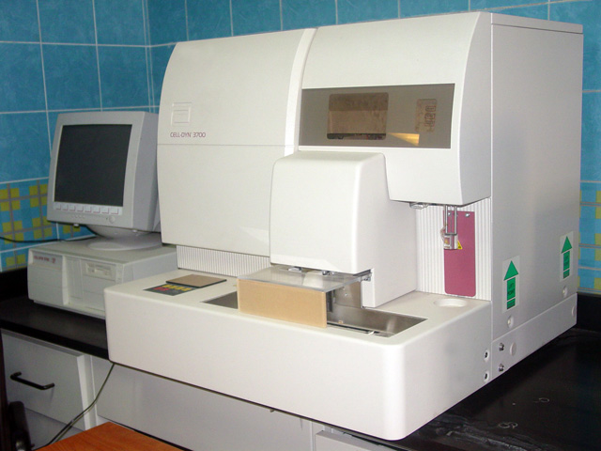
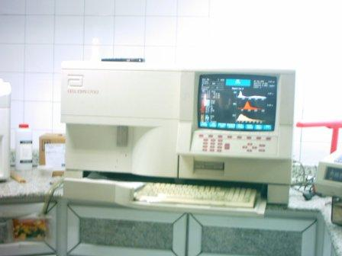

Slide 6
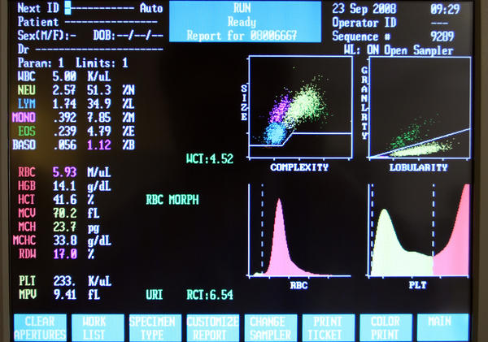

Slide 7
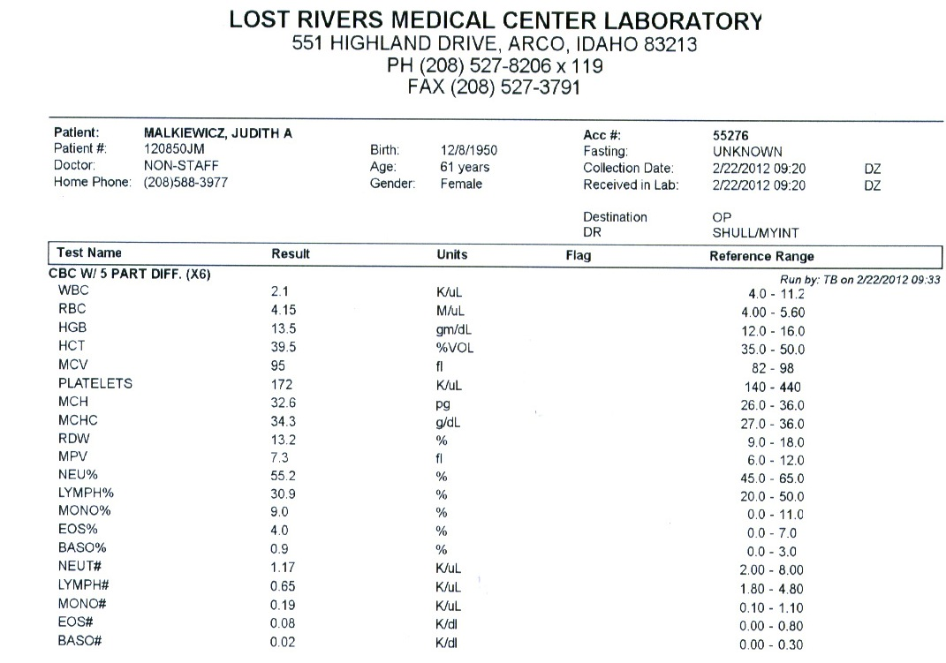

Slide 8
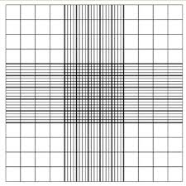
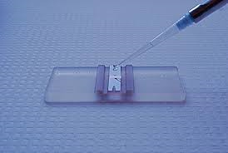
(2) Manual blood count (red and white blood count and differential count):
Blood cell counts By appropriately diluted blood samples and a ruled
counting chamber (hemocytometesr).

Slide 9
*Why the blood should diluted?
As there are far too many cells if it is not diluted.
Objective:
1-to estimate the number of RBC in blood sample
2-to estimate the number of total WBC in blood sample
3-to perform a differential count for a blood sample

Slide 10
(A)Red blood count:
It is test done to determination the number of RBC in a sample of blood , also it evaluate the size and shape of RBC
it is range from 4.2 – 5.5 million RBC per cubic millimeter (mm³)
It is considered a very important indicator of a patent 'health
Low RBC count :
Anemia
Acute or chronic blood loss
Malnutrition
Chronic inflammation
Higher than average RBC count:
polycythemia
Congenital heart disease
Renal problem

Slide 11
Normally high (RBC count)
People who live at high altitudes
Smokers
Principle :
RBC count by use hemocytometer , this instrument is a special microscopic slide .
The processes is involved by counting cells in several squares of the grid and obtain an average number, this number is multiply by a factor that compensates the amount of dilution. The final results expresses the number of RBC /mm³ of original blood sample.

Slide 12
(B)WBC count :
total leukocytes count shows the number of WBC in a sample of blood .
A normal WBC count is between 4,500 and 11,000 cells per cubic millimeter .
The number of WBC is sometimes used to identify an infection or to monitor the body’s response to treatment .
Leukopenia: is a Condition in which the number of leukocytes is abnormally low and which is most commonly due to sever infections and radiation poisoning.
Leukocytosis: is a condition characterized by an elevated the number of WBC occur as a result of an infection , cancer ,
It can occur normally after eating larger meal .

Slide 13
Principle:
It is necessary to obtain RBC free preparation of WBC from blood . Suspension of the red blood cell in a very hypotonic solution will lead to the destruction of RBC .
(C) Differential Count:
It is determines the number of each type of WBC present in the blood
WBC are lymphocytes (25-33%) , monocytes (2-10%) , neutrophils (54-62%) , basphil ( < 1%) , eosinophil (1-6%) . Each type of those cells a differential important role in protecting the body.
Types of WBC:
(1)Non granular (lymphocyte – plasma cell)
(2)Granular ( polymorphonuclear granulocytes – monocytes)

Slide 14
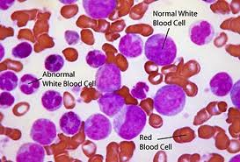
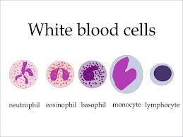
Principle:
Classification of polymorph nuclear granulocytes is based on the size , shape , number and staining characteristics of their granules . Leishman’s stain differentiates between WBC because the nuclei of lymphocytes stain dark purple , neutrophils purple , basophils granules dark blue and eosinophils granules orange-red , platelets violet granules and RBC pink.
This stain based on a mixture of methylene blue and eosin.

Slide 15
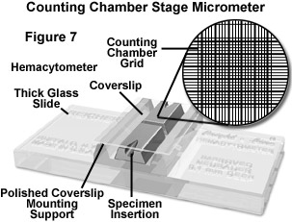
Method:

Slide 16
1-RBC count

Slide 17
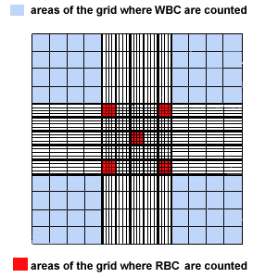
2- WBC count

Slide 18
RBC blood cell count ( 5 squares) Found the total RBCs in 80 (5 X 16) small square, and divide it with 80 to find the average in one square, multiply it by 200 to allow for the dilution and then multiply by 4000 to obtain the number per cubic milliliter. The average of RBC in 5 large square = 84+71+63+93+83/ 5 = 394 cells. The average of RBC in one square= 394/80 = 4.9 cells. RBC count= 4.9X 800000= 4 million/mm³. Normal range= 4.2-5 million/mm³ for women

Slide 19
WBC blood cell count ( 4 squares) Found the total WBCs in 64 (4 X 16) small square, and divide it with 64 to find the average in one square, multiply it by 20 to allow for the dilution and then multiply by 160 to obtain the number per cubic milliliter. The average of WBC in 4 large square = 16+21+17+15/ 4 = 69 cells. The average of WBC in one square= 69/64 = 1.07 cells. WBC count= 1 X 3200= 3200 Cells/mm³. Normal range= 4500-11000 cells /mm³

Slide 20
Thank you

