Slide 1
Cardiovascular
System

Slide 2
The cardiovascular system

Slide 3
The heart and great vessels

Slide 4
Terminology
Pathology
Treatment Procedures
Laboratory Tests
&
Diagnostic Procedures

Slide 5
Terminology
Angi/o
Vessel
-plasty
Surgical Repair
Angioplasty
Surgical repair of a vessel

Slide 6
Terminology
Angioplasty
Surgical repair of a blood vessel by inserting a catheter and a balloon inside an artery to enlarge the opening

Slide 7
Terminology
Aort/o
Aorta
-ic
Pertaining to
-stenosis
Tightening
Aortic Stenosis
Tightening pertaining to the aorta

Slide 8
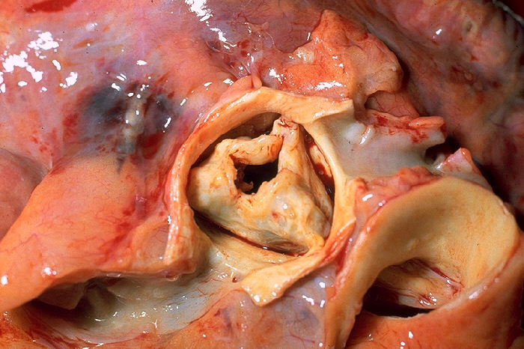
Terminology
Aortic Stenosis
Narrowing of the aorta

Slide 9
Terminology
Arteri/o
Artery
-sclerosis
Hardening
Arteriosclerosis
Hardening of an artery

Slide 10
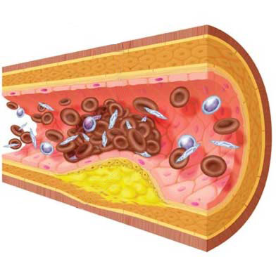
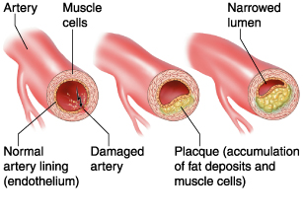
Terminology
Arteriosclerosis
Hardening of an artery by thickening and loss of elasticity of the arterial walls

Slide 11
Terminology
Arteriol/o
Arteriole
-itis
Inflammation
Arteriolitis
Inflammation of an arteriole

Slide 12
Terminology
Cardi/o
Heart
My/o
Muscle
-pathy
Disease
Cardiomyopathy
Disease of the heart’s muscle

Slide 13
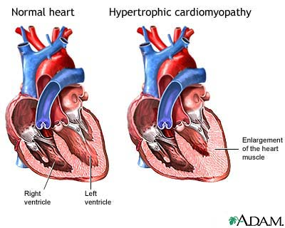
Terminology
Cardiomyopathy
Disease of the heart’s muscle

Slide 14
Terminology
Coron/o
Heart
-ary
Pertaining to
Coronary arteries
Pertaining to the heart’s arteries

Slide 15
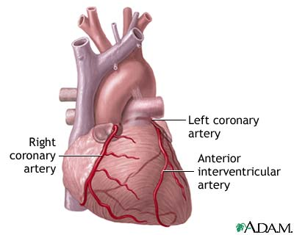
Terminology
Coronary Arteries
Branches of the aorta bringing oxygen-rich blood to the heart’s muscle

Slide 16
Terminology
Phleb/o
Vein
-tomy
Incision / Process of cutting
phlebotomy
Incision of a vein

Slide 17
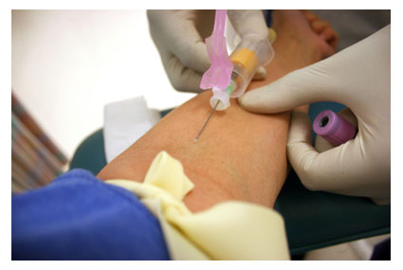
Terminology
Phlebotomy
Incision of a vein for the removal of blood

Slide 18
Terminology
Ven/o
Vein
Intra-
Within / Into
-ous
Pertaining to
Intravenous
Pertaining to within a vein

Slide 19
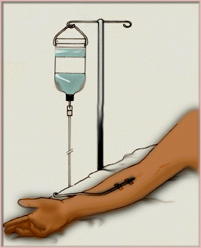
Terminology
Intravenous
Pertaining to within a vein

Slide 20
Terminology
Phlebotomy
Vs.
Intravenous

Slide 21
Terminology
Venul/o
Venule
-itis
Inflammation
Venulitis
Inflammation of a venule

Slide 22
Terminology
Done
Pathology
Treatment Procedures
Laboratory Tests
&
Diagnostic Procedures

Slide 23
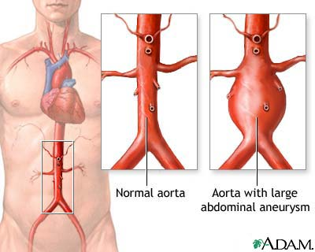
Pathology
Aneurysm
Surgical widening of an artery caused by weakness in the arterial wall or breakdown of the wall from atherosclerosis

Slide 24
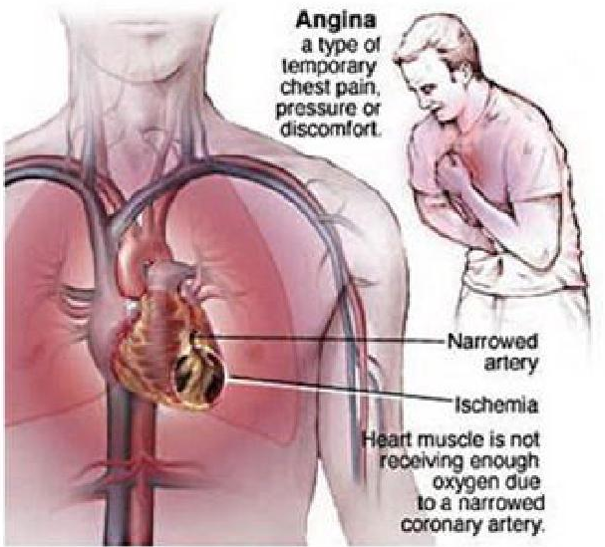
Pathology
angina
Chest pain caused by decreased blood flow to the heart’s muscle
Also called
“Angina pectoris”

Slide 25
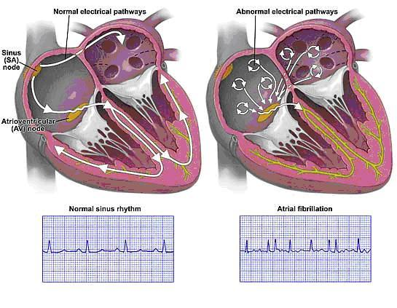
Pathology
arrhythmia
Abnormal heartbeat (rhythm)
Fibrillation and flutter are examples

Slide 26
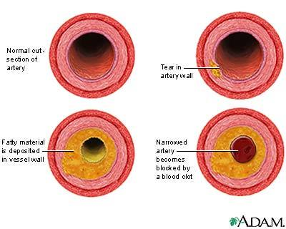
Pathology
atherosclerosis
Hardening of arteries with a collection of cholesterol-like plaque

Slide 27
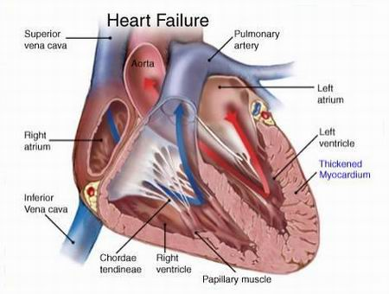
Pathology
Congestive heart failure
Inability of the heart to pump its required amount of blood
Blood accumulates in the lungs causing pulmonary edema

Slide 28
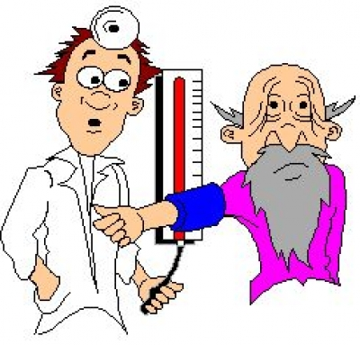
Pathology
hypertension
High blood pressure
Essential hypertension is high blood pressure with an apparent cause
Secondary hypertension is high blood pressure caused by another illness

Slide 29
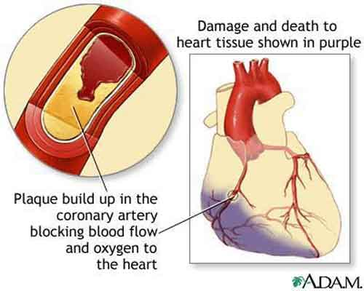
Pathology
Myocardial infarction
Heart attack
An infarction is an area of dead (necrotic) tissue

Slide 30
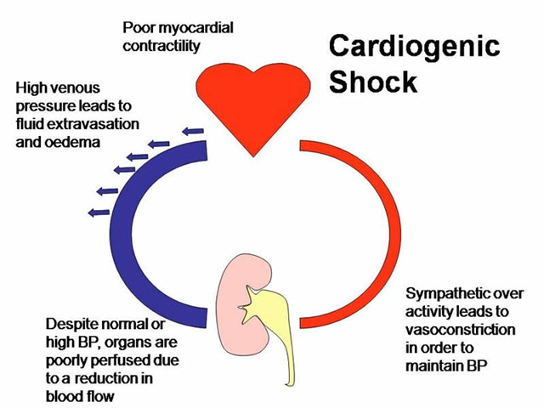
Pathology
shock
A group of signs and symptoms (paleness of skin, weak and rapid pulse, shallow breathing) indicating poor oxygen supply to the tissues and insufficient return of blood to the heart

Slide 31
Done
Pathology
Done
Treatment Procedures
Laboratory Tests
&
Diagnostic Procedures

Slide 32
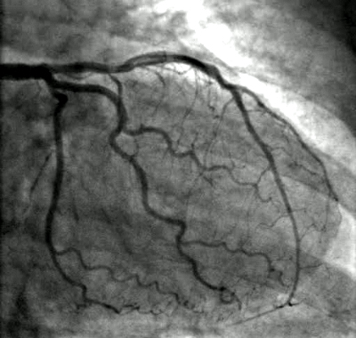
Laboratory Tests & Diagnostic Procedures
Angiography
Recording (via x-ray images) blood vessels after the injection of contrast into the bloodstream

Slide 33
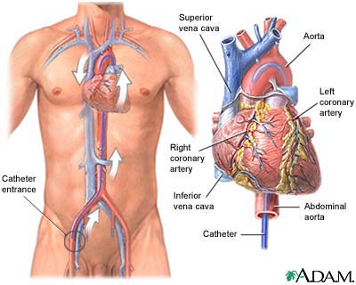
Laboratory Tests & Diagnostic Procedures
Cardiac catheterization
Introducing a catheter (a flexible, tubular instrument) into a vein or an artery to measure pressure and flow patterns of blood

Slide 34
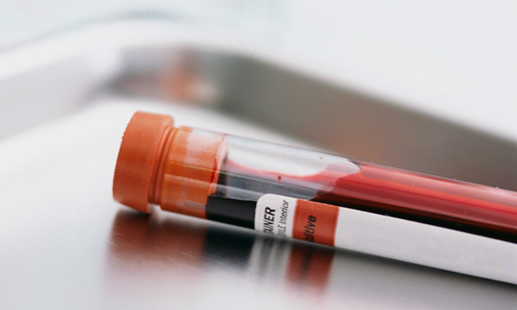
Laboratory Tests & Diagnostic Procedures
Cardiac enzyme tests
Measurements of enzymes released into the bloodstream after a heart attack (myocardial infarction)

Slide 35
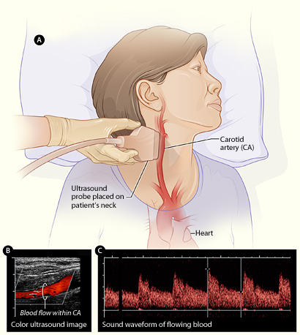
Laboratory Tests & Diagnostic Procedures
Doppler ultrasound
Measuring blood flow in vessels via sound waves

Slide 36
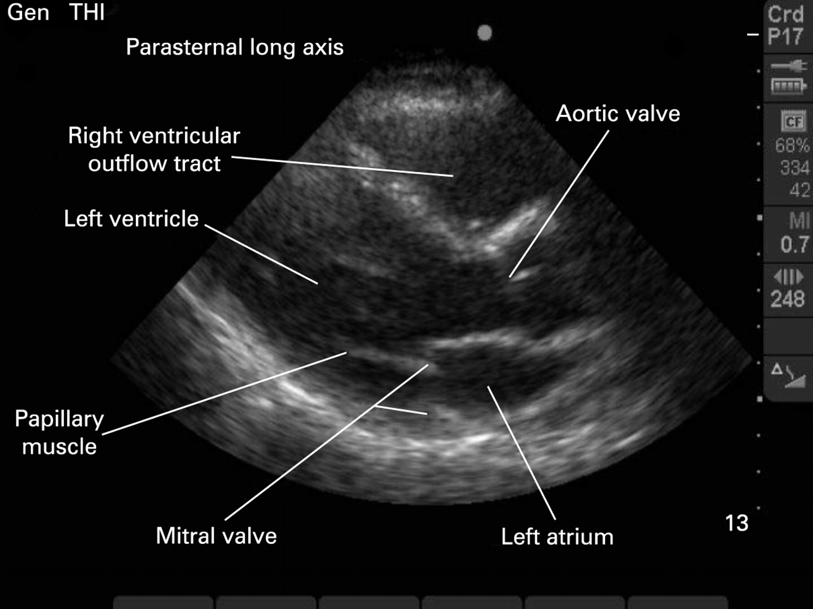
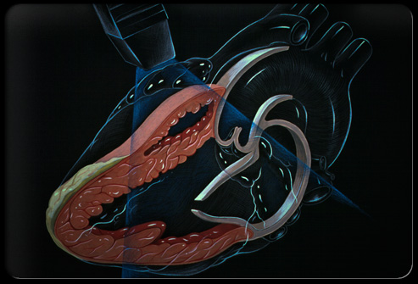
Laboratory Tests & Diagnostic Procedures
Echocardiography
Producing images of the heart via sound waves or echoes

Slide 37
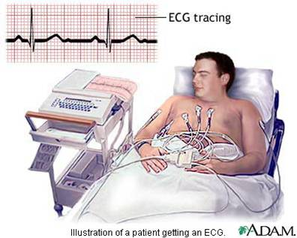
Laboratory Tests & Diagnostic Procedures
Electrocardiography
Recording electricity flowing through the heart

Slide 38
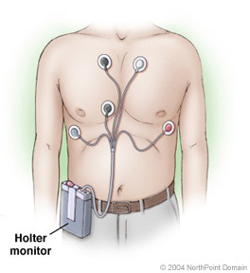
Laboratory Tests & Diagnostic Procedures
Holter monitoring
Detection of abnormal heart rhythms (arrhythmias) that involves having a patient wear a compact version of an electrocardiograph for 24 hours

Slide 39
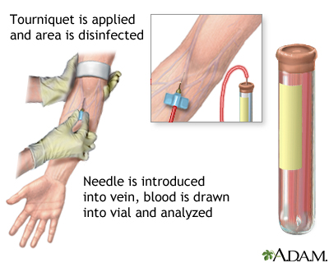
Laboratory Tests & Diagnostic Procedures
Lipid tests
Measurements of cholesterol and triglyceride levels in the blood

Slide 40
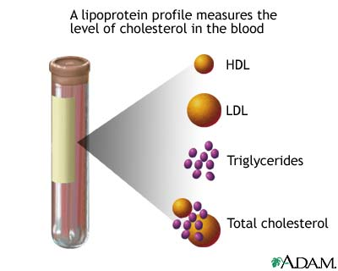
Laboratory Tests & Diagnostic Procedures
Lipoprotein tests
Measurements of high-density lipoprotein (HDL) and low-density lipoprotein (LDL) in the blood

Slide 41
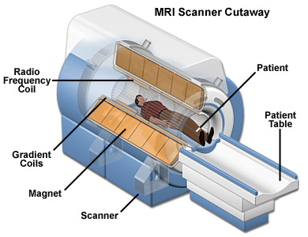
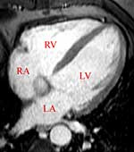
Laboratory Tests & Diagnostic Procedures
Magnetic resonance imaging (MRI)
Producing an image, by beaming magnetic waves at the heart, that gives detailed information about congenital heart diseases, cardiac masses, and diseases within large blood vessels

Slide 42
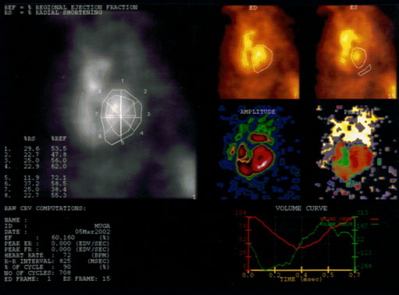
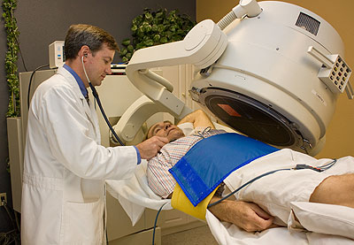
Laboratory Tests & Diagnostic Procedures
MUGA scan
Imaging the motion of heart wall muscles and assessing the function of the heart via a multiple-gated acquisition scan, which uses radioactive chemicals

Slide 43
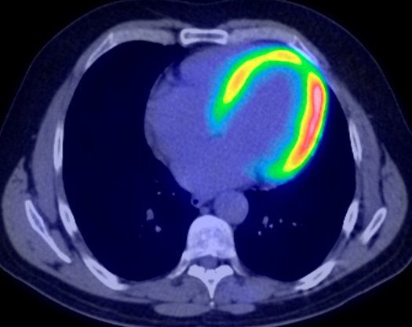
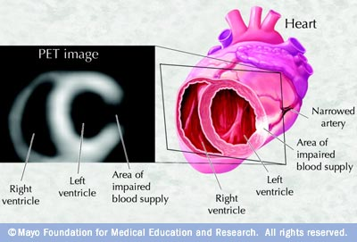
Laboratory Tests & Diagnostic Procedures
Positron emission tomography (PET) scan
Radioactive chemicals are injected into the bloodstream and travel to the heart
Cross-sectional images show the flow of blood and the functional activity of the heart muscle

Slide 44
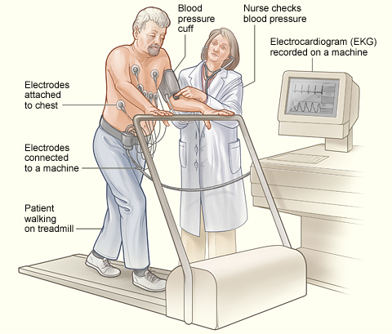
Laboratory Tests & Diagnostic Procedures
Stress test
An electrocardiogram plus blood pressure and heart rate measurements shows the heart’s response to physical exertion (Treadmill test)

Slide 45
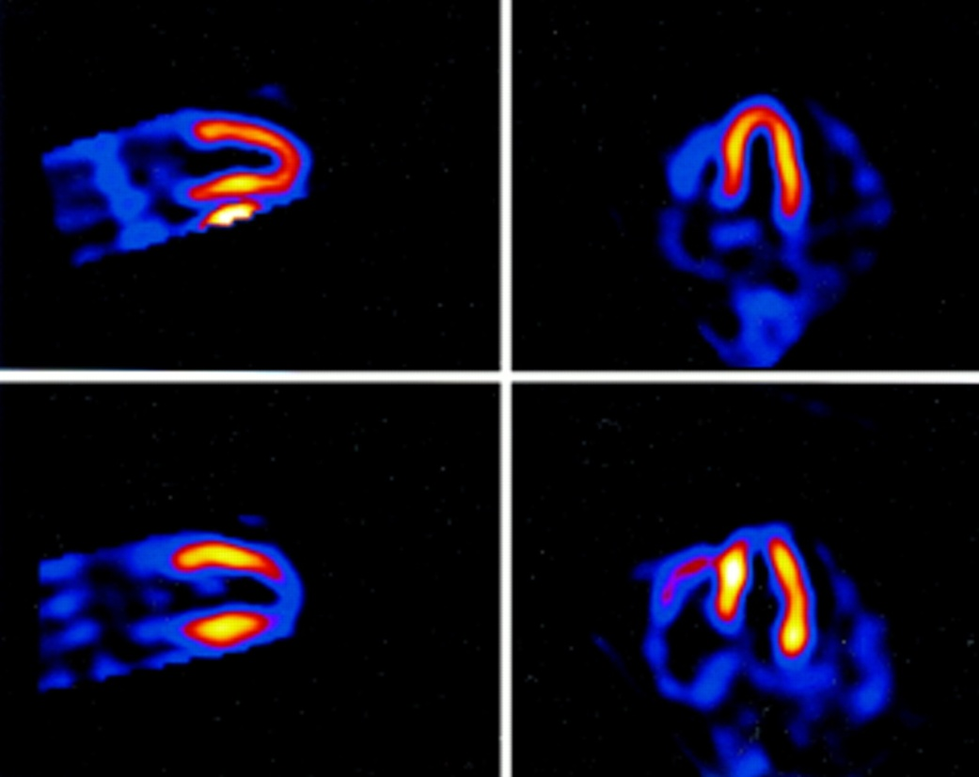
Laboratory Tests & Diagnostic Procedures
Technetium tc 99m sestamibi scan
A radioactive chemical (sestamibi tagged with technetium 99m) is injected intravenously and shows perfusion (flow) of blood in heart muscle
It’s taken up in the area of a myocardial infarction, producing “hot spots”

Slide 46
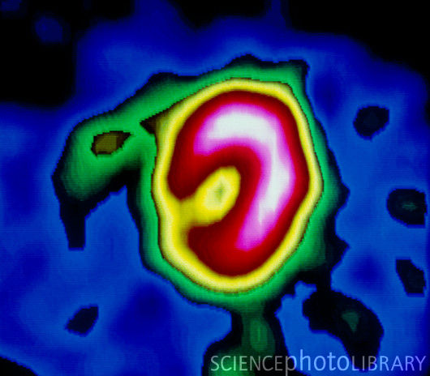
Laboratory Tests & Diagnostic Procedures
Thallium-201 scan
A radioactive test that shows where injected thallium-201 (a radioactive substance) localizes in heart muscle

Slide 47
Done
Done
Treatment Procedures
Laboratory Tests
&
Diagnostic Procedures
Done

Slide 48
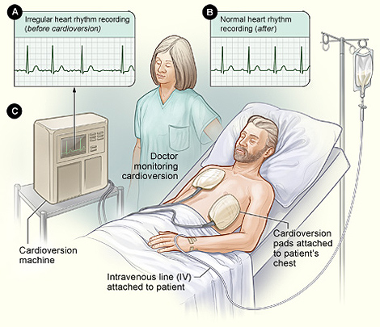
Treatment Procedures
Cardioversion
Brief discharges of electricity passing across the chest to stop a cardiac arrhythmia
Also called defibrillation

Slide 49
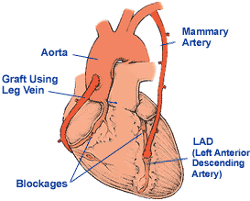
Treatment Procedures
Coronary artery bypass grafting (CABG)
Vessels taken from the patients legs or chest are connected to coronary arteries to make detours around blockages

Slide 50
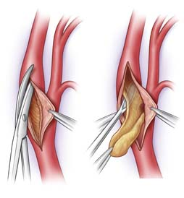
Treatment Procedures
endarterectomy
Surgical removal of the innermost lining of an artery to remove fatty deposits and clots

Slide 51
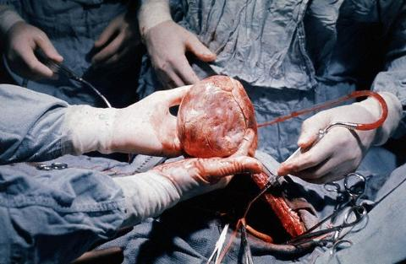
Treatment Procedures
Heart transplantation
A donor heart is transferred to a recipient

Slide 52
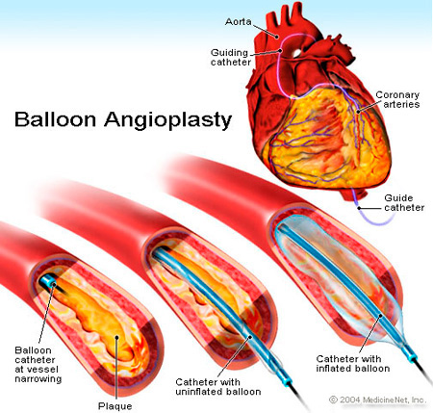
Treatment Procedures
Percutaneous coronary intervention (PCI)
A balloon-tipped catheter (a flexible, tubular instrument) is threaded into a coronary aretery to compress fatty deposits and open the artery.
Stents create wider openings that make the recurrence of blockages less likely, also called balloon angioplasty

Slide 53
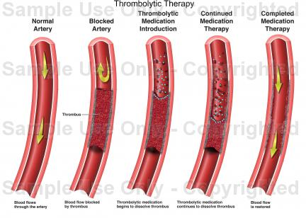
Treatment Procedures
Thrombolytic therapy
Drugs such tpa (tissue plasminogen activator) and streptokinase are injected into a patient’s bloodstream to dissolve clots that may cause a heart attack

Slide 54
Done
Done
Treatment Procedures
Done
Done

Slide 55
Any Questions?

Slide 56
Thank You

