Slide 1
Carbohydrates-II
BCH 302 [practical]

Slide 2
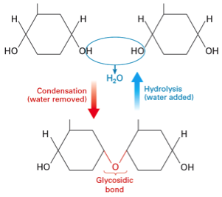
Complex sugars consist of more than one unit of monosachride, it could be:
-Disaccharides contain two monosaccharide units.
- Oligosaccharides contain 3-9 monosaccharide units.
- Polysaccharides can contain more than 9 monosaccharide units.
Complex carbohydrates can be broken down into smaller sugar units through a process known as hydrolysis.

Slide 3
-Polysaccharides can either be :
1. homopolymeric (same repeating monosaccharide unit).
Or
2.heteropolymeric (mixture of monosaccharaides).
-Plants and animals store glucose in the form of very large polysaccharide glucose homopolymers .
-The glucose homopolymer present in plants to store glucose is called starch, while the glucose homopolymer present in animal cells is called glycogen.

Slide 4
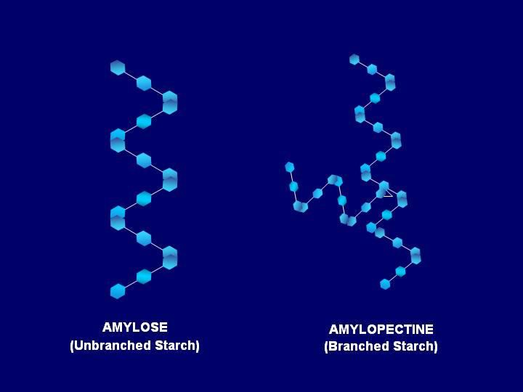
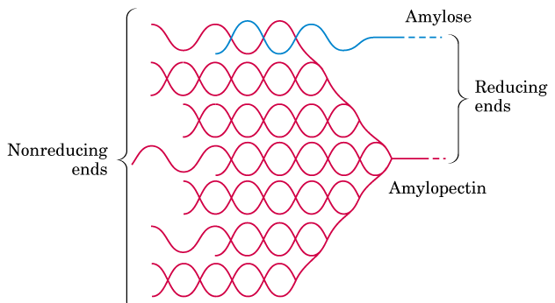
Starch consists of : amylose and amylopectin ..
-Amylose is a Linear helical polymer of glucose linked by α-1,4 glycosidic bonds (100 units).
-Amylopectin Branched polymer containing glucose linked by α-1,4 glycosidic bonds. Branch points has α-1,6glycosidic bonds, (100,000 units).

Slide 5
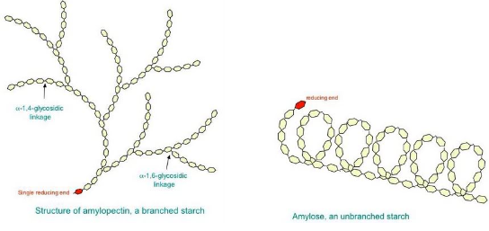

Slide 6
1-Sucrose hydrolysis Test:
Objective:
To identify the products of hydrolysis of di- and polysaccharides.
-This test is used to convert sucrose (non-reducing disaccharide) to glucose and fructose (reducing mono saccharides).
Principle:
-Sucrose is a non-reducing disaccharide so it does not reduce the Cu++ solution (Bendict's test) because the glycosidic bond is formed between the two hemiacetal bonds.
-So there is no free aldehydic or ketonic group to give positive reducing properties.
When glycosidic bond hydrolysed os sucrose (in the presence of acid) to glucose + fructose (which are reducing sugars) are then able to give positive reducing test.

Slide 7
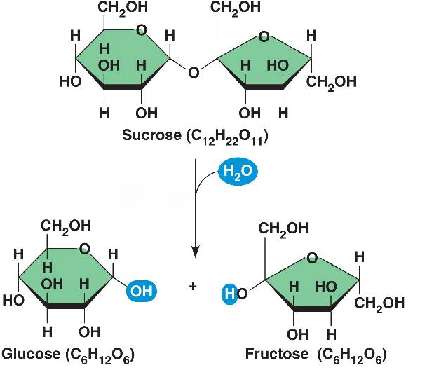
No result with bendict
Positive result with bendect

Slide 8
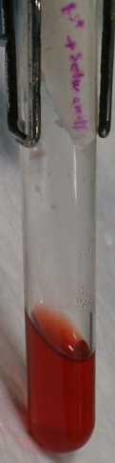
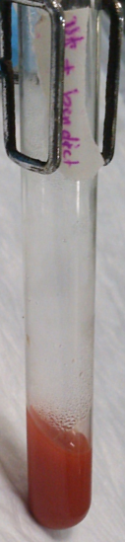
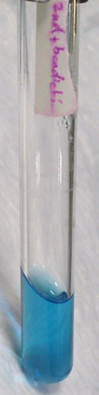
Sucrose+ HCl
(+) Seliwanoff's test
Sucrose+ HCl
(+) Benedict's test
Sucrose only
(-) Benedict's test

Slide 9
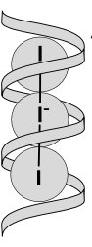
2-The Iodine/Potassium Test:
Objective:
To detect the presence of starch in a sample
Principle:
Starch forms deeply blue color complex with iodine. Starch contains α- amylose, a helical saccharide polymer and amylopectin. Iodine forms a large complex with α-amylose helix. This complex absorbs light and reflects the blue light only. Simple oligosaccharides and mono saccharides do not form this complex.
Note that other polysaccharides like glycogen may give other colors (red).

Slide 10
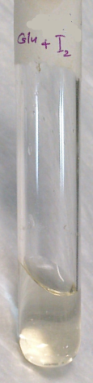
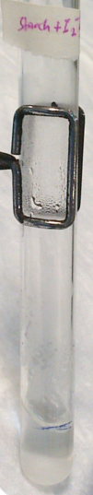
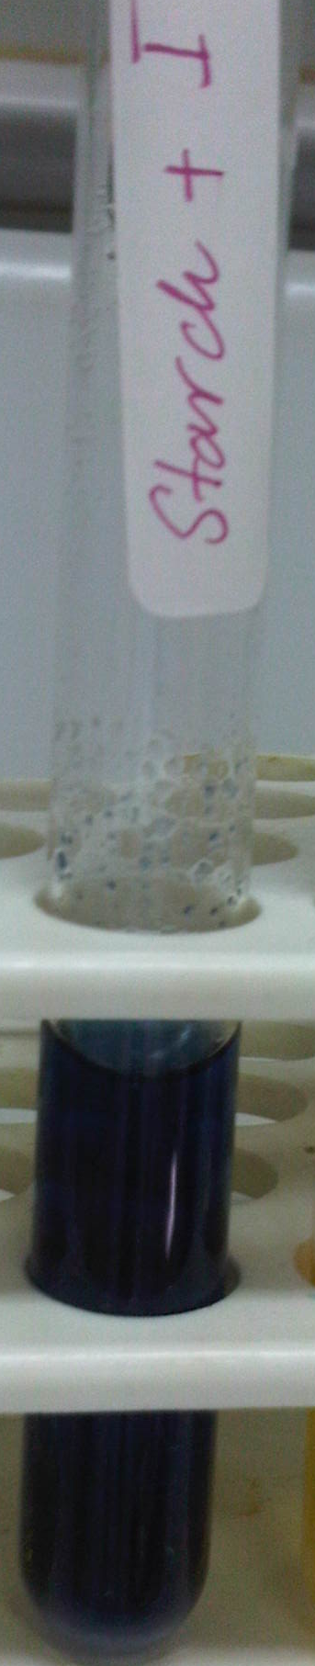
Glucose + iodine
Starch + iodine
[before heating]
Starch + iodine
[after heating]

Slide 11
3-Hydrolysis of Starch:
Objective:
To establish the effect of concentrated HCL on a glycosidic bond in starch.
Principle:
Although starch has free hemiacetal in the terminal glucose residue, it has no reducing properties, because the percentage between the free residues is very low in comparison to the whole molecule.
Heating starch solution in acid medium hydrolyses the glycosidic bonds giving many free glucose residues. These glucose molecules give reducing properties to the hydrolysis product.

Slide 12
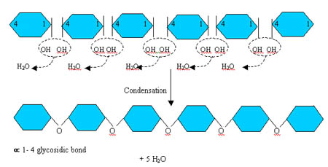
This experiment illustrates the conversion of starch (non-reducing sugar) to a reducing sugar by the action of hydrochloric acid at boiling point. The longer the starch is exposed to the acid the further hydrolysis proceeds.
Hydrolysis of glycosidic bond (HCl+heating)

Slide 13
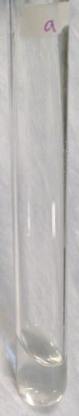

Starch with HCL
[After heating]
[-] Iodine test
[+] Benedict's test

