Slide 1
Carbohydrates-I
BCH 302 [practical]

Slide 2
Carbohydrates[Sugars]:
-Consists of carbon, hydrogen and oxygen.
-Carbohydrate have a formula: (CH₂O)_{n} (but not all of them).
-In human body, the D-glucose is used.
-Simple sugars ends with [–ose].
-Carbohydrates make up the bulk of organic substances on earth and perform numerous roles in living things.
-

Slide 3
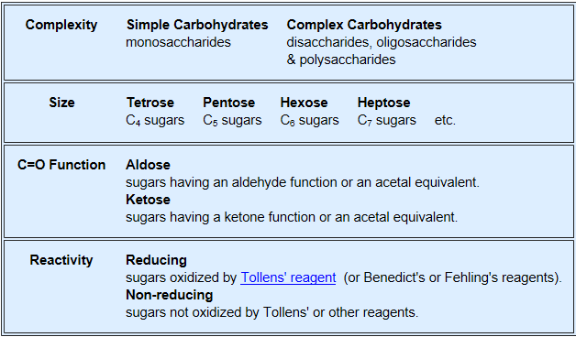
Several classifications of carbohydrates have proven useful, and are outlined in the following table.

Slide 4
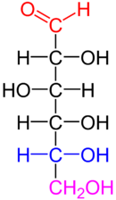
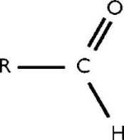
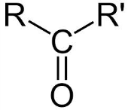
1-According to the complexity:
Simple [one unit, one monosaccharide unit],
and complex[more than one unit].
2-According to number of units:
Mono- Di- Oligo- Poly- saccharide.
3- According to position of carbonyl group[C=O] in mono saccharide:
Aldoses and Ketoses.
4- According to the number of carbon atoms in mono saccharide[size]:
triose(C3),tetrose(C4), pentose(C5),hexose(C6),heptose(C7).
5-According to their reactivity:
Reducing and non reducing sugars.
???

Slide 5
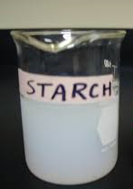
Solubility of sugars [physical property]:
Monosaccharide and disaccharide can be dissolved freely in water because water is a polar substance, while polysaccharide cannot be dissolved easily in water, because, it has high molecular weight , which give colloidal solutions in water.

Slide 6
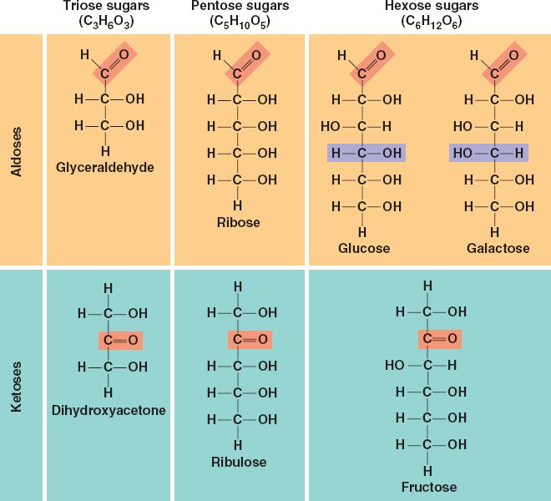

Slide 7
Chemical Properties of Carbohydrates:
1- Molisch Test: specific for carbohydrates.
2- Benedict's Test: presence of reducing sugars.
3- Barfoed's Test: test used for detecting the presence of monosaccharides.
4- Bial's Test: used to detect pentose [5C] monosacharides.
5-Seliwanoff's Test: distinguish between aldoses and ketoses.

Slide 8
1.Molisch test:
Objective:
To identify the carbohydrate from other macromolecules, lipids and proteins.
Principle:
based on the dehydration of the carbohydrate by sulfuric acid [H₂SO₄]to produce an aldehyde (either furfural or a derivative), which then react with α-naphthol present in the test reagent to produce a purple ring.
Note:
This test is specific for all carbohydrates Monosaccharide gives a rapid positive test, Disaccharides and polysaccharides react slower.
-Dehydrates pentose to form furfural and, dehydrates hexoses to form 5- hydroxymethyl furfural.

Slide 9
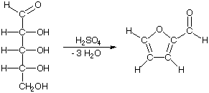
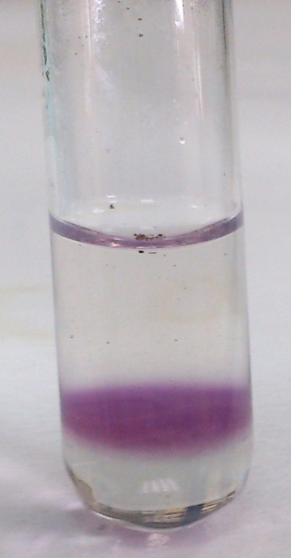
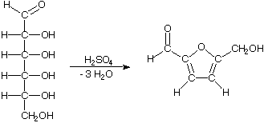
α-naphthol
[Present in the reagent ]
Purple ring
furfural
α-naphthol
Purple ring
5- hydroxymethyl furfural

Slide 10
2.Benedict's test:
Objective:
To detect the presence of reducing sugars.
-All monosaccharides are reducing sugars; they all have a free reactive carbonyl group.
-Some disaccharides have exposed carbonyl groups and are also reducing sugars. Other disaccharides such as sucrose are non-reducing sugars and will not react with Benedict's solution.
-Large polymers of glucose, such as starch, are not reducing sugars.

Slide 11
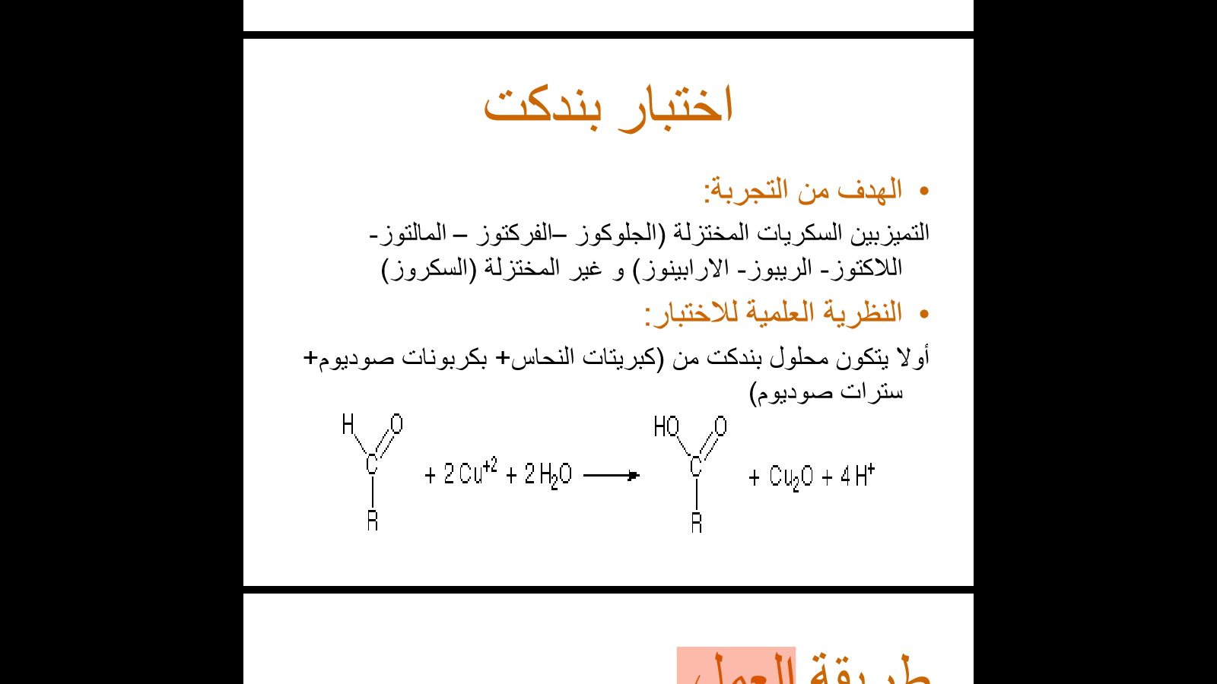
Principle:
The copper sulfate (CuSO4) present in Benedict's solution reacts with electrons from the aldehyde or ketone group of the reducing sugar. Reducing sugars are oxidized by the copper ion in solution to form a carboxylic acid and a reddish precipitate of copper (I) oxide.
reddish
precipitate
[copper oxide].
Reducing
sugar
carboxylic acid
Note: The copper sulfate (CuSO4) present in Benedict's solution is in alkaline medium.

Slide 12
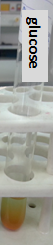

Slide 13
3.Barfoed’s Test:
Objective:
test used for detecting the presence of monosaccharides.
Principle:
It is based on the reduction of copper(II) acetate to copper(I) oxide (Cu₂O), which forms a brick-red precipitate.
or
Reducing monosaccharides are oxidized by the copper ion in solution to form a carboxylic acid and a reddish precipitate of copper (I) oxide within three minutes. Reducing disaccharides undergo the same reaction, but do so at a slower rate.
-The nonreducing sugars give negative result.
Note: Barfoed’s test used copper (II) ions in a slightly acidic medium.

Slide 14


Slide 15
4.Bial’s Test:
Objective:
used to detect pentose [5C] monosacharides.
Principle:
Bial’s test uses concentrated HCl as a dehydrating acid and orcinol + traces of ferric chloride [FeCl₃ ]as condensation reagent.
The test reagent dehydrates pentoses to form furfural. Furfural further reacts with orcinol and the iron ion present in the test reagent to produce a bluish or green product.

Slide 16
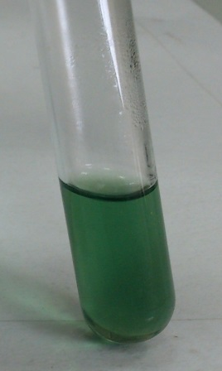
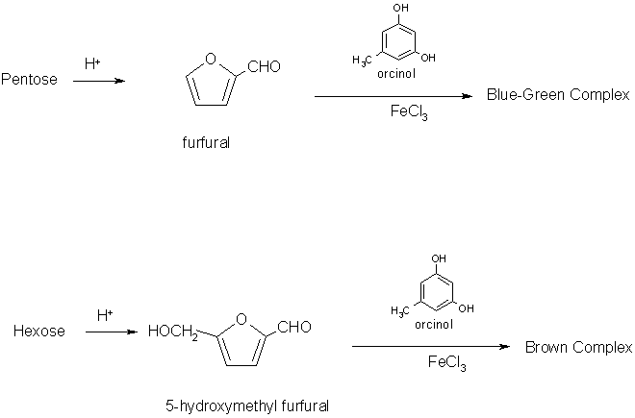
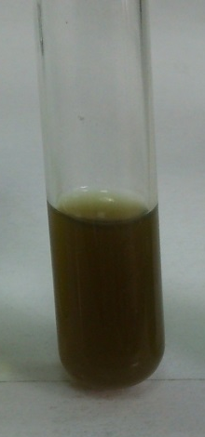

Slide 17
5.Seliwanoff's Test:
Objective:
used to distinguish between aldoses (like glucose) and ketoses (like fructose).
Principle:
Seliwanoff's Test uses 6M HCl as dehydrating agent and resoncinol as condensation reagent.
The test reagent dehydrates ketohexoses to form 5-hydroxymethylfurfural. 5-hydroxymethylfurfural further condenses with resorcinol present in the test reagent to produce a cherry red product within two minutes.
-Aldohexoses react to form the same product, but do so more slowly giving yellow to faint pink color.

Slide 18
