Slide 1
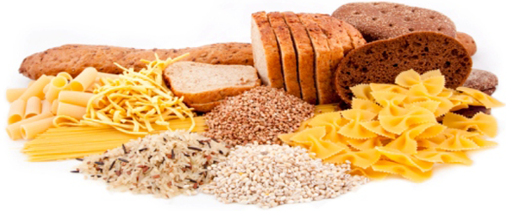
Qualitative tests of Carbohydrate

Slide 2
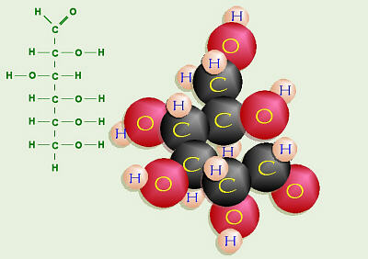
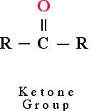
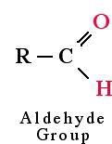
Carbohydrate :
Carbohydrates are the key source of energy used by living things.
Also serve as extracellular structural elements as in cell wall of bacteria and plant.
Carbohydrates are defined as the polyhydroxy aldehydes or polyhydroxy ketones.
Most , but not all carbohydrate have a formula (CH₂O)_{n} (hence the name hydrate of carbon)
In human body, the D-glucose is used.
Simple sugars ends with –ose.
Notes:
D,L?

Slide 3
Several classifications of carbohydrates have proven useful, and are outlined in the following table.
Notes:
Monosaccharide

Slide 4
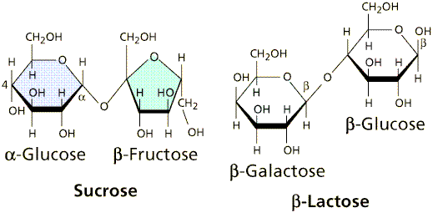
Classification :
1-Simple sugar (one unit) :
Monosaccharides contain one monosaccharide unit.
2-Complex sugar (more than one) :
Disaccharides contain two monosaccharide units.
Oligosaccharides contain 3-9 monosaccharide units.
Polysaccharides can contain more than 9 monosaccharide units.
Complex carbohydrates can be broken down into smaller sugar units through a process known as hydrolysis.

Slide 5
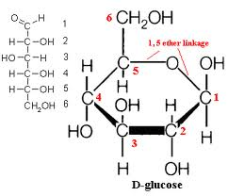
Reducing and non reducing sugars
Reducing and non reducing sugar :If the oxygen on the anomeric carbon of a sugar is not attached to any other structure, that sugar can act as a reducing agent and is termed a reducing sugar.
reducing
Non-reducing
Notes:
Anomeric carbon:C1?
Why lactose reducing, but sucrose nonreducing?

Slide 6
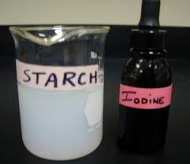
Solubility of sugars [physical property]:
Monosaccharide and disaccharide can be dissolved freely in water because water is a polar substance, while polysaccharide cannot be dissolved easily in water, because, it has high molecular weight , which give colloidal solutions in water.

Slide 7
Chemical Properties of Carbohydrates:
1- Molisch Test: specific for carbohydrates.
2- Benedict's Test: presence of reducing sugars.
3- Barfoed's Test: test used for detecting the presence of monosaccharides.
4- Bial's Test: used to detect pentose [5C] monosacharides.
5- Seliwanoff's Test: distinguish between aldoses and ketoses.

Slide 8
1.Molisch test:
This test is specific for all carbohydrates Monosaccharide gives a rapid positive test, Disaccharides and polysaccharides react slower.
Objective:
To identify the carbohydrate from other macromolecules, lipids and proteins.
Principle:
The test reagent(H2SO4) dehydrates pentose to form furfural and dehydrates hexoses to form 5- hydroxymethyl furfural.
The furfural and 5- hydroxymethyl furfural further react with α-naphthol present in the test reagent to produce a purple ring.

Slide 9
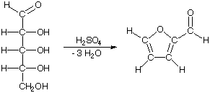
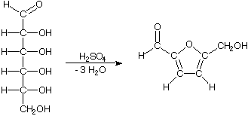
α-naphthol
[Present in the reagent ]
Purple ring
furfural
α-naphthol
Purple ring
5- hydroxymethyl furfural
Notes:
Sulfuric acid

Slide 10
Method :
1-Two ml of a sample solution is placed in a test tube.
2-Two drops of the Molisch reagent (which α-napthol in 95% ethanol) is added.
3-The solution is then poured slowly into a tube containing two ml of concentrated sulfuric acid so that two layers form, producing violet ring appear as liaison between the surface separations.
Observation | Tube
 | Glucose
 | Lactose
 | Starch

Slide 11
2.Benedict's test:
Objective:
To detect the presence of reducing sugars.
All monosaccharides are reducing sugars; they all have a free reactive carbonyl group.
Some disaccharides have exposed carbonyl groups and are also reducing sugars. Other disaccharides such as sucrose are non-reducing sugars and will not react with Benedict's solution
-Large polymers of glucose, such as starch, are not reducing sugars, since the concentration of hemiacetal groups is very low.
Notes:
Why ?

Slide 12
Principle :
The copper sulfate (CuSO4) present in Benedict's solution reacts with electrons from the aldehyde or ketone group of the reducing sugar in alkaline medium.
Reducing sugars are oxidized by the copper ion in solution to form a carboxylic acid and a reddish precipitate of copper (I) oxide.
lactose
sucrose
glucose
Reducing sugar
carboxylic acid
reddish
precipitate
[copper oxide].

Slide 13
Method :
One ml of a sample solution is placed in a test tube.
Two ml of Benedict's reagent is added.
The solution is then heated in a boiling water bath for five minutes.
A positive test is indicated by: The formation of a reddish precipitate.
Tube | observation
1-glucose
2-lactose
3-starch

Slide 14
3.Barfoed’s Test:
Objective :
To distinguish between mono- , di- and poly saccharides.
Principle :
Barfoed’s test used copper (II) ions in a slightly acidic medium.
Reducing monosaccharides are oxidized by the copper ion in solution to form a carboxylic acid and a reddish precipitate of copper (I) oxide within three minutes. Reducing disaccharides undergo the same reaction, but do so at a slower rate.
-The nonreducing sugars give negative result.
Notes:
Barfoed’s reagent, cupric acetate in acetic acid , so in acidic medium , disacchride is a weaker reducing agent than monosacchride, so mono sacchride will reduce the copper in less
time.
اللاكتوز ياخذ وقت طويل

Slide 15
Method :
Place one ml of a sample solution in a test tube.
Add 3 ml of Barfoed's reagent (a solution of cupric acetate and acetic acid).
Heat the solution in a boiling water bath for 6 minutes(after the 3 min check the tubes).
Tube | observation
glucose
lactose
starch
Notes:
لاكتوز ياخذ وقت طويل مره *

Slide 16
4. Bial’s Test:
Objective: To distinguish between pentose monosaccharide and hexose monosaccharide
Principle: Bial’s test uses concentrated HCl as a dehydrating acid and orcinol + traces of ferric chloride [FeCl₃] as condensation reagent. The test reagent dehydrates pentoses to form furfural. Furfural further reacts with orcinol and the iron ion present in the test reagent to produce a bluish or green product, while hexoses yield muddy-brown to grey condensation product.
Notes:
اراقب الالوان لانها ممكن تغمق مع الوقت*

Slide 17
Method :
Put 2 ml of a sample solution in a test tube.
Add 3 ml of Bial's reagent (a solution of orcinol, HCl and ferric chloride) to each tube.
Heat the tubes gently in hot water bath.
If the color is not obvious, more water can be added to the tube.
Tube | observation
1-glucose
2-ribose

Slide 18
5.Seliwanoff's Test:
Objective:
used to distinguish between aldoses (like glucose) and ketoses (like fructose).
Principle:
Seliwanoff's Test uses 6M HCl as dehydrating agent and resoncinol as condensation reagent. The test reagent dehydrates ketohexoses to form 5-hydroxymethylfurfural. 5-hydroxymethylfurfural further condenses with resorcinol present in the test reagent to produce a cherry red product within two minutes.
-Aldohexoses react to form the same product, but do so more slowly giving yellow to faint pink color.
Notes:
الجلكوز ماتغير)ظل شفاف(

Slide 19
Method :
One half ml of a sample solution is placed in a test tube.
Two ml of Seliwanoff's reagent (a solution of resorcinol and HCl) is added.
The solution is then heated in a boiling water bath for two minutes.
Tube | observation
1-glucose
2-fructose

Slide 20
Questions:
1- Name the complex formed by the addition of concentrated sulfuric acid to sugar solution and explain the reaction?
2- Why sucrose gives negative Benedict test?
3- Explain, although starch has free hemiacetal bond it gives negative Benedict test?
4- Why glucose (monosaccharide) and lactose (disaccharide) give positive Benedict test?
5- What is the difference between Benedict and Barfoed's reaction?
6- What are the carbohydrates’ that give positive result with Seliwanoff ? why?

