Slide 1
Business Models and Common Strategies
Learning Objectives
Understand the concept and use of business models;
Be able to describe how business models vary in healthcare and how business models may provide a competitive advantage;
Comprehend generic strategies and their application to healthcare;
Be familiar with strategies for differentiation in healthcare, including focused factories; and
Recognize the advantages and disadvantages of first-mover strategy.

Slide 2
Business Models and Common Strategies
Internal environmental analysis is sometimes accomplished by evaluating functional areas such as clinical operations, information systems, marketing, clinical support, human resources, financial administration, and so on.
With such an approach, each function or organizational subsystem is carefully analyzed and a list of strengths and weaknesses is developed and evaluated. Although this approach has been successful in some instances, by itself it does not adequately address strategic issues.

Slide 3
Business Models and Common Strategies
Value Creation in Health Care Organizations
Organizations are successful when they create value for their customers.
Similarly health care organizations are successful to the extent that they create value for the patients, physicians, and other stakeholders that rely on their services.
Value is defined as the amount of satisfaction received relative to the price paid for a health care service.

Slide 4
Business Models and Common Strategies
Value Creation in Health Care Organizations
For example, a patient may go to a cosmetic surgeon and pay an extremely high price. Despite the high price, the perception of social acceptance, increased feeling of self-esteem and improved self-confidence may provide so much satisfaction that the patient believes a very high value was received.

Slide 5
Business Models and Common Strategies
Value Creation in Health Care Organizations
By contrast, patients may go to a family practice clinic where services are provided in a rude and disrespectful manner and perceive that they have received little or no value.
Value is the perceived relationship between satisfaction and price, not price alone.
The value chain as a strategic thinking map provides the health care strategist with a framework for assessing the internal environment of the organization.

Slide 6
Business Models and Common Strategies
Organizational Value Chain
Health care organizations have numerous opportunities to create value for patients and other stakeholders.
For example, efficient appointment systems, courteous doctors and nurses, “patient friendly” billing systems, easy-to-navigate physical facilities, and the absence of bureaucratic red tape can greatly increase the ratio of satisfaction to price.

Slide 7
Business Models and Common Strategies
Organizational Value Chain
The organizational value chain is an effective means of illustrating how and where value may be created.
The value chain illustrated in Exhibit 4–1 has been adapted from the value chain used in industrial organizations to more closely reflect the value adding components for health care organizations.

Slide 8
Organizational Value Chain

Slide 9
Business Models and Common Strategies
Organizational Value Chain
The value chain utilizes a systems approach; value may be created in the service delivery subsystem (upper portion of the value chain) and by effective use of the support subsystem (lower portion).
Service delivery activities (pre-service, point-of-service, and after-service) are placed above the support activities as they are the fundamental value creation activities but they are “supported” by, activities that facilitate and improve service delivery.

Slide 10
Business Models and Common Strategies
Organizational Value Chain
The three elements of service delivery – pre-service, point-of-service, and after-service – incorporate the production or creation of the service (product) of health care and include primarily operational processes and marketing activities.

Slide 11
Business Models and Common Strategies
Organizational Value Chain
Organizational culture, organizational structure, and strategic resources are the subsystems that support service delivery by ensuring an inviting and supportive atmosphere, an effective organization, and sufficient resources such as finances, highly qualified staff, information systems, and appropriate facilities and equipment.
Although not always apparent, such support systems are critical for an effective and efficient organization.

Slide 12
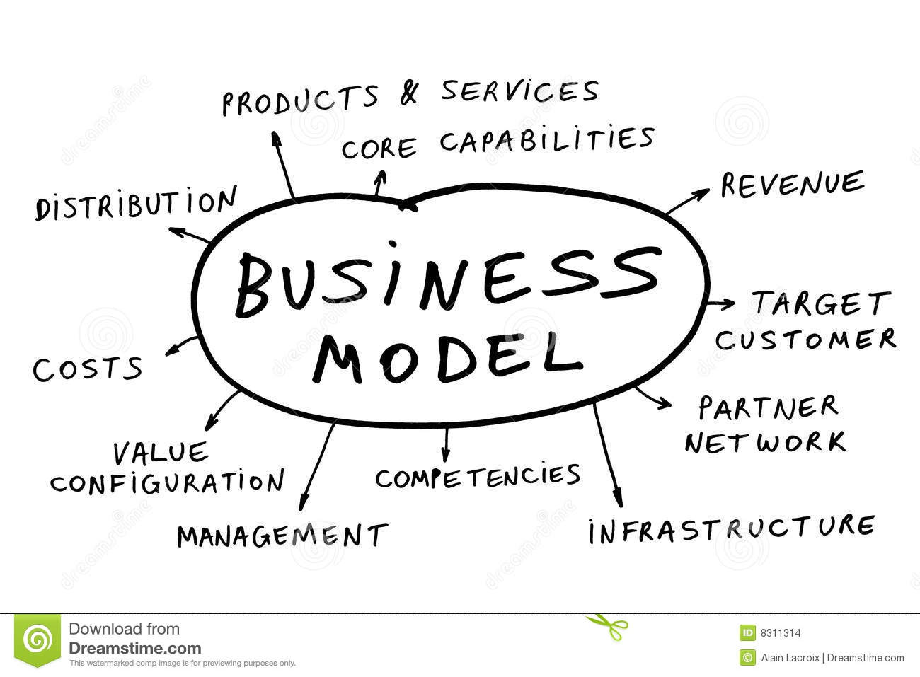
Business Models and Common Strategies
Business Models

Slide 13
Business Models and Common Strategies
Business Models
Whatever their definition of success, organizations constantly face the challenge of devising strategies that will enable them to enhance the value they provide to their key stakeholders.
Business models, the underlying structure and function of organizations, build on the idea of value chains and value creation.

Slide 14
Business Models and Common Strategies
Business Models
Defined as the core elements of an organization and how it is structured to deliver value to its customers and generate revenues.
A company’s business model describes its collaborative portfolio of strategy choices put in place for the handling of the processes and relationships that drive value creation on operational, tactical and executive levels.

Slide 15
The MOH Strategic Plan will Transfer the Healthcare System in Saudi Arabia from Hospital Centered Health System to Health Needs of Rostered Population

Slide 16
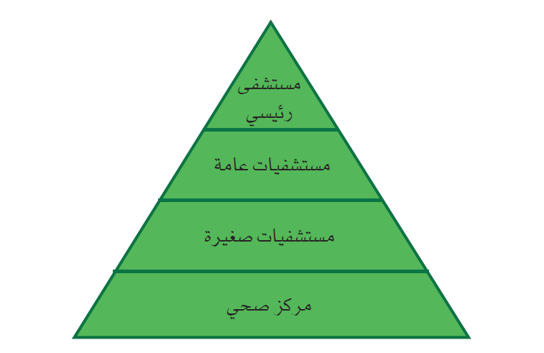
The Current System

Slide 17
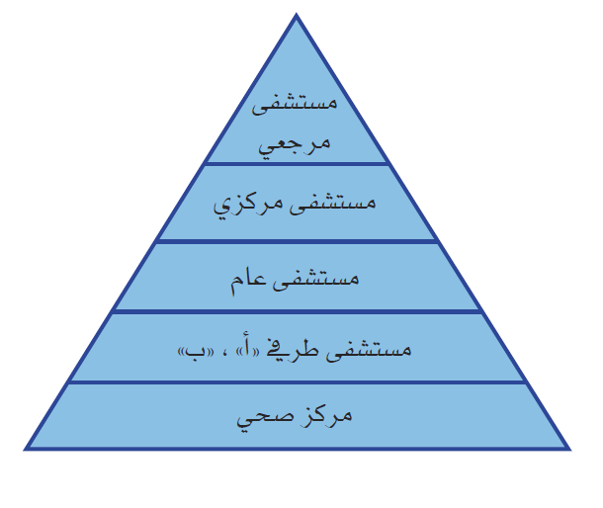
Proposed System

Slide 18
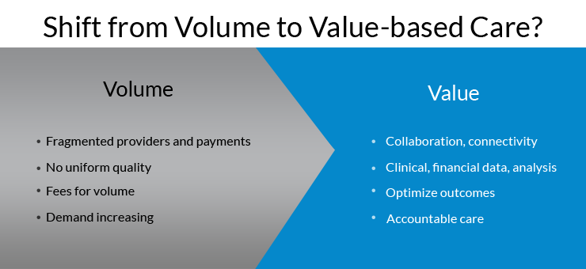
Business Models and Common Strategies
Business Models
Business models encompass all aspects of organizations, including their economic, operational, and strategic domains, and successful organizations design their business models around their internal competencies.

Slide 19
Business Models and Common Strategies
Business Models
Appropriate, competitive business models often succeed when matched against organizations that have better ideas and better technology but a poor business model.
Most established organizations in the same industry do not have distinct business models. Organizations that compete for the same set of customers frequently copy each other’s structures and strategies.
Over time, many organizations may come to offer similar sets of products and services.

Slide 20
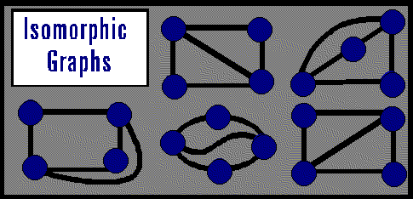
Business Models and Common Strategies
Business Models
Barriers commonly restrict entry into an industry, and mobility barriers limit competition within strategic groups.
With limited entry of new organizations and similar environmental conditions, incumbents become isomorphic over time, adopting homogenous forms and practices.
They look different, nonetheless
they are basically the same.

Slide 21
Business Models and Common Strategies
Business Models
As a result, pronounced differences in business models often emerge only when environmental shifts alter customer preferences, technology, and barriers to entry, thereby allowing new organizations to enter the industry.

Slide 22
Business Models and Common Strategies
Business Models
Business models are often portrayed as four interrelated components: value to customers, organizational inputs, organizational processes, and means of generating and obtaining revenues (see Exhibit 3.2).
The content and structure of these components should result from strategic decisions; their functions and interactions importantly contribute to the success or failure of an organization.

Slide 23
EXHIBIT 3.2 The Four Components of Business Models
Value to Customers
What value is created for customers in terms of product quality, cost, or access and availability?
Inputs
What inputs distinguish the organization in terms of the combination of resources it uses to produce the product/ service?
Processes
What processes are used to create and provide the product/service?
Revenue Generation
What financial mechanism is used to generate revenues to sustain the provision of the product/service?

Slide 24
Business Models and Common Strategies
Customer Value
Organizations seek to produce what customers’ value.
This perceived value consists of a range of products and services, a degree of customization, ease of availability and access, and the quality/cost trade-off.
Dissimilar business models may provide a different type of value to customers.

Slide 25
Business Models and Common Strategies
Customer Value
Customers have differing desires and needs. Some may value ease of access and availability; others want low cost, while yet others seek high quality.
An innovative business model aims to address the needs and desires of all consumers or just a segment.
The value provided by successful organizations reflects their mission and vision and differentiates them from competitors.

Slide 26
Business Models and Common Strategies
Customer Value
  The following questions can be used to explore the customer value an organization provides:
What value is provided to the customer segments served?
What customer problems are solved by the organization’s product/ service?
What customer needs does the product/service satisfy?
What needs are not satisfied?
Does the value created by the organization support its mission and vision?
How does this value distinguish the organization from competitors?

Slide 27
Business Models and Common Strategies
Inputs
The type and mix of resources organizations use to provide a product or service make up the inputs component of the business model.
Resources include personnel, materials, and equipment.
Organizations choose a mix of automated equipment and personal interaction and select types and quantities of materials and supplies according to the value they wish to deliver.

Slide 28
Business Models and Common Strategies
Inputs
Some businesses choose to hire personnel to answer phones and greet customers, while others automate customer interactions.
Other inputs include organizational core competencies—a critical source of competitive advantage—and strategic assets, such as facilities, equipment, location, patents, networks, and partnerships.
An organization may change its inputs over time; for example, innovations in technology often trigger a change of inputs.

Slide 29
Business Models and Common Strategies
Inputs
An organization can use the following questions to examine its inputs:
What key inputs directly contribute to the value of the product/ service?
Are any inputs inconsequential?
Could the organization lower costs or increase value if it changed any of its inputs?
Are there new technologies that the organization should consider adding as new inputs?

Slide 30
Business Models and Common Strategies
Processes
A process is a series of steps that ultimately transforms inputs into customer- valued products and services.
In addition to creating value, processes simplify decision making, increase efficiency, complete tasks, organize functions, and enable an organization to interface with external entities.
A process sits between every input and resultant output.

Slide 31
Business Models and Common Strategies
Processes
Processes are often formalized into policies and procedures and may be categorized as primary, support, or management processes.
Each step in a process should add value.
Organizations vary widely in their use of processes in their business models.

Slide 32
Business Models and Common Strategies
Processes
The following questions can be used to examine processes:
How do the organization’s processes differ from those of its competitors?
Which processes add value and which do not?
Could processes be redesigned to eliminate unneeded steps?
Do processes unnecessarily delay final outputs?
Can processes be automated?
Is there new technology that could streamline existing processes?

Slide 33
Business Models and Common Strategies
Revenue Generation
All organizations must generate sufficient revenues to operate.
To survive and prosper, even not-for-profit organizations must produce “profits” or take in more money than they expend.
The ways in which funds are generated vary significantly.
Organizations may obtain monies directly from consumers or through third parties.

Slide 34
Business Models and Common Strategies
Revenue Generation
Payments for products and services can be made directly (e.g., fee-for-service), through bartering exchanges, via rebates from manufacturers, in advance (e.g., prepayments for a scope of services), and in other ways.
Additional revenues can be generated indirectly from donations, grants, and taxation.
For an organization to remain in business, its total direct and indirect income must exceed its expenses over time.

Slide 35
Business Models and Common Strategies
Revenue Generation
The following questions can be used to assess the profitability of a business model:
In what ways does the organization generate revenues?
If an organization generates revenues in multiple ways, which ones are the most important?
Which will be the most important in the future?
Could new technology significantly affect the ways the organization generates revenues?
Does the organization generate enough revenues to achieve its mission?
If not, what needs to occur?

Slide 36
Business Model Innovation and Adaptation
The four components of a business model constantly interact to execute an organization’s strategies.
To be successful, organizations must be willing to modify their business models as conditions change.
However, organizations with established business models find them difficult to change because the four components are interlinked.

Slide 37
Business Model Innovation and Adaptation
The innovative business models of new market entrants are often difficult for incumbents to imitate.
The inability to copy new organizations’ business models lies in the interconnectedness of the model components.
Older organizations commonly try to compete with new organizations by changing only part of their business model, but this approach has consistently proved to be ineffective.

Slide 38
Business Model Innovation and Adaptation
Nonetheless, business models must change when the external environment substantially shifts and organizations must seek different ways to compete and survive.
For example, most consider the traditional pharmaceutical business model unsustainable.
It consists of large, vertically integrated organizations with large sales forces promoting drugs created from small- molecule compounds.

Slide 39
Business Model Innovation and Adaptation
As detailed in Exhibit 3.3, by 2020 the business model of successful pharmaceutical companies is predicted to evolve into a collaborative network of firms that help manage patient outcomes through a “medicine-plus” approach.
Some large pharmaceutical companies, such as Eli Lilly, are changing their business models and taking to a more collaborative approach.

Slide 40
EXHIBIT 3.3 The Changing Pharmaceutical Business Model
Component | Traditional Pharmaceutical Business Model | Suggested 2020 Pharmaceutical Business Model
Value | Vendor of medicines to physicians and patients | Managing patient outcomes through pharmaceuticals
Inputs | Large, vertically integrated organizations, including research, clinical trials, marketing, and manufacturing based in Western countries | Non-ownership agreements with universities, hospitals, technology providers, and organizations offering such services as compliance programs, stress management, nutrition, physiotherapy, exercise, and health screenings; more research is to migrate to Asia
Processes | Discovery of small-molecule compounds, few of which are approved for sale; sales direct to primary care physicians and patients focused on primary care | Collaboration with many firms to provide offerings of “medicine- plus” packages; sale through insurance and regulated mechanisms
Profits | Profits generated for and by individual organizations; most profits obtained from sale of “blockbuster” drugs to pharmacies and physicians | Profits generated by joint company efforts to achieve health outcomes from sales through governmental payers, which will determine which medicines are prescribed

Slide 41
Us Healthcare Business Model
As illustrated in Exhibit 3.4, healthcare in the United States conventionally has offered fragmented treatment of illness focused on acute care at the expense of primary and preventive care.
Physicians and hospitals have been primarily engaged in curing disease on an individual basis.
Little coordination has occurred among healthcare providers, instigating the delivery of duplicate services and driving up costs.

Slide 42
Us Healthcare Business Model
American hospitals have become some of the most costly structures ever built and, as the hubs of healthcare provision, have promoted high-cost acute care medicine.
Yet, duplication and the high-cost structure have increased hospitals’ profits.
Insurance companies have taken the role of middleman, receiving monies from businesses and negotiating contracts with providers for healthcare services.
The more services providers deliver, the more money they make.

Slide 43
Us Healthcare Business Model
From a public and consumer perspective, this business model has not produced consistent value.
Despite spending more than double per capita on healthcare than any other system in the world, the US healthcare system performs relatively poorly in terms of mortality and morbidity outcomes.

Slide 44
Us Healthcare Business Model
According to a 2010 Commonwealth Fund report, the US healthcare system ranked last or next to last on quality, access, efficiency, equity, and health. (among the 11 nations studied in this report—Australia, Canada, France, Germany, the Netherlands, New Zealand, Norway, Sweden, Switzerland, the United Kingdom, and the United States—the U.S).
The weaknesses inherent in the current US healthcare business model have created a fragmented, inefficient system.

Slide 45
EXHIBIT 3.3 The Changing Pharmaceutical Business Model
Component | Traditional Healthcare Business Model | Changing Healthcare Business Model
Value | Treatment of acute care problems; focus on curative outcomes | Improving population health; focus on preventive medicine and reduction of disease
Inputs | Fragmented system in which many different providers often compete with each other; separate ownership of physicians, insurance companies, and hospitals | Greater integration and communication among delivery systems focused on the health of a population; information systems needed to capture and manage key data
Processes | Insurance companies con- tract with businesses and individuals for healthcare services. Insurance companies negotiate with hospitals and physicians for services. Public health services are not integrated with traditional acute care. Physicians obtain privileges to practice at independently owned hospitals. | Businesses and governments contract with systems to provide a wide scope of healthcare services. Public health services are integrated with acute care services.
Profits | Profits generated by fee-for- service: the more services provided, the more revenue produced | Profits generated by reducing disease and controlling expenses

Slide 46
Business Model Innovation and Adaptation
The Threat of Disruptive Innovation
The concept of disruptive innovation suggests that disruption occurs when technological enablers and business model innovation are successfully combined (see Exhibit 3.5).
These factors can destroy existing organizational competencies and spur the rise of new, dominant organizations.

Slide 47
EXHIBIT 3.5 Components of Disruptive Innovation
Type of Innovation
Radical
Sustaining
High potential for disruptive innovation; incumbents threatened
Low potential for disruptive innovation; innovation benefits incumbents
New
Business Model Change
Low potential for disruptive innovation; new innovations change market relationships
No potential for disruptive innovation; incumbents strengthened
None

Slide 48
Business Model Innovation and Adaptation
The Threat of Disruptive Innovation
Technological enablers that have prompted radical innovation include developments such as the microprocessor, which helped personal computers overwhelm mainframes; the Internet, which gave rise to online news and the development of online retail stockbrokers, and advancements in electronics, such as digital photography.
As the quality of these new technologies improved, they overtook entrenched incumbents by offering better service and lower prices.

Slide 49
Business Model Innovation and Adaptation
The Threat of Disruptive Innovation
Novel business models that utilize disruptive technology enable organizations to better compete in the market and radically diminish incumbents’ ability to generate profits.
As a result, few dominant businesses ever survive disruptive innovation to remain the leading organizations in the new environment.

Slide 50
Business Model Innovation and Adaptation
The Threat of Disruptive Innovation
For example, Kodak produced excellent film for cameras and had expert competencies in chemical engineering.
The advance to digital imaging destroyed the value and relative competence of the thousands of chemical engineers employed by Kodak.
Electrical engineering skills were needed in the new world of digital imaging, and companies without these competencies failed to adapt to the new reality.

Slide 51
Business Model Innovation and Adaptation
The Threat of Disruptive Innovation
Healthcare has not generated many radical innovations but mostly sustaining discoveries that have benefited incumbents.
However, many predict that future innovation whether driven by legislative directive or scientific discovery—may disrupt existing healthcare relationships and the ways in which care is provided as well as reconfigure service offerings to meet customer demand at lower prices.

Slide 52
Business Model Innovation and Adaptation
The Threat of Disruptive Innovation
Advances in genomics, which plays a role in nine of the ten leading causes of disease in the United States, present great potential for disruptive innovation in the diagnoses, treatment, and prevention of disease.
Clinical molecular testing, pharmacogenomics, and other medical genomics discoveries are rapidly expanding and helping physicians provide personalized medicine and make better prescribing and dosing decisions.

Slide 53
Business Model Innovation and Adaptation
The Threat of Disruptive Innovation
Healthcare is prone to fragmentation of care, coordination of care is difficult, consumers lack the proper incentives to shop for care, and many regulatory barriers exist.
For these reasons, disruptive innovation does not easily take root in health- care. Nevertheless, with steadily increasing costs and rampant inefficiencies, healthcare needs radical surgery, and strategists must recognize the possibility that new business models will emerge and bring about major change.

Slide 54
Business Model Innovation and Adaptation
Generic strategies
Decades ago, Michael Porter (1980), professor of business administration at the Harvard Business School, proposed three generic categories of strategy from which organizations may select.
Others have since increased the number of generic categories to five.
Exhibit 3.6 lists the possible combinations and provides examples of organizations that have adopted each type of strategy.

Slide 55
Business Model Innovation and Adaptation
Generic strategies
Porter called these generic strategies because they were general strategies that any organization could use to position itself in the marketplace. For both market wide and market segment focus there are two fundamental positioning strategies – cost leadership and differentiation
Most authors define the generic types of strategy as combinations of a target market (a small, focused customer base versus a large, general customer base) and the type of competitive advantage sought (low cost versus differentiation).

Slide 56
EXHIBIT 3.6 Different Generic Strategies
Target Market | Type of Competitive Advantage | Example
Broad segment | Low costs | Walmart, Dell
Broad segment | Differentiation | Pepsi, Ford
Moderate segment | Moderate costs and differentiation | Community hospitals Grocery stores
Focused segment | Low costs | ALDI
Focused segment | Differentiation | Rolls-Royce, Rolex, concierge medicine
Middle strategy

Slide 57
Business Model Innovation and Adaptation
Broad low-Cost strategy
An organization with a broad low-cost strategy targets a wide customer segment and seeks to achieve competitive advantage in the market by maintaining low costs and underpricing its competitors to earn higher profits.
Low-cost positions can be gained by economies of scale; experience curves; efficient value chain management; effective bargaining; elimination of unnecessary features; and rock- bottom product costs through appropriate outsourcing, vertical integration, and information systems.

Slide 58
Business Model Innovation and Adaptation
Broad low-Cost strategy
Use of the term cost frequently causes confusion because authors at times refer to cost as both the expense of producing a product or a service and the price charged for a product or a service.
Although low-cost and low- price strategies ideally go together, organizations may adopt one but not the other.
Low-cost strategies may be pursued concurrently with some aspect of differentiation to offer reasonable prices, coupled with some unique characteristic (e.g., quality, service, access), while a true low-price strategy may need to offer the lowest price in the market.

Slide 59
Business Model Innovation and Adaptation
Broad low-Cost strategy
Although low production costs often do have a relationship with low prices, in this book low cost refers to the cost of production.
Broad low-cost strategies are most effective in markets where cost is more important than reputation or product characteristics or where large economies of scale exist.
Firms producing commodities, such as wheat, oil, gold, and sugar, may more easily use a low-cost strategy.

Slide 60
Business Model Innovation and Adaptation
Broad low-Cost strategy
Likewise, companies that can exploit large economies of scale, such as manufacturers of computer chips, can compete on the basis of cost.
As a result, organizations using a broad low-cost strategy strive to maximize their market share.
However, low-cost products/services still must maintain a certain level of quality and differentiation.
Consumers must perceive the lowest cost for the value received.

Slide 61
Business Model Innovation and Adaptation
Broad low-Cost strategy
Organizations often take one of the following approaches to create this perception:
Product line narrowed to standardized, no-frills goods.
  Organizations pursuing a broad low-cost strategy may eliminate low- volume products and services from their offerings and retain only those that generate the greatest sales and profitability.

Slide 62
Business Model Innovation and Adaptation
Broad low-Cost strategy
Organizations often take one of the following approaches to create this perception:
Product line narrowed to standardized, no-frills goods.
  They keep production costs low by using standard components, limiting the number of product models, and minimizing overhead and indirect costs. Non-core components may be outsourced.
  For example, specialty hospitals narrow the wide product line of general hospitals, standardize products and processes, and eliminate some services, thereby lowering their costs.

Slide 63
Business Model Innovation and Adaptation
Broad low-Cost strategy
Organizations often take one of the following approaches to create this perception:
High asset turnover.
  Organizations make optimal use of their assets and resources by managing large volumes efficiently and operating their facilities at full capacity.
  Examples include table turnover in restaurants, airlines’ maximization of the time its planes are in flight, and maximization of actual surgical time in operating rooms.

Slide 64
Business Model Innovation and Adaptation
Broad low-Cost strategy
Organizations often take one of the following approaches to create this perception:
Control of purchases and procurement. Organizations seeking to keep costs low generally exercise control over their supply chain and purchases to minimize expenditures. Purchasing in bulk, consigning products (vendor-managed inventory), negotiating high discounts, and using just-in-time purchasing can significantly lower costs.

Slide 65
Business Model Innovation and Adaptation
Broad low-Cost strategy
Organizations often take one of the following approaches to create this perception:
Control of purchases and procurement.
  Hospitals often use consignment, especially for surgical implants. Vendors provide hospitals many different implants, but the hospitals are charged for the implants only when they use them.
  Dell, the computer firm, manages its costs by maintaining low inventories and building computers only after they are ordered.

Slide 66
Business Model Innovation and Adaptation
Broad low-Cost strategy
Organizations often take one of the following approaches to create this perception:
Low-cost distribution systems.
  The costs of distribution are significant for many products and services. Low-cost strategies call for a wide distribution system at a minimal cost.
  Instead of using personal contact, organizations may use online sales and marketing tools to reach customers, some organizations bypass distributors and sell directly to the consumer to reduce costs.

Slide 67
Business Model Innovation and Adaptation
Broad low-Cost strategy
Organizations often take one of the following approaches to create this perception:
Low-cost distribution systems.
  For example, , consider Dell customers order computers from low-cost-focused Dell via the Internet or phone, they also can visit one of Dell’s many local stores and consult with service representatives.
  Likewise, manufacturers of generic drugs may market only to wholesalers, while brand-name drug companies have large, owned sales forces and market directly to pharmacies and physicians.

Slide 68
Business Model Innovation and Adaptation
Focused Low-Cost Strategy
An organization adopting a focused low-cost strategy competes on the basis of costs but targets only a subset of the mass market.
This strategy refines the broad low-cost approach by narrowing its customer base and— possibly—undercutting the pricing of generalists.
Research has shown that in highly competitive markets, smaller, low-cost organizations may find a niche in which the larger rivals cannot compete.

Slide 69
Business Model Innovation and Adaptation
Focused Low-Cost Strategy
For example, ALDI and Walmart are large, international chains. Walmart employs a broad low-cost strategy, while ALDI employs a focused low-cost strategy. Yet their business models are similar in that both focus on cost and reasonable quality.
As shown in Exhibit 3.7, ALDI’s strategy differs from Walmart’s strategy mostly with regard to inputs and processes.

Slide 70
Component | AlDI | Walmart
Value | Low-cost groceries | Low-cost groceries
Input | Stores carry about 700 mostly private-label products bought from independent producers and offer only one brand of each product. Products include a cluster of essential items and about 30 seasonal items. Store size is small, and use of information technology is minimal. | Stores carry about 15,000 products of which about 55% are food items. Only 15% of products are private label. The rest are national brands.
Processes | Customers pay 25 cents to use shopping carts. Stores do not accept checks and do not provide shopping bags. Goods are sold out of cartons. Customers bag their own groceries. An average store may have only 4 or 5 employees. | Food section looks like a normal grocery store. Checkout stands often are congested. A greeter welcomes customers at the door in many stores, and personnel help bag groceries.
Profits | Privately owned; funds expansion with cash; payment for products | Publicly owned; funds expansion with debt and stock; payment for products

Slide 71
Business Model Innovation and Adaptation
Broad Differentiation Strategy
Organizations using broad differentiation strategies offer products and services that have unique features and appeal to a wide segment of a market.
Consumers purchase products and services that have singular characteristics or features they value, and they often will pay more for those valued features.

Slide 72
Business Model Innovation and Adaptation
Broad Differentiation Strategy
  Broad differentiation strategies tend to be most effective in large markets where
Buyer preferences and values are diverse,
Many organizations offer common products, and
Product innovation is rapid.
  Differentiation can be based on characteristics of a product/service or on the attributes of an organization’s personnel, distribution channels, and image.

Slide 73
Business Model Innovation and Adaptation
Broad Differentiation Strategy
A pharmaceutical company might alter the size, texture, reliability, and duration of its medications; accelerate ordering and delivery; or improve the responsiveness and friendliness of its sales personnel.
A radiological equipment manufacturer may elect to focus on ease of installation, customer training, maintenance and repair, and its personnel’s credibility and reliability.

Slide 74
Business Model Innovation and Adaptation
Broad Differentiation Strategy
an organization must have strong marketing capabilities and a perceived reputation for quality or another unique characteristic for broad differentiation strategy to be effective.
Organizations must understand and offer what buyers need and value to succeed through differentiation.
Competitive advantage often is short lived and must be constantly renewed, so innovation and an ability to change are critical factors.

Slide 75
Business Model Innovation and Adaptation
Broad Differentiation Strategy
Certain hospitals have achieved a strong, broad differentiated position and are able to use it to their competitive advantage.
They have carved out “must-have” market positions that enable them to extract higher payments.
A must-have hospital is one that insurance companies must have in their network; else, they face the possibility of losing customers.

Slide 76
Business Model Innovation and Adaptation
Broad Differentiation Strategy
These hospitals such as Cedars-Sinai Medical Center in Los Angeles, have established excellent reputations and most often provide unique, specialized services.
In negotiations with insurance companies, the must-have hospitals demand and frequently receive premium reimbursement rates.

Slide 77
Business Model Innovation and Adaptation
Broad Differentiation Strategy
On the other hand, there is some value to adopting strategies similar to those of competitors and not appearing different.
Conformity sometimes enhances performance and promotes long-term survival.
Customers see that the conforming organization’s product is consistent with those of its competitors and may be more willing to try the new product.
An organization seeking to sustain a differentiation strategy must develop strong creativity and innovation by integrating its marketing and production and hiring and retaining creative personnel.

Slide 78
Business Model Innovation and Adaptation
Focused Differentiation Strategy
Focused differentiation strategy targets a narrow industry niche or customer segment.
The differences are perceived as unique to a narrow group or population.
For example, Rolls-Royce, Rolex, Saks Fifth Avenue, Harrods, Chanel, and Tiffany & Co. focus their products on the luxury market segment.
They offer high-quality, prestigious products at high prices.
Such organizations refrain from expanding into unrelated businesses and offer specialized products.

Slide 79
Business Model Innovation and Adaptation
Focused Differentiation Strategy
Some have suggested that healthcare should be organized in a more specialized, focused way.
Advocated that healthcare’s broad unfocused strategies have led to quality and cost problems and that creating focused factories in healthcare may resolve many of these issues.
Focused healthcare organizations are often owned by physicians (in contrast to public ownership of most general hospitals), offer a relatively narrow line of services, and may attend to only one type of disease.

Slide 80
Business Model Innovation and Adaptation
Focused Differentiation Strategy
Examples include diabetes clinics, cancer clinics, and asthma clinics as well as facilities that specialize in a type of surgery, such as orthopedic surgery or open-heart surgery.
Focused differentiation has emerged in healthcare in other forms as well; some physicians have devised a means of narrowing their customer focus and increasing their incomes by offering differentiated primary care.

Slide 81
Business Model Innovation and Adaptation
Focused Differentiation Strategy
In this arrangement, patients pay an annual fee in addition to regular clinic charges to obtain greater access to their physician and more personalized care.
Similarly, academic medical centers have sought to highlight their differentiation and specialties by establishing luxury primary care clinics to attract wealthy foreign patients.

Slide 82
Business Model Innovation and Adaptation
Middle Strategy
Middle strategy is also called best-cost strategy because it intends to offer customers the optimal mix of distinctive value and attractive costs simultaneously.
Middle strategies are more successful in markets where buyers desire a degree of product differentiation but at the same time is price sensitive.

Slide 83
Business Model Innovation and Adaptation
Middle Strategy
Middle strategy may in fact be the strongest position for many consumer product markets, including groceries, apparel, and hardware, and for many hospitals.
Many community hospitals selectively invest in sophisticated technology and offer “good enough” quality at generally lower prices than those charged by high-quality academic medical centers and tertiary referral hospitals.

Slide 84
Business Model Innovation and Adaptation
Middle Strategy
Of course, the challenge for organizations with middle strategies lies in the difficulty of distinguishing themselves from competitors.
Middle positions are copied more easily by competitors, and differences in cost and quality are often difficult to clearly define to consumers.
For example, patients normally see little quality and cost differences among community hospitals.

