Slide 1
Chapter 16
The Research Report

Slide 2
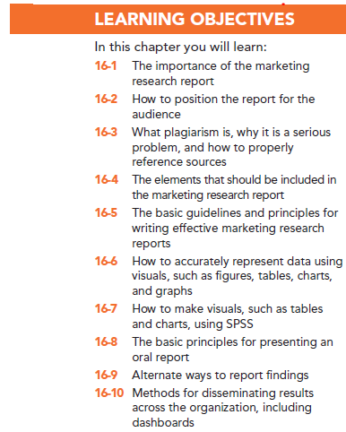

Slide 3
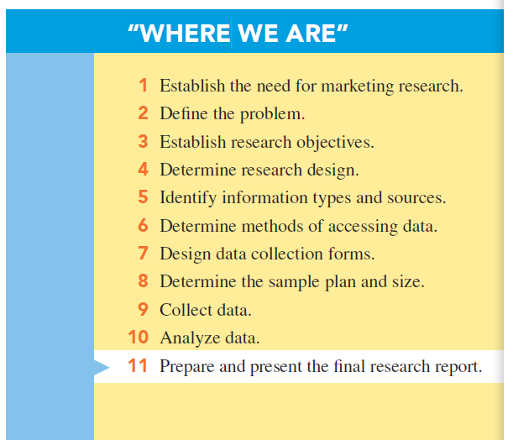

Slide 4
Marketing Research Report
The marketing research report: a written and/or oral report that transmits research results, vital recommendations, conclusions, and other important information to the client, who in turn bases his or her decision making on the contents of the report.

Slide 5
The Importance of the Report
The marketing research report is the product that represents the efforts of the marketing research team, and it may be the only part of the project the client will see.

Slide 6
Know Your Audience
What message do you want to communicate?
What is your purpose?
Who is the audience?
What does your audience know?
What does your audience need to know?
Are there cultural differences you need to consider?
What biases or preconceived notions of the audience might serve as barriers to your message?
What strategies can you use to overcome these negative attitudes?

Slide 7
Plagiarism
Plagiarism refers to representing the work of others as your own.
Properly citing the work of others avoids this problem and also adds credibility to the report.

Slide 9
Elements of the Report -- Front Matter
The front matter consists all pages that precede the first page of the report: the title page, letter of authorization (optional), letter/ memo of transmittal, table of contents, list of illustrations, and abstract/ executive summary

Slide 10
Front Matter
Title Page: contains four major items of information:
The title of the document
The organization/person(s) for whom the report was prepared
The organization/person(s) who prepared the report
The date of submission

Slide 11
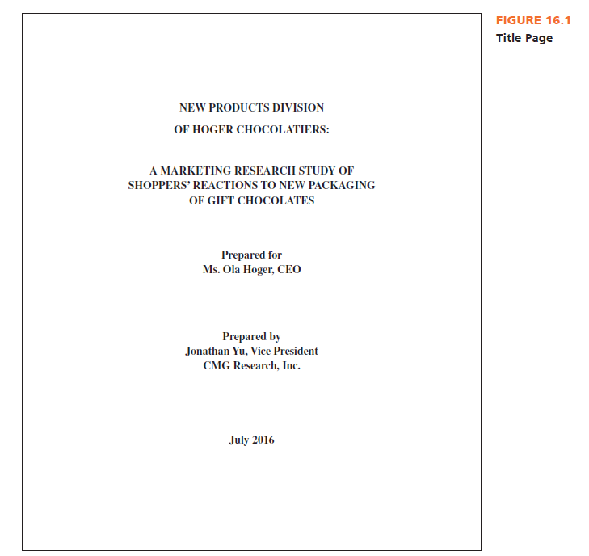

Slide 12
Front Matter
Letter of Authorization: the marketing research firm’s certification to do the project.
Letter/Memo of Transmittal: the letter of transmittal is used to release or deliver the document to an organization for which you are mot a regular employee. The memo of transmittal is used to deliver the document within your organization.

Slide 13
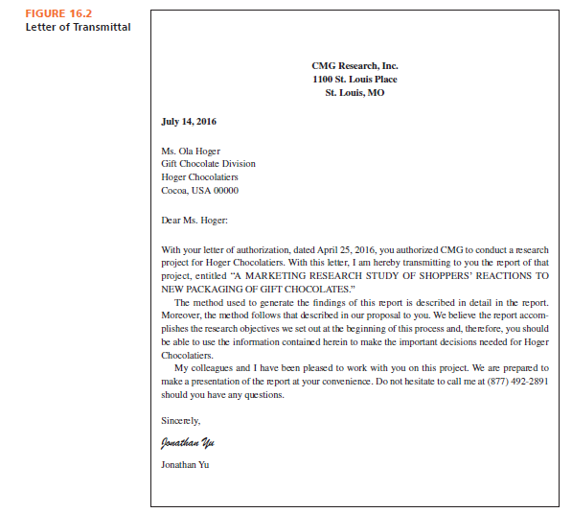

Slide 14
Front Matter
Table of Contents: helps the reader locate information in the research report.
List of Illustrations: if the report contains tables and/or figures, include in the table of contents a list of illustrations with page numbers on which they appear.
Tables: words and/or numbers arranged in rows and columns
Figures: graphs, charts, maps, pictures, and so on.

Slide 15
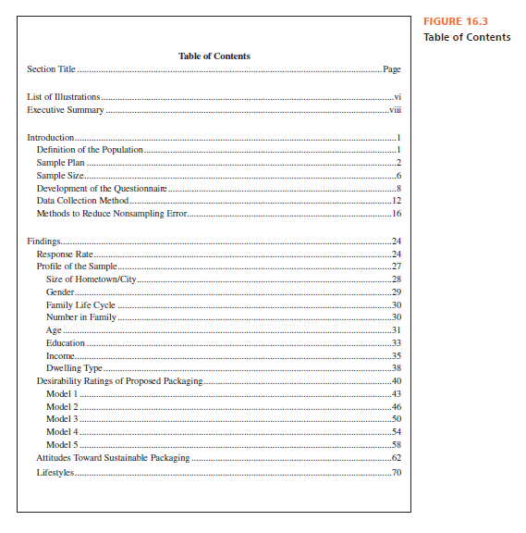

Slide 16
Front Matter
Abstract/Executive Summary: is a “skeleton” of your report and serves as a summary for the busy executive or a preview for the in-depth reader.

Slide 17
Body
The body is the bulk of the report. It contains an introduction to the report, an explanation of your method, a discussion of your results, a statement of limitations, and a list of conclusions and recommendations.

Slide 18
Body
Introduction: orients the reader to its contents. It may contain a statement of the background situation leading to the problem, the statement of the problem, and a summary description of how the research process was initiated.
Research objectives may be listed either as a separate section or within the introduction section.

Slide 19
Body
Method: describes, in as much detail as necessary, how you conducted the research, who (or what) your subjects were, and what tools or methods were used to achieve your objectives.

Slide 20
Body
Use of Word Method or Methodology
Method refers to the tools of scientific investigation (and the tools used in a marketing research project are described in detail in the method section of the report).
Methodology refers to the principles that determine how such tools are deployed and interpreted.

Slide 21
Body
Results: the most important portion of your report. This section should logically present the findings of your research and may be organized around the research objectives for the study.
Limitations: typical limitations in research reports often focus on but are not limited to factors such as constraints of time, money, size of sample, and personnel.

Slide 22
Body
Conclusions and Recommendations:
Conclusions are the outcomes and decisions you have reached based on your research results.
Recommendations are suggestions for how to proceed based on the conclusions.

Slide 23
End Matter
The end matter comprises the appendices, which contain additional information to which the reader may refer for further reading but that is not essential to reporting the data; references list; and endnotes.
A reference list contains all of the sources from which information was collected for the report.
Endnotes are notes at the end of a document that provide supplementary information or comments on ideas provided in the body of the report.

Slide 24
Form and Format
Form and format concerns include:
Headings indicate the topic of each section.
Subheadings should divide the information into segments.
Visuals are tables, figures, charts, diagrams, graphs, and other graphic aids.

Slide 25
Style
A good paragraph has one main idea, and a topic sentence should state that main idea.
The body of the paragraph provides the main idea of the topic sentence by giving more information, analysis, or examples.
The transitional sentence tells readers where they are headed.
Controlling for the length of paragraphs should encourage good communication. As a rule, paragraphs should be short.

Slide 26
Using Visuals: Tables and Figures
Tables, which identify exact values
Graphs and charts, which illustrate relationships among items
Pie charts, which compare a specific part of the whole to the whole
Bar charts and line graphs, which compare items over time or show correlations among items

Slide 27
Using Visuals: Tables and Figures
Common visuals include the following:
Flow diagrams, which introduce a set of topics and illustrate their relationships
Maps, which define geographical locations
Photographs, which present an aura of legitimacy because they are not “created” in the sense that other visuals are created
Drawings, which focus on visual details

Slide 28
Tables
Tables allow the reader to compare numerical data.
Effective table guidelines:
Do not allow computer analysis to imply a level of accuracy that is not achieved. Limit your use of decimal places (12% or 12.2% instead of 12.223%).
Place items you want the reader to compare in the same column, not the same row.

Slide 29
Tables
Effective table guidelines:
If you have many rows, darken alternating entries or double-space after every few (five) entries to assist the reader in accurately lining up items.
Total columns and rows when relevant.
Top-two box scores: in practice, researchers commonly report the first two scores (or the bottom two scores) in a table.

Slide 30
Pie Charts
When you want to illustrate the relative sizes or proportions of one component versus others, pie charts are useful.
The pie chart is a circle divided into sections. Each section represents a percentage of the total area of the circle associated with one component.

Slide 31
Bar Charts
Bar charts are used often in reporting survey data because they are easy to interpret. They are useful to report the magnitude of response or to show magnitude or response comparisons between groups. They are also useful for illustrating change over time.

Slide 32
Line Graphs
Line graphs are easy to interpret if they are designed properly. Line graphs may be drawn in SPSS using the graphs option.
Flow diagrams introduce a set of topics and illustrate their relationships.

Slide 33
Producing an Appropriate Visual
An ethical visual is totally objective in terms of how information is presented in the research report.
Double- and triple-check all labels, numbers, and visual shapes. A faulty or misleading visual discredits your report and work.
Make sure all parts of the scales are presented. Truncated graphs (having breaks in the scaled values on either axis) are acceptable only if the audience is familiar with the data.

Slide 34
Presenting Your Research Orally
Identify and analyze your audience.
Find out the expectations your audience has for your presentation.
Determine the key points your audience needs to hear.
Outline the key points.
Present your points succinctly and clearly.
Make sure your visuals graphically and ethically portray your key points.

Slide 35
Presenting Your Research Orally
Practice your presentation.
Check out the room and media equipment prior to the presentation.
Arrive early.
Be positive and confident.
Speak loudly enough for all in the room to hear, enunciate clearly, maintain eye contact and good posture and dress appropriately.

Slide 36
Alternative Ways to Present Findings
Videos: Many marketing research firms and advertising agencies supplement their written and oral research reports with videos
Infographics: Infographics are visual reports designed to make key research results understood quickly and easily

Slide 37
Disseminating Results Throughout an Organization
Dashboards: provide digital interfaces that allow users to quickly and easily see information that is presented in a simplified manner.
Online reporting software: electronically distributes marketing research reports to selected managers in an interactive format that allows each user to conduct his or her own analyses.

Slide 38
All rights reserved. No part of this publication may be reproduced, stored in a retrieval system, or transmitted, in any form or by any means, electronic, mechanical, photocopying, recording, or otherwise, without the prior written permission of the publisher. Printed in the United States of America.

