Slide 1


Chapter 14
Making Use of Associations Tests

Slide 2
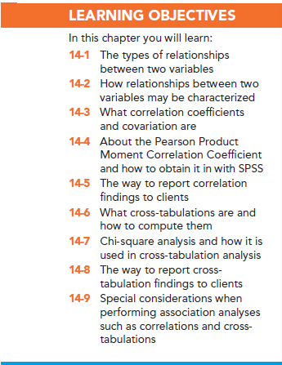

Slide 3
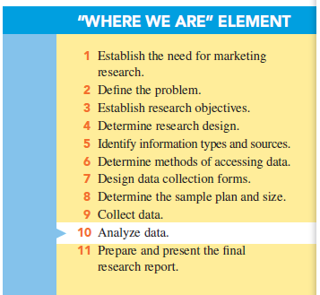

Slide 4
Associative Analyses
Associative analyses: determine where stable relationships exist between two variables

Slide 5
Relationships Between Two Variables
Relationship: a consistent, systematic linkage between the levels or labels for two variables
“Levels” refers to the characteristics of description for interval or ratio scales.
“Labels” refers to the characteristics of description for nominal or ordinal scales.

Slide 6
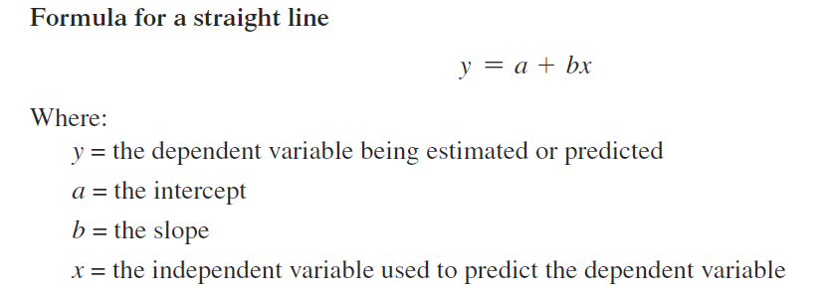
Relationships Between Two Variables
Linear relationship: “straight-line association” between two variables

Slide 7
Relationships Between Two Variables
Monotonic relationship: the general direction of a relationship between two variables is known
Increasing relationship
Decreasing relationship

Slide 8
Relationships Between Two Variables
Nonmonotonic relationship: two variables are associated, but only in a very general sense. The presence (or absence) of one variable is associated with the presence (or absence) of another.

Slide 9
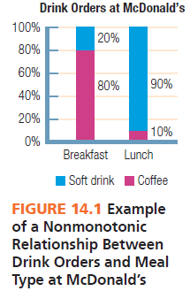

Slide 10
Characterizing Relationships
Between Variables
Presence: whether any systematic (statistical) relationship exists between two variables
Direction: whether the relationship is positive or negative
Strength of association: whether the relationship is consistent

Slide 11
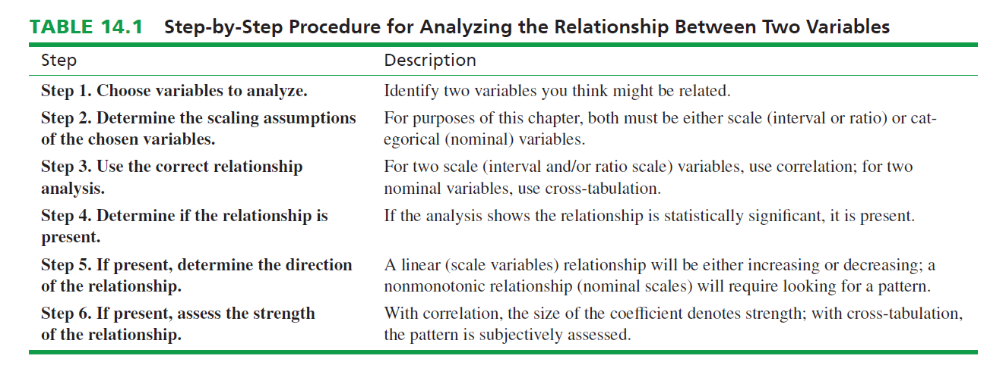

Slide 12
Correlation and Covariation
The correlation coefficient: is an index number, constrained to fall between the range of −1.0 and +1.0.
The correlation coefficient communicates both the strength and the direction of the linear relationship between two metric variables.
Covariation: the amount of change in one variable systematically associated with a change in another variable.

Slide 13
Correlation and Covariation
The amount of linear relationship between two variables is communicated by the absolute size of the correlation coefficient.
The direction of the association is communicated by the sign (+, -) of the correlation coefficient.
Regardless of its absolute value, the correlation coefficient must be tested for statistical significance.

Slide 14
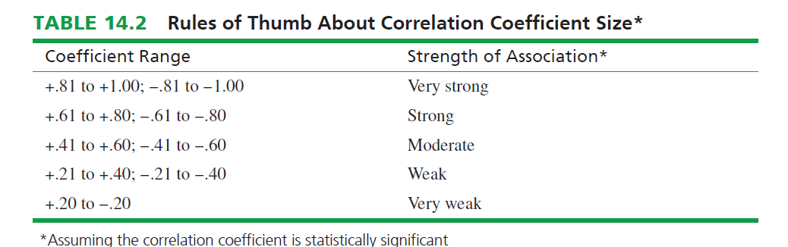

Slide 15
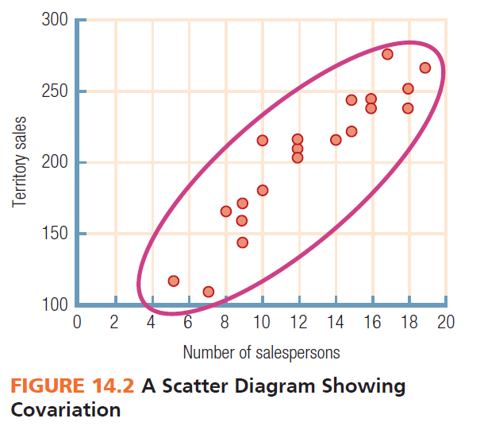

Slide 16
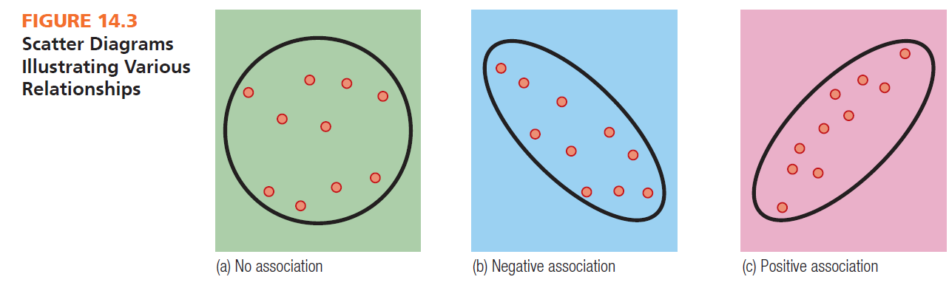

Slide 17
Correlation Coefficient (r)
A correlation coefficient’s size indicates the strength of association between two variables.
The sign (+ or -) indicates the direction of the association.

Slide 18
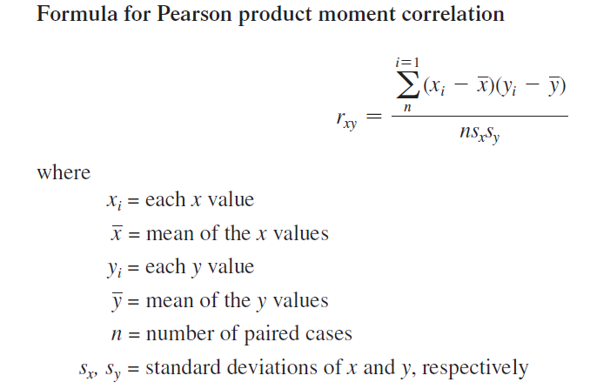

Slide 19
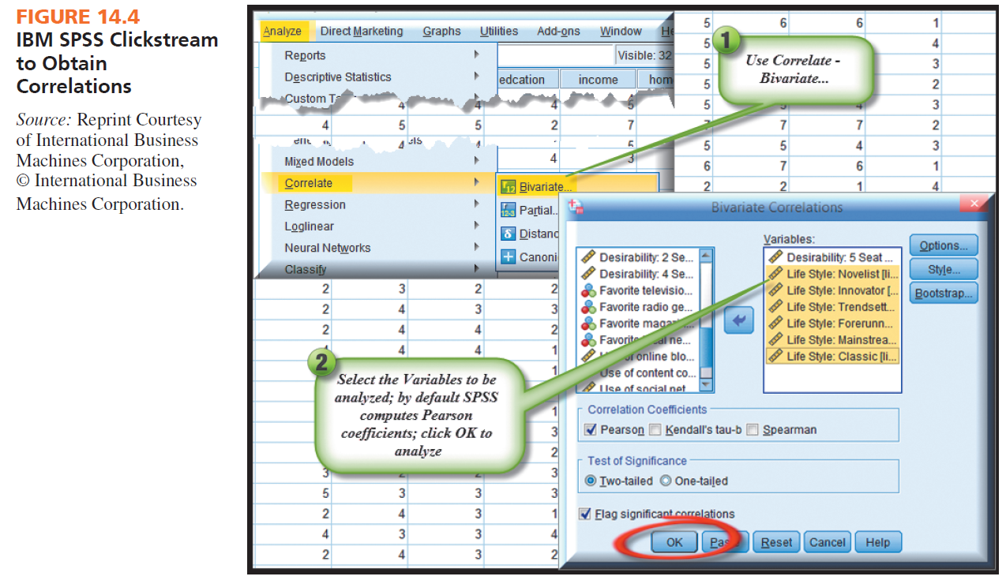

Slide 20
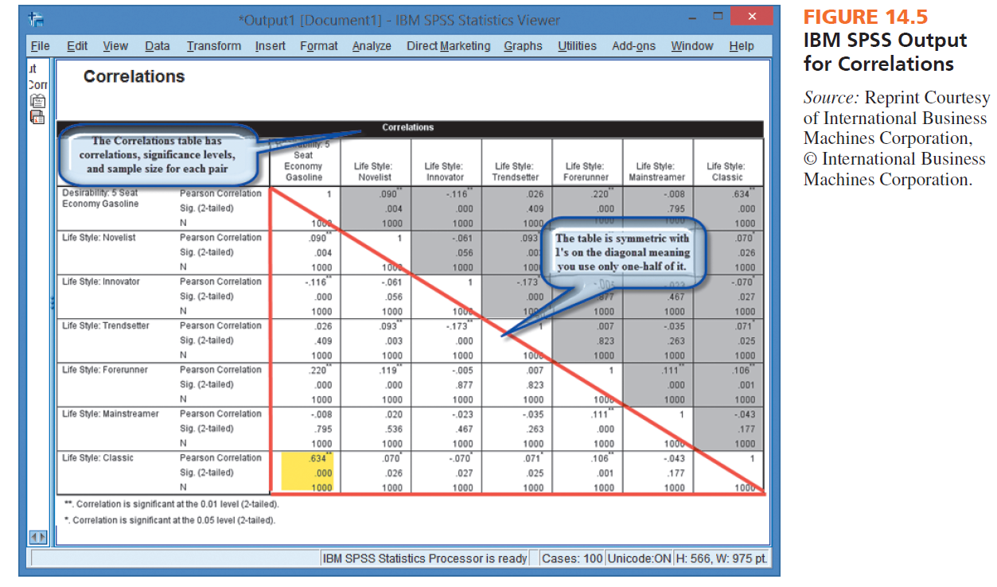

Slide 21
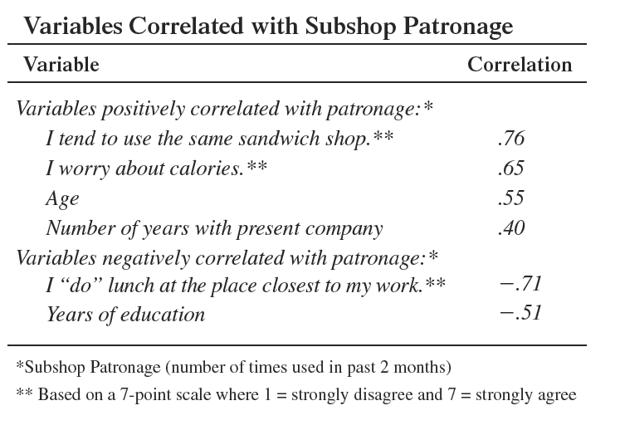
Reporting Example

Slide 22
Cross-Tabulations
Cross-tabulation: rows and columns defined by the categories classifying each variable
Cross-tabulation cell: the intersection of a row and a column

Slide 23
Cross-Tabulations
Cross-tabulation table: four types of numbers in each cell
Frequency
Raw percentage
Column percentage
Row percentage

Slide 24
Cross-Tabulations
Frequencies are the raw numbers in the cell.
Raw percentages are cell frequencies divided by the grand total.
Row percentages are the row cell frequencies divided by its row total.
Column percentages are the column cell frequencies divided by its column total.

Slide 25
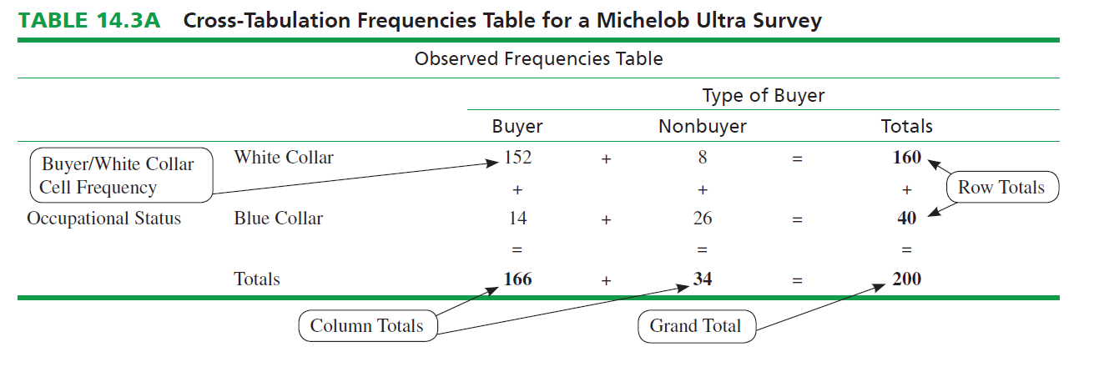

Slide 26
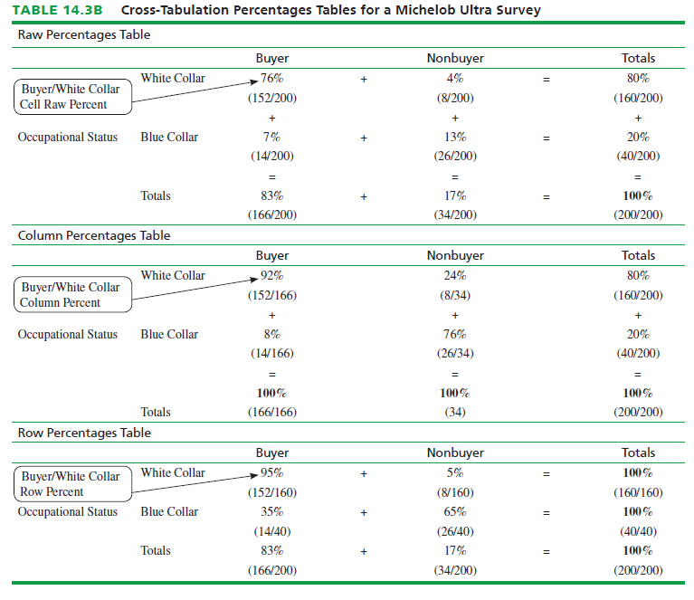

Slide 27
Chi-Square Analysis
Chi-square analysis: is the examination of frequencies for two nominal-scaled variables in a cross-tabulation table to determine whether the variables have a significant relationship.

Slide 28
Chi-Square Analysis
Chi-Square Analysis assesses nonmonotonic association in a cross-tabulation table based upon differences between observed and expected frequencies
The null hypothesis is that the two variables are not related.
Observed frequencies are the actual cell counts in the cross-tabulation table.
Observed frequencies are compared to expected frequencies.

Slide 29

Observed and Expected Frequencies
Expected frequencies are the theoretical frequencies in each cell that are derived from the hypothesis of no association between the two variables

Slide 30
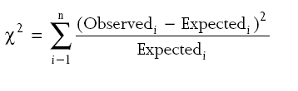
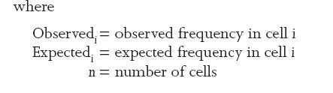
Chi-Square Analysis
Computed Chi-Square values:

Slide 31
The Computed Chi-square Value
The computed Chi-square value compares observed to expected frequencies.
The Chi-square statistic summarizes “how far away” from the expected frequencies the observed cell frequencies are found to be.

Slide 32
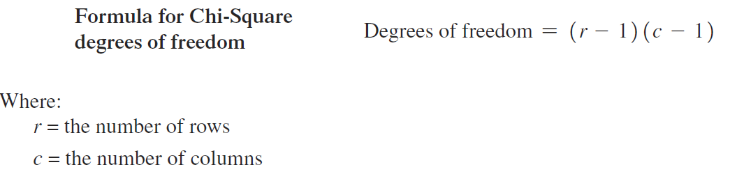
Degrees of Freedom

Slide 33
The Chi-square Distribution
The Chi-square distribution is skewed to the right, and the rejection region is always at the right-hand tail of the distribution.
The shape of the distribution is dependent on degrees of freedom.

Slide 34
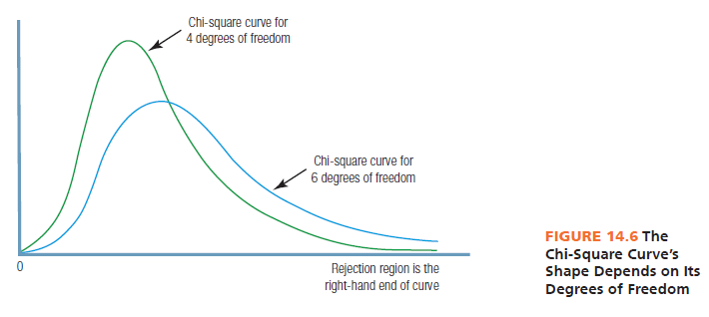

Slide 35
How to Interpret a Chi-square Result
The calculated (computed) value of Chi-square is compared to the table value to determine significance.
SPSS and other statistical analysis programs compare calculated to table values and show the probability for support of the null hypothesis.
A significant Chi-square means the researcher should look at the crosstabulation row and column percentages to “see” the association pattern.

Slide 36
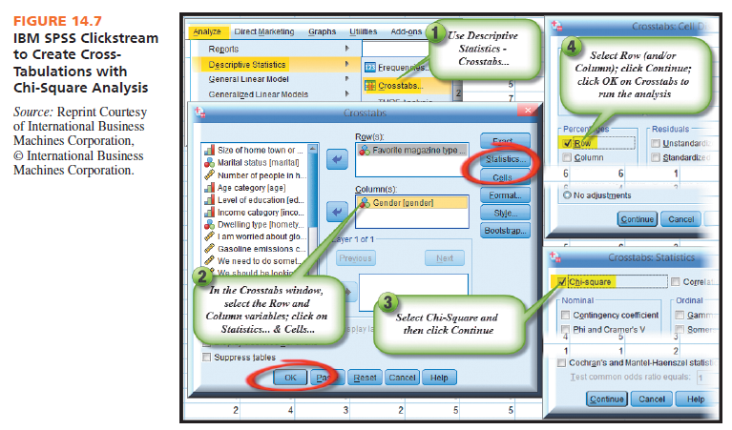

Slide 37
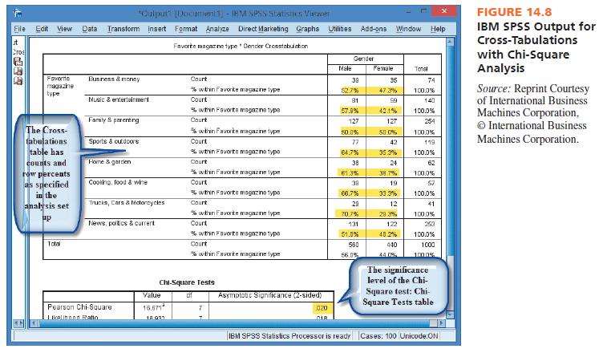

Slide 38
How to Interpret Chi-Square Analysis
The Chi-square analysis yields the likelihood or probability that the researcher would find evidence in support of the null hypothesis.
If the p value is ≤ to 0.05, this means there is little support for the null hypothesis of no association.
Therefore, we have a significant association and have the PRESENCE of a systematic relationship between the two variables.

Slide 39
Chi-Square Analysis
The computed Chi-Square value is 39.382 with 1 d.f.
Read the p value (Asymp. Sig.) across from Pearson Chi-Square.
Since the p value is <0.05, we have a SIGNIFICANT association.

Slide 40
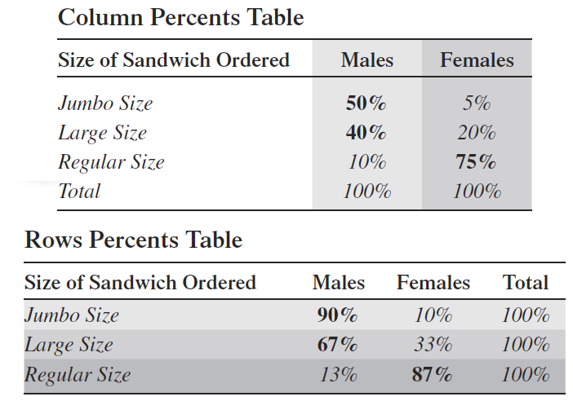
Reporting Findings
Whether to report row or column percentages depends on research objectives

Slide 41

All rights reserved. No part of this publication may be reproduced, stored in a retrieval system, or transmitted, in any form or by any means, electronic, mechanical, photocopying, recording, or otherwise, without the prior written permission of the publisher. Printed in the United States of America.

