Slide 1
Chapter 8
Understanding Measurement, Developing Questions, and Designing the Questionnaire

Slide 2
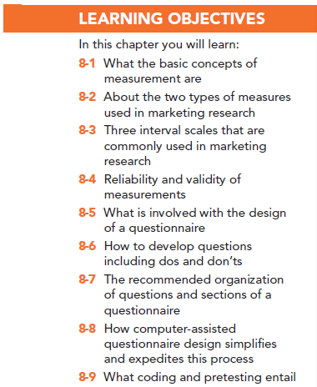

Slide 3
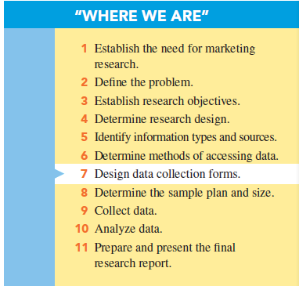

Slide 4
Basic Concepts in Measurement
Measurement: determining how much of a property is possessed by an object

Slide 5
Basic Concepts in Measurement
Properties: specific features or characteristics of an object that can be used to distinguish it from another object
Objective properties are physically verifiable.
Subjective properties are mental constructs.

Slide 6
Measuring Objective Properties
Objective properties are physically verifiable characteristics such as age, gender or number of bottles purchased.

Slide 7
Measuring Subjective Properties
Subjective properties cannot be directly observed because they are mental constructs such as a person’s attitudes, opinions, or intentions.
For subjective properties, researchers must translate mental constructs onto an intensity continuum.

Slide 8
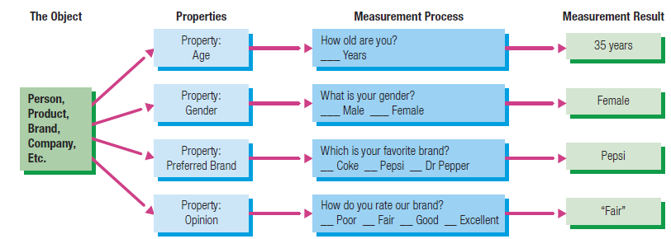
How Measurement Works

Slide 9
Types of Measures
Nominal measures: those that use only labels
Ordinal measures : those with which the researcher can rank-order the respondents or responses
Scale measures: those in which the distance between each level is known
Interval scales: rating scale for subjective properties in which the distance between each descriptor is one scale unit
Ratio scales: ones in which a true zero exists
Notes:
Changed title

Slide 12
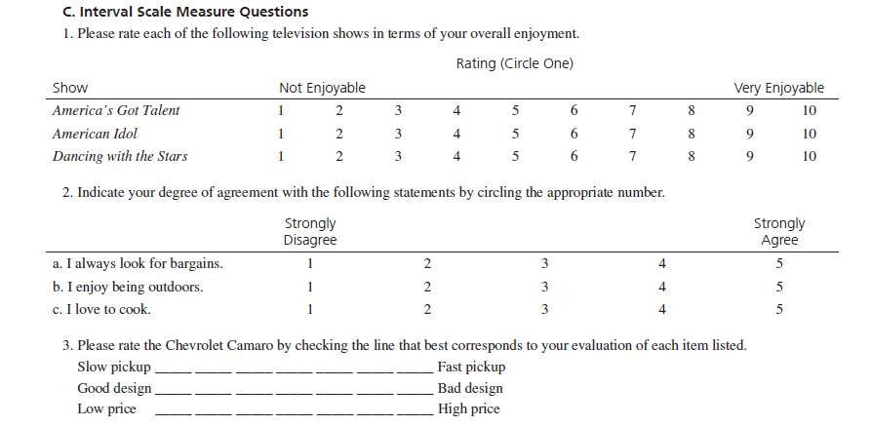

Slide 14
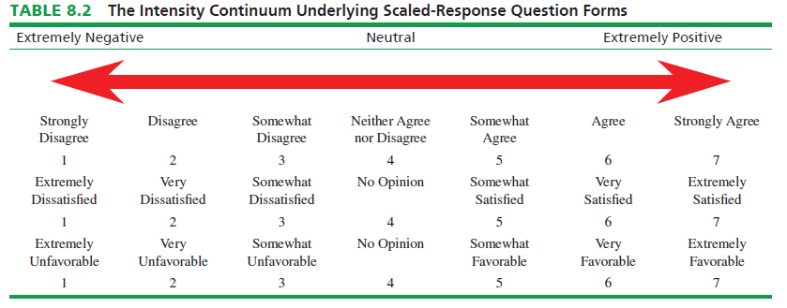

Slide 15
Interval Scales Commonly Used in Marketing Research
Likert Scale
Life-Style Inventory
Semantic Differential Scale
Stapel Scale

Slide 16
Likert Scale
An interval scale commonly used by marketing researchers is the Likert scale, in which respondents are asked to indicate their degree of agreement or disagreement on a symmetric agree–disagree scale for each of a series of statements. The Likert scale format measures intensity of agreement or disagreement.

Slide 17
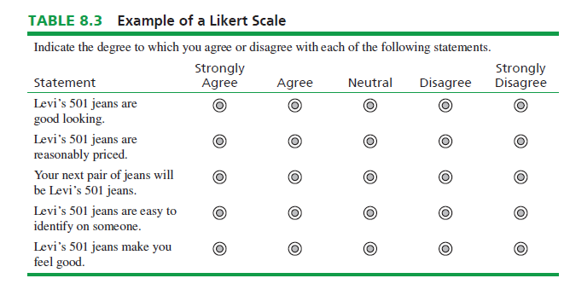

Slide 18
Lifestyle Inventory
A special application of the Likert scale question form called the lifestyle inventory takes into account the values and personality traits of people as reflected in their unique activities, interests, and opinions (AIOs) toward their work, leisure time, and purchases. It measures a person’s activities, interests, and opinions with a Likert scale.

Slide 19
Semantic Differential
A semantic differential scale contains a series of bipolar adjectives for the various properties of the object under study, and respondents indicate their impressions of each property by indicating locations along its continuum. It is a good way to measure a brand, company, or store image.
One concern with this type of scale is the halo effect, in which a general overall feeling about a brand or store could bias responses on its specific properties.

Slide 20
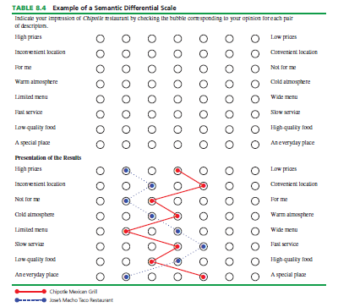

Slide 21
Stapel Scale
The Stapel scale relies on positive and negative numbers, typically ranging from +5 to –5. The scale may or may not have a neutral zero.
Notes:
Definitions for symmetric and nonsymmetric

Slide 22
Two Issues with Interval Scales Used in Marketing Research
Should the scale include a middle or neutral point?
Should the scale be symmetric or nonsymmetric?

Slide 23
Interval Scales Used in Marketing Research
A symmetric interval scale is “balanced,” as it has equal amounts of positive and negative positions, and typically it has “no opinion” or “neutral” separating the negative and positive sides.
A nonsymmetric interval scale has mainly degrees of positive positions, would be more appropriate because most people do not think in degrees of negative importance.

Slide 24
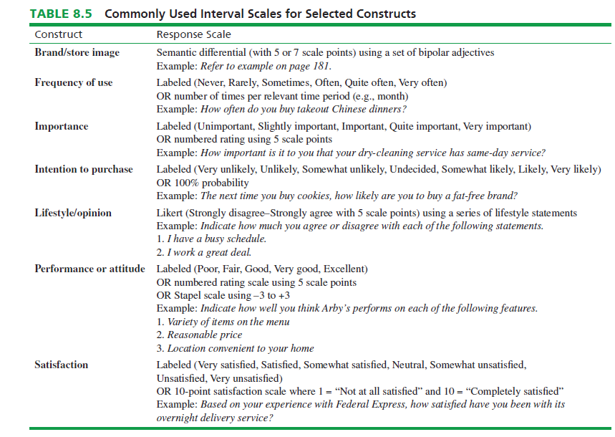

Slide 25
Reliability and Validity of Measurement
Reliability: respondent responds in the same or a similar manner to an identical or nearly identical measure
Validity: accuracy or exactness of the measurement

Slide 26
Designing A Questionnaire
A questionnaire is the vehicle used to present the questions the researcher desires respondents to answer.
Notes:
Add definition for questionnaire

Slide 27
Key Functions of A Questionnaire
Translates the research objectives into specific questions asked of respondents
Standardizes those questions and the response categories so every participant responds to identical stimuli
Serves as an enduring record of the research
Depending on the data collection mode used, such as online, a questionnaire can speed up the process of data analysis
Contains the information on which reliability and validity assessments may be made

Slide 28
Questionnaire Design Process
Questionnaire design is a systematic process in which the researcher contemplates various question formats, considers a number of factors characterizing the survey at hand, ultimately words the various questions carefully, and organizes the questionnaire’s layout.

Slide 29
Questionnaire Design Process
The researcher should strive to minimize question bias.
Question bias is the ability of a question’s wording or format to influence respondents’ answers.
Notes:
Add definition for questionnaire design

Slide 30
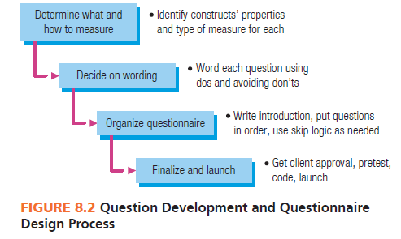

Slide 31
Developing Questions
Questionnaire development is the practice of selecting appropriate response formats and wording questions that are understandable, unambiguous, and unbiased.
Marketing researchers take great care in developing research questions that measure:
Attitudes
Beliefs
Behaviors
Demographics

Slide 32
Four “Dos” of Question Wording
Question evaluation is scrutinizing the wording of a question to ensure that question bias is minimized and that the question is worded so that respondents understand it and can respond to it with relative ease.

Slide 33
Four “Dos” of Question Wording
The question should be focused on a single issue or topic.
The question should be brief.
The question should be grammatically simple.
The question should be crystal clear.

Slide 34
Four “Dont’s” of Question Wording
Do not “lead” the respondent to a particular answer
A leading question gives a strong cue or expectation as what answer to provide.
Do not use “loaded” wording or phrasing
A loaded question has buried in its wording elements a sneaky presupposition, or it might make reference to universal beliefs or rules of behavior.

Slide 35
Four “Dont’s” of Question Wording
Do not use a “double-barreled” question
A double-barreled question is really two different questions posed in one question.
Do not use words that overstate the case
An overstated question places undue emphasis on some aspect of the topic.

Slide 36
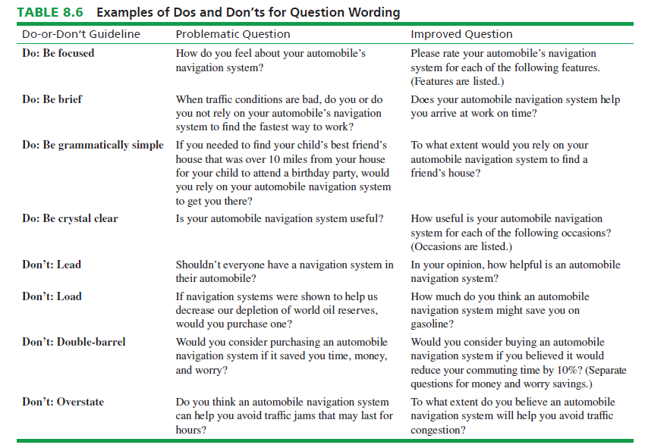

Slide 37
Questionnaire Organization
Questionnaire organization pertains to the sequence of statements and questions that make up a questionnaire.
Well-organized questionnaires motivate respondents to be conscientious and complete.
Poorly organized questionnaires discourage and frustrate respondents and may even cause them to stop answering questions in the middle of the survey.

Slide 38
The Introduction
The introduction sets the stage; it is what a potential respondent reads or hears before he or she begins answering survey questions. What is the survey about?
With an undisguised survey, the sponsor is identified, but with a disguised survey, the sponsor’s name is not divulged to respondents.
The introduction should also indicate to respondents how they were selected.

Slide 39
The Introduction
Incentives are offers to do something for the respondent to increase the probability that the respondent will participate in the survey.
Other forms of incentives address respondent anxieties concerning privacy. Two methods tend to reduce anxieties and, therefore, increase participation. The first is ensuring anonymity. The second method is confidentiality. Anonymity means the respondent is not known and, therefore, may not be identified, while confidentiality means the respondent’s identity is not to be divulged to a client or any other third party.

Slide 40
The Introduction
Screening questions are used to ferret out respondents who do not meet qualifications necessary to take part in the research study.

Slide 41
Question Flow
Question flow pertains to the sequencing of questions or blocks of questions, including any instructions, on the questionnaire.
Warm-up questions are simple and easy-to-answer questions that are used to get the respondents’ interest and to demonstrate the ease of responding to the research request.

Slide 42
Question Flow
Transitions are statements or questions used to let the respondent know that changes in question topic or format are about to happen.
Response to a skip question affects which question will be answered next.
The more complicated and difficult-to-answer questions are placed deep in the questionnaire.
Classification questions are used to classify respondents.

Slide 43
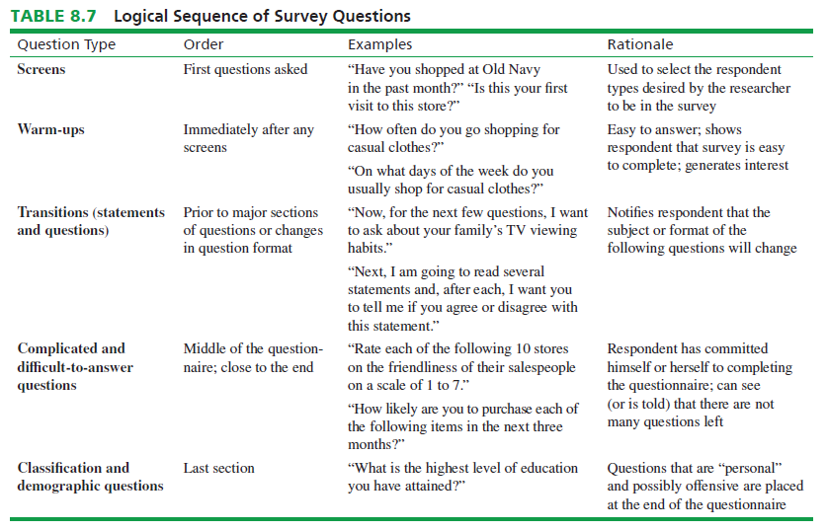

Slide 44
Computer-Assisted Questionnaire Design
Computer-assisted questionnaire design refers to software that allows users to use computer technology to develop and disseminate questionnaires and to retrieve and analyze data gathered by the questionnaire.
Computer-assisted questionnaire design is easy, fast, friendly, and flexible.

Slide 45
Skip and Display Logic
Skip logic lets the questionnaire designer direct the online survey to ask questions based on previous answers.
Display logic is similar to skip logic. The survey displays or asks questions that are appropriate based on the respondent’s prior answers.

Slide 46
Coding The Questionnaire
Codes are numbers associated with question responses to facilitate data entry and analysis.
The codes for an “all that apply” question are set up as though each possible response was answered with “yes” or “no.”

Slide 47
Pretesting The Questionnaire
A pretest is a dry run of a questionnaire to find and repair difficulties that respondents encounter while taking the survey.

Slide 48
All rights reserved. No part of this publication may be reproduced, stored in a retrieval system, or transmitted, in any form or by any means, electronic, mechanical, photocopying, recording, or otherwise, without the prior written permission of the publisher. Printed in the United States of America.

