Slide 1
Chapter 7
Evaluating Survey Data Collection Methods

Slide 2
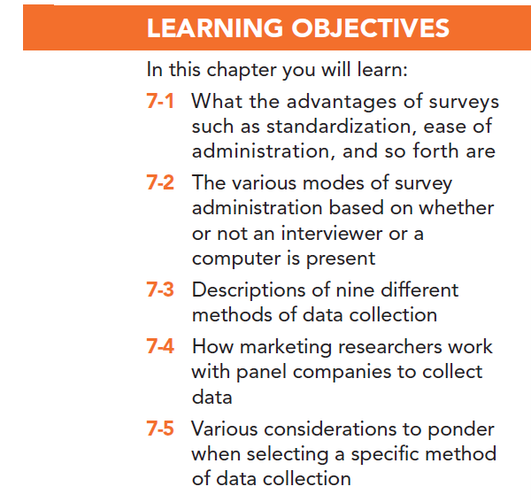

Slide 3
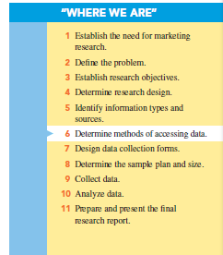

Slide 4
Advantages of Using Survey Methods
Standardization
Ease of administration
Ability to tap the “unseen”
Suitability to tabulation and statistical analysis
Sensitivity to subgroup differences

Slide 5
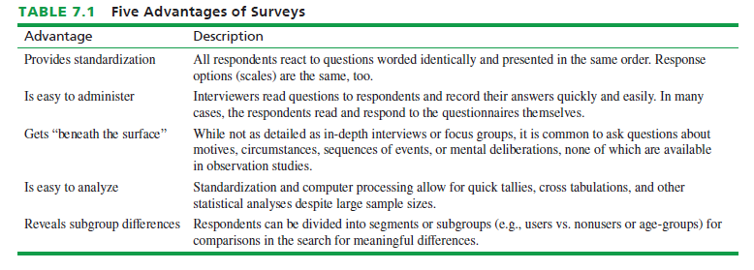

Slide 6
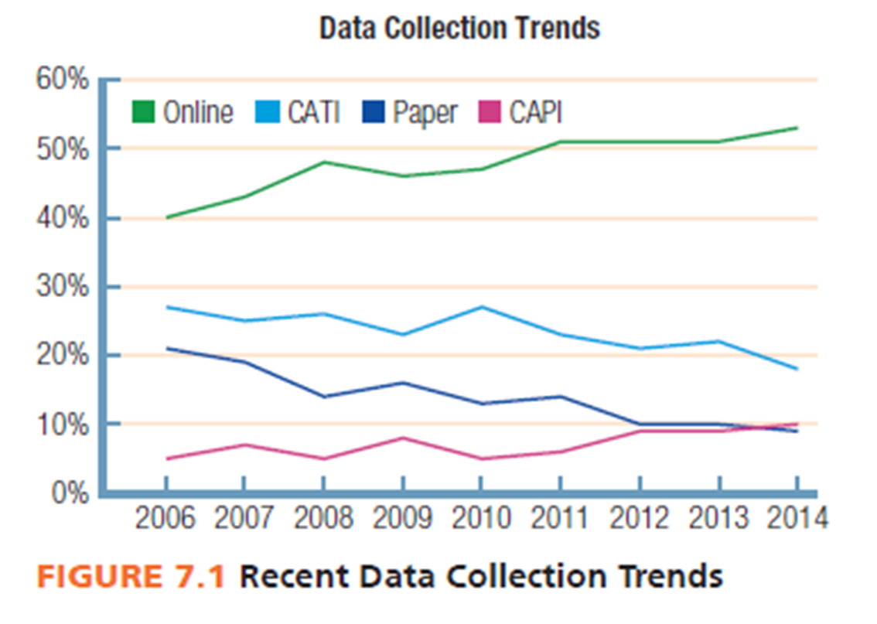
Trends in Data Collection
Computer technology has dramatically changed data collection in recent years.

Slide 7
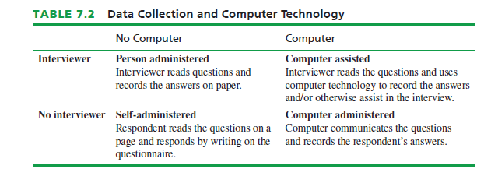

Slide 8
Surveys
A survey involves interviews with a large number of respondents using a predesigned questionnaire.

Slide 9
Person-Administered Surveys
Advantages:
Feedback
Rapport
Quality control
Adaptability

Slide 10
Person-Administered Surveys
Disadvantages:
Humans make errors
Slow speed
High cost
Fear of interview evaluation

Slide 11
Computer-Assisted Surveys
Advantages
Speed
Relatively error-free interviews
Use of pictures, audiovisuals and graphics
Immediate capture of data

Slide 12
Computer-Assisted Surveys
Disadvantages
Technical skills may be required
Setup costs may be high

Slide 13
Self-Administered Surveys
Advantages:
Reduced cost
Respondent control
Reduced interview evaluation apprehension

Slide 14
Self-Administered Surveys
Disadvantages:
Respondent control
Lack of monitoring
High questionnaire requirements

Slide 15
Computer-Administered Surveys
Advantages:
Breadth of user-friendly features
Relatively inexpensive
Reduction of interview evaluation concern in respondents

Slide 16
Computer-Administered Surveys
Disadvantage:
Requires computer-literate and Internet-connected respondents

Slide 17
Mixed-Mode Surveys
Mixed-mode or hybrid surveys use multiple data collection methods.

Slide 18
Mixed-Mode Surveys
Advantages:
Multiple advantages to achieve data collection goal
Example: Could use online survey to quickly reach portion of population with Internet access and telephone calling to reach those without Internet access.

Slide 19
Mixed-Mode Surveys
Disadvantages:
Survey mode may affect response
Additional complexity

Slide 20
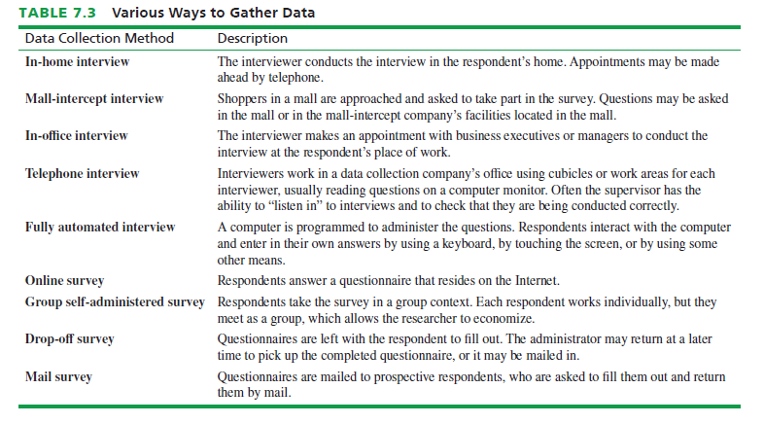

Slide 21
In-Home Surveys
An in-home survey is conducted by an interviewer in the home of the respondent.

Slide 22
In-Home Surveys
Key Advantage:
Conducted in the privacy of the home, which facilitates interviewer-respondent rapport

Slide 23
Mall-Intercept Surveys
The mall-intercept survey is one in which the respondent is encountered and questioned while he or she is visiting a shopping mall

Slide 24
Mall-Intercept Surveys
Key Advantage:
Since mall-intercept interviews are conducted in large shopping malls they are less expensive per interview than are in-home interviews.

Slide 25
Mall-Intercept Surveys
Key Disadvantages:
Sample representativeness may be an issue, as only mall patrons are interviewed
Respondents may feel uncomfortable answering the questions in the mall

Slide 26
In-Office Surveys
In-office surveys take place in person while the respondent is in his or her office or other company area.

Slide 27
In-Office Surveys
Key Advantage:
Useful for interviewing busy executives

Slide 28
In-Office Surveys
Key Disadvantages:
Relatively high cost per interview
Gaining access is sometimes difficult

Slide 29
Telephone Surveys
Key Advantages:
Reasonable cost
Good quality control
Fast turnaround

Slide 30
Telephone Surveys
Key Disadvantages:
Respondents can’t be shown anything or physically interact with the research object
Telephone doesn’t allow for observation of body language or facial expression
Limited in the quantity and types of information obtainable

Slide 31
Central Location Telephone Surveying
Involves a field data collection company installing several telephone lines at one location from which interviewers make calls.

Slide 32
Central Location Telephone Surveying
Key Advantages:
Good quality control
Interviewing process can be monitored
Control over interviewer schedules

Slide 33
Computer–Assisted Telephone Interviews
The most advanced telephone interview companies have computerized the central location telephone interviewing process with systems called computer-assisted telephone interviews (CATI).

Slide 34
Computer-Administered Interviews
Two types:
Fully automated surveys (completely automated telephone surveys -- CATS)
Online surveys

Slide 35
Group Self-Administered Survey
A group self-administered survey entails administering a questionnaire to respondents in groups rather than individually for convenience and to gain economies of scale.

Slide 36
Drop-Off Survey
The drop-off survey, sometimes called “drop and collect,” in which the survey representative approaches a prospective respondent, introduces the general purpose of the survey to the prospect, and leaves it with the respondent to fill out on his or her own.

Slide 37
Mail Survey
A mail survey is one in which the questions are mailed to prospective respondents who are asked to fill them out and return them to the researcher by mail.

Slide 38
Mail Survey
Key Disadvantages:
Nonresponse, which refers to questionnaires that are not returned.
Self-selection bias, which means that those who do respond are probably different from those who do not fill out the questionnaire and return it.

Slide 39
Panel Companies
Panel company – an institution that recruits potential survey respondents who participate for compensation

Slide 40
Panel Companies
Advantages
Fast turnaround
High quality
Database information
Access to targeted respondents
Integrated features

Slide 41
Panel Companies
Disadvantages
Not random samples
Overused respondents
Cost

Slide 42
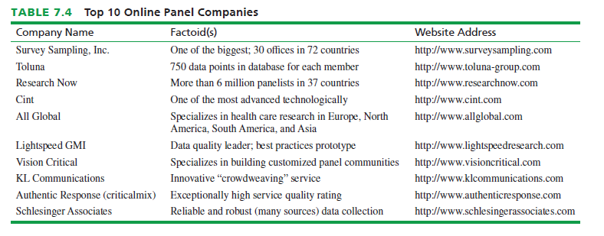

Slide 43
Choice of Survey Method
In selecting a data collection mode, the researcher must consider:
How fast is data collection?
How much will data collection cost?
How good is the data quality?

Slide 44
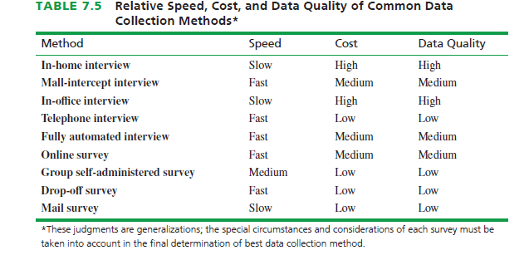

Slide 45
All rights reserved. No part of this publication may be reproduced, stored in a retrieval system, or transmitted, in any form or by any means, electronic, mechanical, photocopying, recording, or otherwise, without the prior written permission of the publisher. Printed in the United States of America.

