Slide 1
Chapter 6
Qualitative Research Techniques

Slide 2
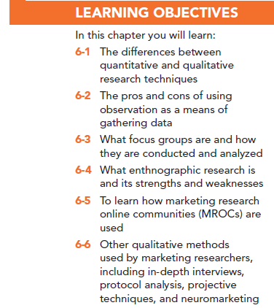

Slide 3
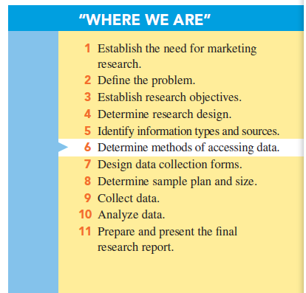

Slide 4
Categories of Research
Quantitative research: research involving the use of structured questions in which response options have been predetermined and a large number of respondents involved

Slide 5
Categories of Research
Qualitative research: research involving collecting, analyzing, and interpreting data by observing what people do and say

Slide 6
Categories of Research
Mixed method research: combination of both quantitative and qualitative research methods in order to gain the advantages of both

Slide 7
Observation Techniques
Observation methods: techniques in which the researcher relies on his or her powers of observation rather than communicating with a person in order to obtain information

Slide 8
Observation Techniques
Types of observation:
Direct versus indirect
Overt versus covert
Structured versus unstructured
In situ versus invented

Slide 9
Observation Techniques
Direct observation: observing behavior as it occurs
Indirect observation: observing the effects or results of the behavior rather than the behavior itself
Archives: secondary sources, such as historical records, that can be applied to the present problem
Physical traces: tangible evidence of some past event

Slide 10
Observation Techniques
Covert observation: subject is unaware that he or she is being observed, mystery shopping, as an example
Overt observation: respondent is aware of observation, Nielsen’s People Meters to monitor media to which a consumer is exposed, as an example

Slide 11
Observation Techniques
Structured – researcher identifies beforehand which behaviors are to be observed and recorded. Often there is a checklist.
Unstructured – all behavior is observed and the observer determines what is to be recorded.

Slide 12
Observation Techniques
In situ observation: the researcher observes the behavior exactly as it happens
Invented observation: the researcher creates the situation

Slide 13
Observation Techniques
Appropriate conditions for use of observation:
Short time interval …event must begin and end in a reasonably short time. You cannot “observe” a process of purchasing that lasts months.
Public behavior …cannot observe private behaviors.
Faulty recall conditions …behaviors are so “automatic” that consumer cannot recall them.

Slide 14
Observation Techniques
Advantages of observational data
Insight into actual, not reported, behaviors
No chance for recall error
Better accuracy
Less cost

Slide 15
Observation Techniques
Limitations of observational data
Small number of subjects
Subjective interpretations
Inability to pry beneath the behavior observed
Motivations, attitudes, and other internal conditions are unobserved

Slide 16
Focus Groups
Focus groups are small groups of people brought together and guided by a moderator through an unstructured, spontaneous discussion for the purpose of gaining information relevant to the research problem.

Slide 17
Types of Focus Groups
Traditional focus group: Select 6 to 12 persons and meet in a dedicated room with one-way mirror for client viewing.

Slide 18
How a Focus Group Works
Moderator: responsible for creating the correct atmosphere in the group and guiding discussion
Focus group report: summarizes the information provided by the focus group participants relative to the research questions

Slide 19
Newer Focus Groups
Online focus group: the respondents and/or clients communicate and/or observe by use of the Internet

Slide 20
Online Focus Groups
Advantages:
No physical setup is necessary
Transcripts are captured on file in real time
Participants can be in widely separated geographical areas
Participants are comfortable in their home or office environments
The moderator can exchange private messages with individual participants

Slide 21
Online Focus Groups
Disadvantages:
Observation of participants’ body language is not possible
Participants cannot physically inspect products or taste food items
Participants can lose interest or become distracted

Slide 22
Advantages of Focus Groups
Can generate fresh ideas
Allow clients to observe their participants
May be directed at understanding a wide variety of issues
Allow fairly easy access to special respondent groups

Slide 23
Disadvantages of Focus Groups
Representativeness of participants
Dependence on the moderator
Interpretation sometimes difficult

Slide 24
When Should Focus Groups Be Used?
Focus groups should be used when the research objective is to describe rather than predict.
How do consumers describe a better package?
How would they describe their satisfaction with our service?
How could they describe their ideas for an ad campaign?

Slide 25
When Should Focus Groups Not Be Used?
Focus groups should not be used when the research questions require a prediction or when a major decision affecting the company’s livelihood rests on the research results.

Slide 26
Some Objectives of Focus Groups
To generate ideas
To understand consumer vocabulary
To reveal consumer goods, motives, perceptions, and attitudes about products or services
To understand findings from quantitative studies

Slide 27
Operational Aspects of Traditional Focus Groups
How many focus groups should be conducted?
How many people should be in a focus group?
Who should be in the focus group?
How should focus group participants be recruited and selected?

Slide 28
Operational Aspects of Traditional Focus Groups
Where should a focus group meet?
When should the moderator become involved in the research project?
How are focus group results reported and used?
What other benefits do focus groups offer?

Slide 29
Marketing Research Online Communities
Marketing research online communities (MROCs) are groups of people that are brought together online to interact, provide ideas and opinions, and complete tasks.

Slide 30
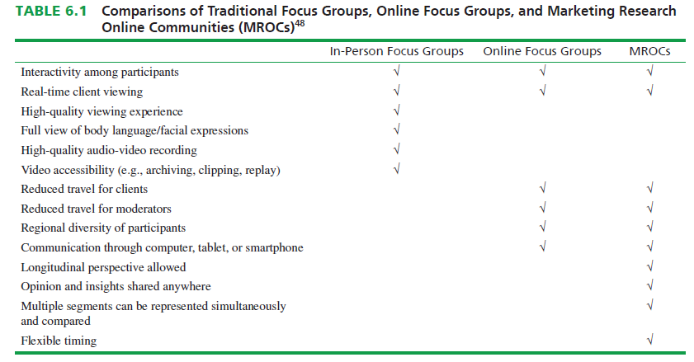

Slide 31
Ethnographic Research
Ethnographic research is a term borrowed from anthropology to describe a detailed, descriptive study of a group and its behavior, characteristics, culture, and so on.

Slide 32
Examples
Shopalongs are a types of research in which a researcher accompanies a shopper (with permission) on a shopping trip and observes and records the shopper’s activities
Mobile ethnography is a type of marketing research in which respondents document their own experiences through their own mobile phones
Netnography is the name for the ethnographic study of online activities.

Slide 33
Other Qualitative Techniques
In-depth interview (IDI) is a set of probing questions posed one-on-one to a subject by a trained interviewer so as to gain an idea of what the subject thinks about something or why he or she behaves a certain way.
Laddering attempts to discover how product attributes are associated with consumer values.

Slide 34
Other Qualitative Techniques
Protocol analysis involves placing a person in a decision-making situation and asking him or her to verbalize everything he or she considers when making a decision.

Slide 35
Other Qualitative Techniques
Projective techniques involve situations in which participants are placed in (projected into) simulated activities in the hopes that they will divulge things about themselves that they might not reveal under direct questioning

Slide 36
Five Common Projective Techniques
Word-association test,
Sentence completion test,
Picture test,
Cartoon or balloon test
Role-playing activity

Slide 37
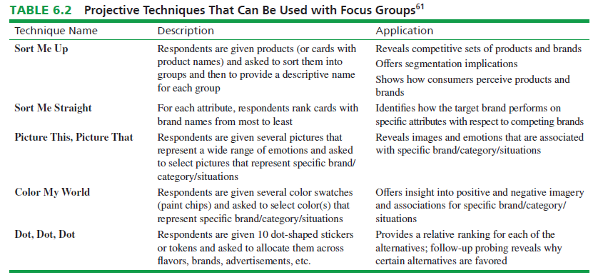

Slide 38
Neuromarketing
Neuromarketing is the study of an individual’s involuntary responses to marketing stimuli, including eye movement, heart rate, skin conductance, breathing, and brain activity

Slide 39
Example of Neuromarketing
Neuroimaging, or viewing brain activity, may aid marketing researchers to better understand consumers’ unconscious emotions.
Electroencephalography (EEG), or the measure of electrical activity in brains, is also used to measures consumers’ responses to products and advertising.
Eye tracking is a technique for measuring eye positions and eye movement.
Facial coding is a system that is used to measure universal expressions of emotions, such as happiness, sadness, fear, and surprise, by their appearance on faces.

Slide 40
Physiological Measurements
Physiological measurements: involves monitoring a respondent’s involuntary responses to marketing stimuli via the use of electrodes and other equipment
Pupilometer -- determines interest by measuring amount of dilation of the pupil of the eye.
Galvanometer -- determines level of excitement by measuring electrical activity on respondents' skin.

Slide 41
All rights reserved. No part of this publication may be reproduced, stored in a retrieval system, or transmitted, in any form or by any means, electronic, mechanical, photocopying, recording, or otherwise, without the prior written permission of the publisher. Printed in the United States of America.

