Slide 1
Chapter 5
Secondary Data and Packaged Information

Slide 2
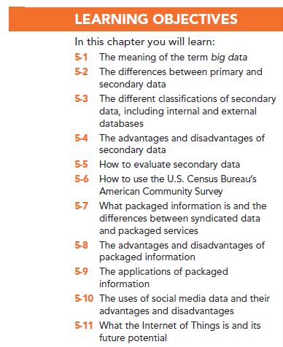

Slide 3
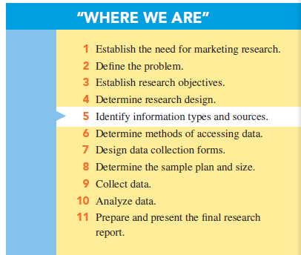

Slide 4
What is “Big Data”?
Big data can be defined simply as large amounts of data from multiple sources.
The term has been popularized in recent years in response to the numerous types and huge amounts of data to which companies now have access in real time.

Slide 5
Primary Versus Secondary Data
Primary data: information that is developed or gathered by the researcher specifically for the research project at hand.
Secondary data: information that has previously been gathered by someone other than the researcher and/or for some other purpose than the research project at hand.

Slide 6
Uses of Secondary Data
Secondary data has many uses in marketing research and sometimes the entire research project may depend on the use of secondary data.
Applications include economic-trend forecasting, corporate intelligence, international data, public opinion, and historical data.

Slide 7
Classification of Secondary Data
Internal secondary data are data that have been collected within the firm, such as sales records, purchase requisitions, and invoices.
Internal secondary data is used for database marketing.
Database marketing is the process of building, maintaining customer (internal) databases and other (internal) databases for the purpose of contacting, transacting, and building relationships. Example: data mining.

Slide 8
Internal Databases
Internal databases consist of information gathered by a company, typically during the normal course of business transactions.
Companies use their internal databases for purposes of direct marketing and to strengthen relationships with customers, which is referred to as customer relationship management (CRM).
Notes:
definition

Slide 9
Internal Databases
Data mining is the name for software that helps managers make sense out of seemingly senseless masses of information contained in databases.
Micromarketing refers to using a differentiated marketing mix for specific customer segments, sometimes fine-tuned for the individual shopper.
Notes:
datamining

Slide 10
Ways Companies Use Databases
To identify prospects
To decide which customers should receive a particular offer
To deepen customer loyalty
To reactivate customer purchases
To avoid serious customer mistakes

Slide 11
External Secondary Data
External databases are databases supplied by organizations outside the firm:
Published sources
Official data
Data aggregators
Notes:
Add definition

Slide 12
External Secondary Data
Published sources: sources of information prepared for public distribution and normally found in libraries or a variety of other entities, such as trade organizations.
Notes:
Add definition

Slide 13
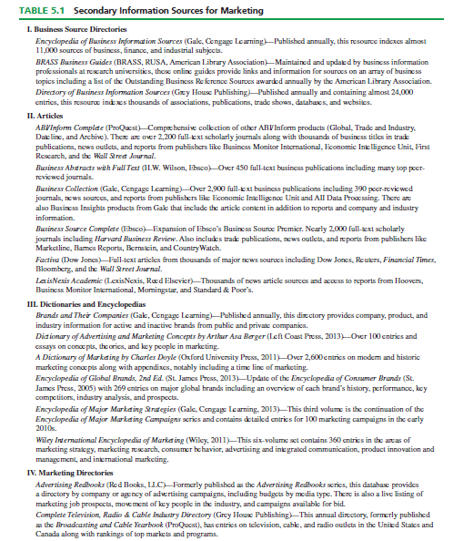

Slide 14
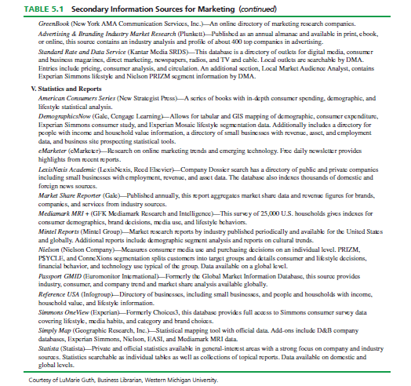

Slide 15
Official Statistics
Official statistics are information published by public organizations, including government institutions and international organizations

Slide 16
External Secondary Data
Data aggregators are services or vendors that organize and package information on focused topics.

Slide 17
External Secondary Data
Syndicated services data: provided by firms that collect data in a standard format and make them available to subscribing firms – highly specialized and not available in libraries.

Slide 18
External Secondary Data
External databases: databases supplied by organizations outside the firm such as online information databases.

Slide 19
Advantages of Secondary Data
Are obtained quickly
Are inexpensive
Are readilly available
Enhance existing primary data
May achieve research objective

Slide 20
Disadvantages of Secondary Data
Reporting units may be incompatible
Measurement units do not match
Class definitions are not usable
May be outdated
May not be credible

Slide 21
Evaluating Secondary Data
What was the purpose of the study?
Who collected the information?
What information was collected?
How was the information attained?
How consistent is the information with other information?

Slide 22
The American Community Survey
The American Community Survey is an example of an official external secondary data source that is available for free from the U.S. Census.

Slide 23
What is Packaged Information?
Packaged information is a type of secondary data in which the data collected and/or the process of collecting the data are prepackaged for all users.
There are two broad classes of packaged information:
Syndicated data
Packaged services

Slide 24
Syndicated Data
Syndicated data are a form of external, secondary data that are supplied from a common database to subscribers for a service fee

Slide 25
Packaged Services
Packaged services refers to a prepackaged marketing research process that is used to generate information for a particular user

Slide 26
Advantages of Syndicated Data
Shared costs
Quality of the data collected is typically very high
Speed

Slide 27
Disadvantages of Syndicated Data
Buyers have little control over what information is collected
Firms often must commit to long-term contracts when buying syndicated data
No strategic information advantage in purchasing syndicated data

Slide 28
Advantages of Packaged Services
Advantage of the experience of the research firm offering the service
Reduced cost of the research
Speed of the research service
Ability to obtain benchmarks for comparison

Slide 29
Disadvantages of Packaged Services
Inability to customize aspects of a project when using a packaged service.
The company providing the packaged service may not know the idiosyncrasies of a particular industry.
Notes:
Add disadv – pg 108

Slide 30
Marketing Applications of Packaged Information
Measuring consumer attitudes and opinions
Market segmentation (often using geodemographics)
Monitoring media usage and promotion effectiveness
Market tracking studies

Slide 31
Social Media Data
Social media data, also termed user-generated content (UGC), is any information that is created by users of online systems and intended to be shared with others
Examples:
Reviews
Tips
New uses
Competitors

Slide 32
Monitoring Social Media
Sentiment is the ratio of positive to negative comments posted about products and brands on the web.

Slide 33
Social Media Data
Advantages
Currency
Inexpensive
Unprompted
Can track trends
Disadvantages
Audience may not be representative
Consumers not identifiable
Review websites subject to manipulation
Shallow content

Slide 34
The Internet of Things
The Internet of Things (IoT) is defined as the network of physical objects that are embedded with software or sensors that allow them to gather and distribute data.
Passive data are information that is collected without overt consumer activity.
Wearables, or wearable technology, are clothing or accessories that are equipped with computer technology or sensors that allow the collection and sharing of data.

Slide 35
All rights reserved. No part of this publication may be reproduced, stored in a retrieval system, or transmitted, in any form or by any means, electronic, mechanical, photocopying, recording, or otherwise, without the prior written permission of the publisher. Printed in the United States of America.

