Slide 1
Chapter 3
The Marketing Research Process and
Defining the Problem and Research Objectives

Slide 2
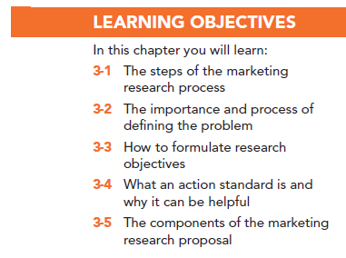

Slide 3
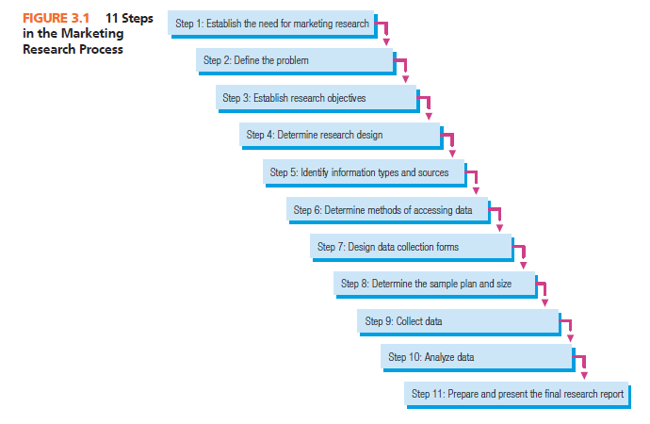

Slide 4
The Marketing Research Process: Caveats to a Step-by-Step Process
The “Step-by-Step Process”
Not always presented as an 11-step process
Not all studies use all 11 steps
Few studies follow the steps in order
Notes:
Change title

Slide 5
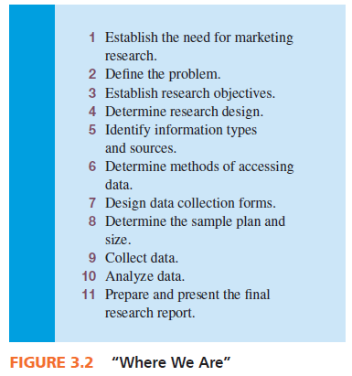

Slide 6
Step 1: Establish the Need for Marketing Research
Is there a real need for marketing research?
Research takes time and costs money
Cost of information may outweigh value of information

Slide 7
Step 1: Establish the Need for Marketing Research
Is there a real need for marketing research?
Marketing research is not always needed.
We often have the information

Slide 8
Step 1: Establish the Need for Marketing Research
When is marketing research NOT needed?
The information is already available
The timing is wrong to conduct marketing research
Funds are not available for marketing research
Costs outweigh the value of marketing research

Slide 9
Step 2: Define the Problem
The need to make a decision requires decision alternatives. If there are no alternatives, no decision is necessary.

Slide 10
Step 3: Establish Objectives
Research objectives state what the researchers must do.
Research objectives, when achieved, provide the information necessary to solve the problem identified in step 2.

Slide 11
Step 4: Determine Research Design
Exploratory Research: collecting information in an unstructured and informal manner.
Descriptive research: research that describes the phenomena of interest.
Causal studies: attempt to uncover what factor or factors cause some event.

Slide 12
Step 5: Identify Information Types and Sources
Primary information: information collected specifically for the problem at hand
Secondary information: information already collected

Slide 13
Step 6: Determine Methods of Accessing Data
Secondary data is relatively easy to access
Primary data is more complex

Slide 14
Step 7: Design Data Collection Forms
The questionnaire must be worded objectively, clearly, and without bias in order to communicate with respondents.
If a focus group is used, a focus group guide must be developed.
If we observe respondents, the form is called an observation form.

Slide 15
Step 7: Design Data Collection Forms
Software programs are available to assist marketing researchers in preparing data collection forms.

Slide 16
Step 8: Determine Sample Plan and Size
A sample is drawn from an entire group or population. The sample plan describes how each sample element, or unit, is to be drawn from the total population. Gives you representativeness!
Sample size refers to determining how many elements of the population should be included in the sample. Gives you accuracy!

Slide 17
Step 9: Collect Data
Nonsampling errors in data collection will occur, so researchers must know the sources of these errors and implement controls to minimize them.
Researchers aim to minimize this possibility by undertaking a control referred to as validation.
Companies that specialize in data collection are referred to as field service firms.

Slide 18
Step 10: Analyze Data
Data analysis involves entering data into computer files, inspecting data for errors, and running tabulations and various statistical tests.
Notes:
Check for new spss image

Slide 19
Step 11: Prepare and Present the Final Research Report
Reporting, the last step, is one of the most important phases of marketing research.
Its importance cannot be overstated because it is the report, or its presentation, that properly communicates the results to the client.

Slide 20
Defining the Problem
Problems are situations calling for managers to make choices among decision alternatives.

Slide 21
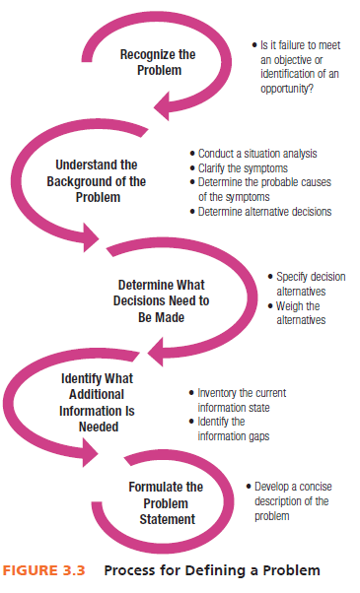

Slide 22
The Research Objective
Research objectives are specific and tell the researcher exactly what information must be collected to solve the problem by facilitating selection of an alternative.

Slide 23
The Research Objective
Specify from whom information is to be gathered
Specify what information is needed
Specify the unit of measurement used to gather information
Word questions used to gather information using the respondents’ frame of reference

Slide 24
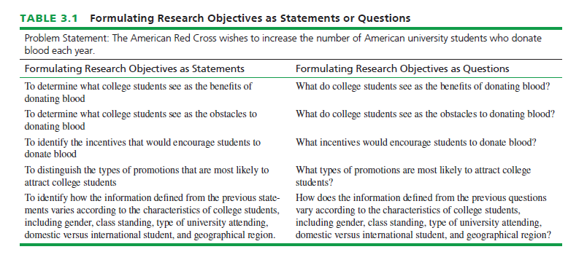

Slide 25
Hypotheses and Constructs
Hypotheses are statements that are taken as true for the purposes of argument or investigation.
A construct is an abstract idea or concept composed of a set of attitudes or behaviors that are thought to be related.
What is the unit of measurement?
What is the proper frame of reference?

Slide 26
The Importance of Properly Defining the Problem
When you define a problem incorrectly, there is nothing you can do in the research process to overcome this error.
This makes defining the problem and research objectives the most important step in the marketing research process.

Slide 27
Action Standards
An action standard is a predesignation of some quantity of a measured attribute or characteristic that must be achieved for a research objective for a predetermined action to take place.

Slide 28
The Market Research Proposal
The marketing research proposal serves as the basis of a contract as it documents what the marketing researcher proposes to deliver to the client for some consideration, typically a fee.
When a client first contacts a marketing research supplier to conduct research, the client will generally request a proposal prior to agreeing to work with the firm in a process called an invitation to bid (ITB) or request for proposal (RFP) .

Slide 29
The Market Research Proposal
Elements include:
Statement of the problem
The research objectives
The research method
Statement of deliverables
Costs
Timetable

Slide 30
All rights reserved. No part of this publication may be reproduced, stored in a retrieval system, or transmitted, in any form or by any means, electronic, mechanical, photocopying, recording, or otherwise, without the prior written permission of the publisher. Printed in the United States of America.

