Slide 1
Burns management
Ruqayah A Al Hajji

Slide 2
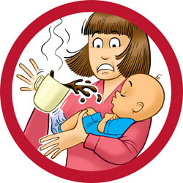
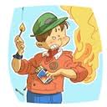
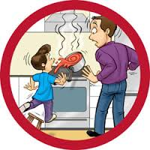

Slide 3
Burns definition
A burn refers to any damage to body tissue due to heat, chemicals, radiation or electricity

Slide 4
Thermal burns
are caused by direct contact with an external heat source such as fire, hot liquids (scalding), hot objects or steam.

Slide 5
Radiation burns
are caused by sunlight or artificial sources such as radiation therapy or tanning beds.

Slide 6
Chemical burns
are caused by chemicals such as strong acids (hydrochloric or sulfuric acid) or alkalis.

Slide 7
Electric shock
can cause burns due to the massive amount of electricity which passes through the body. Electrical burns may involve deeper areas of the body such as the internal organs, muscles and nerves without obvious damage to the skin.

Slide 8
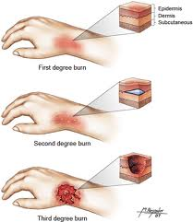
Types of Burns

Slide 9
When is Emergency Treatment Needed for Burns?
https://www.youtube.com/watch?v=jdd-xgeCJ_Y

Slide 10
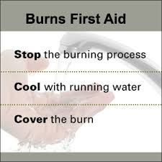

Slide 11
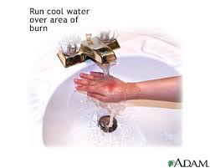
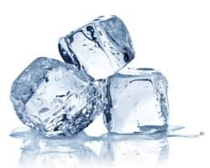
Cool the burn

Slide 12


Slide 13
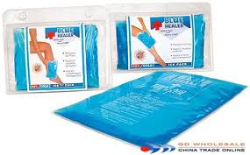

Slide 14
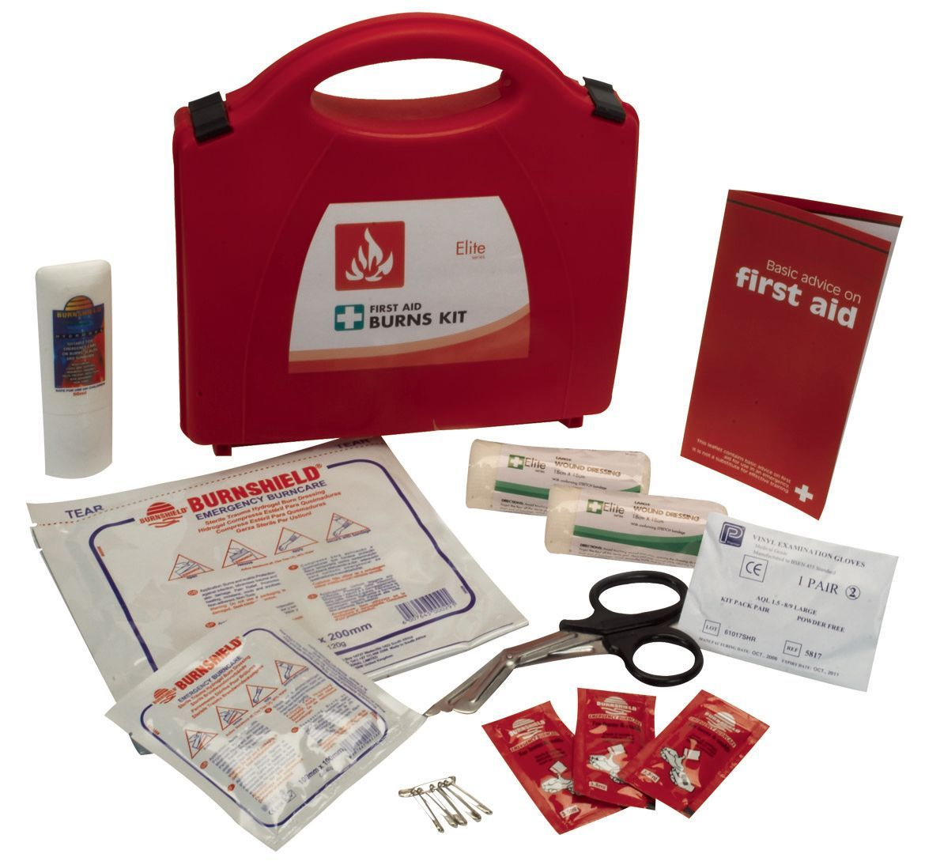

Slide 15
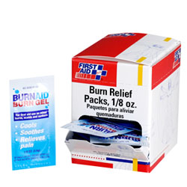
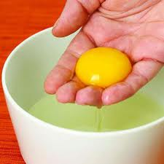

Slide 16
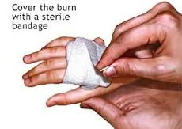

Slide 17
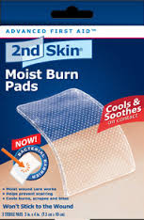
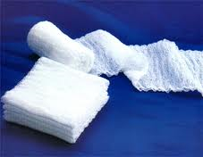

Slide 18
https://www.youtube.com/watch?v=CJt7XySKqYI

Slide 19
Burns Complications
Burns can cause fluid loss, and may result in decreased blood volume (hypovolemia) if the affected area is large.
Infection is due to the loss of integrity of the epidermal barrier

Slide 20
Read more >>
http://www.woundcarecenters.org/wound-types/burns.html#ixzz2vXqUzfll

