Slide 1
Chapter 17
Dividends, Dividend Policy, and Stock Splits

Slide 2
Learning Objectives
Understand the formal process for paying dividends and differentiate between the most common types.
Explain individual preferences and issues surrounding different dividend policies.
Explain how a company selects its dividend policy.
Understand stock splits and reverse splits and why companies use them.
Understand stock repurchases and dividend reinvestment programs.

Slide 3
17.1 Cash Dividends
Many firms pay cash dividends on a regular basis.
The payments of these dividends do correlate with economic times, as anything else, and in recessionary times firms may cease to pay dividends or cut back on the amount they pay per share.

Slide 4
17.1 (A) Buying and Selling Stock
Typically done via
stock brokers on organized stock exchanges like the NYSE or
through dealers in the over-the-counter market like the NASDAQ.

Slide 5
17.1 (B) Declaring and Paying a Cash Dividend: A Chronology
Figure 17.1 PepsiCo dividend dates.
4 key dates include:
1. Declaration date: ➔ day on which the board of directors announce that they will be paying a dividend. The amount per share, the last day to record ownership information, and the payment mailing date are typically announced.

Slide 6
17.1 (B) Declaring and Paying a Cash Dividend: A Chronology (continued)
2. Ex-dividend date: informally called the ex-date—is the date that establishes the recipient of the dividend. It is two days before the date of record (discussed next). If you buy before the ex-date, you get any declared dividend; the seller does not. If you buy on or after the ex-date, the seller gets any declared dividend; you do not.
3. The record date determines which shareholders are entitled to receive a dividend. The issuer of the security establishes a list of the owners of record as of this date.
4. Payment date is the actual day on which the declared cash dividend is paid.

Slide 7
17.1 (B) Different Types of Dividends
Various types of dividends declared by companies include:
regular cash dividends,
extra dividends,
stock dividends, and
liquidating dividends.

Slide 8
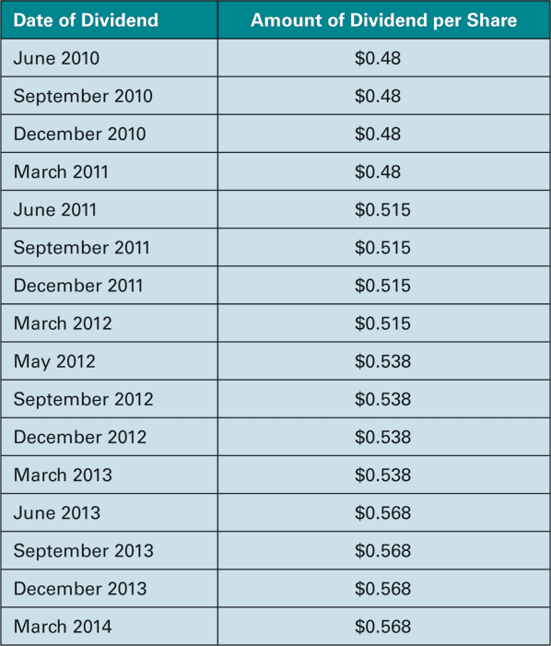
17.1 (B) Different Types of Dividends (continued)
Regular cash dividends: are typically paid quarterly and don’t vary much from one quarter to the next of the same year
Table 17.2 PepsiCo Quarterly Cash Dividend History

Slide 9
17.1 (B) Different Types of Dividends (continued)
Special or extra cash dividends: are non-recurring occasional dividends paid by companies after periods of unusually strong performance.
Stock dividends: are paid in the form of shares of stock instead of cash and are typically stated as a percentage, i.e. a 25% stock dividend would mean that you would get 1 new share for every 4 shares already owned.
Liquidating dividends are issued once a firm has ceased its operations and all liabilities and obligations have been cleared.

Slide 10
17.2 Dividend Policy
Dividend policy wrestles with the question… Should the firm pay out a large amount now? or should it invest more in the company?
Some firms pay a lot, while others choose not to pay at all.
Two big questions that researchers have attempted to answer are:
(1) “Is there an optimal dividend policy?” and
(2) “Does dividend policy really matter at all?”

Slide 11
17.2 (A) Dividend Clienteles
➔What the different groups of investors with different appetites for dividends are typically called.
Older, retired folks welcome dividends as a source of income to pay for their expenses, while……
Richer, wealthier investors dislike dividend due to their tax bite.

Slide 12
17.2 (B) Dividend Policy Irrelevance
➔is the examination of whether dividend policy has any effect on the overall value of a firm.
Dividend policy in a world of no taxes and no transactions costs would be completely irrelevant ➔stock holder could create his own source of income by selling off some shares.
When a firm declares a dividend the price of shares goes down by the amount of the dividend.
Thus, the remaining shares are worth less and the total value of the dividends received and the lower priced shares is the same as it would have been had no dividends been paid.
So the dividend just amounts to a return of capital to the shareholder and has no real value in a world of no taxes and no transaction costs.

Slide 13
17.2 (B) Dividend Policy Irrelevance
Example 1: Creating home-made dividends. Let’s say that Jill is living in a country that does not tax dividends and stocks can be purchased directly from the company with no transactions costs.
She owns 5000 shares of The XYZ Company that has announced that it will not pay any dividends this year.
Jill is concerned because her friend Jane just informed her that a competing company, RST just declared a dividend of $1 per share.
The price of XYZ is at $8 per share and the price of RST, which was also $8 per share, has gone down to $7 per share after the dividend.
Should Jill be concerned? Explain your answer.

Slide 14
17.2 (B) Dividend Policy Irrelevance (continued)
Example 1 Answer
Jill’s value in XYZ ➔ 5000*$8 = $40,000.
To generate an equivalent amount of dividend income, i.e. $1*5000 = $5000, she can sell $5000/$8 ➔ 625 shares and receive $5000.
Her remaining shares will be worth 4375*$8 = $35,000 and including the $5000 from the sale, she will still have a value of $40,000 from the shares.
Likewise, if RST pays $1 per share and the stock price drops to $7 after the dividend, an investor with 5000 shares would have received $5,000 from the dividends and have stock worth $7*5000 ➔$35,000, for a total wealth of $40,000.

Slide 15
17.2 (B) Dividend Policy Irrelevance (continued)
Example 2: Undoing a firm’s dividend payout. Let’s say that The XYZ Co. declared a dividend of $1.75 per share and Jill is unhappy because she doesn’t really need the money.
How can she undo the dividend and still have no loss of value?

Slide 16
17.2 (B) Dividend Policy Irrelevance (continued)
Example 2 Answer
If the company pays $1.75 per share, the share price will go down by $1.75➔$6.25 per share.
Jill can take the dividend amount of $8750 and purchase 1400 shares.
She will end up with 6400 shares worth $6.25 each for a total of $40,000, thereby keeping the original value intact and undoing XYZs dividend policy

Slide 17
17.2 (B) Dividend Policy Irrelevance (continued)
Dividends in a world of taxes: would continue to remain irrelevant as long as…
the tax rate applied to dividend income and capital gains is the same, and
if the price of the stock declines by the after-tax value of the dividend.

Slide 18
17.2 (B) Dividend Policy Irrelevance (continued)
Example 3: Do dividends matter with taxes and no capital gains? So let’s say that The XYZ Co. declares a $1 per share dividend and Jill is paying 25% taxes on dividend income but capital gains income is tax exempt.
Also, we assume that the stock price is $8 before the dividend declaration and drops by $0.75 (the after-tax value of the dividend) i.e. it drops to $7.25.
Should Jill be concerned?

Slide 19
17.2 (B) Dividend Policy Irrelevance (continued)
Example 3 Answer
As long as the price drops by the after-tax value of the dividend per share, Jill should not be concerned.
She will receive $5000 from the company and will be taxed .25*$5000 = $1250
She can take the remaining amount i.e.$3750 and purchase additional shares with it. ➔$3750/$7.25 = 517.2414 shares.
Her wealth will now be worth….5517.2414 * $7.25 ➔ $40,000 which is the same as her initial value of $8*5000 shares. SO DIVIDENDS STILL DON’T MATTER!

Slide 20
17.2 (B) Dividend Policy Irrelevance (continued)
Example 4: Dividend Policy with taxes and capital gains. Let’s say that The XYZ Co. declares $1 per share dividend and that the price goes down by the after-tax amount of $0.75 due to the tax rate of 25%.
Moreover, capital gains are also taxable at 25% and Jill would be liable for capital gains tax since she had purchased the stock for $4 a few months ago.
Would it have been better for the firm to have not paid the dividend or was the dividend payment irrelevant as far as Jill is concerned?

Slide 21
17.2 (B) Dividend Policy Irrelevance (continued)
Example 4 Answer
Jill receives a before-tax distribution of $5000 and pays $1250 in taxes, ➔$3750 in after-tax income,
Her shares will be worth ($8-$0.75) ➔=$7.25 each,
➔total value of $5,000*7.25 ➔ $36,250 + 3750➔ $40,000.
If the company does not pay $1 per share, and Jill wanted the $5000 income …

Slide 22
17.2 (B) Dividend Policy Irrelevance Example 4 Answer (continued)
She would have to sell her shares to generate enough money after paying the capital gains tax on the shares.
For every share sold she would pay ($8-$4)*.25 = $1 in capital gains tax and net only $7, which means to generate $3,750 she have to sell $3,750/7 = 535.714 shares and have (5000-535.714) shares remaining worth $8 each➔$35,714.29.
Jill’s wealth would be worth $3,750 + ➔$35,714.29➔ $39,464.29 which is lower than her value with dividends.
So in a world with taxes on dividends and capital gains on stock sales, DIVIDEND POLICY DOES MATTER!

Slide 23
17.2 (B) Dividend Policy Irrelevance (continued)
So it seems as if in a world like the one we live in, with dividends and capital gains being taxed at more or less the same rate, dividend policy will matter at least to some types of investors.
A lot depends, of course, on the individual investor’s original purchase price, marginal tax rate, and expectation about future stock prices.

Slide 24
17.2 (C) Reasons Favoring a Low- or No-Dividend-Payout Policy
There are three commonly cited reasons for a low- or no-dividend-payout policy:
The avoidance or postponement of taxes on distributions for shareholders i.e. capital gains are not taxed till realized.
Higher potential for future returns for shareholders from firms reinvesting their own relatively less costly internal equity in positive NPV projects.
Less need for additional costly outside funding: since the firm is retaining and investing its own profits.

Slide 25
17.2 (D) Reasons Favoring a High-Dividend-Payout Policy
There are two commonly cited reasons for a high-dividend-payout policy:
Freedom from transaction costs: Unlike stock sales which require the payment of brokerage commissions, dividends are received without transactions costs
Certainty versus uncertainty: Unlike dividends, which are here and now, capital gains and future performance on the stock are uncertain.

Slide 26
17.2 (E) Optimal Dividend Policy
With investors’ marginal tax rates, income requirements, future stock price expectations, and original basis in the stock being significantly different, any dividend policy that a firm follows will leave some investors unhappy.
So for any firm, the dividend policy that is optimal is the one that suits the majority of their stockholders.

Slide 27
17.3 Selecting a Dividend Policy
Some firms follow a “residual dividend” policy, i.e. they pay dividends only from leftover equity after future capital requirements are met. The dividend per share fluctuates from year to year under such a policy.
An alternative policy that many firms follow is termed a “sticky dividend” policy, under which the firm keeps the dividend per share uniform for a few quarters to avoid sending “false signal” to the market which could come back to haunt them later.

Slide 28
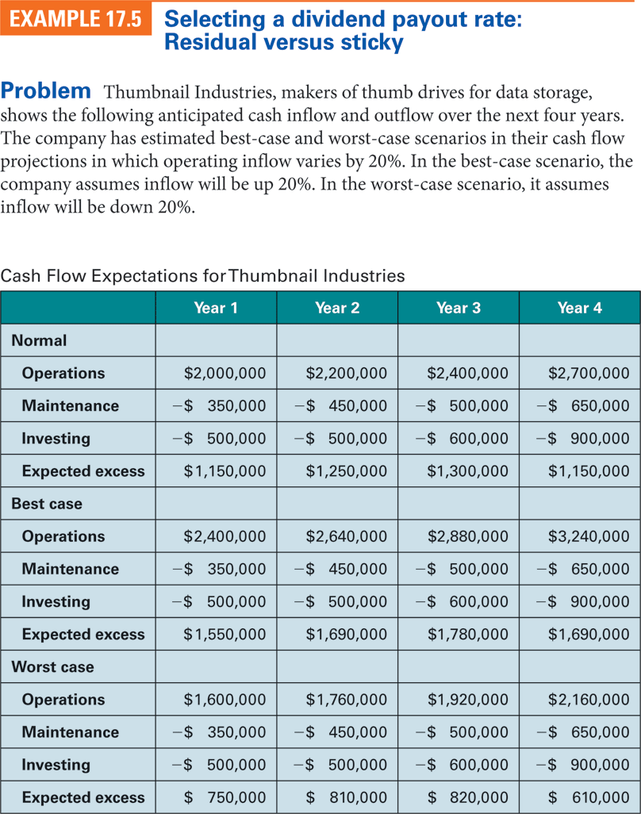
17.3 Selecting a Dividend Policy (continued)

Slide 29
17.3 Selecting a Dividend Policy (continued)
The company has estimated best-case and worst-case scenarios in their cash flow projections in which operating inflow varies by 20%.
In the best-case scenario, the company assumes inflow will be up 20%;
in the worst-case scenario, it assumes inflow will be down 20%.
Currently, 2,000,000 shares are outstanding, and Thumbnail Industries pays annual cash dividends.
What are the highest dividends Thumbnail can pay each year under the anticipated cash flow, the best-case scenario, and the worst-case scenario if a residual dividend policy is maintained?
If Thumbnail wants to avoid cutting dividends and use a sticky dividend policy, what is the largest dividend it should declare considering the income in the worst-case scenario?

Slide 30
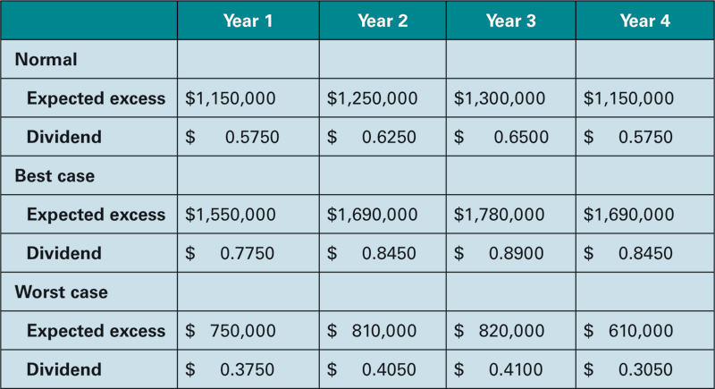
17.3 Selecting a Dividend Policy (continued)
Residual Dividends for Thumbnail Industries

Slide 31
17.3 Selecting a Dividend Policy (continued)
Under the residual dividend policy the firm would simply divide the expected excess under the different scenarios by the number of outstanding shares—in this case, 2,000,000—and pays it out in dividends. The dividends will vary from $0.305 per year to $0.89 per year, depending on the outcome of the cash flow.
Under the sticky dividend policy that incorporates no reductions in cash flow, however, the company will declare a $0.3050 dividend and not raise the dividend until sufficient cash is saved to cover the downside potential of the fourth year’s worst-case scenario.

Slide 32
17.3 (A) Some Further Considerations in the Selection of a Dividend Policy
Restrictions on legal capital: i.e. the par value and the paid in excess of par on common stock, being used for payment of dividends are enforced in many states to protect suppliers, customers, and employees’ from going unpaid due to the reduction of capital via dividend payments.
Restrictive bond covenants: are placed by bondholders to prevent dividends from being paid prior to coupon interest being paid or to prevent exorbitant dividends being paid at the detriment of the creditors.
Cash availability can be a constraint since most lenders do not look favorably at dividends being paid out of borrowed funds.

Slide 33
17.4 Stock Dividends, Stock Splits, and Reverse Splits
Stock dividends involve the payment of shares to current shareholders up to a value equal to 25% of the stock value.
Thus the maximum stock dividend that can be paid is 1 share for every 4 shares held.
With stock dividends there is no real change in wealth, only a paper transaction is involved.
Stock splits involve the conversion of the number of shares and the price by the split ratio.
For example, if a person owned 100 shares valued at $40 per share, and it split 2:1, he would now own 200 shares worth $20 each.
Stock splits, like stock dividends do not change an investor’s real wealth position, and are merely accounting gimmicks.

Slide 34
17.4 (A) Reasons for Stock Splits
Include:
bringing the price within a preferred trading range,
sending out positive signals to investors,
and increasing liquidity and demand for lower priced stock.

Slide 35
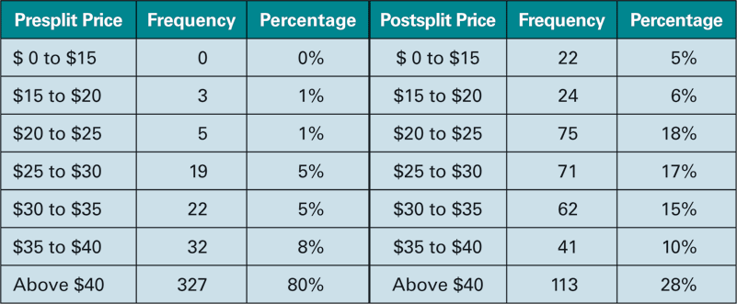
17.4 (A) Reasons for Stock Splits (continued)
Preferred trading range: A majority of splits occur when the stock price gets outside the $25-$40 price range.
Table 17.4 Prices Before and After Stock Splits

Slide 36
17.4 (A) Reasons for Stock Splits (continued)
Signaling hypothesis i.e. stock splits signal continued strong performance to the public.
Increased liquidity due to more shares being demanded and sold when it is trading in a modest trading range

Slide 37
17.4 (B) Reverse Splits
Are the exact opposite of stock splits in that investors receive a fraction of their original number of shares, based on the split.
For example if a $4 stock is split 1:3, for every 3 shares that an investor owns, he will now hold one $12 share.
Reverse splits are done to put the stock back up to its usual trading range once it has fallen below it, and to prevent the stock from being de-listed due to its low price level.

Slide 38
17.5 Specialized Dividend Plans
Stock Repurchases are done so as to reduce the number of shares outstanding and thereby increase the earnings per share.
A share repurchase is the same as a cash dividend except that shareholders will choose how much cash they want by the number of shares they choose to sell.

Slide 39
17.5 Specialized Dividend Plans (continued)
Figure 17.2 Stock repurchase
plan announcement by Freese.

Slide 40
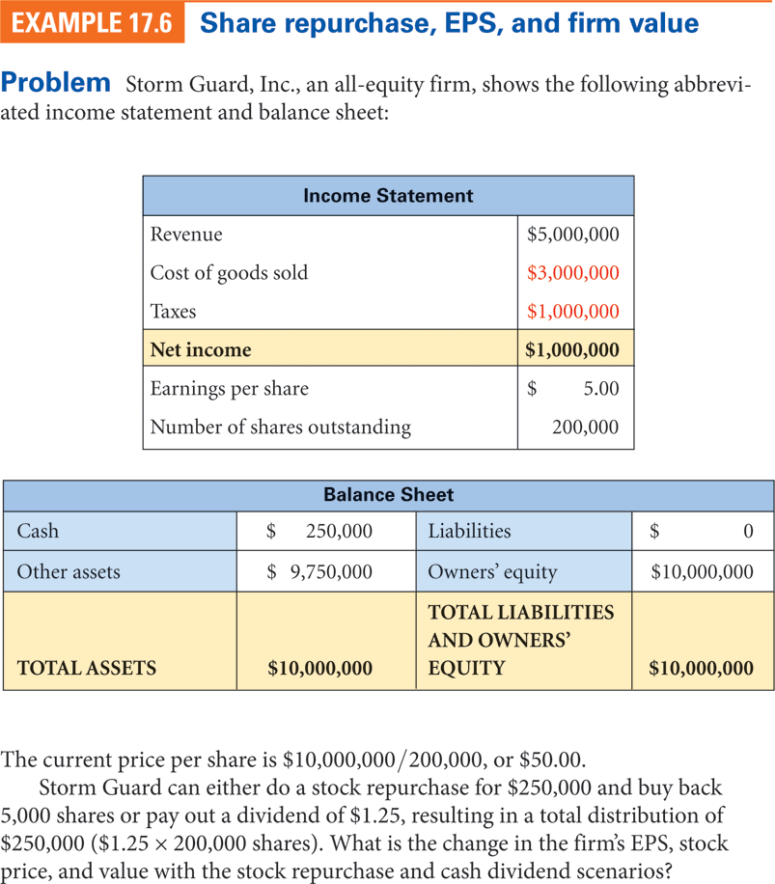
17.5 Specialized Dividend Plans (continued)

Slide 41
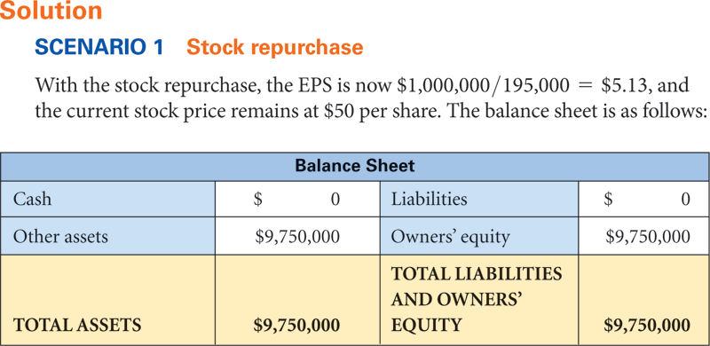
17.5 Specialized Dividend Plans (continued)

Slide 42
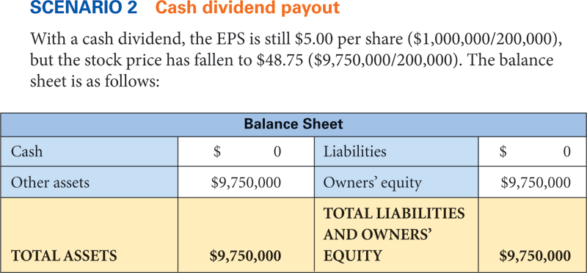
17.5 Specialized Dividend Plans (continued)

Slide 43
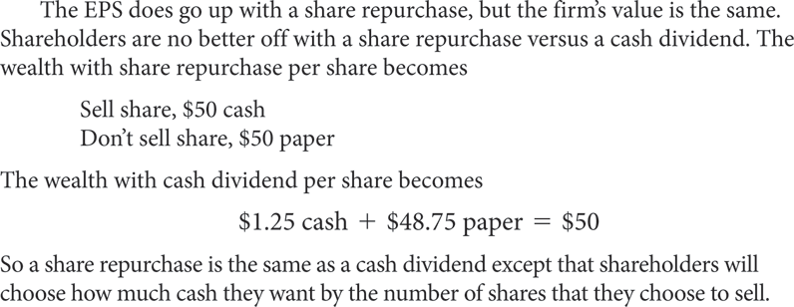
17.5 Specialized Dividend Plans (continued)

Slide 44
17.5 (B) Dividend Reinvestment Plans
DRIPs are set up so that investors can choose to have their dividends re-invested into additional shares of common stock,

Slide 45
17.5 (B) Dividend Reinvestment Plans (continued)
DRIPs can be found in three types of investment programs:
1. Company-run programs are usually administered from the company’s investor relations department, which deals directly with each shareholder.
2. Transfer-agent-run programs are administered by financial institutions on behalf of a company.
3. Brokerage-run programs may offer their clients the option to reinvest their dividends.

Slide 46
Additional Problems with Answers Problem 1
Stock Price around Dividend . On April 4th, Forex Corporation announced that it would pay a dividend of $0.75 per share to all shareholders that were on record as of April 11th, with checks being mailed on April 21st.
Determine what the stock price of Forex Corporation will be after the cash dividend announcement in a world of no taxes.
Assume that the current price is $37.50 per share and that the price does not change between April 4 and April 21.
On what day does the price change?
What is the cost to a buyer after the announcement?
What is the sales revenue to a seller after the announcement? Assume that stock settlements take 2 days.

Slide 47
Additional Problems with Answers Problem 1 (Answer)

Slide 48
Additional Problems with Answers Problem 2
Change to low-dividend-payout policy (no taxes). Joan currently owns 800 shares of
RST Inc.
RST has a high-dividend-payout policy and this year will pay $3.00 cash dividend on its shares selling currently at $30.00 per share.
Joan wants a low-dividend-payout policy of 5% of the stock price.
What will Joan need to do to convert this high-dividend-payout policy to a low dividend-payout policy for her?

Slide 49
Additional Problems with Answers Problem 2 (Answer)
Current dividend policy: ($3.00/$30.00) = 10% (800 Shares x $3.00)= $2,400➔ Div
Desired dividend policy: $30x 0.05 = $1.5 (800 Shares x $1.5) =$1200 ➔ Div
Joan needs to repurchase the difference at the ex-dividend price
$2400-$1200 = $1200/($30.00-$3.00) = 44.44 Shares.
Wealth:
High dividend policy:
$2,400 cash + $ 21,600 ($27.00 x 800shares) paper = $24,000
Low dividend policy:
$1,200 cash + $ 22,800 ($27.00 x 844.44 shares) paper = $24,000

Slide 50
Additional Problems with Answers Problem 3
Change to High Dividend Policy – Pearl currently owns 600 shares of Ajax, Incorporated.
Ajax has a low-payout dividend policy, and this year will pay 4% cash dividend on its shares selling currently at $40.
Pearl wants a high-dividend policy of 9% of the stock price.
What will Pearl need to do to convert this low- dividend policy to a high-dividend policy for herself? Assume a world of no taxes.

Slide 51
Additional Problems with Answers Problem 3 (Answer)
Current dividend policy: 600Shares x $1.6 = $960.00➔ Div
Desired dividend policy: $40.00 x0 0.09 = $3.6 (600 Shares x $3.6) = $2,160➔ Div
Pearl needs to sell the difference at the ex-dividend price
$2,160 - $960 = $1200, $1200/($40-$1.60) = 31.25 Shares.
Wealth:
High dividend policy:
$2160 cash + $ 21,840 [$38.40 x (600-31.25 shares)] paper
= $24,000
Low dividend policy:
$960 cash + $ 23,040 ($38.4 x 600shares) paper = $24,000

Slide 52
Additional Problems with Answers Problem 4
Stock Repurchase Plan – Get Real Inc. has announced that it will buy back 3,000,000 of its 27,000,000 shares over the next year.
If the stock is selling for $15.30, what is the equivalent cash dividend that the company could pay?
If you owned 500 shares of stock, how many would you need to sell to get this cash- equivalent dividend?

Slide 53
Additional Problems with Answers Problem 4 (Answer)
Available funds: 3,000,000 x $15.30
$45,900,000
Per share funds: $45,900,000/27,000,000 ➔ $1.70/share
Dividend with 500 shares: $1.70 x 500
$850
To generate dividend sell: $850/$15.30
➔ 55.56 shares

Slide 54
Additional Problems with Answers Problem 5

Slide 55
Additional Problems with Answers Problem 5 (Answer)
Start: 100 Shares
Yr #shares Dividend Purchased shares
10’ 100.00 x $4.50 = $450.00 = 7.75862
$58.00
11’ 107.75 x $4.75 = $511.85 = 8.42557
$60.75
12’ 116.18 x $5.25 = $609.92 = 9.34746
$65.25
13’ 125.53 x $6.50 = $815.93 = 11.91136
$68.50
14’ 137.44 x $7.00 = $962.09 = 13.74414
$70
Ending balance: 151.18 shares x $70 = $10,582.89

Slide 56
Table 17.1 Cash Flow at Dividend Payment and Stock Purchase of PepsiCo

Slide 57
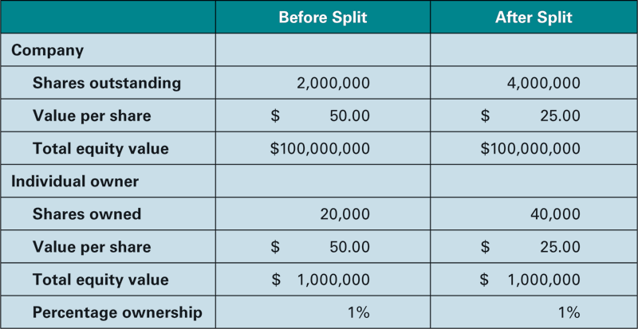
TABLE 17.3 Stock Split Value Changes on a 2-for-1 Split

